Slide 1
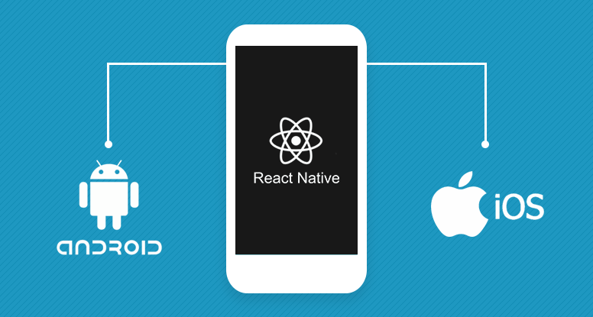

Slide 2
Introduction To REACT NATIVE

Slide 3

REACT NATIVE
React Native lets you build mobile apps using only JavaScript.
• Built using React
• Build cross platform applications using JavaScript
• Target not only iOS & Android, but also Apple TV, VR, AR, Windows, & Desktop
• Released March 2015
• Rapidly gaining in popularity & adoption
• Learn once write anywhere
• Real world projects typically see 80% – 95% code reuse

Slide 4
Who’s using React Native
• Facebook
• Instagram
• Walmart
• Airbnb
• Skype
• Baidu
• Tesla
• Adidas
• Discord
• Wix
• Bloomberg
• JD.com

Slide 5
Why React Native
• Faster speed of development
• Lower cost of development
• Code reuse
• Easier to find developers
• Ship across multiple platforms
• Possible to ship over the air updates bypassing App Store / Play Store

Slide 6
How does it work?
›There are two important threads running in each React Native application.
One of them is the main thread, which also runs in each standard native app. It handles displaying the elements of the user interface and processes user gestures.
The other one is specific to React Native. Its task is to execute the JavaScript code in a separate JavaScript engine.

Slide 7
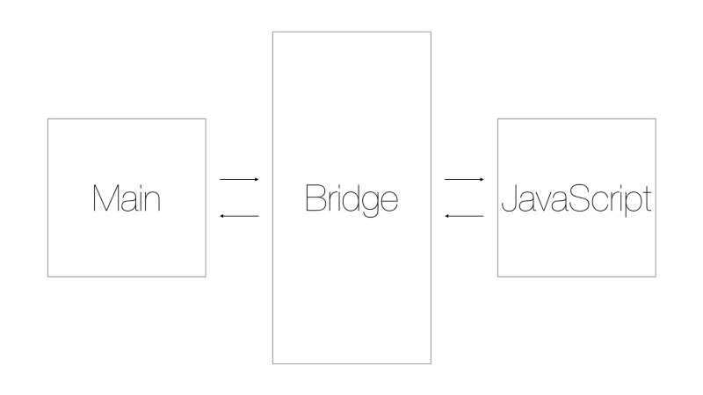
How does it work?

Slide 8
How to start?
›Download and install Node JS (~ 12 MB)
https://nodejs.org/en/
›Download React Libraries [Shell command]
npm install -g react-native-cli
›Development IDE (Visual Studio Code) (~34 MB)
https://code.visualstudio.com/
›Install Android https://developer.android.com/studio
›Java Development Kit https://www.oracle.com/technetwork/java/javase/downloads/jdk8-downloads-2133151.html

Slide 9

Another solution
How to learn and test react-native applications
without install anything on your machine ?

Slide 10
How to start with expo
› npm install -g expo-cli
› expo init AwesomeProject
› cd AwesomeProject
› npm start # you can also use: expo start

Slide 11


