Slide 1
Introduction?
Naveed Sarwar
› Top rated Freelancer at Upwork.
› Level one seller at Fiverr.
› Teacher at SMTP and PIAIC.
› StartUp - CodeFrame.tech

Slide 2
How we can run multiple OS into a single machine?

Slide 3


Question why even need that?
Most applications run on servers. And in the past, we could only run one application per server. The open-systems world of Windows and Linux just didn’t have the technologies to safely and securely run multiple applications on the same server.
So, the story usually went something like this… Every time the business needed a new application, IT would go out and buy a new server. And most of the time nobody knew the performance requirements of the new application!
This meant IT had to make guesses when choosing the model and size of servers to buy.
As a result, IT did the only thing it could do - it bought big fast servers with lots of resiliency.

Slide 4
Deployment - Past
Problems arise when the supporting software environment is not identical, "You're going to test using Python 2.7, and then it's going to run on Python 3 in production and something weird will happen.

Slide 5
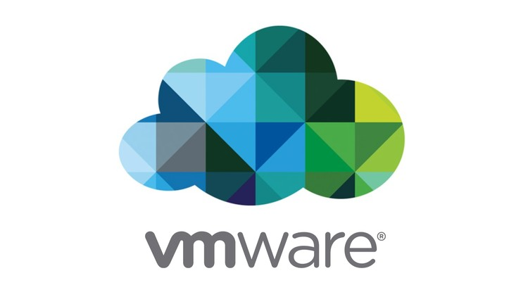
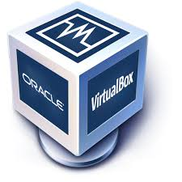
Hello to virtualization

Slide 6
VMWare
Put simply, a consists of an entire runtime environment: an application, plus all its dependencies, libraries and other binaries, and configuration files needed to run it, bundled into one package. the application platform and its dependencies, differences in OS distributions and underlying infrastructure are abstracted away.

Slide 7
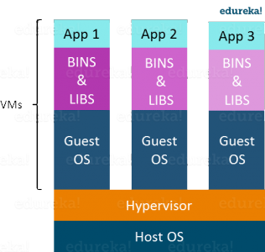
VMWare
Multiple operating systems can run on the same machine
Maintenance and Recovery were easy in case of failure conditions
Total cost of ownership was also less due to the reduced need for infrastructure

Slide 8
VMWare
Another problem with Virtual Machines which uses virtualization is that it takes almost a minute to boot-up. This is very critical in case of real-time applications.
Following are the disadvantages of Virtualization:
Running multiple Virtual Machines leads to unstable performance
Fixed resources
Boot up process is long and takes time

Slide 9
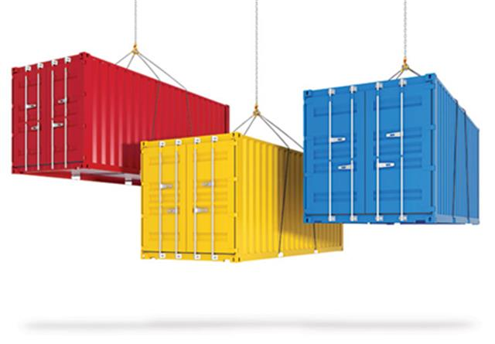
Hello to modern Containerization

Slide 10
Containerization
In the container model, the container is roughly analogous to the VM. The major difference is that every container does not require its own full-blown OS. In fact, all containers on a single host share a single OS. This frees up huge amounts of system resources such as CPU, RAM, and storage. It also reduces potential licensing cost and reduces the overhead of OS patching and other maintenance. Net result: savings
on the cap-ex and op-ex fronts.

Slide 11
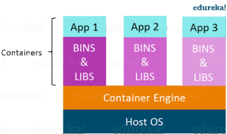
What other benefits do containers offer?
Advantages of Containerization over Virtualization:
Containers on the same OS kernel are lighter and smaller
Better resource utilization compared to VMs
Boot-up process is short and takes few seconds

Slide 12
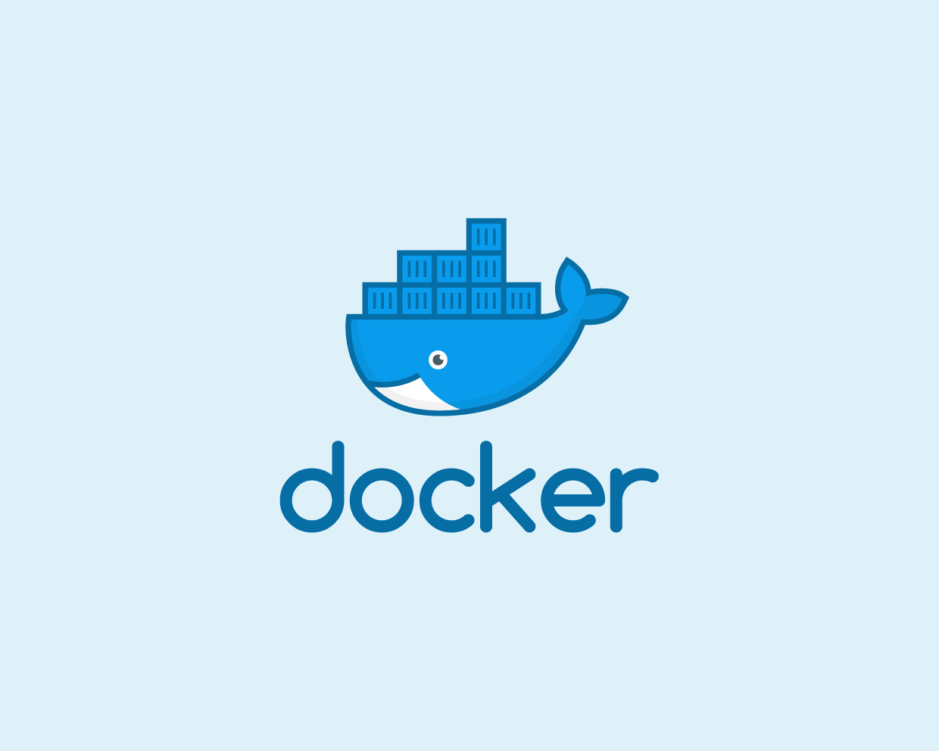
Intro to docker!
Docker is a set of platform-as-a-service products that use OS-level virtualization to deliver software in packages called containers.
Containers are isolated from one another and bundle their own software, libraries and configuration files; they can communicate with each other through well-defined channels

Slide 13
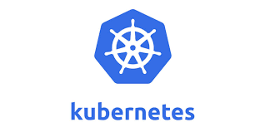
Containers orchestration !
Kubernetes is an open-source container-orchestration system for automating application deployment, scaling, and management.
It was originally designed by Google, and is now maintained by the Cloud Native Computing Foundation

Slide 14


