Slide 1
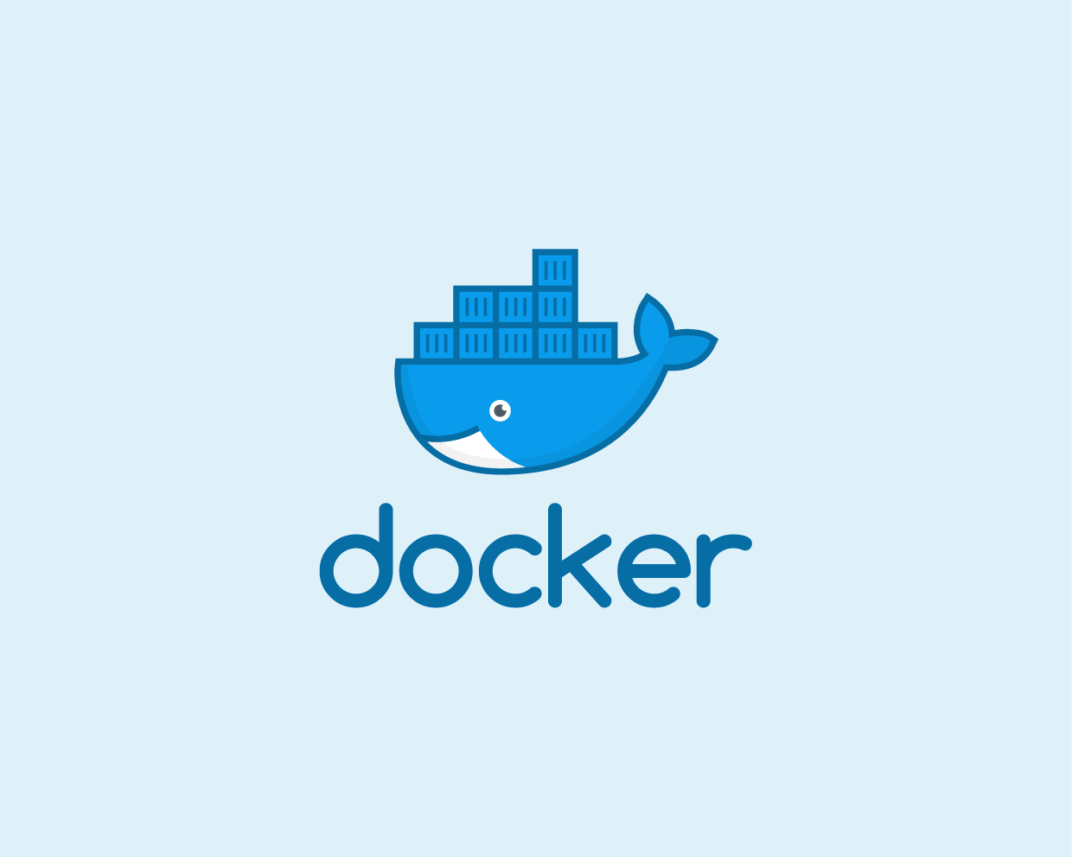


Slide 2


Slide 3
Deployment - Past
How to get software to run reliably when moved from one computing environment to another. This could be from a developer's laptop to a test environment, from a staging environment into production, and perhaps from a physical machine in a data center to a virtual machine in a private or public cloud.

Slide 4
Deployment - Past
Problems arise when the supporting software environment is not identical, "You're going to test using Python 2.7, and then it's going to run on Python 3 in production and something weird will happen.

Slide 5
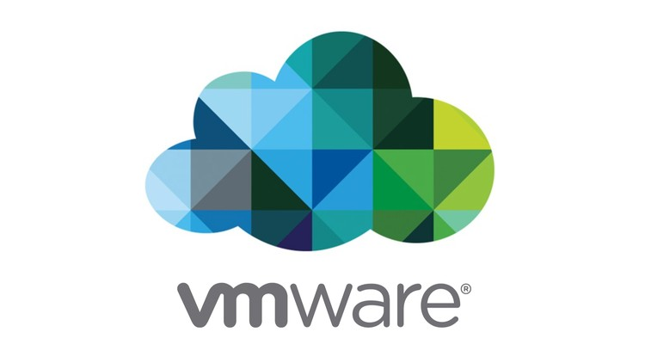

Slide 6
VMWare
Put simply, a consists of an entire runtime environment: an application, plus all its dependencies, libraries and other binaries, and configuration files needed to run it, bundled into one package. the application platform and its dependencies, differences in OS distributions and underlying infrastructure are abstracted away.

Slide 7
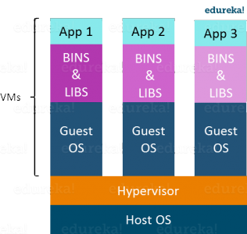
VMWare
Multiple operating systems can run on the same machine
Maintenance and Recovery were easy in case of failure conditions
Total cost of ownership was also less due to the reduced need for infrastructure

Slide 8
VMWare
Another problem with Virtual Machines which uses virtualization is that it takes almost a minute to boot-up. This is very critical in case of real-time applications.
Following are the disadvantages of Virtualization:
Running multiple Virtual Machines leads to unstable performance
Fixed resources
Boot up process is long and takes time

Slide 9
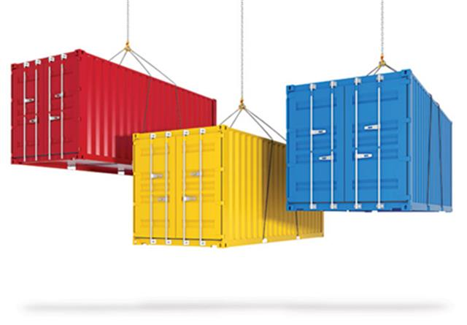

Slide 10
Containerization
In the container model, the container is roughly analogous to the VM. The major difference is that every container does not require its own full-blown OS. In fact, all containers on a single host share a single OS. This frees up huge amounts of system resources such as CPU, RAM, and storage. It also reduces potential licensing cost and reduces the overhead of OS patching and other maintenance. Net result: savings
on the cap-ex and op-ex fronts.

Slide 11
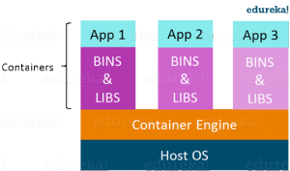
What other benefits do containers offer?
Advantages of Containerization over Virtualization:
Containers on the same OS kernel are lighter and smaller
Better resource utilization compared to VMs
Boot-up process is short and takes few seconds

Slide 12


