Slide 1

React + Redux

Slide 2
Why React + Redux?

Slide 3




State to React
Store
App
Recipes
Recipes
Add Recipe
Recipe 1
Recipe 2
Recipe 1
Recipe 2

Slide 4

State to React
Store
App
Recipes
Recipes
Add Recipe
Recipe 1
Recipe 2
Recipe 1
Recipe 2

Slide 5


State to React
Store
App
Recipes
Recipes
Add Recipe
Recipe 1
Recipe 2
Recipe 1
Recipe 2

Slide 6
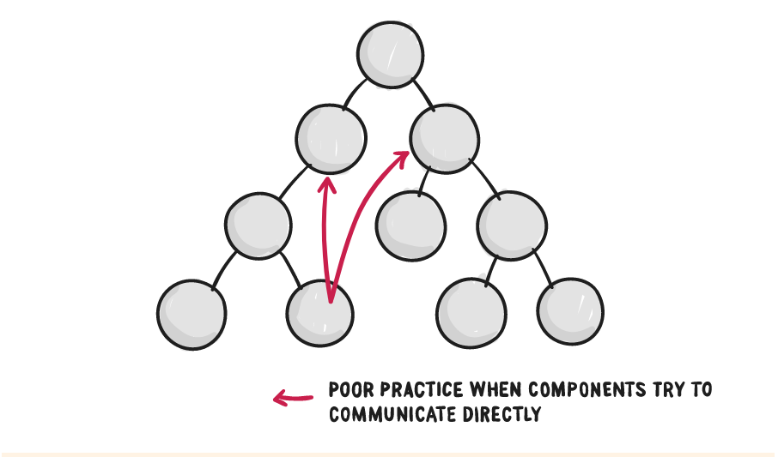
Poor Practice

Slide 7
What is Redux?
Redux is a tool for managing both data-state and UI-state in JavaScript applications.
It's ideal for Single Page Applications (SPAs) where managing state over time can be complex.

Slide 8
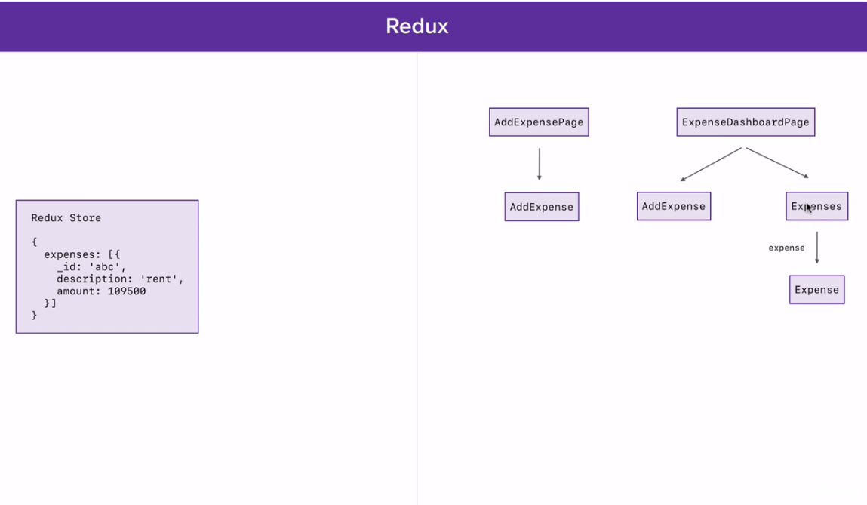

Slide 9
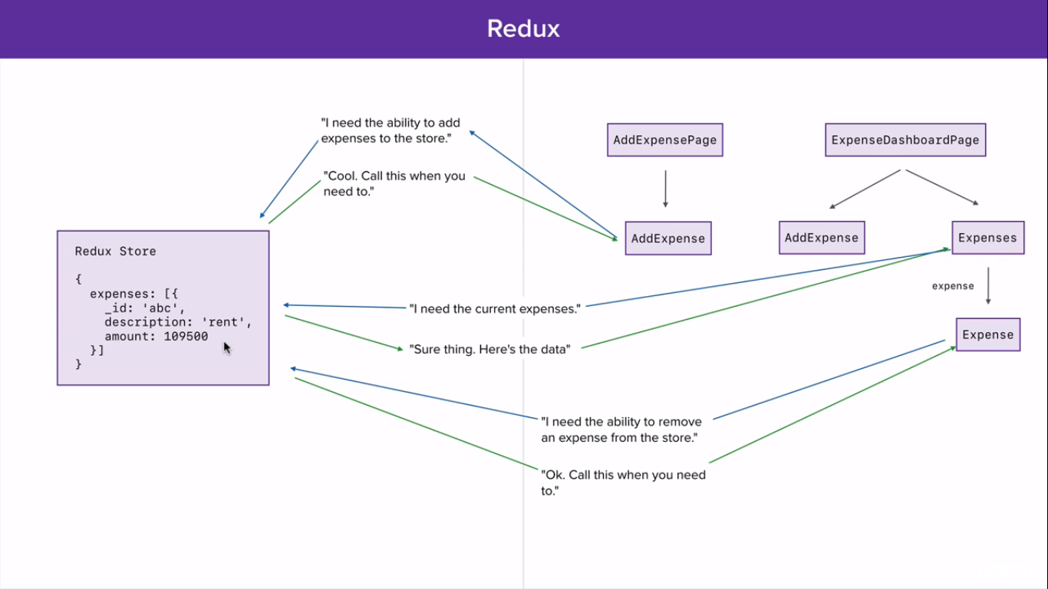

Slide 10
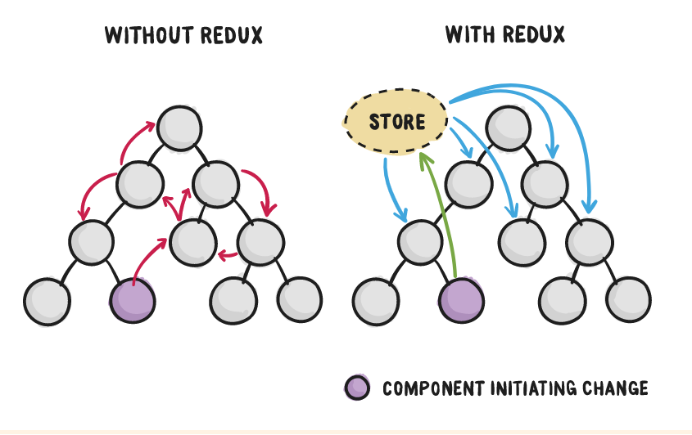
Conclusion

Slide 11
Redux to rescue!
Redux allows you to manage the state with a minimal API but completely predictable behaviour.

Slide 12
Basic Principle
(previousState, action) => newState

Slide 13
Redux Flow
dispatch(action)
(previousState, action)
Store Reducers
Action Creators
(newState)
(state)
React Components
Interaction e.g onClick

Slide 14
What is Store?
A store holds the whole state tree of your application. The only way to change the state inside it is to dispatch an action on it.
A store is not a class. It's just an object with a few methods on it. To create it, createStore()
To get state, getState()

Slide 15
Store
import { createStore } from 'redux' import todoReducer from '../reducers' let store = createStore(todoReducer);
store.subscribe(() => console.log(store.getState())
)

Slide 16
What is Action?
Actions are payloads of information that send data from your application to your store. They are the only source of information for the store.

Slide 17
Action
const action = { type: 'ADD_TODO', text: 'Call Mom',
}

Slide 18
Action Creator
function addTodo(text) {
const trimmedText = text.trim(); return {
type: 'ADD_TODO', text: trimmedText,
}
}
actions.js
<button onClick={ dispatch(addTodo('Call Mom Add Todo
</button>
') }>

Slide 19
What is Reducer?
Actions describe the fact that something happened, but don't specify how the application's state changes in response. This is the job of reducers.

Slide 20
Reducer
const todos = (state = [], action) => { switch (action.type) {
case 'ADD_TODO': return [
...state,
{
text: action.text, completed: false
}
]
default: return state
}
}
reducers.js

Slide 21
Provider & Connect
A Provider component that makes it possible for any components to take data from the store.
A connect() function that wraps any component and lets you map certain parts of your application state from the store to the component’s properties.

Slide 22
Connect React with Redux
import React from 'react'; import ReactDOM from 'react-dom';
import { createStore } from 'redux'; import { Provider } from 'react-redux'; import todoApp from './reducers'; import App from './containers/App';
let store = createStore(todoApp);
let exampleNode = document.getElementById('example'); ReactDOM.render(
<Provider store={store}><App /></Provider>, exampleNode
);

Slide 23
Connect React +Redux
import React from 'react';
import { connect } from 'react-redux';
import { addTodo } from '../actions.js';
const App = ({dispatch, state}) => { return (
<button onClick={ dispatch(addTodo('Call Mom') }> Add Todo
</button>
);
};
export default connect(App);

Slide 24
Redux Summary
Redux allows you to manage the state with
predictable behaviour.
(previousState, action) => newState

Slide 25
Is it production ready?
React
used by Facebook, Firefox, Airbnb and many more
Redux
used by Firefox, Docker, Technical University of Vienna, Mattermark and many more
“Love what you’re doing with Redux” Jing Chen, creator of Flux

Slide 26
The End
Thanks for listening!
React + Redux

