Slide 1


Slide 2

WHO AM I?
Naveed Sarwar
› Full Stack Developer.
› Freelancer at Upwor & Fiverr.
› Teacher at SMTP.
› StartUp - CodeFrame.
› Social Links.
› fb.com/naveed.trainer
› codeframe.tech/
› linkedin.com/in/naveed-trainer

Slide 3


Slide 4


Slide 5


Slide 6

OPTIONS?
1- Job
2- Freelancing / Own Startup
3- Family Business

Slide 7

REQUIREMENT?

Slide 8

IT'S TIME TO SKILL UP

Slide 9
MAJOR AREAS
› Mobile Applications Development.
› Web Development.
› Desktop Applications.
› Blockchain.
› A.I (Artificial Intelligence).
› Graphic Designing.
› Networking.

Slide 10
Course
Web Designing

Slide 11


Slide 12


Slide 13
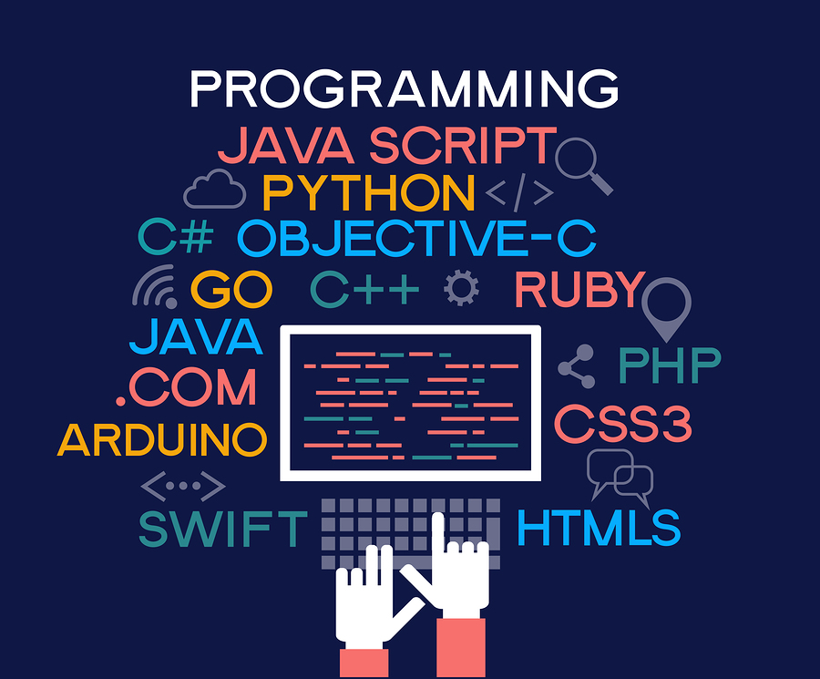
Technology we covered
› HTML.
› CSS.
› Bootstrap.
› Basic js.
› Wordpress.
› Deployment.

Slide 14
Introduction to HTML

Slide 15

CAN I DO?

Slide 16


ONE MORE THING

Slide 17

ONE MORE THING

Slide 18

ONE MORE THING

Slide 19


