Slide 1


Slide 2

What do we mean by ‘freelancing’??
Freelancer, or freelance worker refers to a person who is self- employed and is not necessarily committed to a particular employer long-term.
Ability to inﬂuence when you work, where you work, how you work, what you work

Slide 3

Why freelance???
1- Self-employed
2- Flexibility in Schedule
3- Be Your Own Boss
4- Passion
5- Work remotely

Slide 4
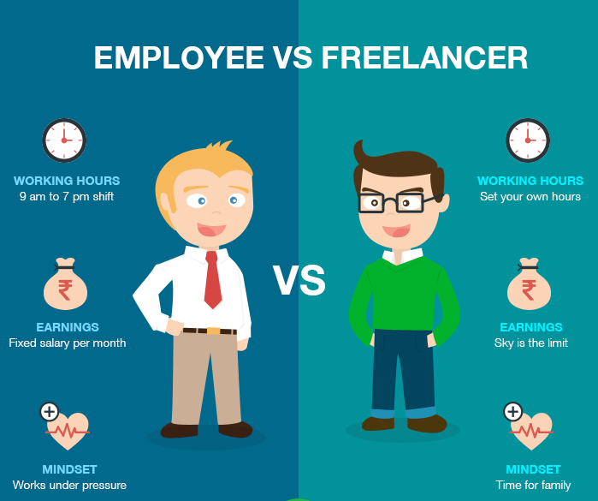
Why freelance???

Slide 5
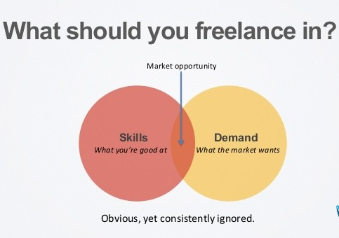
What should you freelance in???
Art What excites you Skills What you’re good at Your best and smart work Demand What the market wants.

Slide 6
Some of most common frelancing sites?
• www.upwork.com (Formerly: oDesk and Elance - Top famous freelancing site)
• www.freelancer.com (One of the most famous sites)
• www.toptal.com (exclusive network of the top expert freelancers)
• www.guru.com
• www.peopleperhour.com
• www.fiverr.com (For small services)
• www.rentacoder.com
• www.vworker.com

Slide 7
Any Difference?
There are two types:
• Freelancer offers services closely related to one set of skills
e.g Upwork, Freelancer.com
• Freelancer Offer gigs that can cover a wide range of services.
e.g Fiverr.com, Guro.com

Slide 8
How they work?
There are two types:
• Freelancer bids on jobs by sending their application and cover letter as a response to the client’s job posting
• Clients buy gigs already pre-defined by freelancers.

Slide 9
How To Start ??

Slide 10

Upwork.com
How to make a successful Upwork profile with 100% completeness level.
Be specific, and focus on specific skills that you’re mastering them good enough.
Choosing your profile picture (it’s important).
Choosing a professional job title.
Choose relevant skills.
Write a good overview statement.

Slide 11
Upwork.com
Add an introduction video (Big plus).
Set your rate.
Set your availability.
Set your Experience level, and choose the related categories for your skills.
Set your English language level.
Add you education, your employment history and your work portfolio.
Your response time (it’s very important).
English level verification.
Mobile Number verification.
Link your social media accounts.

Slide 12

ONE MORE THING

Slide 13


