Slide 1
Diabetes Prediction Using Machine Learning
Group Project — CP70066E
University of West London (RAK Campus)
Academic Year 2025–26
Group Members
Izhar ul Islam Khan 34150038
Naveed Akram 34150039
Subhan 21519460
Haseeb 34150055

Slide 2
agenda
Business & Understanding
Data Preparation
Modeling
Evaluation
Deployment

Slide 3
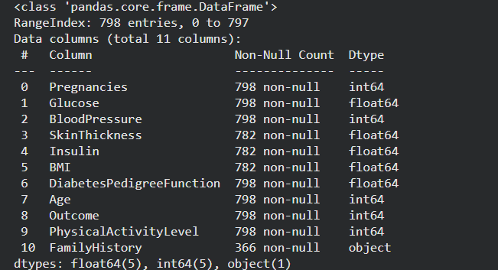
Dataset Background
Includes diagnostic data of women of Pima Indian heritage.
Features: Glucose, BMI, blood pressure, insulin, age, pregnanciese etc

Slide 4
Key EDA Insights
Diabetic patients show higher glucose and BMI.
Insulin, skin thickness, BMI contain many missing values.
Duplicate entries.
Dataset is imbalanced (~1/3 diabetic).
Low number of records.
Missing Features(Demographics)
Data Skewness
Outliers

Slide 5
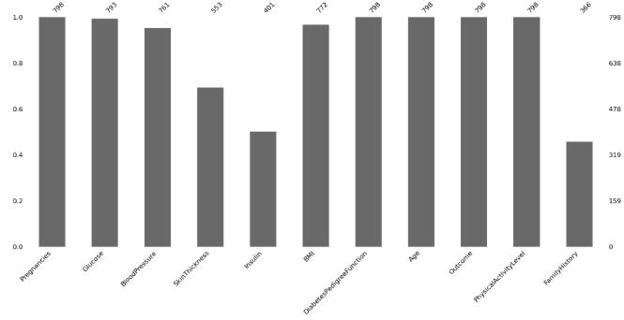
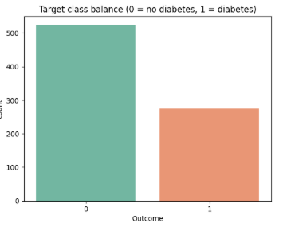
Key EDA Insights – Cont.

Slide 6
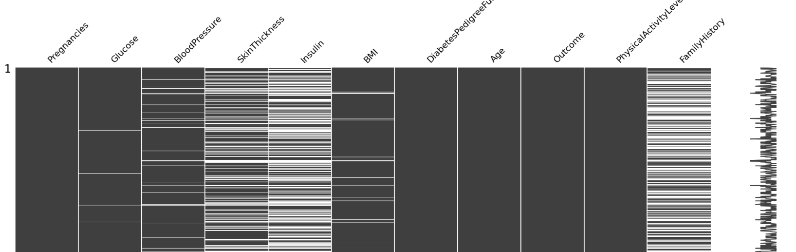
Key EDA Insights – Cont.

Slide 7
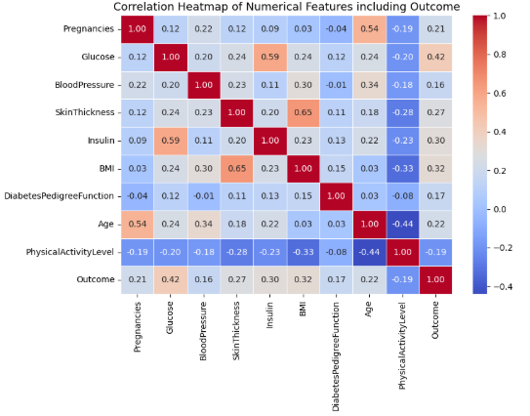
Key EDA Insights – Cont.

Slide 8
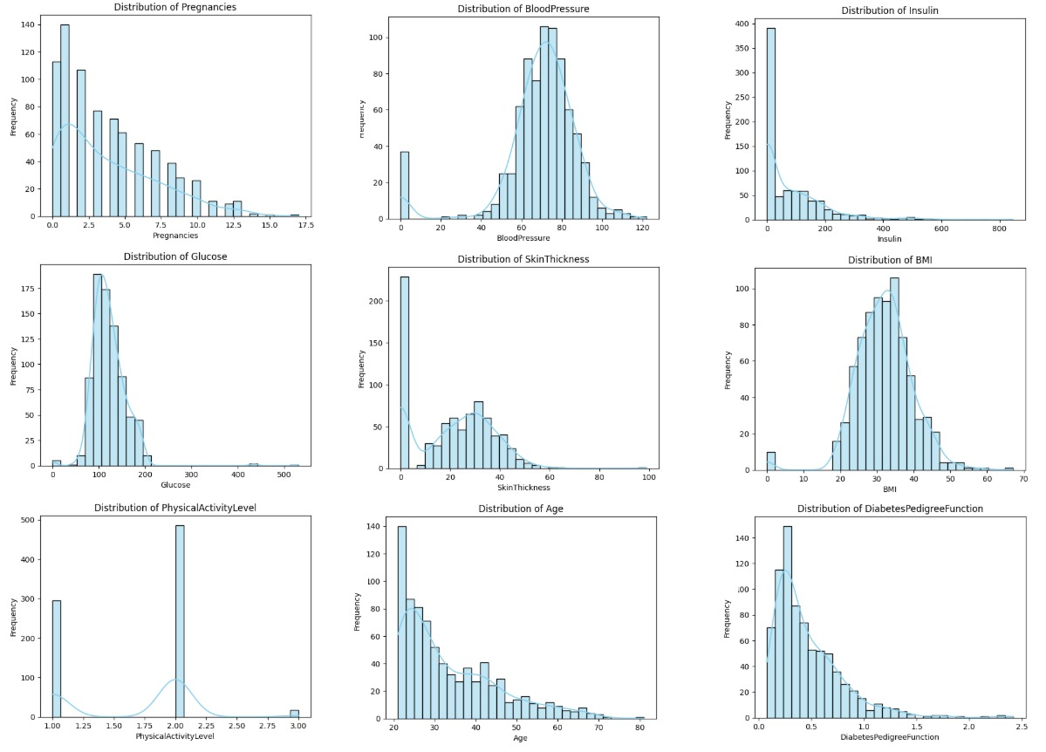
Key EDA Insights – Cont.

Slide 9
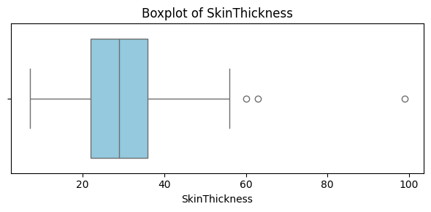
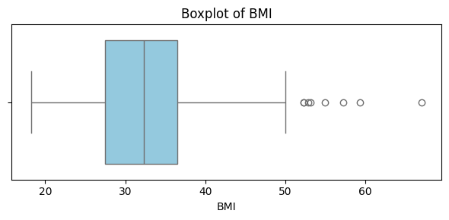
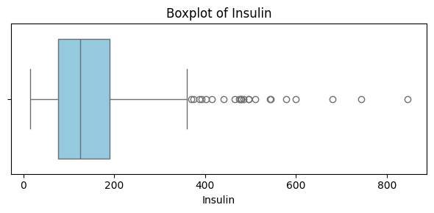
Key EDA Insights – Cont.

Slide 10
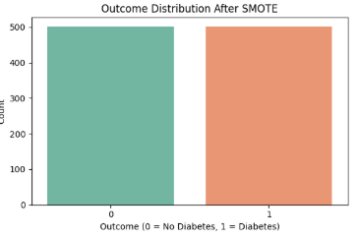
Data Cleaning & Preparation
Mean imputation for numerical missing features.
Added quality-flag features.
Categorical → numerical conversions.
SMOTE used to handle imbalance.

Slide 11
Feature Engineering
HOMA-IR: Insulin resistance indicator.
Glucose risk levels.
BMI categories.
Combined metabolic indicators.
Polynomial features

Slide 12
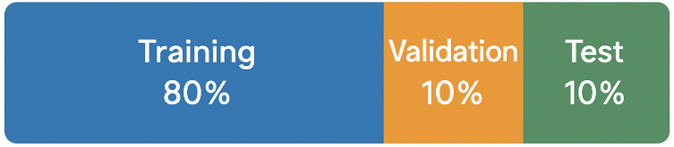
Train / Validation / Test Split
Dataset was split into training, validation, and testing subsets
Ensures fair evaluation and prevents overfitting
Validation used for tuning; test set used for final performance check

Slide 13
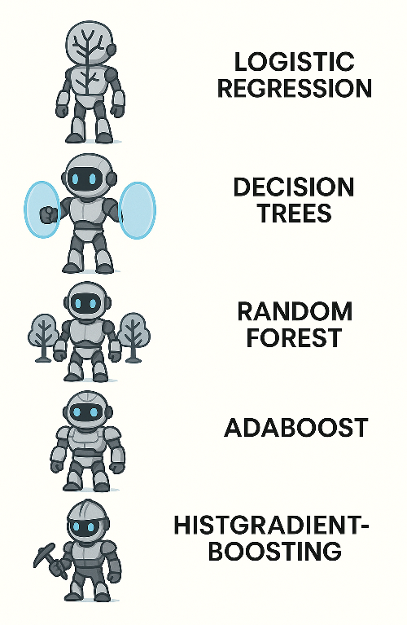
Models Evaluated
Logistic Regression
Decision Trees
SVM
Random Forest
Voting Classifier
AdaBoost
HistGradientBoosting
XGBoost
GradientBoosting
Light Gradient Boosting Machine (LGBM)
Scaled Model

Slide 14
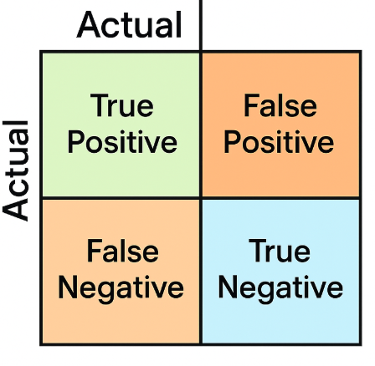
Evaluation Metrics
Compared models using accuracy, precision, recall, and F1-score
Recall prioritized due to medical risk of false negatives
Confusion matrix used to interpret error types

Slide 15
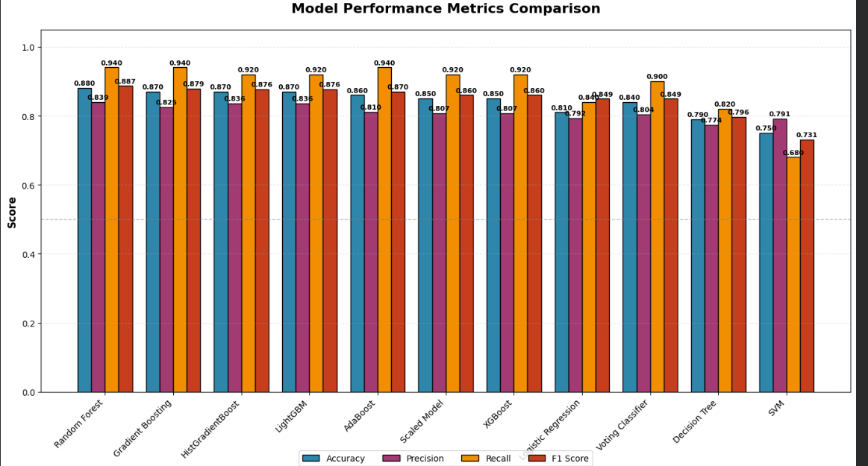
Model Performance Comparison
We compared several models including Random Forest, LightGBM, HistGradientBoosting, and an ensemble Voting Classifier.
Random Forest achieved the best balance across accuracy, recall, and F1.

Slide 16
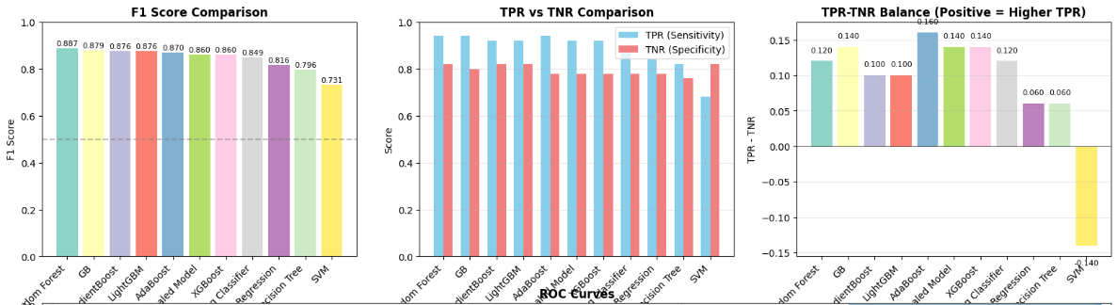
Model Performance Comparison

Slide 17
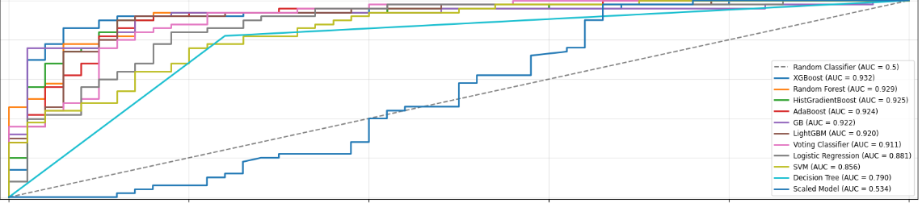
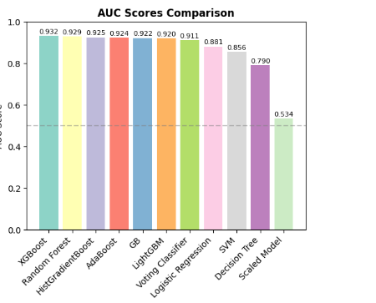
Model Performance Comparison

Slide 18
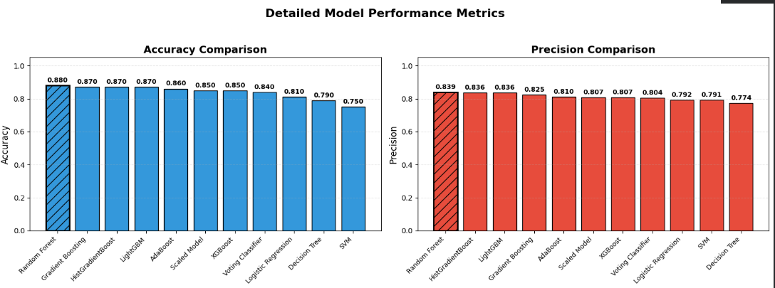
Detailed Metrics Breakdown

Slide 19
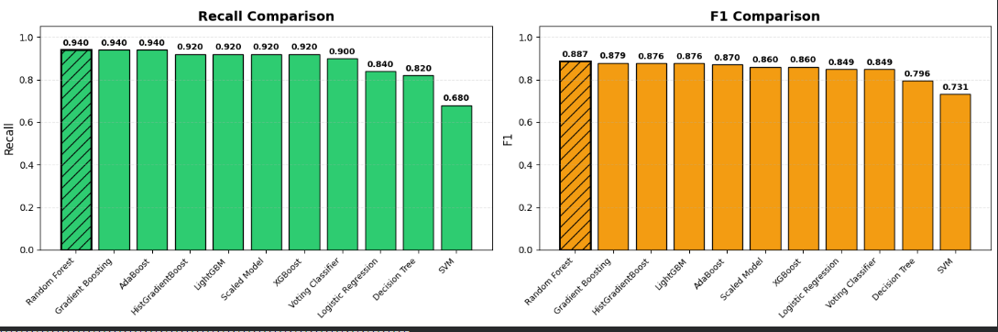
Detailed Metrics Breakdown

Slide 20
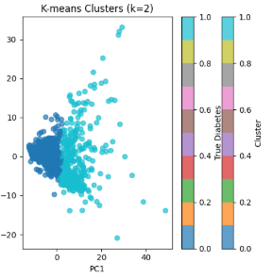
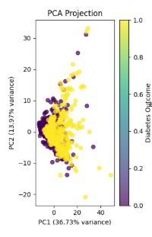
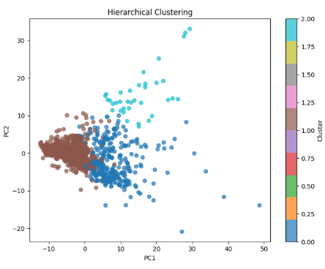
Unsupervised Learning
We experimented with advanced optimization methods, including Selective Retraining.
These methods did not improve performance on our dataset due to data size, noise, and feature variability.
We removed this step from the final pipeline to keep the model simpler, more stable, and easier to interpret.

Slide 21
Ethical Considerations
Dataset represents only one demographic group.
Risk of bias and uneven predictions.
False negatives can delay treatment.
Transparency is important for trust.
Model should support not replace clinicians.

Slide 22
Conclusions
Best models achieved strong recall and balanced F1.
Feature engineering and cleaning improved results significantly.
Threshold tuning made the model more clinically useful.
Unsupervised methods identified clusters but did not improved performance metrics.

Slide 23
Thank You
QUESTIONS?

