Slide 1
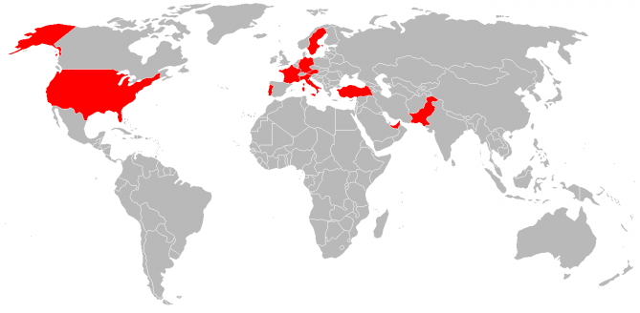
United States of America
Sweden
Italy
Portugal
Turkey
Germany
United Arab Emirates
Austria
France
Pakistan

Slide 2


