Slide 1

Web scraping to gain company insights
23/11/2023

Slide 2
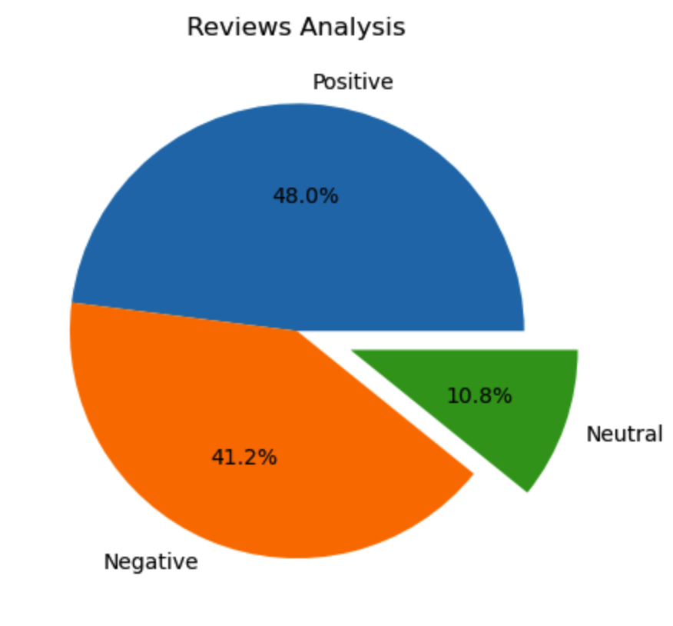
INSIGHTS FROM CUSTOMER REVIEWS
From cleaning 1000 reviews given by the customers, we obtained
Positive Reviews - 480
Negative Reviews - 412
Neutral Reviews – 108

