Slide 1

Heroku
Group Members
Umair Azad
Faiq Aslam
Tayyub Naveed

Slide 2
What is Heroku?
Heroku is a container-based cloud Platform as a Service (PaaS)
Today it supports Java, Node.js, Scala, Python, PHP, and Go.
Developers use Heroku to deploy, manage, and scale modern apps
Heroku has been in development since June 2007, when it supported only the Ruby programming language.
Heroku platform is flexible, and easy to use, offering developers the simplest path to getting their apps to market.

Slide 3
4 Core Principle
Forget Servers
Run Anything
See Everything
Trust and Manage

Slide 4
Forget Servers
Focus 100% on your code
Fully managed platform
Trust Heroku to be your DevOps support

Slide 5
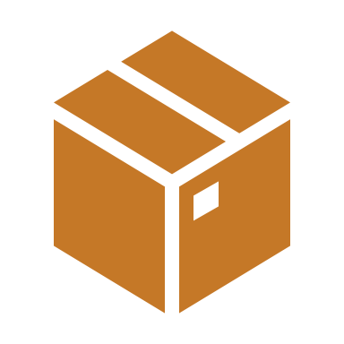
Dynos
The heart of the Heroku platform
A self-contained resource in which to run your application.
When it comes to running apps, containerization abstracts away the burden of managing hardware or virtual machines.
Instead of hardware management, you deploy an app to Heroku, which packages the app’s code and dependencies into containers — lightweight, isolated environments that provide compute, memory, an OS, and an ephemeral filesystem.

Slide 6
Inside Heroku Dyno
Embedded container
Application Dependencies
Your Application code

Slide 7

Run Anything
An Elastic “Polyglot” platfrom-as-a-service.
Polyglot means knowing or using several languages

Slide 8
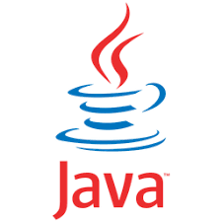
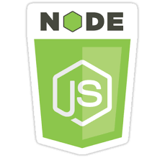

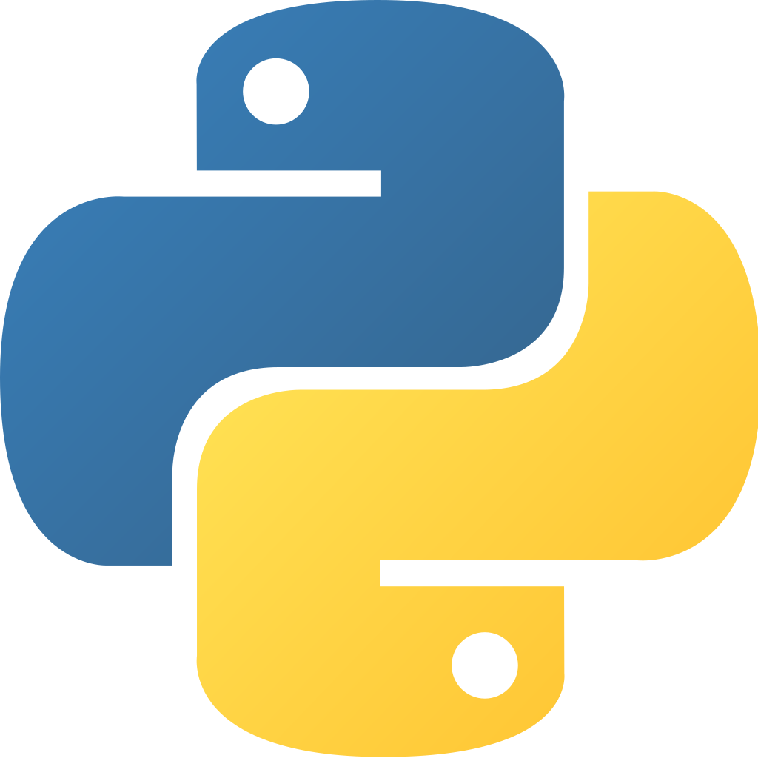
First Class Languages On Heroku
Heroku make it easy for you to run apps written in a variety of programming languages, including its first-class languages Ruby, Java, PHP, Python, Node, Go and Scala.
An application is a collection of source code written in one of these languages, perhaps a framework, and some dependency description that instructs a build system as to which additional dependencies are needed in order to build and run the application.

Slide 9
See Everything
Application logs
Administrative commands
Realtime dyno information

Slide 10
Logplex
A Heroku app’s logs come from the output streams of all of its running processes, system components
Logplex router is responsible for collating and distributing the log entries generated by your app and other components of the Heroku platform.

Slide 11
Heroku Logs
App logs - Logging output from the application itself, including logs generated by your app’s code and dependencies. (Filter: --source app)
System logs - Messages about actions taken by the Heroku platform infrastructure on behalf of your app, such as: restarting a crashed process, sleeping or waking a web dyno, or serving an error page due to a problem in your app. (Filter: --source heroku)
API logs - Messages about administrative actions taken by you and other developers working on your app, such as: deploying new code, scaling the process formation. (Filter: --source app --dyno api)

Slide 12
Trust and Manage
Effortless scaling
Procfile

Slide 13
Effortless Scaling
Adding more dynos of a given dyno process type scales your application horizontally. For example, adding more web dynos lets Heroku route incoming HTTP requests across more running instances of your web servers
Upgrading dynos to larger dyno types will provide your app with more memory and CPU resources scale your application vertically
Heroku enables you to automatically increase the number of web dynos needed to meet your specified response time threshold.

Slide 14
Procfile
Heroku apps include a Procfile that specifies the commands that are executed by the app on startup. You can use a Procfile to declare a variety of process types, including:
Your app’s web server
Multiple types of worker processes
A singleton process

Slide 15
Getting started with Heroku
Create an account on Heroku
Create your app
Choose the deployment method (Github, Heroku CLI)
Connect your github
Choose the app/project you want to deploy
Your good to go

Slide 16

Thank You

