Slide 1
CSCI 4717/5717
Computer Architecture
Topic: Input/Output
Reading: Stallings, Chapter 7

Slide 2
General Description of I/O
Wide variety of peripherals
Delivering different amounts of data
At different speeds
In different formats (bit depth, etc.)

Slide 3
Closing the Gap
Need I/O modules to act as bridge between processor/memory bus and the peripherals
Device Interface
Processor
External sensors
and controls
I/O Module
Bus
Device Interface
Device Interface

Slide 4
External Devices
External devices are needed as a means of communication to the outside world (both input and output – I/O)
Types
  Human readable – communication with user (monitor, printer, keyboard, mouse)
  Machine readable – communication with equipment (hard drive, CDROM, sensors, and actuators)
  Communication – communication with remote computers/devices (Can be any of the first two or a network interface card or modem)

Slide 5
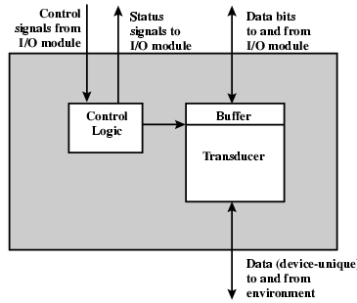
Generic Device Interface Configuration

Slide 6
Device Interface Components
The control logic is the I/O module's interface to the device
The data channel passes the collected data from or the data to be output to the device. On the opposite end is the I/O module, but eventually it is the processor.
The transducer acts as a converter between the digital data of the I/O module and the signals of the outside world.
  Keyboard converts motion of key into data representing key pressed or released
  Temperature sensor converts amount of heat into a digital value
  Disk drive converts data to electronic signals for controlling the read/write head

Slide 7
I/O Module Functions
Control & Timing
Processor Communication
Device Communication
Data Buffering
Error Detection

Slide 8
I/O Module: Control and Timing
Required because of multiple devices all communicating on the same channel
Example
  CPU checks I/O module device status
  I/O module returns status
  If ready, CPU requests data transfer
  I/O module gets data from device
  I/O module transfers data to CPU
  Variations for output, DMA, etc.

Slide 9
I/O Module: Processor Communication
Commands from processor – Examples: READ SECTOR, WRITE SECTOR, SEEK track number, and SCAN record ID.
Data – passed back and forth over the data bus
Status reporting – Request from the processor for the I/O Module's status. May be as simple as BUSY and READY
Address recognition – I/O device is setup as a block of one or more addresses unique to itself

Slide 10
Other I/O Module Functions
Device Communication – specific to each device
Data Buffering – Due to the differences in speed (device is usually orders of magnitude slower) the I/O module needs to buffer data to keep from tying up the CPU's bus with slow reads or writes
Error Detection – simply distributing the need for watching for errors to the module. They may include:
  Malfunctions by device (paper jam)
  Data errors (parity checking at the device level)
  Internal errors to the I/O module such as buffer overruns

Slide 11
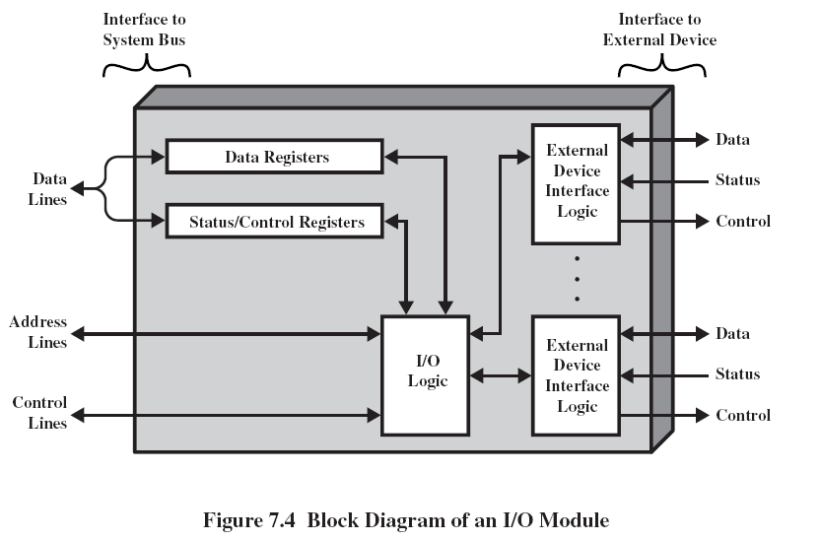
I/O Module Structure

Slide 12
I/O Module Level of Operation
How much control will the CPU be required to handle?
How much will the CPU be allowed to handle?
What will the interface look like, e.g., Unix treats everything like a file
Support multiple or single device
Will additional control be needed for multiple devices on a single port (e.g., serial port versus USB)

Slide 13
Input/Output Techniques
Programmed I/O – poll and response
Interrupt driven – module calls for CPU when needed
Direct Memory Access (DMA) – module has direct access to specified block of memory

Slide 14
Addressing I/O Devices
“Memory-Mapped I/O”
Data transfer is the same as a memory access (chip selects)
80x86 example, any assembly language command accessing memory use memory read (^MRDC) and write (^MWTC) lines
Can use ALL memory instructions which is much greater than I/O instructions

Slide 15
Addressing I/O Devices
“Isolated I/O”
Data transfer uses the same address lines but different read/write control lines
8086 example, in and out commands use same bus with different read (^IORC) and write (^IOWC) lines
Limited number of instructions to choose from

Slide 16
Programmed I/O –
CPU has direct control over I/O
Processor requests operation with commands sent to I/O module
  Control – telling a peripheral what to do
  Test – used to check condition of I/O module or device
  Read – obtains data from peripheral so processor can read it from the data bus
  Write – sends data using the data bus to the peripheral
I/O module performs operation
When completed, I/O module updates its status registers
Sensing status – involves polling the I/O module's status registers

Slide 17
Programmed I/O (continued)
I/O module does not inform CPU directly
CPU may wait or do something and come back later
Wastes CPU time because typically processor is much faster than I/O
  CPU acts as a bridge for moving data between I/O module and main memory, i.e., every piece of data goes through CPU
  CPU waits for I/O module to complete operation

Slide 18
Programmed I/O Example
Motorola 68HC11 Serial Communications
Memory-mapped control registers
  SCCR1(0x102C)
  SCCR2 (0x102D)
Memory-mapped status register SCSR (0x102E)
R8 | T8 | 0 | M | WAKE | 0 | 0 | 0
TIE | TCIE | RIE | ILIE | TE | RE | RWU
TDRE | TC | RDRF | IDLE | OR | NF | FE | 0

Slide 19
Programmed I/O Example (continued)
Control:
Transmit enable (TE) – Set to one in order to enable serial output
Receive enable (RE) – Set to one in order to enable serial input
Status:
Transmit data register empty (TDRE) – Set to one to indicate data can be placed in buffer
Transmit complete (TC) – zero means character is being sent; one means transmitter idle
Receive data register full – Set to a one when received data needs to be read

Slide 20
Programmed I/O Example (continued)
“Transmitting a character”
SCCR2 |=0x08; // Set TE to 1
while !end_of_stream
{
while !(SCSR & 0x80); // Wait until TDRE=1
SCDR = next_byte_to_send;
}

Slide 21
Programmed I/O Example (continued)
“Receiving a character”
SCCR2 |=0x04; // Set RE to 1
while !(SCSR & 0x20); // Wait until RDRF=1
received_byte = SCDR;

Slide 22
Interrupt Driven I/O
Overcomes CPU waiting
Requires setup code and interrupt service routine
No repeated CPU checking of device
I/O module interrupts when ready
Still requires CPU to be go between for moving data between I/O module and main memory

Slide 23
Analogy: Exception Handling
Before exception handling, functions would indicate an error with a return value
  Calling code would check return code and handle error accordingly
  Code littered with extra if-statements
  Ex: if(myFunction() == -1) printf("Error occurred.");
Exception handling creates some sort of error flag.
  Third party code watches for flag, and if it gets set, executes error handler.
  Allows for single error handler and cleaner code
Configuration consists of trigger, listener, and handler

Slide 24
Basic Interrupt I/O Operation
CPU initializes the process
I/O module gets data from peripheral while CPU does other work
I/O module interrupts CPU
CPU requests data
I/O module transfers data

Slide 25
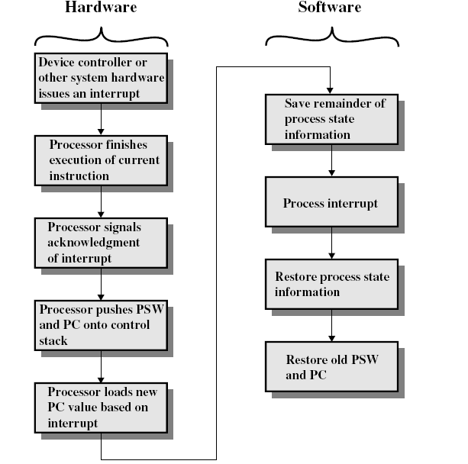
CPU
Viewpoint

Slide 26
CPU Viewpoint (continued)
Issue read command
Do other work
Check for interrupt at end of each instruction cycle (NO CODE IS INVOLVED IN THIS)
I/O module issues interrupt request

Slide 27
CPU Viewpoint (continued)
I/O module issues interrupt request forcing processor to:
Save context on stack
  Registers (this may have to be done by ISR)
  Pointers including PC/IP, but not SP
  Flags (Program Status Word)
Send acknowledgement so I/O module can release request
Process interrupt by loading address of ISR into PC/IP
Interrupt must save results of ISR because more than likely, returning from the interrupt will erase all indications that it happened at all
Retrieve context including PC/IP

Slide 28
Interrupt I/O Example
(continued from programmed I/O)
Control:
Transmit interrupt enable (TIE) – set to one enables interrupt when TDRE is set to one
Transmit complete interrupt enable (TCIE) – set to one enables interrupt when TC is set to one
Receive interrupt enable (RIE) – set to one enables interrupt when RDRF is set to one or when error occurs

Slide 29
Interrupt I/O Example (continued)
Status:
Overrun error (OR) – set to one when character received but there was no room in SCDR
Noise flag (NF) – set to one when noise is detected on receive input
Framing error (FE) – set to one when received data had error with framing bits

Slide 30
Interrupt I/O Example (continued)
“Transmitting a character”
SCCR2 |=0x88; // Set TIE and TE to 1
setISR(&ser_tx_ISR());
// At this point, processor can do something else
void INTERRUPT ser_tx_ISR()
{
SCDR = next_byte_to_send;
}

Slide 31
Interrupt I/O Example (continued)
“Receiving a character”
SCCR2 |=0x24; // Set RIE and RE to 1
setISR(&ser_rx_ISR());
// At this point, processor can do something else
void INTERRUPT ser_rx_ISR()
{
if ((SCSR & 0x2E) == 0x20)
received_byte = SCDR;
else if ((SCSR & 0xE) != 0) process_error();
}

Slide 32
Design Issues
Resolution of multiple interrupts – How do you identify the module issuing the interrupt?
Priority – How do you deal with multiple interrupts at the same time or interrupting in the middle of an interrupt?

Slide 33
Identifying Interrupting Module
Different interrupt line for each module
Limits number of devices
Even with this method, there are often multiple interrupts still on a single interrupt lined
Priority is set by hardware

Slide 34
Software poll
Single interrupt line – when interrupt occurs, CPU then goes out to check who needs attention
Slow
Priority is set by order in which CPU polls devices

Slide 35
Daisy Chain or Hardware poll
Interrupt Acknowledge sent down a chain
Module responsible places unique vector on bus
CPU uses vector to identify handler routine
Priority is set by order in which interrupt acknowledge gets to I/O modules, i.e., order of devices on the chain

Slide 36
Bus Arbitration
Allow multiple modules to control bus (See “Method of Arbitration,” p. 75)
I/O Module must claim the bus before it can raise interrupt
Can do this with:
  Bus controller/arbiter
  Distribute control to devices
Must be one master, either processor or other device
Device that "wins" places vector on bus uniquely identifying interrupt
Priority is set by priority in arbitration, i.e., whoever is currently in control of the bus

Slide 37
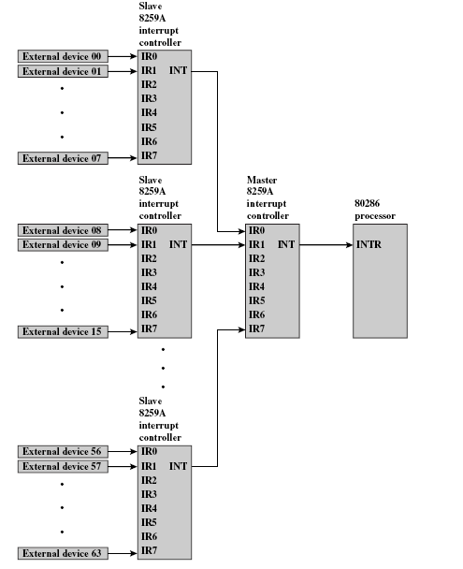
Example:
82C59A
(Fig. 7.9)

Slide 38
82C59A (continued)
80386 has one interrupt line
8259A has 8 interrupt lines

Slide 39
82C59A Sequence of Events
82C59A accepts interrupts
82C59A determines priority
  Fully nested IR0 (highest) through IR7 (lowest)
  Rotating – after interrupt is serviced, it goes to bottom of priority list
  Special mask – allows individual interrupts to be disabled
82C59A signals 8086 (raises INTR line)
CPU Acknowledges with INTA line
82C59A puts correct vector on data bus
CPU processes interrupt

Slide 40
Direct Memory Access (DMA)
Impetus behind DMA – Interrupt driven and programmed I/O require active CPU intervention (All data must pass through CPU)
Transfer rate is limited by processor's ability to service the device
CPU is tied up managing I/O transfer

Slide 41
DMA (continued)
Additional Module (hardware) on bus
DMA controller takes over bus from CPU for I/O
  Waiting for a time when the processor doesn't need bus
  Cycle stealing – seizing bus from CPU (more common)

Slide 42
DMA Operation
CPU tells DMA controller:
  whether it will be a read or write operation
  the address of device to transfer data from
  the starting address of memory block for the data transfer
  the amount of data to be transferred
DMA performs transfer while CPU does other processes
DMA sends interrupt when completed

Slide 43
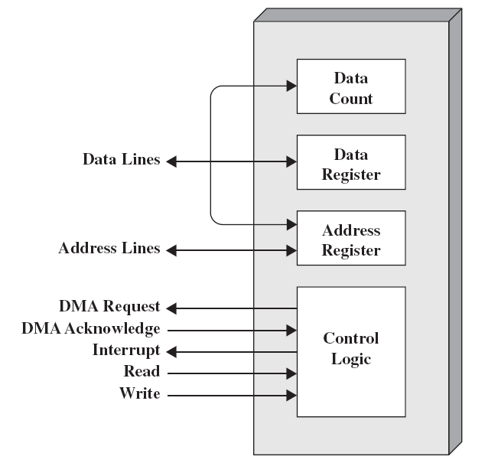
DMA Function

Slide 44
Cycle Stealing
DMA controller takes over bus for a cycle
Transfer of one word of data
Not an interrupt – CPU does not switch context
CPU suspended just before it accesses bus – i.e. before an operand or data fetch or a data write
Slows down CPU but not as much as CPU doing transfer

Slide 45
In-class discussion
What effect does caching memory have on DMA?
Hint: How much are the system buses available?

Slide 46
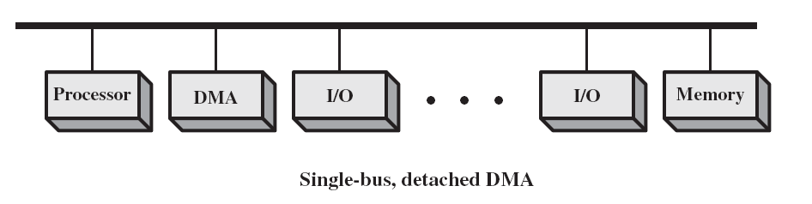
DMA Configurations
Single Bus, Detached DMA controller
  Each transfer uses bus twice – I/O to DMA then DMA to memory
  CPU is suspended twice

Slide 47
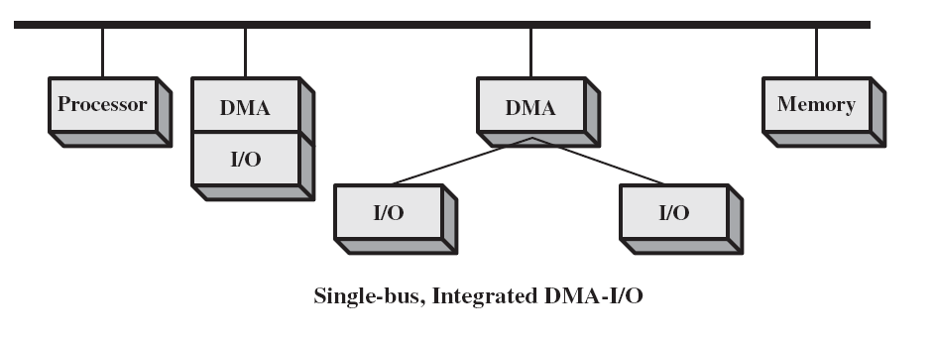
DMA Configurations (continued)
Single Bus, DMA controller integrated into I/O module
  Controller may support one or more devices
  Each transfer uses bus once – DMA to memory
  CPU is suspended once

Slide 48
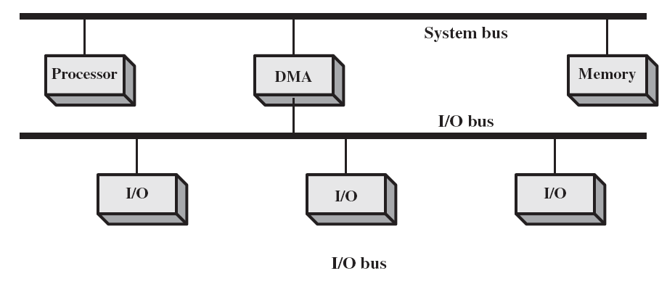
DMA Configurations (continued)
Separate I/O Bus
  Bus supports all DMA enabled devices with single DMA controller
  Each transfer uses bus once – DMA to memory
  CPU is suspended once

Slide 49
Evolutions of I/O Methods
Growth of more sophisticated I/O devices
Processor directly controls device
Processor uses Programmed I/O
Processor uses Interrupts
Processor uses DMA
Some processing moved to processors in I/O module that access programs in memory and execute them on their own without CPU intervention (I/O Module referred to as an I/O Channel)
Distributed processing where I/O module is a computer in its own right(I/O Module referred to as an I/O Processor)

Slide 50
I/O Channels (continued)
I/O Channel is extension of DMA concept
CPU instructs the I/O channel to execute a program in memory
Following these instructions, the I/O channel does the transfer of data itself
Architecture
  Selector – one device transferring block of data at a time
  Multiplexor – TDM

Slide 51
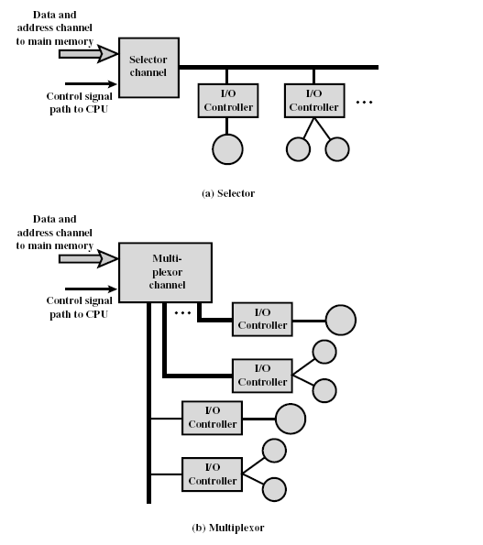
I/O Channels (continued)

