Slide 1
CSCI 4717/5717
Computer Architecture
Topic: Buses
Reading: Stallings, Sections 3.4, 3.5, and 7.7

Slide 2
Buses – Common Characteristics
Multiple devices communicating over a single set of wires
Only one device can talk at a time or the message is garbled
Each line or wire of a bus can at any one time contain a single binary digit. Over time, however, a sequence of binary digits may be transferred
These lines may and often do send information in parallel
A computer system may contain a number of different buses

Slide 3
Buses – Structure
Serial versus parallel
Around 50-100 lines although it's possible to have as few as 3 or 4
Lines can be classified into one of four groups
  Data lines
  Address Lines
  Control Lines
  Power

Slide 4
Buses – Structure (continued)
Bus lines (parallel)
  Data
  Address
  Control
  Power
Bus lines (serial)
  Data, address, and control are sequentially sent down single wire
  There may be additional control lines
  Power

Slide 5
Buses – Structure (continued)
Data Lines
  Passes data back and forth
  Number of lines represents width
Address lines
  Designates location of source or destination
  Width of address bus specifies maximum memory capacity
  High order selects module and low order selects a location within the module

Slide 6
Bus Structure – Control lines
Because multiple devices communicate on a line, control is needed
Timing
Typical lines include:
  Memory Read or Write
  I/O Read or Write
  Transfer ACK
  Bus request
  Bus grant
  Interrupt request
  Interrupt acknowledgement
  Clock
  Reset

Slide 7
Operation – Sending Data
Obtain the use of the bus
Transfer the data via the bus
Possible acknowledgement

Slide 8
Operation – Requesting Data
Obtain the use of the bus
Transfer the data request via the bus
Wait for other module to send data
Possible acknowledgement

Slide 9
Classic Bus Arrangement
All components attached to bus (STD bus)
Due to Moore's law, more and more functionality exists on a single board, so major components are now on same board or even the same chip

Slide 10
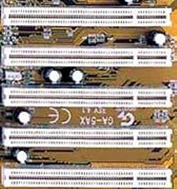
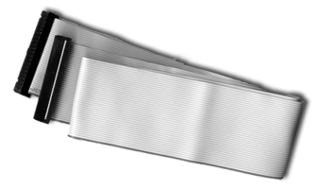
Physical Implementations
Parallel lines on circuit boards (ISA or PCI)
Ribbon cables (IDE)

Slide 11
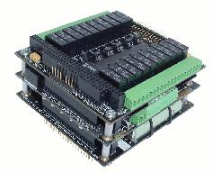
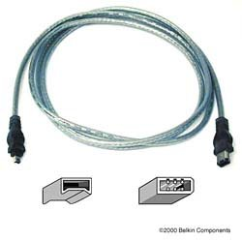
Physical Implementations (continued)
Strip connectors on mother boards (PC104)
External cabling (USB or Firewire)

Slide 12
Single Bus Problems
Lots of devices on one bus leads to:
Physically long buses
  Propagation delays – Long data paths mean that co-ordination of bus use can adversely affect performance
  Reflections/termination problems
Aggregate data transfer approaches bus capacity
Slower devices dictate the maximum bus speed

Slide 13
Multiple Buses
Most systems use multiple buses to overcome these problems
Requires bridge to buffer (FIFO) data due to differences in bus speeds
Sometimes I/O devices also contain buffering (FIFO)

Slide 14
Multiple Buses – Benefits
Isolate processor-to-memory traffic from I/O traffic
Support wider variety of interfaces
Processor has bus that connects as direct interface to chip, then an expansion bus interface interfaces it to external devices (ISA)
Cache (if it exists) may act as the interface to system bus

Slide 15
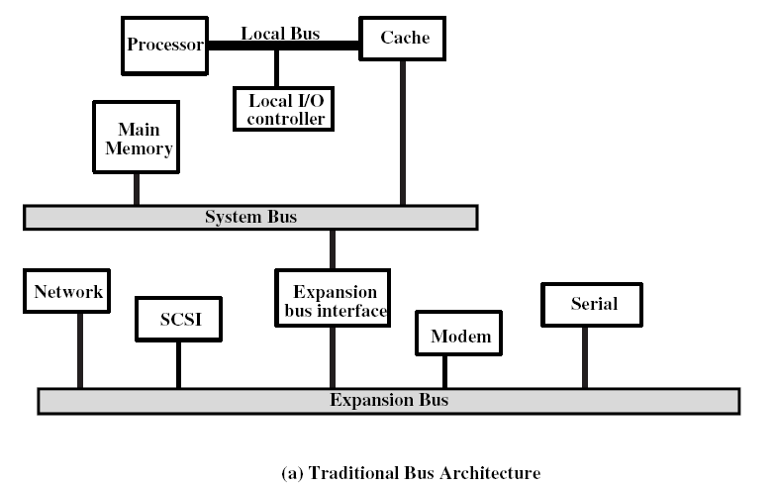
Expansion Bus Example

Slide 16
Mezzanine Approach
Differences in I/O speeds demands separating devices.
Separate items that are high-speed and those that are not
An additional high-speed bus is added to communicate with the faster devices and also the slower expansion bus
Advantage is that high-speed devices are brought closer to processor

Slide 17
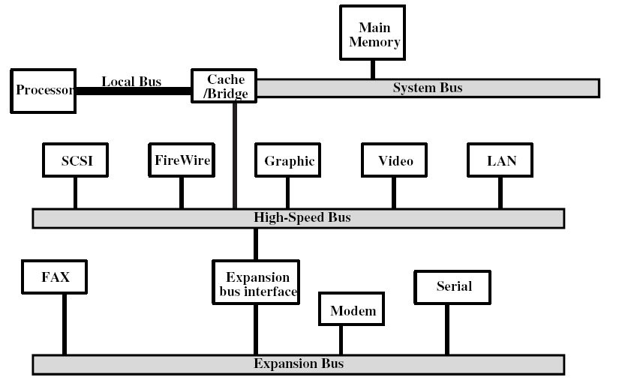
Mezzanine Approach (continued)

Slide 18
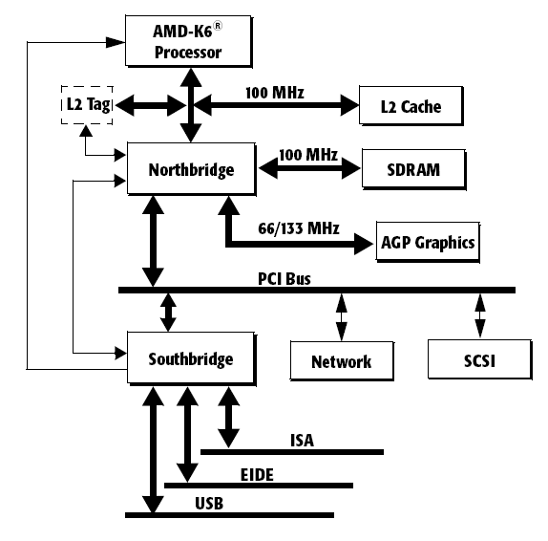
Pentium Example
(Source: http://www.amd.com/us-en/assets/content_type/white_papers_and_tech_docs/21644.pdf)

Slide 19
Bus Types
Dedicated vs. Time Multiplexed
Dedicated
  Separate data & address lines
Time multiplexed
  Shared lines
  Address valid or data valid control line
  Advantage - fewer lines
  Disadvantages
    More complex control
    Degradation of performance

Slide 20
Bus Types
Physical Dedication
  Physically separating buses and controlling them with a "channel changer“
  Advantages – faster
  Disadvantages – physically larger

Slide 21
Bus Arbitration
Listening to the bus is not usually a problem
Talking on the bus is a problem – need arbitration to allow more than one module to control the bus at one time
Arbitration may be centralised or distributed

Slide 22
Centralised vs. Distributed Arbitration
Centralised Arbitration
  Single hardware device controlling bus access – Bus Controller/Arbiter
  May be part of CPU or separate
Distributed Arbitration
  Each module may claim the bus
  Access control logic is on all modules
  Modules work together to control bus

Slide 23
Bus Timing
Co-ordination of events on bus
Synchronous – controlled by a clock
Asynchronous – timing is handled by well-defined specifications, i.e., a response is delivered within a specified time after a request

Slide 24
Synchronous Bus Timing
Events determined by clock signals
Control Bus includes clock line
A single 1-0 cycle is a bus cycle
All devices can read clock line
Usually sync on leading/rising edge
Usually a single cycle for an event
Analogy – Orchestra conductor with baton
Usually stricter in terms of its timing requirements

Slide 25
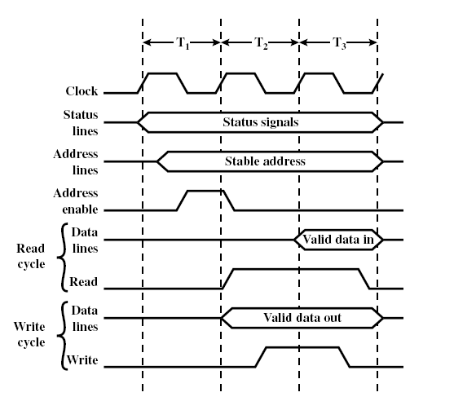
Synchronous Bus Timing

Slide 26
Asynchronous Timing
Devices must have certain tolerances to provide responses to signal stimuli
More flexible allowing slower devices to communicate on same bus with faster devices.
Performance of faster devices, however, is limited to speed of bus

Slide 27
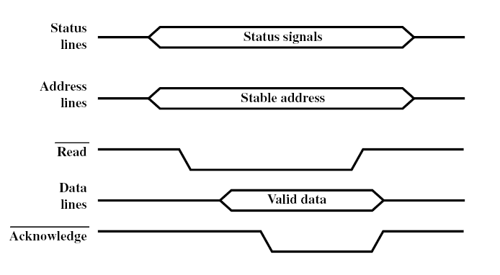
Asynchronous Timing – Read

Slide 28
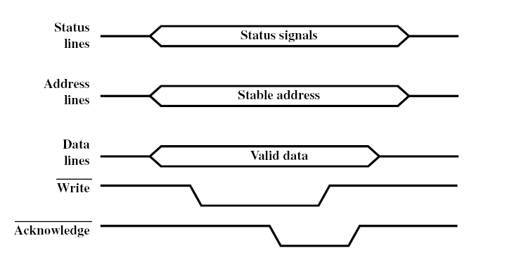
Asynchronous Timing – Write

Slide 29
Bus Width
Wider the bus the better the data transfer rate or the wider the addressable memory space
Serial “width” is determined by length/duration of frame

Slide 30
Peripheral Component Interconnection (PCI) Bus
Brief history
Original PC came out with 8-bit ISA bus which was slow, but had enormous amount of existing equipment.
For AT, IBM expanded ISA bus to 16-bit by adding connector
Many PC board manufacturers started making higher speed, proprietary buses
Intel released the patents to its PCI and this soon took over as the standard

Slide 31
PCI Bus (continued)
Brief list of PCI 2.2 characteristics
General purpose
Mezzanine or peripheral bus
Supports single- and multi-processor architectures
32 or 64 bit – multiplexed address and data
Synchronous timing
Centralized arbitration (requires bus controller)
49 mandatory lines (see Table 3.3)

Slide 32
Required PCI Bus Lines (Table 3.3)
Systems lines – clock and reset
Address & Data
  32 time multiplexed lines for address/data
  Parity lines
Interface Control
  Hand shaking lines between bus controller and devices
  Selects devices
  Allows devices to indicates when they are ready

Slide 33
Required PCI Bus Lines (continued)
Arbitration
  Not shared
  Direct connection to PCI bus arbiter
Error lines – parity and critical/system

Slide 34
Optional PCI Bus Lines
There are 51 optional PCI 2.2 bus lines
Interrupt lines
  Not shared
  Multiple lines for multiple interrupts on a single device
Cache support
64-bit Bus Extension
  Additional 32 lines
  Time multiplexed
  2 lines to enable devices to agree to use 64-bit transfer
JTAG/Boundary Scan – For testing procedures

Slide 35
PCI Commands
Transaction between initiator (master) and target
Master claims bus
During address phase of write, 4 C/BE lines signal the transaction type
One or more data phases

Slide 36
PCI Transaction Types
Interrupt acknowledge – prompts identification from interrupting device
Special cycle – message broadcast
I/O read – read to I/O address space
I/O write – write to I/O address space
Memory read – 1 or 2 data transfer cycles
Memory read line – 3 to 12 data transfer cycles
Memory read multiple – more than 12 data transfers

Slide 37
PCI Transaction Types (continued)
Memory write – writing 1 or more cycles to memory
Memory write and invalidate – writing 1 or more cycles to memory allowing for cache write-back policy
Configuration read – reading PCI device's configuration (up to 256 configuration registers per device)
Configuration write – writing PCI device's configuration (up to 256 configuration registers per device)
Dual address cycle – indication of 64-bit addressing on 32 bit lines

Slide 38
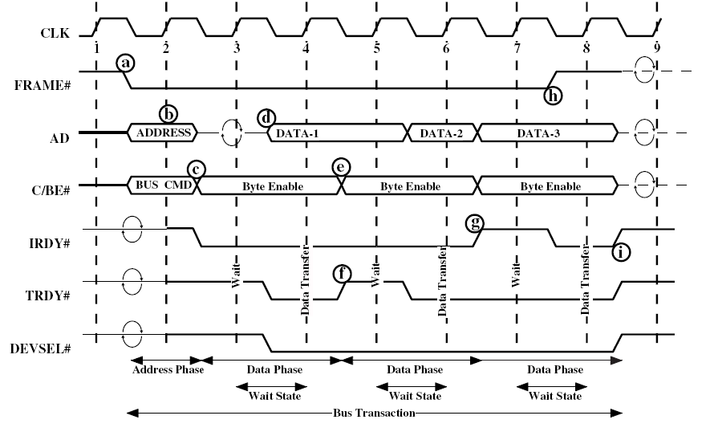
PCI Read Timing Diagram

Slide 39
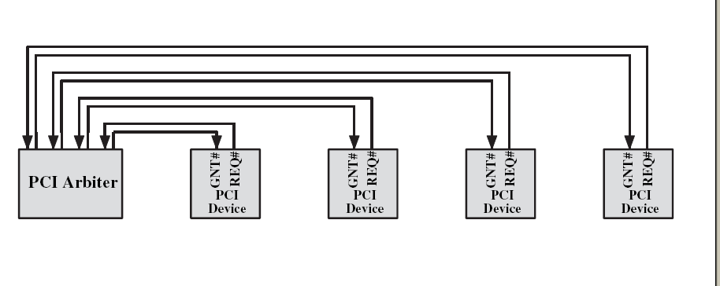
PCI Bus Arbiter

Slide 40
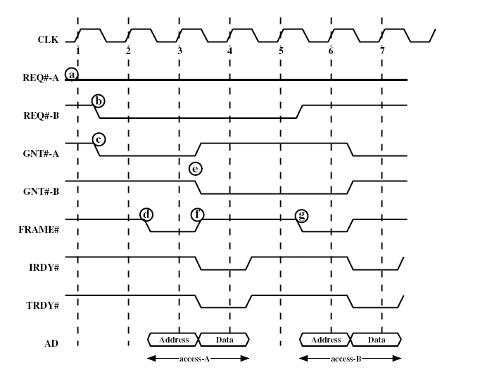
PCI Bus Arbitration Between Two Masters

Slide 41
Higher Performance External Buses
Historically, parallel has been used for high speed peripherals (e.g., SCSI, parallel port zip drives rather than serial port). High speed serial, however, has begun to replace this need
Serial communication also used to be restricted to point-to-point communications. Now there's an increasing prevalence of multipoint

Slide 42
IEEE 1394 FireWire
Inexpensive alternative needed for SCSI
High performance serial bus
Serial implies cheaper cabling (fewer wires, less shielding, less synchronization)
Small connectors for smaller devices
Fast
Low cost
Easy to implement
Also being used in digital cameras, VCRs and TVs

Slide 43
FireWire Configuration
Daisy chain/tree structure (Mac O/S Help indicates that daisy chain is preference for up to 16 devices)
Up to 63 devices on single port – really 64 of which one is the interface itself
Up to 1022 buses can be connected with bridges
Automatic configuration for addressing
No bus terminators
Hot swappable

Slide 44
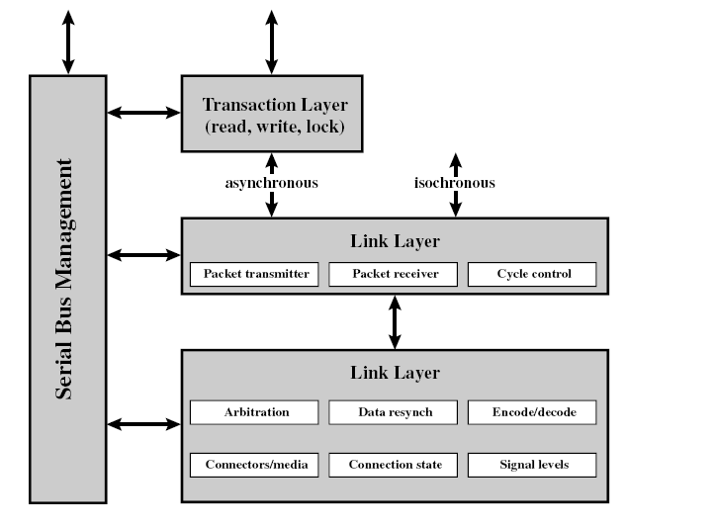
FireWire 3 Layer Stack

Slide 45
FireWire 3 Layer Stack
Physical Layer
Transmission medium, electrical and signaling characteristics
Up to 400 Mbps
Arbitration – basic form
  Fair arbitration
  Urgent arbitration
Link layer packet transmission
  Asynchronous
  Isochronous

Slide 46
Arbitration – Basic form
Upon automatic configuration, each tree designates a root
Parent/child relationship forms tree topology
Root acts as central arbitrator
Requests are first-come-first-serve
Simultaneous requests are granted first to the closest node to the root and second to the lower ID number
Two additional functions are used to best allocate the use of the bus
  Fair arbitration
  Urgent arbitration

Slide 47
Fair arbitration
Keeps one device from monopolizing the bus by allowing only one request during a set fairness interval
At beginning of interval, all devices set arbitration_enable flag
Each device may compete for bus access
If bus access is granted, arbitration_enable flag is cleared prohibiting bus access until next fairness interval

Slide 48
Urgent arbitration
Allows overriding of fairness interval by nodes configured as having an urgent priority
Provides support for devices with severe latency requirements or high throughput such as video
They may use the bus up to 75% of the time, i.e., for each non-urgent packet, three urgent packets may be sent

Slide 49
FireWire 3 Layer Stack
Link Layer
Transmission of data in packets
Two types of transmission supported:
  Asynchronous
  Isochronous

Slide 50
Asynchronous
Packets contain
Variable amount of data
Several bytes of transaction layer information
Addressing information
Acknowledgement

Slide 51
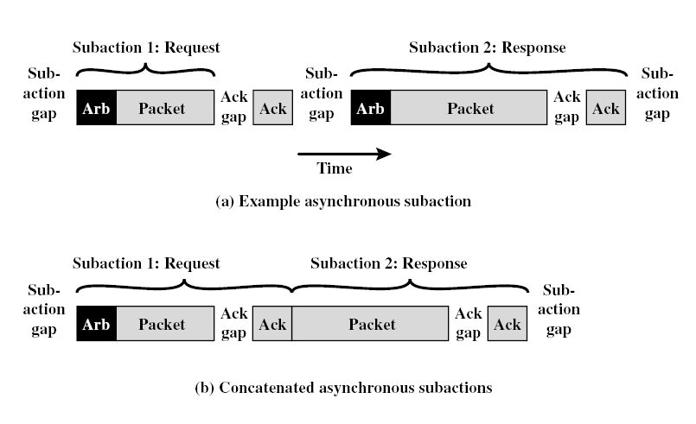
Asynchronous Sequence

Slide 52
Asynchronous Sequence (continued)
Arbitration sequence – gives one device control of the bus
Packet transmission – packet contains source and destination IDs, type, CRC, and possible data
Acknowledgement gap – allows destination to receive and process message
Acknowledgement – destination sends packet containing source and destination IDs and code indicating action taken
Subaction gap – idle period between packets to avoid bus contention

Slide 53
Isochronous
Fixed packet size w/variable amount of data
Simplified addressing
No acknowledgement
Periodically, cycle_start packet is sent indicating period where only isochronous packets are transmitted
Transaction – Request-response protocol (This is what your code sees. It separates the programmer from the packet-level stuff)

Slide 54
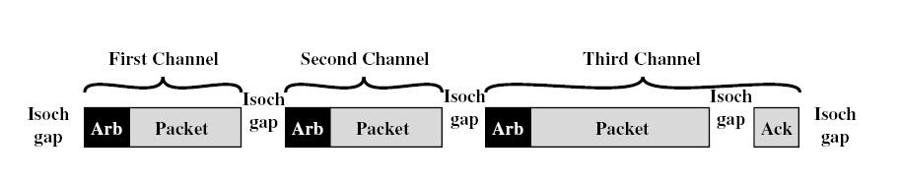
Isochronous Sequence

