Slide 1
CSCI 4717/5717
Computer Architecture
Topic: Cache Memory
Reading: Stallings, Chapter 4

Slide 2
Characteristics of Memory
“Location wrt Processor”
Inside CPU – temporary memory or registers
Inside processor – L1 cache
Motherboard – main memory and L2 cache
Main memory – DRAM and L3 cache
External – peripherals such as disk, tape, and networked memory devices

Slide 3
Characteristics of Memory
“Capacity – Word Size”
The natural data size for a processor.
A 32-bit processor has a 32-bit word.
Typically based on processor's data bus width (i.e., the width of an integer or an instruction)
Varying widths can be obtained by putting memory chips in parallel with same address lines

Slide 4
Characteristics of Memory
“Capacity – Addressable Units”
Varies based on the system's ability to allow addressing at byte level etc.
Typically smallest location which can be uniquely addressed
At mother board level, this is the word
It is a cluster on disks
Addressable units (N) equals 2 raised to the power of the number of bits in the address bus

Slide 5
Characteristics of Memory
“Unit of transfer”
The number of bits read out of or written into memory at a time.
Internal – Usually governed by data bus width, i.e., a word
External – Usually a block which is much larger than a word

Slide 6
Characteristics of Memory
“Access method”
Based on the hardware implementation of the storage device
Four types
  Sequential
  Direct
  Random
  Associative

Slide 7
Sequential Access Method
Start at the beginning and read through in order
Access time depends on location of data and previous location
Example: tape

Slide 8
Direct Access Method
Individual blocks have unique address
Access is by jumping to vicinity then performing a sequential search
Access time depends on location of data within "block" and previous location
Example: hard disk

Slide 9
Random Access Method
Individual addresses identify locations exactly
Access time is consistent across all locations and is independent previous access
Example: RAM

Slide 10
Associative Access Method
Addressing information must be stored with data in a general data location
A specific data element is located by a comparing desired address with address portion of stored elements
Access time is independent of location or previous access
Example: cache

Slide 11
Performance – Access Time
Time between "requesting" data and getting it
RAM
  Time between putting address on bus and getting data.
  It's predictable.
Other types, Sequential, Direct, Associative
  Time it takes to position the read-write mechanism at the desired location.
  Not predictable.

Slide 12
Performance – Memory Cycle time
Primarily a RAM phenomenon
Adds "recovery" time to cycle allowing for transients to dissipate so that next access is reliable.
Cycle time is access + recovery

Slide 13
Performance – Transfer Rate
Rate at which data can be moved
RAM – Predictable; equals 1/(cycle time)
Non-RAM – Not predictable; equals
T_{N} = T_{A} + (N/R)
where
  T_{N} = Average time to read or write N bits
  T_{A} = Average access time
  N = Number of bits
  R = Transfer rate in bits per second

Slide 14
Physical Types
Semiconductor – RAM
Magnetic – Disk & Tape
Optical – CD & DVD
Others
  Bubble (old) – memory that made a "bubble" of charge in an opposite direction to that of the thin magnetic material that on which it was mounted
  Hologram (new) – much like the hologram on your credit card, laser beams are used to store computer-generated data in three dimensions. (10 times faster with 12 times the density)

Slide 15
Physical Characteristics
Decay
  Power loss
  Degradation over time
Volatility – RAM vs. Flash
Erasable – RAM vs. ROM
Power consumption – More specific to laptops, PDAs, and embedded systems

Slide 16
Organization
Physical arrangement of bits into words
Not always obvious
Non-sequential arrangements may be due to speed or reliability benefits, e.g. interleaved

Slide 17
Memory Hierarchy
Trade-offs among three key characteristics
  Amount – Software will ALWAYS fill available memory
  Speed – Memory should be able to keep up with the processor
  Cost – Whatever the market will bear
Balance these three characteristics with a memory hierarchy
Analogy –
Refrigerator & cupboard (fast access – lowest variety)
freezer & pantry (slower access – better variety)
grocery store (slowest access – greatest variety)

Slide 18
Memory Hierarch (continued)
Implementation – Going down the hierarchy has the following results:
  Decreasing cost per bit (cheaper)
  Increasing capacity (larger)
  Increasing access time (slower)
  KEY – Decreasing frequency of access of the memory by the processor

Slide 19
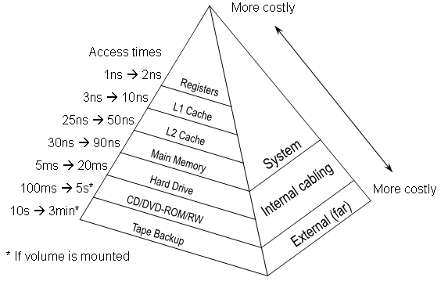
Memory Hierarch (continued)
Source: Null, Linda and Lobur, Julia (2003). Computer Organization and Architecture (p. 236). Sudbury, MA: Jones and Bartlett Publishers.

Slide 20
Mechanics of Technology
The basic mechanics of creating memory directly affect the first three characteristics of the hierarchy:
  Decreasing cost per bit
  Increasing capacity
  Increasing access time
The fourth characteristic is met because of a principle known as locality of reference

Slide 21
In-Class Exercise
In groups, examine the following code. Identify how many times the processor "touches" each piece of data and each line of code:
int values[8] =
{9, 34, 23, 67, 23, 7, 3, 65};
int count;
int sum = 0;
for (count = 0; count < 8; count++)
sum += values[count];
For better results, try the same exercise using the assembly language version found at:
http://faculty.etsu.edu/tarnoff/ntes4717/week_03/assy.pdf

Slide 22
Locality of Reference
Due to the nature of programming, instructions and data tend to cluster together (loops, subroutines, and data structures)
  Over a long period of time, clusters will change
  Over a short period, clusters will tend to be the same

Slide 23
Breaking Memory into Levels
Assume a hypothetical system has two levels of memory
  Level 2 should contain all instructions and data
  Level 1 doesn't have room for everything, so when a new cluster is required, the cluster it replaces must be sent back to the level 2
These principles can be applied to much more than just two levels
If performance is based on amount of memory rather than speed, lower levels can be used to simulate larger sizes for higher levels, e.g., virtual memory

Slide 24
Memory Hierarchy Examples
Example: If 95% of the memory accesses are found in the faster level, then the average access time might be:
(0.95)(0.01 uS) + (0.05)(0.1 uS) = 0.0095 + 0.0055
= 0.015 uS

Slide 25
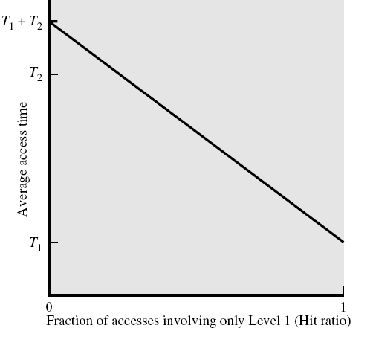
Performance of a Simple Two-Level Memory (Figure 4.2)

Slide 26
Hierarchy List
Registers – volatile
L1 Cache – volatile
L2 Cache – volatile
CDRAM (main memory) cache – volatile
Main memory – volatile
Disk cache – volatile
Disk – non-volatile
Optical – non-volatile
Tape – non-volatile

Slide 27
Cache
What is it? A cache is a small amount of fast memory
What makes small fast?
  Simpler decoding logic
  More expensive SRAM technology
  Close proximity to processor – Cache sits between normal main memory and CPU or it may be located on CPU chip or module

Slide 28

Cache (continued)

Slide 29
Cache operation – overview
CPU requests contents of memory location
Check cache for this data
If present, get from cache (fast)
If not present, one of two things happens:
  read required block from main memory to cache then deliver from cache to CPU (cache physically between CPU and bus)
  read required block from main memory to cache and simultaneously deliver to CPU (CPU and cache both receive data from the same data bus buffer)

Slide 30
Going Deeper with Principle of Locality
Cache "misses" are unavoidable, i.e., every piece of data and code thing must be loaded at least once
What does a processor do during a miss? It waits for the data to be loaded.
Power consumption varies linearly with clock speed and the square of the voltage.
Adjusting clock speed and voltage of processor has the potential to produce cubic (cubed root) power reductions (http://www.visc.vt.edu/~mhsiao/papers/pacs00ch.pdf)
Identify places in in-class exercise where this might happen.

Slide 31
Cache Structure
Cache includes tags to identify the address of the block of main memory contained in a line of the cache
Each word in main memory has a unique n-bit address
There are M=2^{n}/K block of K words in main memory
Cache contains C lines of K words each plus a tag uniquely identifying the block of K words

Slide 32
Cache Structure (continued)
Line
number
0
1
2
C-1
Tag Block
Block length
(K words)

Slide 33
Memory Divided into Blocks
Memory Address
1
2
3
2^{n}-1
Block of
K words
Block
Word length

Slide 34
Cache Design
Size
Mapping Function
Replacement Algorithm
Write Policy
Block Size
Number of Caches

Slide 35
Cache size
Cost – More cache is expensive
Speed
  More cache is faster (up to a point)
  Larger decoding circuits slow up a cache
  Algorithm is needed for mapping main memory addresses to lines in the cache. This takes more time than just a direct RAM

Slide 36

Typical Cache Organization

Slide 37
Mapping Functions
A mapping function is the method used to locate a memory address within a cache
It is used when copying a block from main memory to the cache and it is used again when trying to retrieve data from the cache
There are three kinds of mapping functions
  Direct
  Associative
  Set Associative

Slide 38
Cache Example
These notes use an example of a cache to illustrate each of the mapping functions. The characteristics of the cache used are:
  Size: 64 kByte
  Block size: 4 bytes – i.e. the cache has 16k (2¹⁴) lines of 4 bytes
  Address bus: 24-bit– i.e., 16M bytes main memory divided into 4M 4 byte blocks

Slide 39
Direct Mapping Traits
Each block of main memory maps to only one cache line – i.e. if a block is in cache, it will always be found in the same place
Line number is calculated using the following function
i = j modulo m
where
  i = cache line number
  j = main memory block number
  m = number of lines in the cache

Slide 40
Direct Mapping Address Structure
Each main memory address can by divided into three fields
Least Significant w bits identify unique word within a block
Remaining bits (s) specify which block in memory. These are divided into two fields
  Least significant r bits of these s bits identifies which line in the cache
  Most significant s-r bits uniquely identifies the block within a line of the cache
s-r bits
r bits
w bits
Tag
Bits identifying
row in cache
Bits identifying word
offset into block

Slide 41
Direct Mapping Address Structure
(continued)
Why are the r-bits used to identify which line in cache?
More likely to have unique r bits than s-r bits based on principle of locality of reference

Slide 42
Direct Mapping Address Structure Example
Tag s-r
Line or slot r
Word w
8
14
2
24 bit address
2 bit word identifier (4 byte block)
22 bit block identifier
8 bit tag (=22–14)
14 bit slot or line
No two blocks in the same line have the same tag
Check contents of cache by finding line and comparing tag

Slide 43
Direct Mapping Cache Line Table
Cache line | Main Memory blocks held
0 | 0, m, 2m, 3m…2^{s}–m
1 | 1, m+1, 2m+1…2^{s}–m+1
m–1 | m–1, 2m–1, 3m–1…2^{s}–1

Slide 44
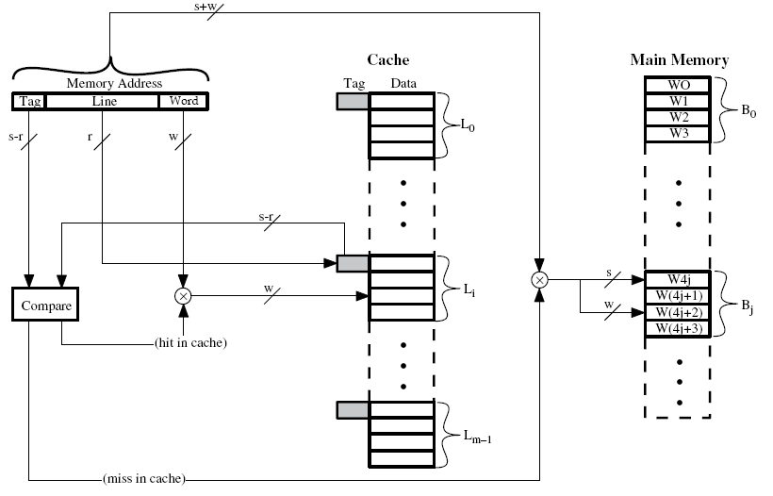
Direct Mapping Cache Organization

Slide 45
Direct Mapping Examples
What cache line number will the following addresses be stored to, and what will the minimum address and the maximum address of each block they are in be if we have a cache with 4K lines of 16 words to a block in a 256 Meg memory space (28-bit address)?
a.) 9ABCDEF₁₆
b.) 1234567₁₆
Tag s-r
Line or slot r
Word w
12
12
4

Slide 46
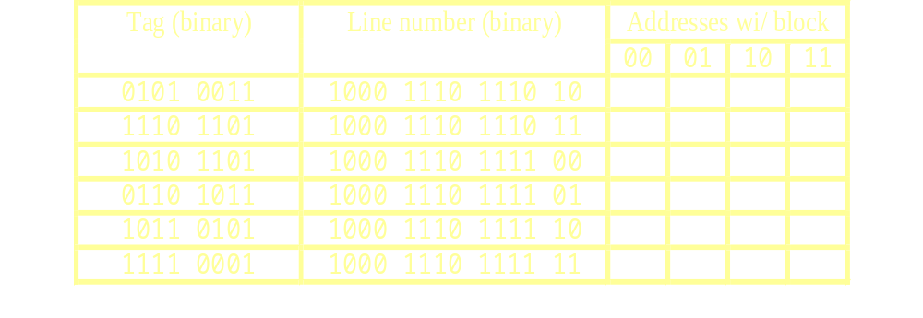
More Direct Mapping Examples
Assume that a portion of the tags in the cache in our example looks like the table below. Which of the following addresses are contained in the cache?
a.) 438EE8₁₆ b.) F18EFF₁₆ c.) 6B8EF3₁₆ d.) AD8EF3₁₆

Slide 47
Direct Mapping Summary
Address length = (s + w) bits
Number of addressable units = 2^{s+w} words or bytes
Block size = line width = 2^{w} words or bytes
Number of blocks in main memory = 2^{s+ w}/2^{w} = 2^{s}
Number of lines in cache = m = 2^{r}
Size of tag = (s – r) bits

Slide 48
Direct Mapping pros & cons
Simple
Inexpensive
Fixed location for given block –
If a program accesses 2 blocks that map to the same line repeatedly, cache misses are very high (thrashing)

Slide 49
Associative Mapping Traits
A main memory block can load into any line of cache
Memory address is interpreted as:
  Least significant w bits = word position within block
  Most significant s bits = tag used to identify which block is stored in a particular line of cache
Every line's tag must be examined for a match
Cache searching gets expensive and slower

Slide 50
Associative Mapping Address Structure Example
Tag – s bits
(22 in example)
Word – w bits
(2 in ex.)
22 bit tag stored with each 32 bit block of data
Compare tag field with tag entry in cache to check for hit
Least significant 2 bits of address identify which of the four 8 bit words is required from 32 bit data block

Slide 51
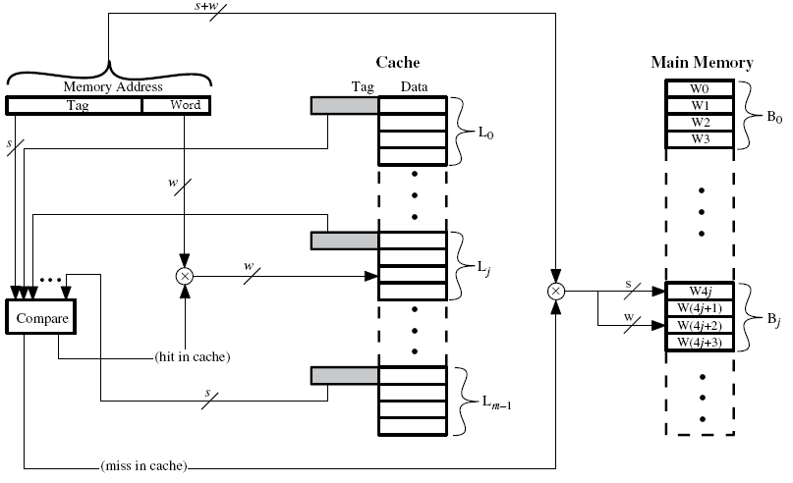
Fully Associative Cache Organization

Slide 52
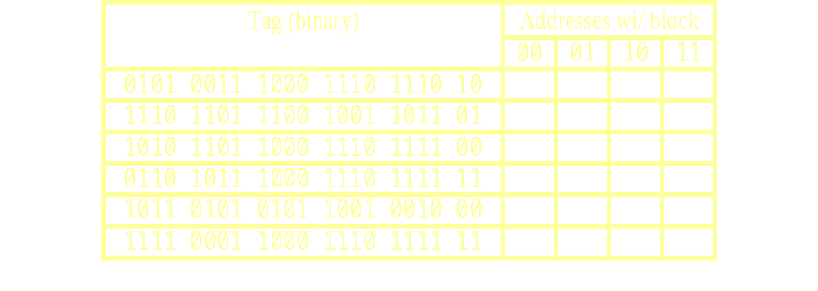
Fully Associative Mapping Example
Assume that a portion of the tags in the cache in our example looks like the table below. Which of the following addresses are contained in the cache?
a.) 438EE8₁₆ b.) F18EFF₁₆ c.) 6B8EF3₁₆ d.) AD8EF3₁₆

Slide 53
Associative Mapping Summary
Address length = (s + w) bits
Number of addressable units = 2^{s+w} words or bytes
Block size = line size = 2^{w} words or bytes
Number of blocks in main memory = 2^{s+ w}/2^{w} = 2^{s}
Number of lines in cache = undetermined
Size of tag = s bits

Slide 54
Set Associative Mapping Traits
Address length is s + w bits
Cache is divided into a number of sets, v = 2^{d}
k blocks/lines can be contained within each set
k lines in a cache is called a k-way set associative mapping
Number of lines in a cache = v•k = k•2^{d}
Size of tag = (s-d) bits

Slide 55
Set Associative Mapping Traits (continued)
Hybrid of Direct and Associative
k = 1, this is basically direct mapping
v = 1, this is associative mapping
Each set contains a number of lines, basically the number of lines divided by the number of sets
A given block maps to any line within its specified set – e.g. Block B can be in any line of set i.
2 lines per set is the most common organization.
  Called 2 way associative mapping
  A given block can be in one of 2 lines in only one specific set
  Significant improvement over direct mapping

Slide 56
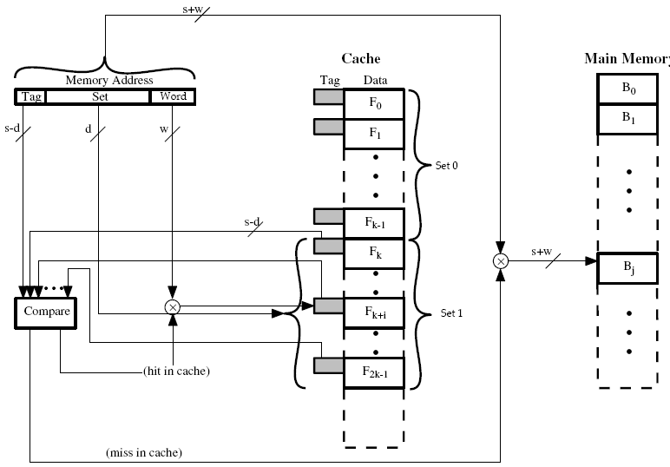
K-Way Set Associative Cache Organization

Slide 57
How does this affect our example?
Let’s go to two-way set associative mapping
Divides the 16K lines into 8K sets
This requires a 13 bit set number
With 2 word bits, this leaves 9 bits for the tag
Blocks beginning with the addresses 000000₁₆, 008000₁₆, 010000₁₆, 018000₁₆, 020000₁₆, 028000₁₆, etc. map to the same set, Set 0.
Blocks beginning with the addresses 00000416, 008004₁₆, 010004₁₆, 018004₁₆, 020004₁₆, 028004₁₆, etc. map to the same set, Set 1.

Slide 58
Set Associative Mapping Address Structure
Tag
9 bits
Set
13 bits
Word
2 bits
Note that there is one more bit in the tag than for this same example using direct mapping.
Therefore, it is 2-way set associative
Use set field to determine cache set to look in
Compare tag field to see if we have a hit

Slide 59
Set Associative Mapping Example
For each of the following addresses, answer the following questions based on a 2-way set associative cache with 4K lines, each line containing 16 words, with the main memory of size 256 Meg memory space (28-bit address):
What cache set number will the block be stored to?
What will their tag be?
What will the minimum address and the maximum address of each block they are in be?
9ABCDEF₁₆
1234567₁₆
Tag s-r
Set s
Word w
13
11
4

Slide 60
Set Associative Mapping Summary
Address length = (s + w) bits
Number of addressable units = 2^{s+w} words or bytes
Block size = line size = 2^{w} words or bytes
Number of blocks in main memory = 2^{s+ w}/2^{w} = 2^{s}
Number of lines in set = k
Number of sets = v = 2^{d}
Number of lines in cache = kv = k * 2^{d}
Size of tag = (s – d) bits

Slide 61
Replacement Algorithms
There must be a method for selecting which line in the cache is going to be replaced when there’s no room for a new line
Hardware implemented algorithm (speed)
Direct mapping
  There is no need for a replacement algorithm with direct mapping
  Each block only maps to one line
  Replace that line

Slide 62
Associative & Set Associative Replacement Algorithms
Least Recently used (LRU)
  Replace the block that hasn't been touched in the longest period of time
  Two way set associative simply uses a USE bit. When one block is referenced, its USE bit is set while its partner in the set is cleared
First in first out (FIFO) – replace block that has been in cache longest

Slide 63
Associative & Set Associative Replacement Algorithms (continued)
Least frequently used (LFU) – replace block which has had fewest hits
Random – only slightly lower performance than use-based algorithms LRU, FIFO, and LFU

Slide 64
Writing to Cache
Must not overwrite a cache block unless main memory is up to date
Two main problems:
  If cache is written to, main memory is invalid or if main memory is written to, cache is invalid – Can occur if I/O can address main memory directly
  Multiple CPUs may have individual caches; once one cache is written to, all caches are invalid

Slide 65
Write through
All writes go to main memory as well as cache
Multiple CPUs can monitor main memory traffic to keep local (to CPU) cache up to date
Lots of traffic
Slows down writes

Slide 66
Write back
Updates initially made in cache only
Update bit for cache slot is set when update occurs
If block is to be replaced, write to main memory only if update bit is set
Other caches get out of sync
I/O must access main memory through cache
Research shows that 15% of memory references are writes

Slide 67
Multiple Processors/Multiple Caches
Even if a write through policy is used, other processors may have invalid data in their caches
In other words, if a processor updates its cache and updates main memory, a second processor may have been using the same data in its own cache which is now invalid.

Slide 68
Solutions to Prevent Problems with Multiprocessor/cache systems
Bus watching with write through – each cache watches the bus to see if data they contain is being written to the main memory by another processor. All processors must be using the write through policy
Hardware transparency – a "big brother" watches all caches, and upon seeing an update to any processor's cache, it updates main memory AND all of the caches
Noncacheable memory – Any shared memory (identified with a chip select) may not be cached.

Slide 69
Line Size
There is a relationship between line size (i.e., the number of words in a line in the cache) and hit ratios
As the line size (block size) goes up, the hit ratio could go up due to more words available to the principle of locality of reference
As block size increases, however, the number of blocks goes down, and the hit ratio will begin to go back down after a while
Lastly, as the block size increases, the chances of a hit to a word farther from the initially referenced word goes down

Slide 70
Multi-Level Caches
Increases in transistor densities have allowed for caches to be placed inside processor chip
Internal caches have very short wires (within the chip itself) and are therefore quite fast, even faster then any zero wait-state memory accesses outside of the chip
This means that a super fast internal cache (level 1) can be inside of the chip while an external cache (level 2) can provide access faster then to main memory

Slide 71
Unified versus Split Caches
Split into two caches – one for instructions, one for data
Disadvantages
  Questionable as unified cache balances data and instructions merely with hit rate.
  Hardware is simpler with unified cache
Advantage
  What a split cache is really doing is providing one cache for the instruction decoder and one for the execution unit.
  This supports pipelined architectures.

Slide 72
Intel x86 caches
80386 – no on chip cache
80486 – 8k using 16 byte lines and four-way set associative organization (main memory had 32 address lines – 4 Gig)
Pentium (all versions)
  Two on chip L1 caches
  Data & instructions

Slide 73
Pentium 4 L1 and L2 Caches
L1 cache
  8k bytes
  64 byte lines
  Four way set associative
L2 cache
  Feeding both L1 caches
  256k
  128 byte lines
  8 way set associative

Slide 74
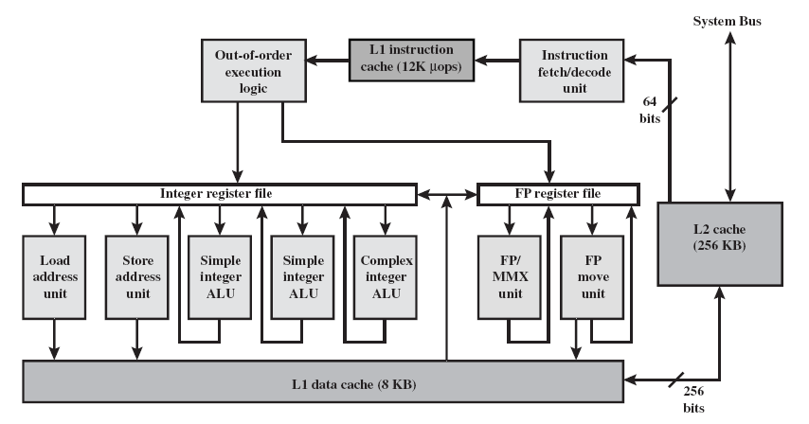
Pentium 4 (Figure 4.13)

Slide 75
Pentium 4 Operation – Core Processor
Fetch/Decode Unit
  Fetches instructions from L2 cache
  Decode into micro-ops
  Store micro-ops in L1 cache
Out of order execution logic
  Schedules micro-ops
  Based on data dependence and resources
  May speculatively execute

Slide 76
Pentium 4 Operation – Core Processor (continued)
Execution units
  Execute micro-ops
  Data from L1 cache
  Results in registers
Memory subsystem – L2 cache and systems bus

Slide 77
Pentium 4 Design Reasoning
Decodes instructions into RISC like micro-ops before L1 cache
Micro-ops fixed length – Superscalar pipelining and scheduling
Pentium instructions long & complex
Performance improved by separating decoding from scheduling & pipelining – (More later – ch14)

Slide 78
Pentium 4 Design Reasoning (continued)
Data cache is write back – Can be configured to write through
L1 cache controlled by 2 bits in register
  CD = cache disable
  NW = not write through
  2 instructions to invalidate (flush) cache and write back then invalidate

Slide 79
Power PC Cache Organization
601 – single 32kb 8 way set associative
603 – 16kb (2 x 8kb) two way set associative
604 – 32kb
610 – 64kb
G3 & G4
  64kb L1 cache – 8 way set associative
  256k, 512k or 1M L2 cache – two way set associative

Slide 80
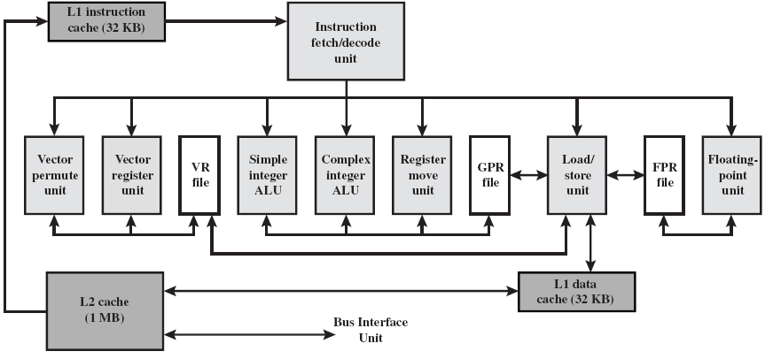
PowerPC G4 (Figure 4.14)

Slide 81
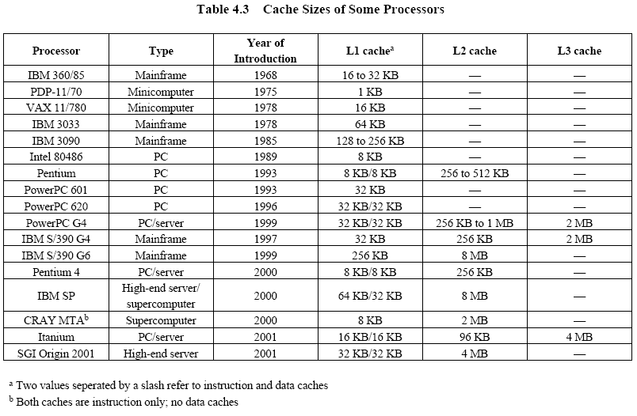
Comparison of Cache Sizes (Table 4.3)

