Slide 1
CSCI 4717/5717
Computer Architecture
Topic: Error Detection & Correction
Reading: Stallings, Section 5.2

Slide 2
Error Correction in Memory
Types of errors: hard or soft
Hard Failure – Permanent defect caused by
  Harsh environmental abuse (including static electricity)
  Manufacturing defect
  Wear such as trace erosion
Soft Error
  Random, non-destructive
  Caused by electrical or EM/radioactive glitches
  No permanent damage to memory

Slide 3
Error Detection & Correction
Additional information must be stored to detect these errors
When M bits of data are stored, they are run through function f where a K bit code is created
M+K bits are then stored in memory
When data is read out, it is once again run through function f and the resulting K bits of code are compared with the stored K bits of code
In some cases, the code can be corrected (error correcting codes)
In all cases, and error code is generated

Slide 4
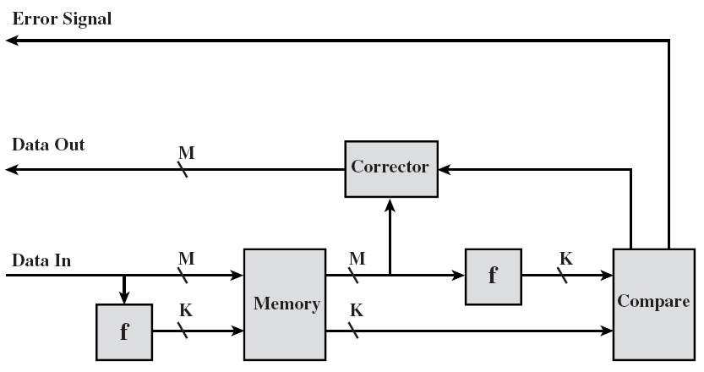
Error Correcting Code Function

Slide 5
Hamming Error Correction Code
One way to detect specific bit errors is to use multiple parity bits, each bit responsible for the parity of a smaller, overlapping portion of the data
A flipped bit in the data would show up as a parity error in the overlapping groups of which it was a member and not in the other groups
This would handle single-bit corrections

Slide 6
4-bit Hamming Code
Below is an example of a 4-bit word broken into 3 groups; each group has a parity bit to generate even parity.
D_{n} represent data bits while P_{n} represent parity bits
 | D₃=1 | D₂=0 | D₁=1 | D₀=1 |  | P₀ | P₁ | P₂
Group A | 1 | 0 | 1 |  |  | 0
Group B | 1 |  | 1 | 1 |  |  | 1
Group C | 1 | 0 |  | 1 |  |  |  | 0

Slide 7
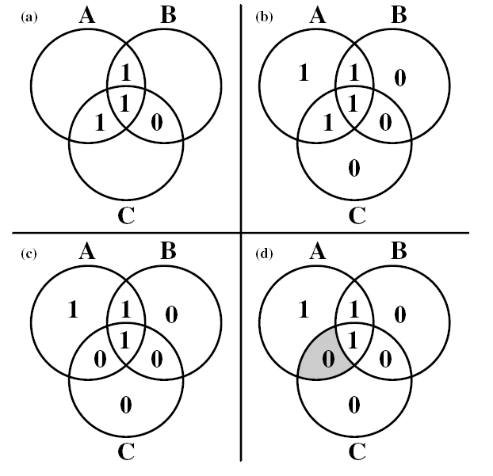
4-bit Hamming Code (continued)
Can be represented graphically using three intersecting circles.

Slide 8
4-bit Hamming Code (continued)
Areas are defined as:
  A and B, but not C
  A and C, but not B
  B and C, but not A
  A and B and C
Each non-intersecting area contains a parity bit to make it and the three intersecting areas in a single circle have even parity.
A change in only one area will make parity odd in 2 or all 3 of the circles indicating which intersection changed.

Slide 9
General Single-Bit Error Correction
The mechanics of the typical error correction/detection system are created with XOR gates
  Odd number of ones input to an XOR → 1 output
  Even number of ones input to an XOR → 0 output
Upon data retrieval, two K-bit values are generated:
  The stored K-bit value
  The K-bit value generated from the stored data
A bit-by-bit comparison is performed on these two values generating a K-bit result
  0’s in bit positions where there is no error
  1’s in bit positions where two bits disagree
  K-bit result is called a syndrome word

Slide 10
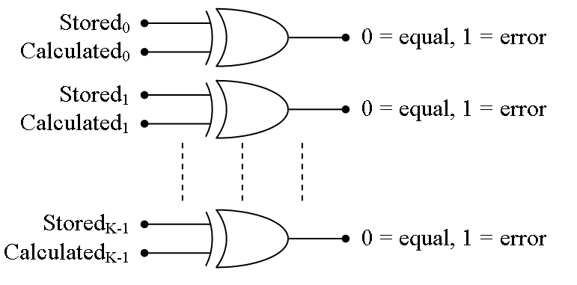
Generation of Syndrome Word

Slide 11
Syndrome Word
All zeros means that the data was successfully retrieved
For data with M bits and K code bits, then there are M+K possible single bit errors, i.e., there could be an error in the data OR the K-bit code
For a K bit syndrome word, there are 2^{K}-1 (minus one for the no error case) possible values to represent single-bit errors
Therefore, for the system to uniquely identify bit errors, 2^{K}-1 > M+K

Slide 12
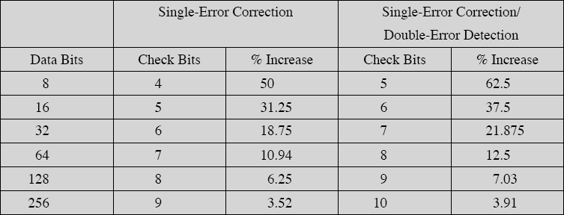
Single Error Correcting (SEC) Code Example
Assume M=8
First, how big does K have to be?
K=3: 2³-1 > 8+3? (7 is not > 11)
K=4: 2⁴-1 > 8+4? (15 is > 12)

Slide 13
SEC Code Example (continued)
Next, decide what the values of the syndrome word represent
0 = no errors in syndrome word or data
Only one bit of syndrome word set to one (1000, 0100, 0010, or 0001) = error was in syndrome word and data needs no correction
Multiple bits of syndrome word set to one = digit represented by syndrome word identifies which bit of data was flipped and needs to be corrected

Slide 14
SEC Code Example (continued)
The table below is used to identify which bits of the M+K bits of the combined data and syndrome word are associated with which possible values of the syndrome word.
M+K Bit position | 12 | 11 | 10 | 9 | 8 | 7 | 6 | 5 | 4 | 3 | 2 | 1
Position number | 1100 | 1011 | 1010 | 1001 | 1000 | 0111 | 0110 | 0101 | 0100 | 0011 | 0010 | 0001
Data bits | D8 | D7 | D6 | D5 |  | D4 | D3 | D2 |  | D1
Code bits |  |  |  |  | C8 |  |  |  | C4 |  | C2 | C1

Slide 15
SEC Code Example (continued)
We need a system such that the XOR-ing of the stored code or check bits with the code or check bits calculated identifies the position number from the table above.
This means that when a bit changes in the data, then ones need to appear in the digits identifying that position.
Each code bit C8, C4, C2, and C1 is calculated by XOR-ing all of the bits in that position that have a 1.

Slide 16
SEC Code Example (continued)
C8 = D8 ⊕ D7 ⊕ D6 ⊕ D5
C4 = D8 ⊕ D4 ⊕ D3 ⊕ D2
C2 = D7 ⊕ D6 ⊕ D4 ⊕ D3 ⊕ D1
C1 = D7 ⊕ D5 ⊕ D4 ⊕ D2 ⊕ D1

Slide 17
Single Error Correcting, Double Error Detecting (SEC-DED) Code
Double error detection will not correct double errors, but it will see if a double error has occurred.
Adds additional bit for even parity to the M+K bits of the data and check code
If one bit changed, the change caused parity to go from even to odd.
Changing it back will restore parity
If two bits changed, parity stayed even and a correction will force parity to go to odd indicating a double error.

Slide 18
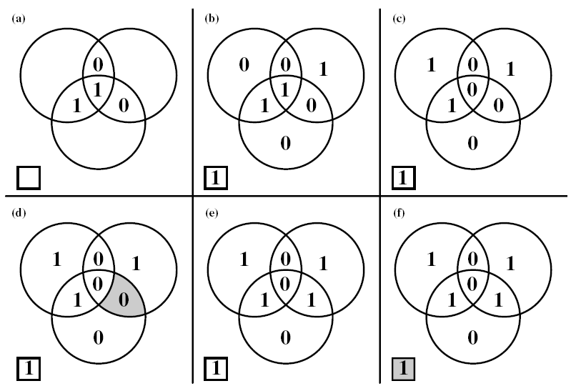
SEC-DED Example

