Slide 1
CSCI 4717/5717
Computer Architecture
Topic: Functional View & History
Reading: Sections 1.2, 2.1, & 2.3

Slide 2
Function
All computer functions are comprised of four basic operations:
  Data processing
  Data storage
  Data movement
  Control

Slide 3
Data Processing
  The basic function of any computer is to process data
  Describes arithmetic and logical operations performed on data
  Although end result may be complex, there are few distinct types of data processing

Slide 4
Data Storage
Long term
  Logging
  Data records
Short term
  temp variables – e.g., buffer containing the last key pressed
  program control data – e.g., loop variables

Slide 5
Data Movement
Computer must be able to communicate with outside world
Data must be “accessible” to devices outside computer
Two types:
  Peripheral
  Data communications

Slide 6
Data movement to a peripheral
Data must be passed between computer and I/O devices connected to computer
Typically to simple devices
Examples
  monitors and keyboards
  data acquisition
  peripheral control

Slide 7
Data Movement to remote devices (data communications)
Data communications is data movement over a longer range
Typically to smart devices or other computers

Slide 8
Control
Something needs to monitor operation and maintain control of data processing, data storage, and data movement.
Automated control of computer’s resources

Slide 9

Functional view
Figure 1.1, p. 9

Slide 10

Operations:
Data movement
Figure 1.2a, p. 11

Slide 11
Operations:
Storage
Figure 1.2b, p. 11

Slide 12
Operations:
Processing from/to storage
Figure 1.2c, p. 11

Slide 13
Operations:
Processing from storage to I/O
Figure 1.2d, p. 11

Slide 14
In-Class Exercise
Determine which of the previous operations applies each of the following uses:
  Router system
  Hard drive controller
  SETI@Home
  Video capture or CD player
Come up with additional examples for each of the previous operations

Slide 15
Structure - Top Level
Peripherals
Computer
Central
Processing
Unit
Main
Memory
Computer
Systems
Interconnection
Input
Output
Communication
lines
Figure 1.4, p. 12

Slide 16
Structure - The CPU
CPU
Computer
Arithmetic
and
Logic Unit
I/O
Registers
System
Bus
CPU
Internal CPU
Interconnection
Memory
Control
Unit
Figure 1.5, p. 13

Slide 17
Structure - The Control Unit
Control Unit
CPU
ALU
Sequencing
Logic
Internal
Bus
Control
Unit
Control Unit
Registers and
Decoders
Registers
Control
Memory
Figure 1.6, p. 14

Slide 18
In-Class Exercise
Think back to your first computer
Try to recall the characteristics
  Processor type
  Processor speed (Hz)
  Memory size
  Characteristics such as:
    Types of storage devices
    Cache
    Bus
    Network

Slide 19
ENIAC (Electronic Numerical Integrator And Computer)
Need:
  Army’s Ballistic Research Lab developed range and trajectory tables for new weapons
  Used >200 people with desktop calculators to create trajectory tables for weapons

Slide 20
ENIAC (continued)
Mauchly (EE professor) and Eckert (grad student) at University of Pennsylvania's Moore School of Electrical Engineering
Proposed general purpose computer
Started 1943
Finished 1946
  1 year to design
  18 months to build
  Cost $500,000
  Too late for war effort

Slide 21
ENIAC (continued)
General purpose nature proven by using ENIAC to perform calculations for:
hydrogen bomb feasibility
weather prediction
cosmic-ray studies
thermal ignition
random-number studies
wind-tunnel design

Slide 22
ENIAC (continued)
Programmed manually by 6,000 switches (programming took weeks)
Used 17,468 vacuum tubes (relays had been used up to this point)
Other components included 70,000 resistors, 10,000 capacitors, 1,500 relays, and 5 million soldered joints
30 tons, 1800 square feet of floor space
Consumed 160 kilowatts of electrical power

Slide 23
ENIAC (continued)
Twenty 10 digit accumulators
Decimal (base-10) machine, each digit represented by one of ten tubes “ON”
5,000 additions per second (1,000 times faster then any other device at that time)
357 multiplications per second
38 divisions per second

Slide 24
ENIAC I/O
Constants were loaded using switches
Numbers changed during the course of computation were entered using punch cards or punch tape
The basic memory device was a flip-flip (latch) that had a neon lamp to represent its state

Slide 25
von Neumann/Turing
Stored Program Computer
ALU operates on binary data
Main memory stores both instructions and data – must be considerable in order to carry out long, complicated sequences of operations
Control unit interprets instructions from memory and causes them to be executed
Input and output equipment operated by control unit

Slide 26
Princeton Institute for Advanced Studies (IAS)
First implementation of von Neumann stored program computer
Completed 1952

Slide 27

Structure of IAS machine

Slide 28
IAS Memory
1000 x 40 bit words of either number or instruction
Signed magnitude binary number
  1 sign bit
  39 bits for magnitude
2 x 20 bit instructions
  Left and right instructions (left executed first)
  8-bit opcode
  12 bit address

Slide 29
IAS Registers
Set of registers (storage in CPU)
  Memory Buffer Register (MBR)
  Memory Address Register (MAR)
  Instruction Register (IR)
  Instruction Buffer Register (IBR)
  Program Counter (PC)
  Accumulator (AC)
  Multiplier Quotient (MQ)

Slide 30

Structure of IAS
Figure 2.3, p. 22

Slide 31
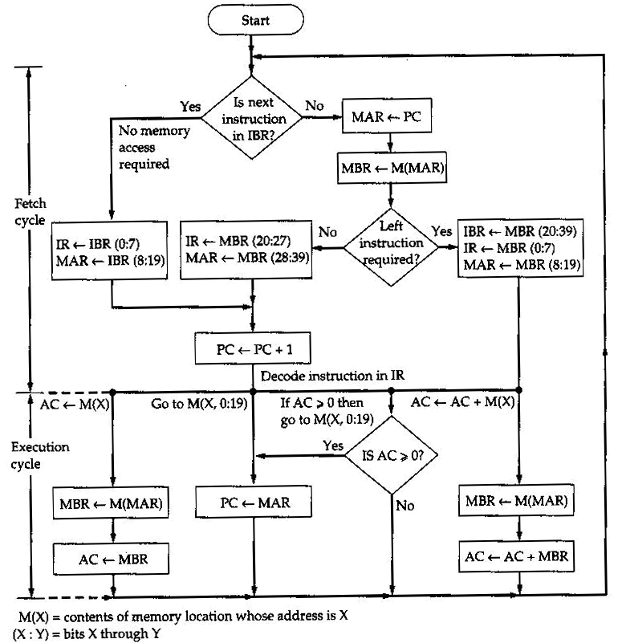
IAS execution of instruction
Figure 2.4, p. 23

Slide 32
Transistors
Replaced vacuum tubes
Smaller
Cheaper
Less heat dissipation
Solid State device
Made from Silicon (Sand)
Invented 1947 at Bell Labs by William Shockley et al.

Slide 33
Moore’s Law
Gordon Moore - cofounder of Intel
He observed (based on experience) that number of transistors on a chip doubled every year
Since 1970’s growth has slowed a little
Number of transistors doubles every 18 months
Cost of a chip has remained almost unchanged
Higher packing density means shorter electrical paths, giving higher performance
Smaller size gives increased flexibility/portability
Reduced power and cooling requirements
Fewer system interconnections increases reliability

Slide 34
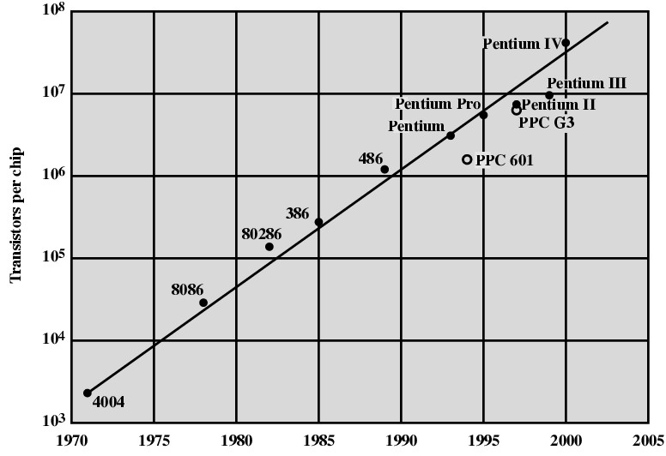
Growth in CPU Transistor Count

