Slide 1
CSCI 4717/5717
Computer Architecture
Topic: Memory Management
Reading: Stallings, Sections 8.3 and 8.4

Slide 2
Memory Management
Uni-program – memory split into two parts
  One for Operating System (monitor)
  One for currently executing program
Multi-program
  Non-O/S part is sub-divided and shared among active processes
Remember segment registers in the 8086 architecture
  Hardware designed to meet needs of O/S
  Base Address = segment address

Slide 3
Swapping
Problem: I/O (Printing, Network, Keyboard, etc.) is so slow compared with CPU that even in multi-programming system, CPU can be idle most of the time
Solutions:
  Increase main memory
    Expensive
    Programmers will eventually use all of this memory for a single process
  Swapping

Slide 4
What is Swapping?
Long term queue of processes stored on disk
Processes “swapped” in as space becomes available
As a process completes it is moved out of main memory
If none of the processes in memory are ready (i.e. all I/O blocked)
  Swap out a blocked process to intermediate queue
  Swap in a ready process or a new process
But swapping is an I/O process!
  It could make the situation worse
  Disk I/O is typically fastest of all, so it still is an improvement

Slide 5
Partitioning
Splitting memory into sections to allocate to processes (including Operating System)
Two types
  Fixed-sized partitions
  Variable-sized partitions

Slide 6
Fixed-Sized Partitions (continued)
Equal size or Unequal size partitions
Process is fitted into smallest hole that will take it (best fit)
Some wasted memory due to each block having a hole of unused memory at the end of its partition
Leads to variable sized partitions

Slide 7
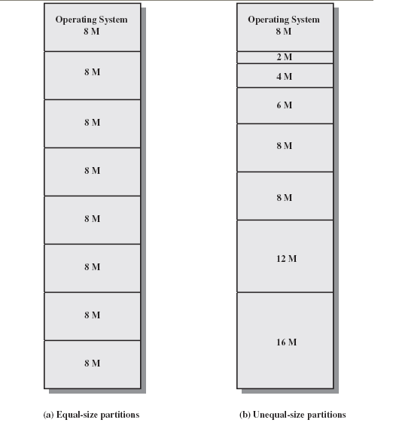
Fixed-sized partitions

Slide 8
Variable-Sized Partitions
Allocate exactly the required memory to a process
This leads to a hole at the end of memory, too small to use – Only one small hole - less waste
When all processes are blocked, swap out a process and bring in another
New process may be smaller than swapped out process
Reloaded process not likely to return to same place in memory it started in
Another hole
Eventually have lots of holes (fragmentation)

Slide 9
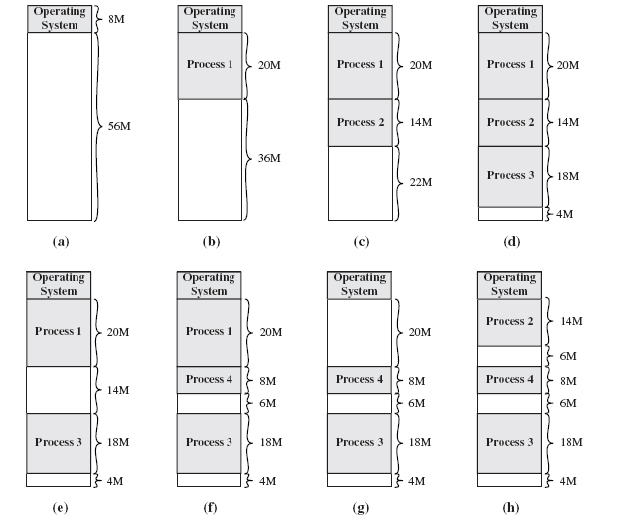
Variable-Sized Partitions

Slide 10
Solutions to Holes in Variable-Sized Partitions
Coalesce - Join adjacent holes into a single large hole
Compaction - From time to time go through memory and move all holes into one free block (c.f. disk de-fragmentation)

Slide 11
Overlays
In the early days of computing, programmers had a small amount of memory to squeeze programs into
First "stabs" at memory management were overlays:
  Programmer divided single application into smaller independent programs called overlays
  When program first loaded, load first overlay into memory
  When new overlay was required, next overlay is read from drive and loaded in place of previous one

Slide 12
Relocation
No guarantee that process will load into the same place in memory
Instructions contain addresses
  Locations of data
  Addresses for instructions (branching)
Logical address – relative to beginning of program
Physical address – actual location in memory (this time)
Base Address – start of program or block of data
Automatic conversion using base address

Slide 13
Paging (continued)
Split memory into equal sized, small chunks -page frames
Split programs (processes) into equal sized small chunks – pages
Allocate the required number page frames to a process
Operating System maintains list of free frames
A process does not require contiguous page frames

Slide 14
Paging (continued)
Use page table to keep track of how the process is distributed through the pages in memory
Now addressing becomes page number:relative address within page which is mapped to frame number:relative address within frame.

Slide 15
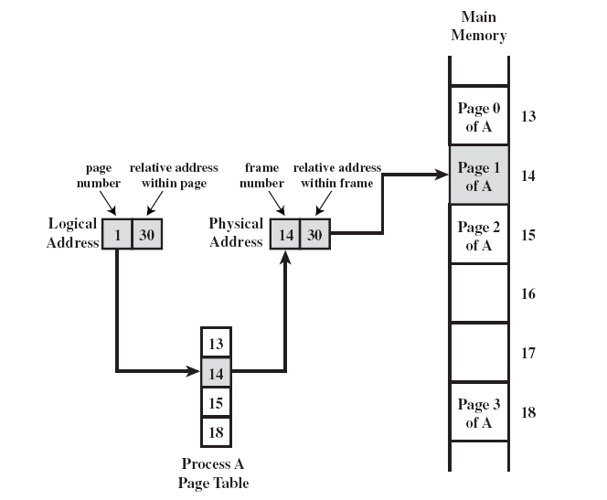
Paging (continued)

Slide 16
Paging Example – Before
Free frame list
13
14
15
18
20
13
14
15
16
17
18
19
20
21
In
use
In
use
Process A
Page 0
Page 1
Page 2
Page 3
In
use
In
use

Slide 17
Paging Example – After
Free frame list
20
13
14
15
16
17
18
19
20
21
Page 0
of A
Page 1
of A
Page 2
of A
In
use
Process A
page table
Process A
In
use
Page 0
Page 1
Page 2
Page 3
13
Page 3
of A
14
15
In
use
18
In
use

Slide 18
Virtual Memory
Remember the Principle of Locality which states that “active” code tends to cluster together, and if a memory item is used once, it will most likely be used again.
Demand paging
  Do not require all pages of a process in memory
  Bring in pages as required

Slide 19
Page Fault in Virtual Memory
Required page is not in memory
Operating System must swap in required page
May need to swap out a page to make space
Select page to throw out based on recent history

Slide 20
Virtual Memory Bonus
We do not need all of a process in memory for it to run
We can swap in pages as required
So - we can now run processes that are bigger than total memory available!
Main memory is called real memory
User/programmer sees much bigger memory - virtual memory

Slide 21
Thrashing
Too many processes in too little memory
Operating System spends all its time swapping
Little or no real work is done
Disk light is on all the time
Solutions
  Better page replacement algorithms
  Reduce number of processes running
  Get more memory

Slide 22
Page Table Structure
VAX architecture – each process may be allocated up to 2³¹ = 2 GBytes of virtual memory broken in to 2⁹=512 byte pages.
Therefore, each process may have a page table with 2⁽³¹⁻⁹⁾=2²²=4 Meg entries.
This uses a bunch of memory!

Slide 23
Pages of Page Table
Some processors solve this with a page directory that points to page tables, each table of which is limited to a page and treated as such
Another approach is the inverted page table structure

Slide 24
Inverted Page Table
Page tables based on logical (program's) address space can be huge
Alternatively, restrict page table entries to real memory, not virtual memory
Problem:
  Simple page table says each line of table maps to logical page
  Inverted Page Table need to have mapping algorithm because there isn't a one-to-one mapping of logical to virtual pages

Slide 25
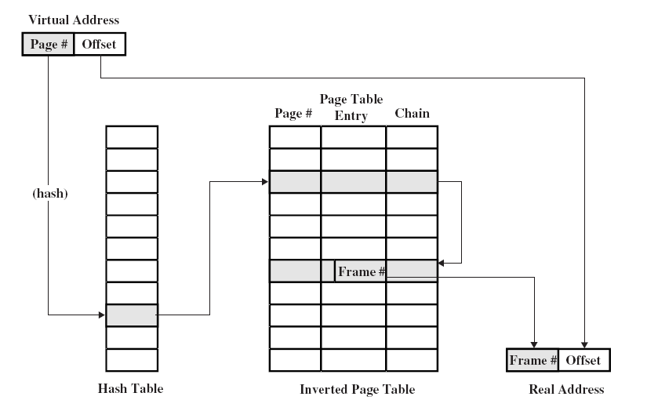
Page of Page Table (continued)

Slide 26
Translation Lookaside Buffer
Every virtual memory reference causes two physical memory access
Fetch page table entry
Fetch data
Use special cache for page table – TLB

Slide 27
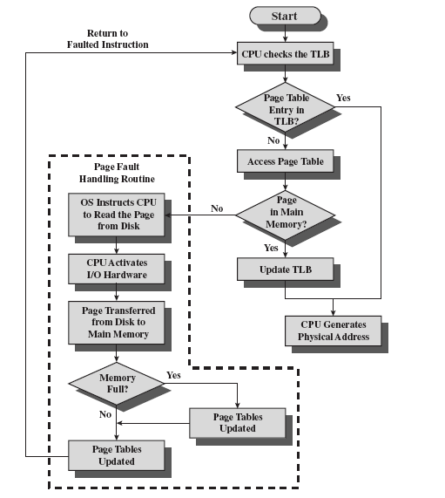
Translation Lookaside Buffer (continued)

Slide 28
Translation Lookaside Buffer (continued)
Complexity! Virtual address translated to a physical address
Reference to page table – might be in TLB, main memory, or disk
Referenced word may be in cache, main memory, or disk
If referenced word is on disk, it must be copied to main memory
If in main memory or on disk, block must be loaded to cache and cache table must be updated

Slide 29
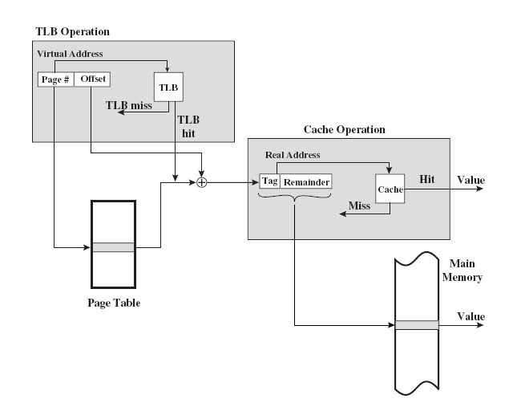
TLB and Cache Operation

Slide 30
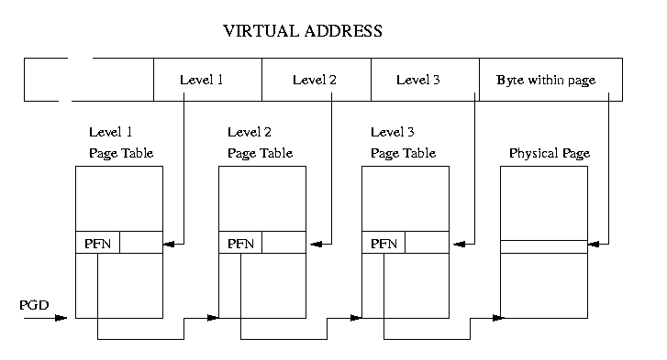
Multi-Level Page Tables
Source: Rusling, D., "Linux Page Tables," The Linux Knowledge Base and Tutorial, On-line: http://www.linux-tutorial.info/modules.php?name=MContent&pageid=307

Slide 31
Segmentation
Paging is not (usually) visible to the programmer
Segmentation is visible to the programmer
Usually different segments allocated to program and data
There may be a number of program and data segments
Segmentation partitions memory

Slide 32
Advantages of Segmentation
Simplifies handling of growing data structures – O/S will expand or contract the segment as needed
Allows programs to be altered and recompiled independently, without re-linking and re-loading
Lends itself to sharing among processes
Lends itself to protection since O/S can specify certain privileges on a segment-by-segment basis
Some systems combine segmentation with paging

Slide 33
In-Class Discussion
The TLB is basically a cache for page tables. A TLB "miss" is a request for a page that isn't in the TLB. Name some ways that we can reduce the chances of a TLB miss.
Using paging with N processes and a page size of P, what is the most memory that is wasted?
What problem is caused by small pages?
What problem is caused by large pages?

Slide 34
Recursion
Many complex algorithmic functions can be broken into a repetitive application of a simple algorithm.
The typical recursion function begins with an initial value of n which is decremented with each recursive call until the last call reaches a terminal value of n.
A recursive function contains a call to itself.
"Definition of recursion: See recursion"

Slide 35
Recursion – Factorial
Non-Recursive Function:
int factorial(int n)
{
int return_val = 1;
for (int i = 1; i <= n; i++)
return_val = return_val * i;
return return_val;
}
Recursive Function:
int rfactorial(int n)
{
if ((n == 1) || (n == 0)) return (1);
else return (n*rfactorial(n - 1));
}

Slide 36
Recursion – Fibonacci Numbers
"f(i) = f(i–1) + f(i–2)"
Non-Recursive Function:
int fibonacci(int n)
{
int fibval_i = 1;
int fibval_i_minus_1 = 0;
int fibval_i_minus_2 = 0;
if ((n == 0)||(n == 1)) return n;
else
{
for (int i = 2; i <= n; i++)
{
fibval_i_minus_2 = fibval_i_minus_1;
fibval_i_minus_1 = fibval_i;
fibval_i = fibval_i_minus_1 +
fibval_i_minus_2;
}
}
return fibval_i;
}

Slide 37
Recursion – Fibonacci Numbers (continued)
Recursive Function:
int rfibonacci(int n)
{
if ((n == 0)||(n == 1)) return n;
else return rfibonacci(n - 1) +
rfibonacci(n - 2);
}

Slide 38
Comparing Recursive and Non-Recursive Functions
Non-recursive function has more variables. Where does recursive function store values.
Non-recursive function has more code → recursive requires less code and therefore less memory.

Slide 39
In-Class Exercise
In groups, discuss how recursion might affect an operating system
Compare & contrast iterative vs. recursion algorithms in terms of growth/memory usage

Slide 40
Pentium II
Hardware for segmentation and paging
Unsegmented unpaged
  virtual address = physical address
  Low complexity
  High performance
Unsegmented paged
  Memory viewed as paged linear address space
  Protection and management via paging
  Berkeley UNIX

Slide 41
Pentium II (continued)
Segmented unpaged
  Collection of local address spaces
  Protection to single byte level
  Translation table needed is on chip when segment is in memory
Segmented paged
  Segmentation used to define logical memory partitions subject to access control
  Paging manages allocation of memory within partitions
  Unix System V

Slide 42
Pentium II Segmentation
Each virtual address is 16-bit segment and 32-bit offset
2 bits of segment are protection mechanism
14 bits specify segment
Unsegmented virtual memory 2³² = 4Gbytes
Segmented 2⁴⁶=64 terabytes
  Can be larger – depends on which process is active
  Half (8K segments of 4Gbytes) is global
  Half is local and distinct for each process

Slide 43
Pentium II Protection
Protection bits give 4 levels of privilege
0 most protected, 3 least
Use of levels software dependent
Usually level 3 is for applications, level 1 for O/S and level 0 for kernel (level 2 not used)
Level 2 may be used for apps that have internal security, e.g., database
Some instructions only work in level 0

Slide 44
Pentium II Paging
Segmentation may be disabled in which case linear address space is used
Two level page table lookup
First, page directory
  1024 entries max
  Splits 4G linear memory into 1024 page groups of 4Mbyte
  Each page table has 1024 entries corresponding to 4Kbyte pages
  Can use one page directory for all processes, one per process or mixture
  Page directory for current process always in memory
Use TLB holding 32 page table entries
Two page sizes available 4k or 4M

Slide 45
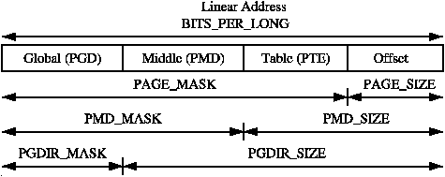
Pentium Virtual Address Breakdown

Slide 46
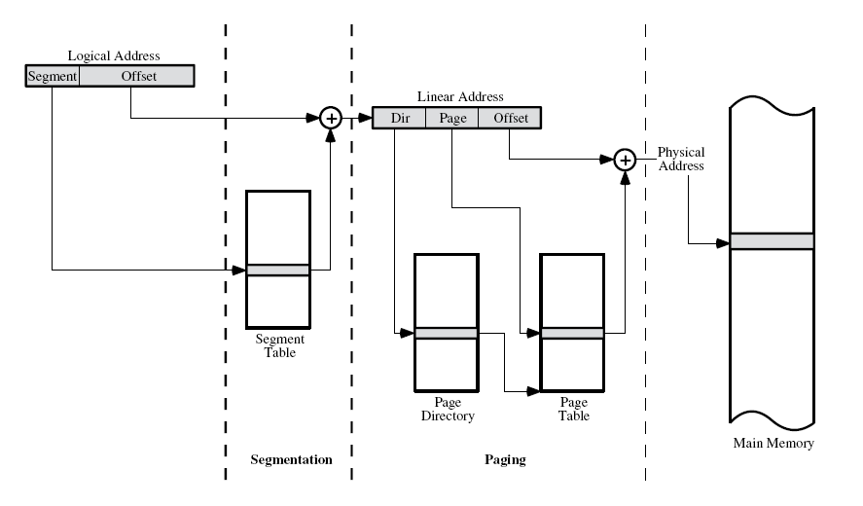
Pentium Segment/Paging Operation

Slide 47
PowerPC Memory Management Hardware
32 bit – paging with simple segmentation
  64 bit paging with more powerful segmentation
Or, both do block address translation
  Map 4 large blocks of instructions & 4 of memory to bypass paging
  e.g. OS tables or graphics frame buffers
32 bit effective address
  12 bit byte selector → 4kbyte pages
  16 bit page id → 64k pages per segment
  4 bits indicate one of 16 segment registers → Segment registers under OS control

Slide 48
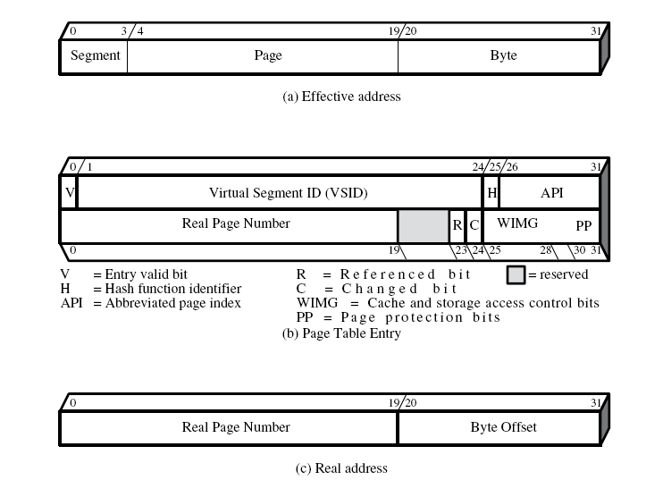
PowerPC 32-bit Memory Management Formats

Slide 49
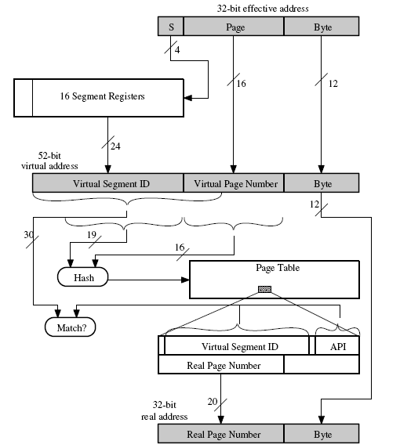
PowerPC 32-bit Address Translation

