Slide 1
CSCI 4717/5717
Computer Architecture
Topic: Internal Memory Details
Reading: Stallings, Sections 5.1 & 5.3

Slide 2
Basic Organization
Memory Cell Operation
Represent two stable/semi-stable states representing 1 and 0
Capable of being written to at least once
Capable of being read multiple times

Slide 3
Semiconductor Memory Types
Random Access Memory (RAM)
Read Only Memory (ROM)
Programmable Read Only Memory (PROM)
Eraseable Programmable Read Only Memory (EPROM)
Electronically Eraseable Programmable Read Only Memory (EEPROM)
Flash Memory

Slide 4
Random Access Memory
Misnomer (Last week we learned that the term Random Access Memory refers to accessing individual memory locations directly by address)
RAM allows reading and writing (electrically) of data at the byte level
Two types
  Static RAM
  Dynamic RAM
Volatile

Slide 5
Read Only Memory (ROM)
Sometimes can be erased for reprogramming, but might have odd requirements such as UV light or erasure only at the block level
Sometimes require special device to program, i.e., processor can only read, not write
Types
  EPROM
  EEPROM
  Custom Masked ROM
  OTPROM
  FLASH

Slide 6
ROM Uses
Permanent storage – nonvolatile
Microprogramming
Library subroutines
Systems programs (BIOS)
Function tables
Embedded system code

Slide 7
EPROM
Written to only with a programmer.
Erased with ultraviolet light
Positive
  non-volatile storage without battery
  can write to it, but only with aid of programmer
Negative
  programmer requirements
  Expensive
  locations must be erased before writing

Slide 8
EEPROM
Written to with either programmer or the processor (electrically)
Erased with either a programmer or the processor (byte-by-byte electrically)
Positive
  non-volatile memory without batteries
  programmable a single-location at a time
Negative
  Expensive
  only smaller sizes available
  extremely slow write times (10 mS vs. 100 to 200 nS)

Slide 9
Custom masked ROM
You send the ROM manufacturer your data and they mask it directly to the ROM
Use only when you are selling large volume of a single product
Positive
  becomes cheaper to use for approximately more than 2000 parts
  components come from chip manufacturer already programmed and tested taking out a manufacturing step
Negative
  costs several thousand dollars for custom mask
  software changes are costly
  cannot be reprogrammed

Slide 10
OTPROM
Uses fuses that are burned to disconnect a logic 1 and turn it to a logic 0.
Written to by you using a programmer similar to EPROM
Once it's written to, the data is in there forever.
Positive
  cheaper than EPROM due to cheaper packaging
  more packaging options than EPROM due to less constraints like erasure window
  standard "off-the-shelf" component
  cheaper than Custom masked ROM up to about 10,000 devices
Negative – to reprogram, have to throw out the chip - Should only be used for stable design

Slide 11
FLASH
These memories are basically EEPROMs except that erasure occurs at the block level in order to speed up the write process
Non-volatile
This makes FLASH work like a fast, solid state hard drive
Positive
  non-volatile
  higher densities than both SRAM and DRAM
Negative
  process of storing data is at a block level (and slower)
  data cell must be erased before writing data to it

Slide 12
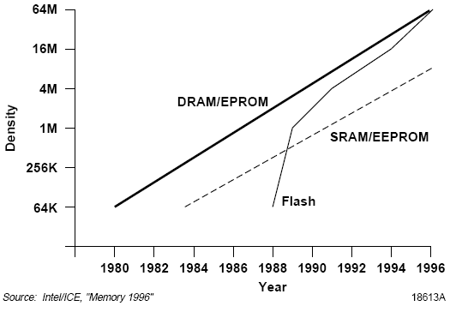
Flash Density Comparison
Source: Griffin, J., Matas, B., de Suberbasaux, C., ”Memory 1996” ,
Integrated Circuit Engineering Corporation, Scottsdale, AZ, on-line:
http://smithsonianchips.si.edu/ice/cd/MEM96/TITLE.PDF

Slide 13
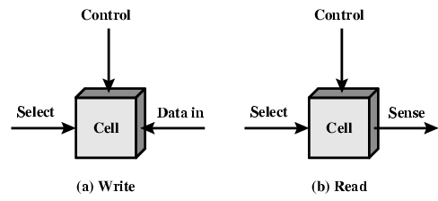
Memory Cell Operation
(Figure 5.1 from textbook)

Slide 14
Dynamic RAM (DRAM)
Bits stored as charge in capacitors
Simpler construction
Smaller per bit
Less expensive
Slower than SRAM (maintenance and read overhead explained later)
Typical application is main memory
Essentially analogue -- level of charge determines value

Slide 15
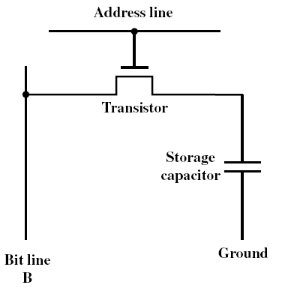
DRAM Structure
(Figure 5.2a from textbook)

Slide 16
DRAM Operation
Address line active when bit read or written
Logic ‘1’ closes transistor switch (i.e., current flows)
Write
  Voltage to bit line – High for 1 low for 0
  Signal address line – Controls transfer of charge to capacitor
Read
  Address line selected – transistor turns on
  Charge from capacitor fed via bit line to sense amplifier
  Compares with reference value to determine 0 or 1

Slide 17
Static RAM (SRAM)
Essentially uses latches to store charge (transistor circuit)
As long as power is present, transistors do not lose charge (no refresh)
Very fast (no sense circuitry to drive nor charge depletion)
Can be battery-backed – A small battery is piggy-backed to the RAM chip an allows data to remain even when power is removed (Not possible with DRAM)
More complex construction
Larger per bit
More expensive
Used for Cache RAM because of speed and no need for large volume or high density

Slide 18
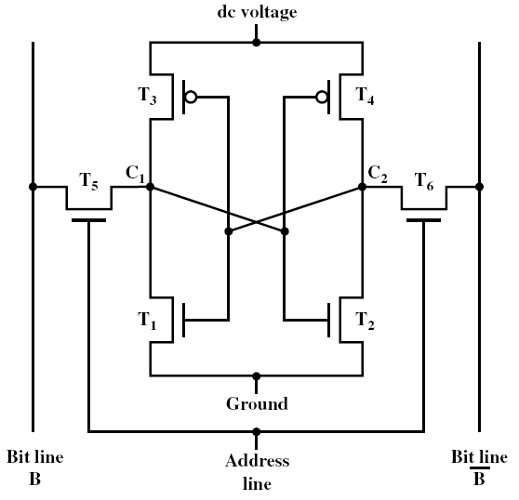
SRAM Operation
(Figure 5.2b from textbook)

Slide 19
SRAM Operation
Transistor arrangement gives stable logic state
State 1
  C1 high, C2 low
  T1 T4 off, T2 T3 on
State 0
  C2 high, C1 low
  T2 & T3 off, T1 & T4 on
Address line transistors
  T5 & T6 act as switches connecting cell
Write – apply value to B & compliment to B
Read – value is on line B

Slide 20
SRAM vs. DRAM
Both volatile – Power needed to preserve data
DRAM
  Simpler to build, smaller
  More dense
  Less expensive
  Needs refresh
  Larger memory units
SRAM
  Faster
  Used for cache

Slide 21
DRAM Organization Details
(by example)
A 16Mbit chip can be organised as a 2048 x 2048 x 4 bit array
This arrangement reduces the number of address pins
Multiplex row address and column address
11 pins to address (2¹¹=2048)
Adding one more pin doubles range of values for rows and for columns and therefore increases capacity by factor of four

Slide 22
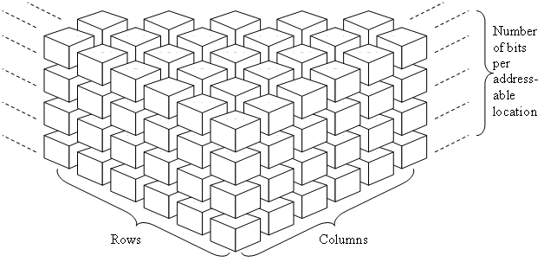
DRAM Organization Details (continued)

Slide 23
DRAM Process
Total number of address lines is half that of the total needed for the addressable locations
A single addressable memory location has the address divided in half, e.g., the MSB half representing the row address and the LSB half representing the column address. This saves on pins.

Slide 24
DRAM Process (continued)
^RAS (row address select) strobes the row address in to its buffer or latch while ^CAS (column address select) strobes the column address into its buffer or latch.
Note: one more pin on the address quadruples the size of the matrix (doubles rows and doubles columns for an increase by factor of four)
To make 16 bit wide data bus, you'll need four of these example modules

Slide 25
DRAM Refresh
Two things discharge a DRAM capacitor
  Data read
  Leakage current
Need refreshing even when powered and idle (once every few milliseconds)
Refresh circuit included on chip – Even with added cost, still cheaper than SRAM cost
Refresh process involves disabling chip, then reading data and writing it back
Performed by counting through “rows”
Takes time – Slows down apparent performance

Slide 26
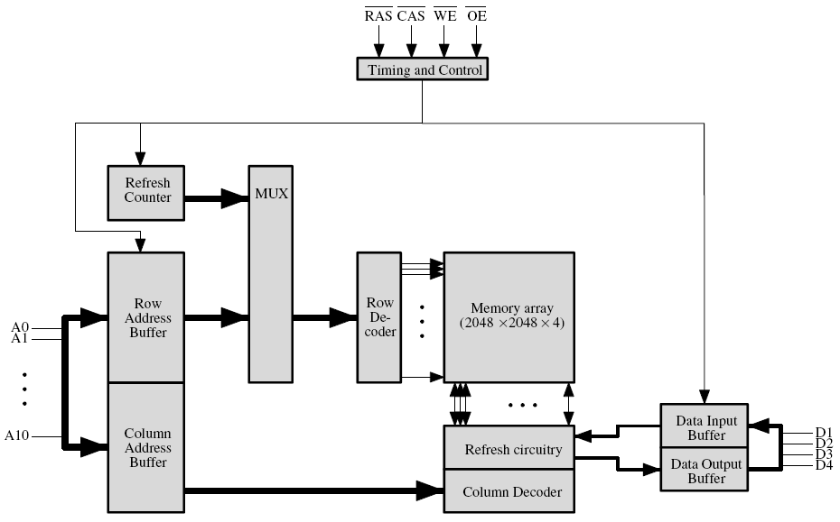
DRAM Organization Example

Slide 27
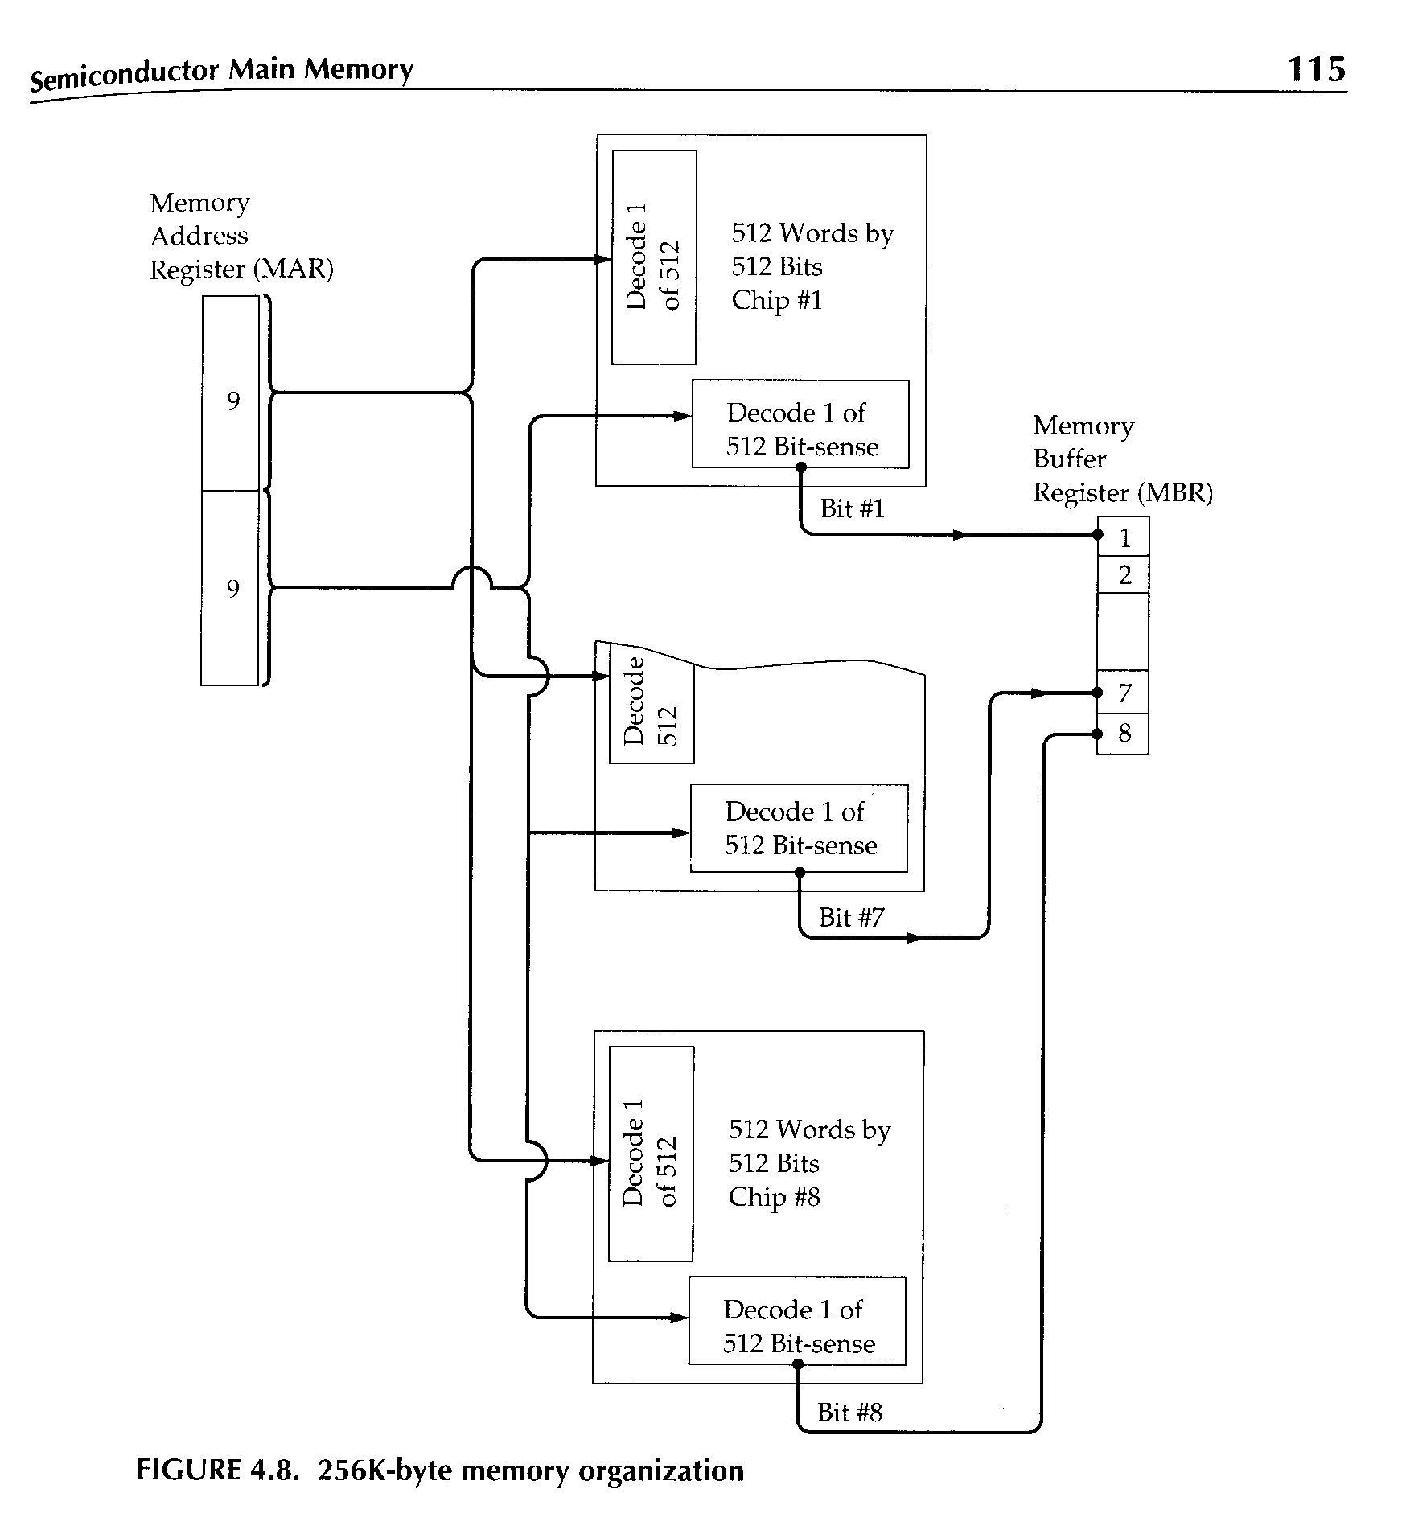
Module Organization:
Using multiple memories in parallel to increase data bus width

Slide 28
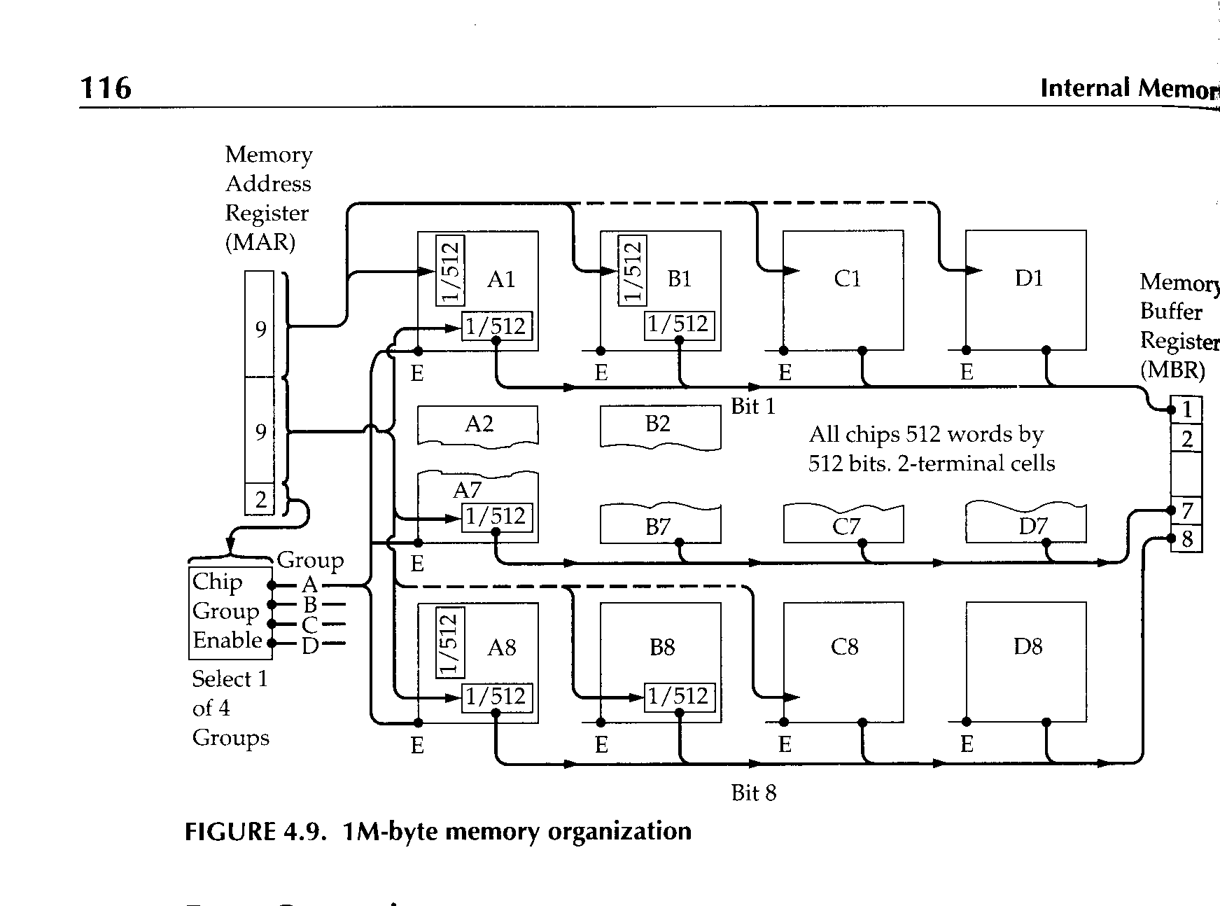
Module Organization: Using chip selects to increase the number of words

Slide 29
Advanced DRAM Organization
SRAM Cache was the traditional way to improve performance of the DRAM
Basic DRAM is unchanged since first RAM chips
Enhanced DRAM
  Contains small SRAM as well
  SRAM acts as cache holding last line read
Cache DRAM (CDRAM)
  Larger SRAM added
  Acts as either cache or serial buffer

Slide 30
FPM and EDO DRAM
Fast Page Mode (FPM) shortens cycle time by allowing processor to use the same row address, but a different column address (removes one step in the addressing sequence)
The data of a single row is referred to as a "page"
Extended Data-Out (EDO) allows the processor to overlap the data read cycle with the write for the next column address
EDO result is a savings of approximately 10 ns for each read within a single page

Slide 31
Synchronous DRAM (SDRAM)
Access is synchronized with an external clock
Address is presented to RAM
RAM finds data (CPU waits in conventional DRAM)
Since SDRAM moves data in time with system clock, CPU knows when data will be ready
CPU does not have to wait, it can do something else
Burst mode allows SDRAM to set up stream of data and fire it out in block
DDR-SDRAM sends data twice per clock cycle (leading & trailing edge)

Slide 32
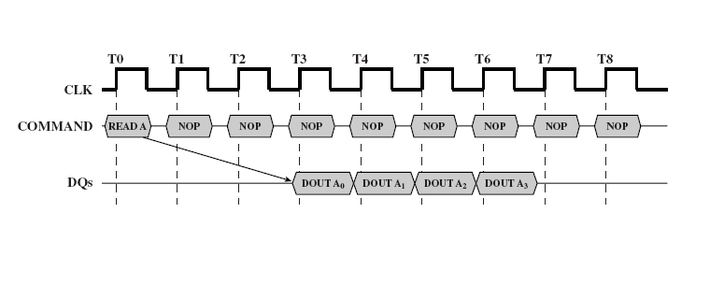
SDRAM Sample Timing

Slide 33
RAMBUS or RDRAM
Suggests transfer rates from 1.6 to 10.7 GBytes per second.
Subsystem consists of the memory array, the RAM controller, and a well-defined bus
Bus definition includes all components including the microprocessor and any other devices that may use it
Vertical package (all pins on one side) called Rambus in-line memory modules (RIMMs)
Adopted by Intel for Pentium & Itanium

Slide 34
Bus definition
Data exchange over 28 wires
Different definitions require bus lengths less than 12 cm long (some definitions are longer up to 25 cm long)
Bus addresses up to 320 RDRAM chips
Communication protocol is packet-based
Implements pipelined operation overlapping command and data
800 to 1200 MHz operation
Inititial access time = 480ns
After that, 1.6 GBps

