Slide 1
CSCI 4717/5717
Computer Architecture
Topic: Performance
Reading: Stallings, Section 2.2

Slide 2
Performance from User’s
Point of View
Types of applications that require performance:
Image processing
Handwriting and speech recognition
Video conferencing
Multimedia development
Multimedia playback
Simulations
Artificial intelligence

Slide 3
Real-World Applications
Gaming/entertainment
Weather forecasting
Oceanography
Seismic/petroleum exploration
Medical research and diagnosis
Aerodynamics and structure analysis
Nuclear physics
Military/defense
Interfaces for disabled
Socio-economics

Slide 4
Original Architecture
Basic building blocks are the same as IAS computer from 60 years ago.
Not one component, however, has been left unexamined in terms of squeezing out more performance.
Design and implementation has become extremely sophisticated.
This course examines techniques for achieving maximum performance

Slide 5
Measuring performance
The benefits of a new or modified design cannot be determined without having a way to measure the difference
An increase in a machine's performance is viewed in one of two (sometimes competing) ways:
  Reduced response time to an individual job
  “do stuff faster"
  Increase in overall throughput
  “do more stuff”

Slide 6
Other measures of performance
Cost
  Cost of designing SW
  Purchase cost of hardware
  Purchase of components such as peripherals
Compatibility
S/W availability
Maintainability

Slide 7
Effect of Improved Technology
Of the following technological improvements, which increases throughput, reduces response time, or both?
  Faster clock cycle time
  Multiple processors for separate tasks
  Parallel processing of array or vector-type problems

Slide 8
Effects of Moore’s Law
The doubling of the number of transistors on a single chip every 18 months has had some effects on the application of technology:
  Costs have fallen dramatically since chip prices have not changed substantially since Moore made his prediction
  Tighter packaging has allowed for shorter electrical paths and therefore faster execution
  Smaller packaging has allowed for more applications in more environments
  Reduction in power and cooling requirements which also helps with portability
  Solder connections are not as reliable, therefore, with more functions on a single chip, there are fewer unreliable solder connections

Slide 9
Effects of Moore’s Law (continued)
As technology allows for higher levels of performance, processor designers must come up with ways to use it.
  Keeping all parts of the processor busy
    Coordinating multiple pipelines
    Improved branch prediction
  Multiple processors
  Optimizing execution
    Real-time analysis of code to “re-order” execution
    Speculative execution of code
  Incorporating multiple functions on single chip

Slide 10
Performance Mismatch
Experienced significant improvement
  Processor speed
  Memory capacity
Experienced only minor improvement
  Memory speed
  Bus rates
  I/O device performance

Slide 11
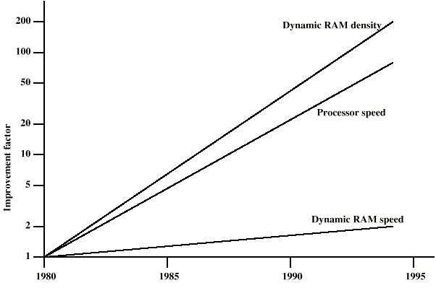
DRAM and Processor Characteristics

Slide 12
Effects of Performance Mismatch
Processor stalls – “wait states”
Fewer DRAMs are needed per system reducing opportunity for parallel transfers
I/O device performance improvements are offset by greater demands, e.g., video capture.

Slide 13
DRAM Solutions
Increase number of bits retrieved at one time
  Make DRAM “wider” rather than “deeper”
  How does "wide" DRAM affect programs?
Change DRAM interface
  Add additional levels of cache
Reduce frequency of main memory access
  More complex cache and cache on chip
  Is there a software rather than a hardware solution?
Increase interconnection bandwidth
  High speed buses
  Hierarchy of buses

Slide 14
I/O Solutions
Caching and buffering schemes
Higher speed interfaces
Distributed processors
Imposing physical restrictions on peripherals
  Distance
  Number of devices on a bus

Slide 15
Changes Affect Entire System
Design is more than making a component go faster. Designer must also:
  Assess how the change affects the system as a whole
  Investigate a wider number of performance measurements, i.e., be careful when using narrowly defined test/benchmark data

Slide 16
Johnson City to New York City
Walking (3 miles/hour) -- Distance: 620.11 miles
Estimated Time: 8 days, 14 hours, 40 minutes
Bicycle -- Total Distance: 620.11 miles
Estimated Time: 3 days, 5 hours, 30 minutes
Bus -- 09:35p to 11:20a
Estimated Time: 13 hours, 45 minutes
Driving -- Distance: 620.11 miles
Estimated Time: 10 hours, 43 minutes
Flying -- TRI 6:10 am to Charlotte, then NC to LaGuardia 10:47 am
Estimated Time: 3 hours and 42 minutes (add two hours for travel at ends and security)
Drive to Charlotte (166.92 miles) and fly from Charlotte 7:50 am to LaGuardia 9:47 am
Estimated Time: 6 hours (add 1.5 hours for additional travel to NYC destination and security)

Slide 17
Other considerations
Car rental in NY
Stress of driving that long
Parking your own car in NY
Differences in ticket prices
Fear of flying
Parking fees at airports
Security checks at airports (add at least an hour to trip) and inevitable delays

Slide 18
Computer Example
Which is faster for a short (1K to 5K) data transfer, 56K modem or 2400 BAUD modem?
Issues to consider
  Data transfer time
  Synchronization
  Disconnect time

Slide 19
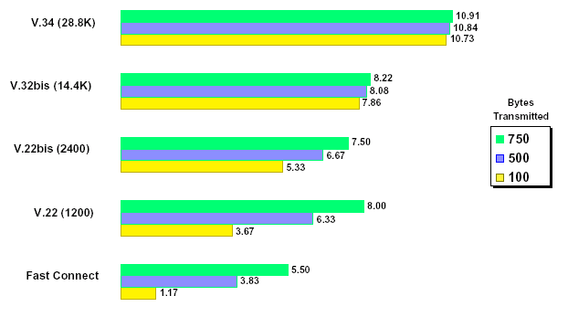
Computer Example (continued)
Image source: Arc Electronics, "Quick Connection modems," on-line: http://www.arcelect.com/Transaction_based_quick_connect_modem_tutorial.htm,
last visited: August 31, 2005

Slide 20
In-Class Exercise
Brainstorm on the following performance issues as they pertain to the applications of a banking database (customer accounts and such) and on-line multimedia content.
  What items should we measure?
  What are the units of these measures?
  What applications rely on these measures?
  What laboratory methods can we use to take these measures?

Slide 21
Memory Access Times
Measured in nanoseconds or bandwidth (bits per second)
Write speed (time to reliably store data)
Read speed (time to reliable retrieve data)

Slide 22
Instruction Execution - MIPS
MIPS – Millions of instructions per second
Affected by two things
How many cycles it takes to complete an instruction
Clock rate, from which cycle duration is calculated
Advantage -- this measurement can be used to determine the speed of your program since you know how many instructions each part of your program contains

Slide 23
Problems with MIPS
Comparing different processors (e.g., RISC machines to non-RISC machines) is useless since measurement is dependent on instruction set
Different instructions use different number of cycles
Example: Using floating point instructions has a lower MIPS rating than using a floating point function based on integer instructions

Slide 24
Instruction Execution – MFLOPS
MFLOPS – Millions of floating point operations per second
Better than MIPS only when primary application is something that requires a great deal of floating point instructions
Still not completely balanced between different processor architectures

Slide 25
Final Analysis
When comparing systems regarding performance, be sure your performance measurements match your requirements.
Be sure your data points are measuring the right things.
Be sure to compare apples to apples.

