Slide 1
CSCI 4717/5717
Computer Architecture
Topic: Single Processor Architecture
Reading: Stallings, Sections 3.1 through 3.3

Slide 2
Review of Three Key Concepts of von Neumann Architecture
Data and instructions in single read-write memory
Memory contents are addressable by location regardless of whether content is data or instruction
Execution of code is sequential from one instruction to the next unless a jump is encountered

Slide 3
Program Concept
Just about any function can be realized with hardwired logic components (calculator)
Hardwired systems, however, are inflexible
General purpose hardware can do different tasks, given correct control signals
Instead of re-wiring, supply a new set of control signals

Slide 4
How Can We Create a Program?
Each step activates a set of control signals to control general purpose logic
Each step is an arithmetic or logical operation
For each operation, a different set of control signals is needed
Program equals the sequence of steps
Programming is no longer a case of rewiring

Slide 5
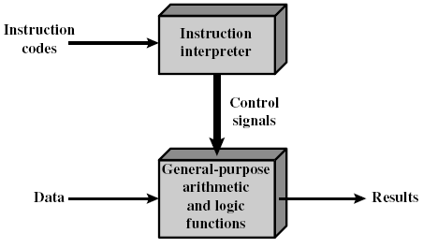
Instruction Interpreter
Now we need a device to accept instruction codes and turn them into control signals for the arithmetic and logic hardware.

Slide 6
Encoding Instructions
Unique binary patterns identify operation to be performed.
Examples:
  Simple addition machine in Figure 3.4 on page 61 of textbook
  X86 Encoding – http://webster.cs.ucr.edu/AoA/DOS/ch03/CH03-3.html#HEADING3-102

Slide 7
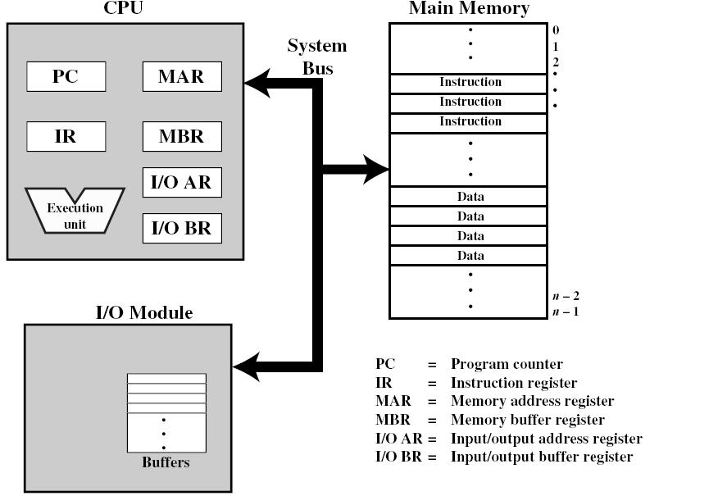
Computer Components: Top-Level View

Slide 8

Simplified 2-Step Instruction Cycle
Instruction cycle is not the same thing as a clock cycle
Two steps:
  Fetch
  Execute

Slide 9
Fetch Cycle
Program Counter (PC) holds address of next instruction to fetch
Processor fetches instruction from memory location pointed to by PC
Increment PC unless instructed otherwise
Instruction loaded into Instruction Register (IR)
Processor interprets instruction and performs required actions
What problems can you predict happening in this cycle?

Slide 10
Execute Cycle
Processor-memory
  data transfer between CPU and main memory
Processor I/O
  Data transfer between CPU and I/O module
Data processing
  Some arithmetic or logical operation on data
Control
  Alteration of sequence of operations, e.g. jump
Combination of above

Slide 11
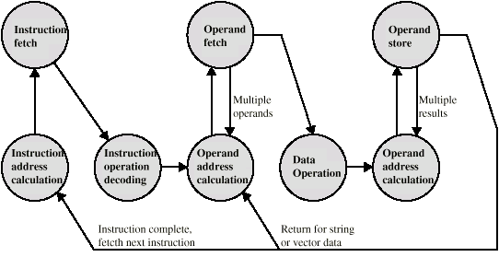
Instruction Cycle State Diagram

Slide 12
Interrupts
No special code is needed in main code
Interrupt Service Routines (ISR) handle condition
Interrupts may be disabled; pending interrupts serviced as soon as interrupts are enabled again
  Global enabling – affects all maskable interrupts
  Local enabling – affects individual interrupts

Slide 13
Types of Interrupts
Program – Something that occurs as a result of program execution such as illegal instructions, arithmetic overflow, divide by zero, or memory handling error
Timer – Generated by one of the processor's internal timers so that the processor can perform some time-scheduled task
I/O – Generated by an I/O controller to request service from the processor such as keyboard, mouse, NIC, disk drive
Hardware failure – signifies some error condition with the hardware

Slide 14
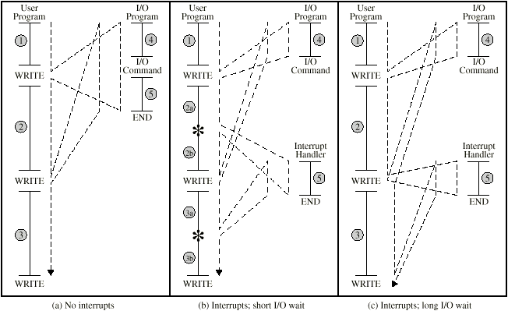
Program Flow Control

Slide 15
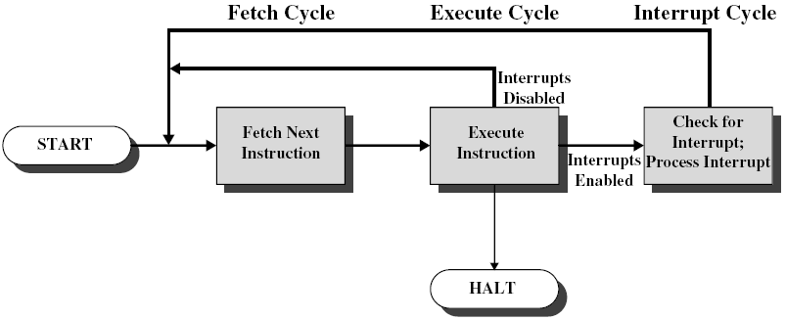
Interrupt Cycle

Slide 16
Interrupt Cycle (continued)
Added to instruction cycle
Processor checks for interrupt
If no interrupt, fetch next instruction
If interrupt pending:
  Suspend execution of current program
  Save context on stack (typically registers, PC, flags, etc.)
  Set PC to start address of interrupt handler routine
  Process interrupt
  Restore context and continue interrupted program

Slide 17

Transfer of Control via Interrupts

Slide 18
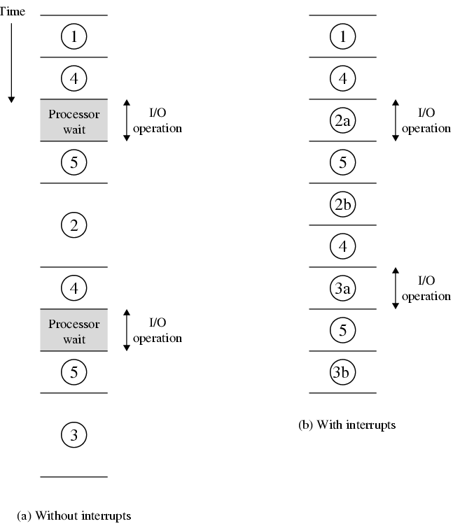
Program Timing -- Short I/O Wait

Slide 19
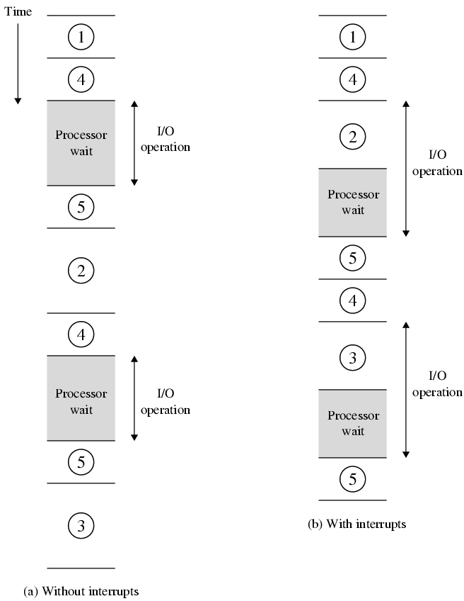
Program Timing -- Long I/O Wait

Slide 20
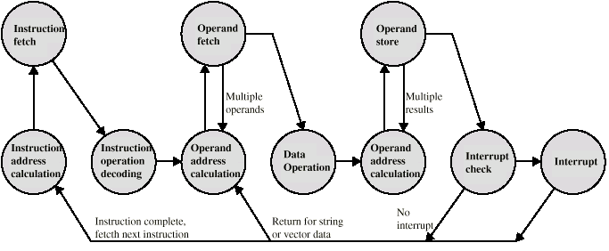
Instruction Cycle (with Interrupts) - State Diagram

Slide 21
Multiple Interrupts
Disable interrupts
  Processor can ignore further interrupts whilst processing one interrupt or interrupts may be nested
  Ignored interrupts remain pending and are checked after first interrupt has been processed
Define priorities
  Low priority interrupts can be interrupted by higher priority interrupts
  When higher priority interrupt has been processed, processor returns to previous interrupt

Slide 22

Multiple Interrupts - Sequential

Slide 23
Multiple Interrupts – Nested

Slide 24

Time Sequence of Multiple Interrupts

Slide 25
I/O Modules
I/O modules occasionally require attention, usually in the form of a data transfer
Processor can simply transfer data back and forth with the device as if it were memory
Alternatively, processor can grant I/O module permission to write directly to memory – Direct Memory Access (DMA) – Interrupt occurs when DMA is complete

