Slide 1
CSCI 4717/5717
Computer Architecture
Topic: Storage Media
Reading: Stallings, Chapter 6

Slide 2
Types of External Memory
Magnetic Disk
  RAID
  Removable
Optical
  CD-ROM
  CD-Recordable (CD-R)
  CD-R/W
  DVD
Magnetic Tape
Magnetic Disk

Slide 3
Physical Disk
Disk substrate coated with magnetizable material (iron oxide…rust)
Substrate used to be aluminium – now glass
  Improved surface uniformity -- Increases reliability
  Reduction in surface defects -- Reduced read/write errors
  Lower fly heights
  Better stiffness
  Better shock/damage resistance

Slide 4
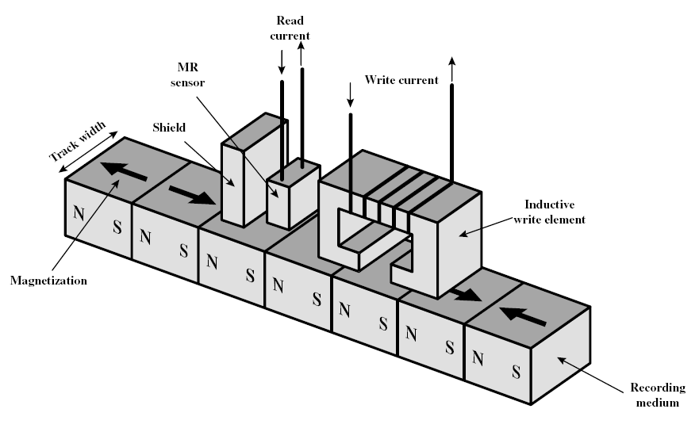
Read and Write Mechanisms

Slide 5
Read and Write Mechanisms (continued)
Recording and retrieval via conductive coil(s) called a head(s)
May be single read/write head or separate ones
During read/write, head is stationary (actually moves radially to platters) and platter rotates beneath head

Slide 6
Hard Drive Write
Current through coil produces magnetic field
Pulses sent to head
Magnetic pattern recorded on surface below

Slide 7
Hard Drive Read (traditional)
Magnetic field moving relative to coil produces current – Analogous to a generator or alternator
Coil can be the same for read and write
Used with:
  Floppies
  Older harddrives

Slide 8
Hard Drive Read (contemporary)
Separate read head, close to write head
Partially shielded magneto resistive (MR) sensor
Electrical resistance depends on direction of magnetic field – Passing current through it results in different voltage levels for different resistances
High frequency operation -- Higher storage density and speed

Slide 9
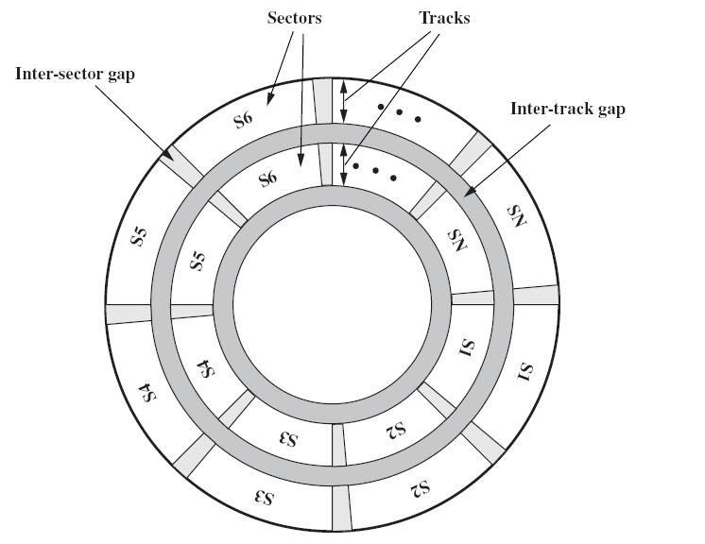
Data Organization and Formatting

Slide 10
Data Organization and Formatting (continued)
Concentric rings or tracks
Track is same width as head
Thousands of tracks per platter surface
Intertrack gaps – Gaps between tracks protect data integrity
Reduce intertrack gap
  increase capacity
  possibly increase errors due to misalignment of head or interference from other tracks
Constant angular velocity – Same number of bits per track (variable packing density)

Slide 11
Tracks divided into sectors
Minimum block size is one sector although may have more than one sector per block
Typically hundreds of sectors per track
May be fixed or variable in length
Contemporary systems are fixed-length with 512 bytes being common
Sectors also have gaps called intratrack or intersector gaps

Slide 12
Constant Angular Velocity (CAV)
Imagine a matrix with the rows as tracks and the columns as sectors.
Twist matrix into a disk and see how much more packed the center is than the outside.
Creates pie shaped sectors and concentric tracks
Regardless of head position, sectors pass beneath it at the same (constant) speed
Capacity limited by density on inside track
Outer tracks waste with lower data density

Slide 13
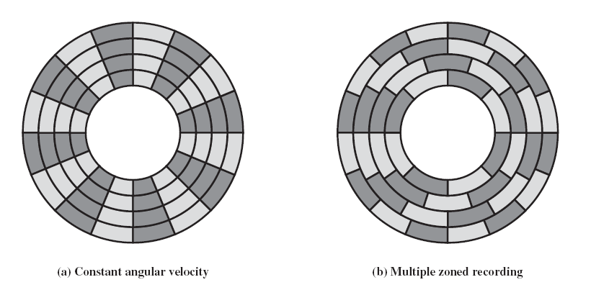
Multiple Zone Recording

Slide 14
Multiple Zone Recording (continued)
Divide disk into zones – typical number is 16
Each zone has fixed bits/sectors per track
More complex circuitry to adjust for different data rates as heads move farther out.

Slide 15
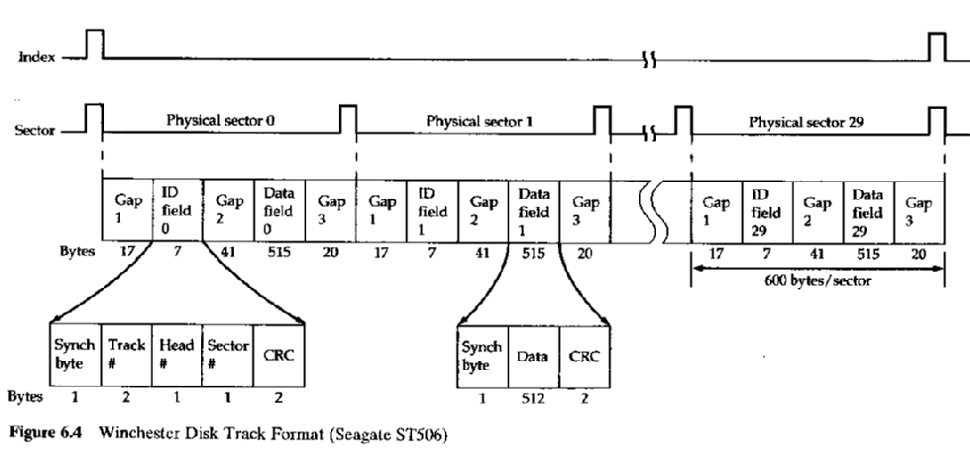
Identifying Sectors
ST506 Example (old)

Slide 16
Formatting
Two kinds of formatting
  Low level – allows hard drive to find sectors
  O/S level – allows for file system
Must be able to identify start of track and sector
Format disk
  Additional information not available to user
  Marks tracks and sectors

Slide 17
Characteristics of Hard Drives
Head Motion
Disk Portability
Sides
Platters
Head Mechanism

Slide 18
Head Motion
Fixed head vs. heads on a movable arm
Fixed head (old)
  One read write head per track
  Heads mounted on fixed ridged arm
Movable head
  Heads move radially across tracks
  One read write head per side

Slide 19
Disk Portability
Removable vs. fixed
Removable disk
  Examples: floppy, ZIP, Jazz
  Can be removed from drive and replaced with another disk
  Provides unlimited storage capacity
  Easy data transfer between systems
Non-removable disk – permanently mounted in the drive

Slide 20
Sides and Platters
Single (old or cheap) vs. double (typical) sided
Single or multiple platter
One head per side
Heads are joined and aligned
Aligned tracks on each platter form cylinders
Data is striped by cylinder
reduces head movement
Increases speed (transfer rate)

Slide 21
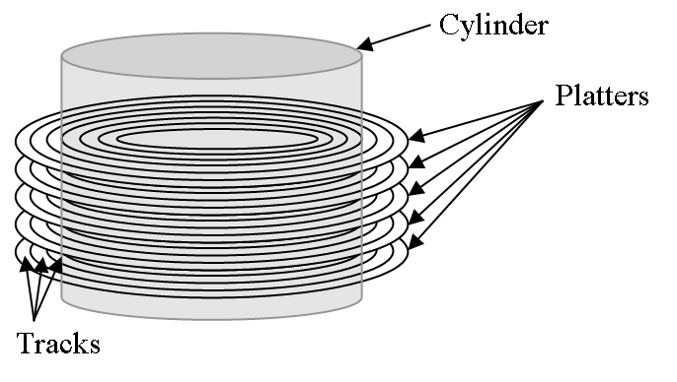
Cylinders

Slide 22
Head mechanism
There are a number of characteristics of the head that affect drive performance
  Head size
  Distance of head from platter

Slide 23
Head Mechanism Tradeoffs
Smaller heads allow for higher densities, but force head to be closer to the disk
The closer the head, the greater risk of "crashes“
Distance of head from magnetic media
  Contact (Floppy)
  Fixed gap
  Flying (Winchester)
    Head rests on platter at rest
    When platter spins, air pressure lifts head from platter

Slide 24
Data Encoding
Data is not stored as two directions of magnetic polarization corresponding to two values, 1 and 0.
Reasons:
  Hard drive heads detect the changes in magnetic direction, not the direction of the field
  Difficult to read large blocks of all ones or all zeros – eventually controller would lose synchronization
One method for storing data uses a clock to define the bit positions, and by watching how the magnetic field changes with respect to that clock indicates presence of one or zero

Slide 25
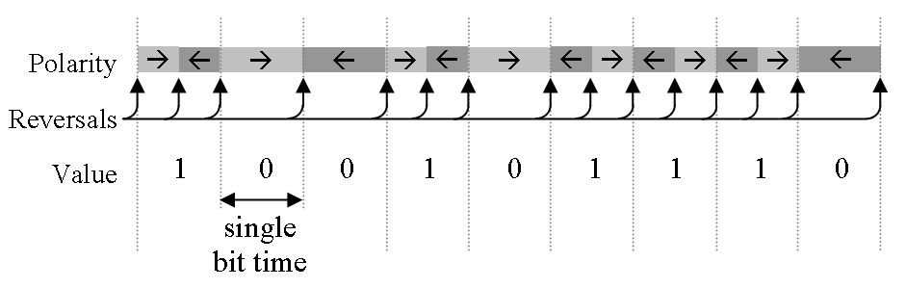
FM Encoding
A magnetic field change at the beginning and middle of a bit time represents a logic one
A a magnetic field change only at the beginning represents a logic zero
Referred to as Frequency Modulation (FM)

Slide 26
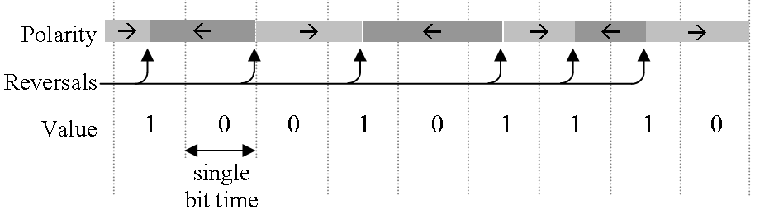
MFM Encoding
Just like FM except that changes at beginning of bit time are removed unless two 0’s are next to each other
Called Modified Frequency Modulation (MFM)

Slide 27
RLL Encoding
Goals of encoding:
to ensure enough polarity changes to maintain bit synchronization;
to ensure enough bit sequences are defined so that any sequence of ones and zeros can be handled; and
to allow for the highest number of bits to be represented with the fewest number of polarity changes

Slide 28
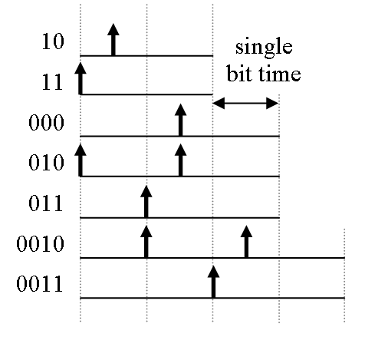
RLL Encoding (continued)
Run Length Limited (RLL) uses polarity changes to represent sequences of bits rather than individual 0’s or 1’s

Slide 29
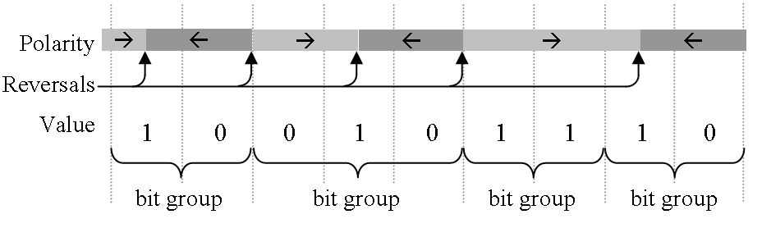
RLL Encoding (continued)
Note that the shortest period between polarity changes is one and a half bit periods.
This produces a 50% increased data density over MFM encoding.

Slide 30
Latest Encoding Technology
Improved encoding methods have been introduced since the development of RLL
Use digital signal processing and other methods to realize better data densities.
These methods include Partial Response, Maximum Likelihood (PRML) and Extended PRML (EPRML) encoding.

Slide 31
S.M.A.R.T.
Self-Monitoring, Analysis & Reporting Technology System (S.M.A.R.T.) is a method used to predict hard drive failures
Controller monitors hard drive functional parameters
For example, longer spin-up times may indicate that the bearings are going bad
S.M.A.R.T. enabled drives can provide an alert to the computer's BIOS warning of a parameter that is functioning outside of its normal range
Attribute values are stored in the hard drive as an integer in the range from 1 to 253. The lower the value, the worse the condition is.
Depending on the parameter and the manufacturer, different failure thresholds are set for each of the parameters.

Slide 32
Sample S.M.A.R.T. Parameters
Power On Hours: This indicates the age of the drive.
Spin Up Time: A longer spin up time may indicate a problem with the assembly that spins the platters.
Temperature: Higher temperatures also might indicate a problem with the assembly that spins the platters.
Head Flying Height: A reduction in the flying height of a Winchester head may indicate it is about to crash into the platters.
Doesn’t cover all possible failures: IC failure or a failure caused by a catastrophic event

Slide 33
Speed
Queuing time – waiting for I/O device to be useable
  Waiting for device – if device is serving another request
  Waiting for channel – if device shares a channel with other devices (multiplexing)
Disk rotating at a constant speed (energy saver – disk may stop)

Slide 34
Seek time
Process of finding data on a disk
Find correct track by moving head (moveable head)
Selecting head (fixed head) takes no time
Some details cannot be pinned down
  Ramping functions
  Distance between current track and desired track
  Shorter distances and lighter components have reduced seek time

Slide 35
Rotational Latency
Waiting for data to rotate under head
  Floppies – 3600 RPM
  Hard Drives – up to 15,000 RMP
  Average rotational delay is 1/2 time for full rotation
Total Access time = Seek + Latency

Slide 36
Transfer Time
Transfer time = time it takes to retrieve the data as it passes under the head
T = b/(rN)
where
  T = transfer time
  b = number of bytes to transfer
  N = number of bytes on a track (i.e., bytes per full revolution)
  r = rotation speed in RPS (i.e., tracks per second)

Slide 37
Rotational Position Sensing (RPS)
Allows other devices to use I/O channel while seek is in process.
When seek is complete, device predicts when data will pass under heads
At a fixed time before data is expected to come, tries to re-establish communications with requesting processor – if fails to reconnect, must wait full disk turn before new attempt is made: RPS miss

Slide 38
Random access
File is arranged in contiguous sectors – only one seek time per track
File is scattered to different sectors or device is shared with multiple processes – seek time increased to once per sector

Slide 39
Redundant Array of Independent Disks (RAID)
Rate of improvement in secondary storage has not kept up with that of processors or main memory
In many system, gains can be had through parallel systems
In disk systems, multiple requests can be serviced concurrently if there are multiple disks and the data for parallel requests is stored on different disks

Slide 40
RAID (continued)
Standardization of multi-disk arrays
7 levels (0 through 6)
Not a hierarchy
Common characteristics
  Set of physical disks viewed as single logical drive by O/S
  Data distributed across multiple physical drives of array
  Can use redundant capacity to store parity information to aid in error correction/detection
Third characteristic is needed because multiple mechanisms mean that there are more possibilities for failure

Slide 41
Striping
User's data and applications see one logical drive
Data is divided into strips
  Could be physical blocks, sectors, or some other unit
  The strips are then mapped to the different physical drives

Slide 42
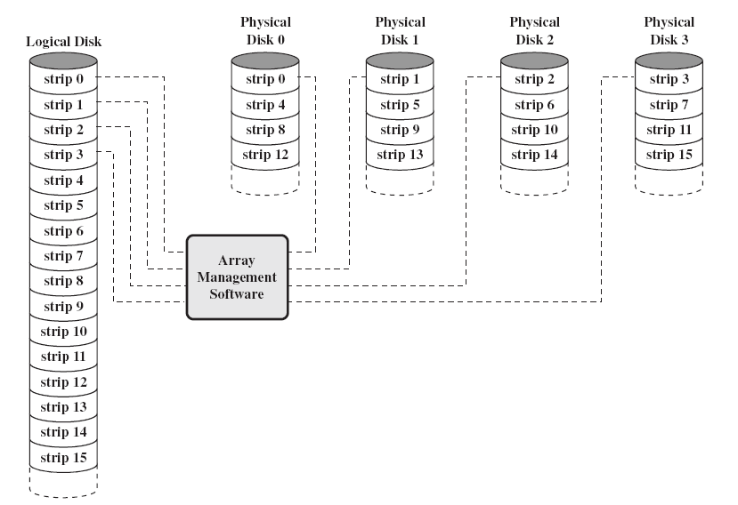
Striping (continued)

Slide 43
RAID 0
May not be considered RAID officially as it doesn't support third characteristic from above common characteristics – No redundancy
Data striped across all disks
Round Robin striping
Performance characteristics: Increases speed since multiple data requests are probably in sequence of strips and therefore can be done in parallel (High I/O request rate)

Slide 44
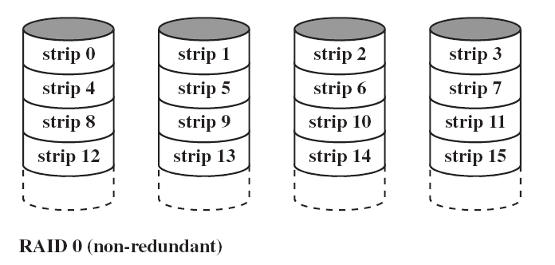
RAID 0 (continued)

Slide 45
RAID 1
Mirrored Disks – 2 copies of each stripe on separate disks
Data is striped across disks just like RAID 0
Read from either –slight performance increase; 1 disk has shorter seek time
Write to both – slight performance drop; one disk will have longer seek time
Recovery is simple – swap faulty disk & re-mirror; no down time
Performance characteristics: Same as for RAID 0
Expensive since twice capacity is required – likely to be limited to critical system software and data files

Slide 46
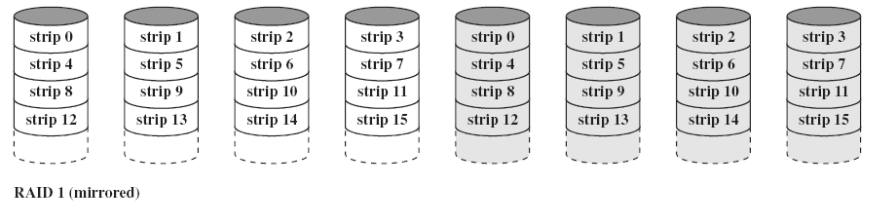
RAID 1 (continued)

Slide 47
RAID 2
Disks are synchronized to the point where each head is in same position on each disk
On a single read or write, all disks are accessed simultaneously
Striped at the bit level
Error correction calculated across corresponding bits on disks
Multiple parity disks store Hamming code w/parity (SEC-DED) error correction in corresponding position

Slide 48
RAID 2 (continued)
Error correction is redundant as Hamming and such are already used within stored data.
Only effective when many errors occur
Lots of redundancy
Expensive
Not commercially accepted
Performance characteristics: Only one I/O request at a time (non-parallel)

Slide 49
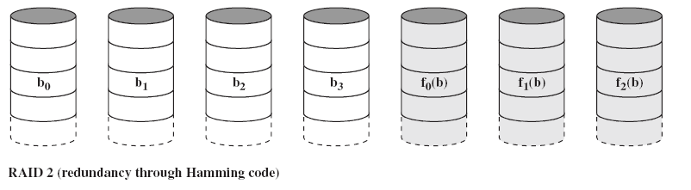
RAID 2 (continued)

Slide 50
RAID 3
Similar to RAID 2
Only one redundant disk, no matter how large the array
Simple parity bit for each set of corresponding bits – doesn't actually detect failed drive, but can replace it
Data on failed drive can be reconstructed from surviving data and parity info

Slide 51
RAID 3 (continued)
Example, assume RAID 3 with 5 drives
X4(i) = X3(i) ⊕ X2(i) ⊕ X1(i) ⊕ X0(i)
Failed bit (e.g., X1(i)) can be replaced with:
X1(i) = X4(i) ⊕ X3(i) ⊕ X2(i) ⊕ X0(i)
Equation derived from XOR'ing X4(i) ⊕ X1(i) to both sides.
Performance characteristics: Very high transfer rates
Problem: Only one I/O request at a time (non-parallel)

Slide 52
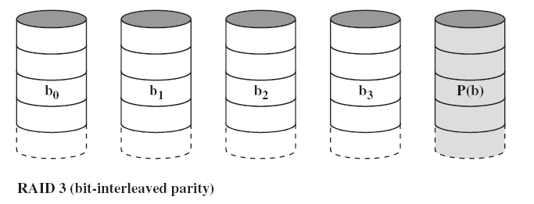
RAID 3 (continued)

Slide 53
RAID 4
Not commercially accepted
Each disk operates independently
Large stripes
Bit-by-bit parity calculated across stripes on each disk – stored on parity disk
Performance characteristics
  High I/O request rates (parallel)
  Less suited for high data transfer rates

Slide 54
RAID 4 (continued)
Problem – there is a write penalty with each write
old data strip must be read
old parity strip must be read
a new parity strip must be calculated
a new parity strip must be stored
new data must be stored

Slide 55
RAID 4 (continued)
Original parity calculation
X4(i) = X3(i) ⊕ X2(i) ⊕ X1(i) ⊕ X0(i)
New bit is stored (e.g., X1(i)) – parity is recalculated:
X4'(i) = X3(i) ⊕ X2(i) ⊕ X1'(i) ⊕ X0(i)
X4'(i) = X3(i) ⊕ X2(i) ⊕ X1'(i) ⊕ X0(i) ⊕ X1(i) ⊕ X1(i)
X4'(i) = X4(i) ⊕ X1(i) ⊕ X1'(i)

Slide 56
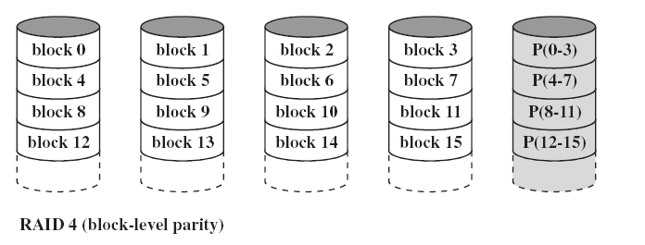
RAID 4 (continued)

Slide 57
RAID 5
Like RAID 4 except drops parity disk
Parity strips are staggered across all data disks
Round robin allocation for parity stripe
Avoids RAID 4 bottleneck at parity disk
Commonly used in network servers

Slide 58
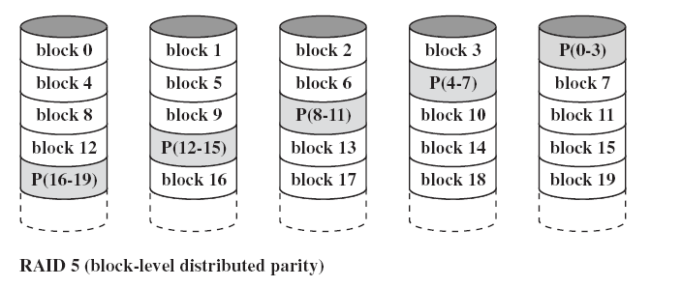
RAID 5 (continued)

Slide 59
RAID 6
Two parity calculations
XOR parity is one of them
Independent data check algorithm
Stored in separate blocks on different disks
User requirement of N disks needs N+2
High data availability
Three disks need to fail for data loss
Significant write penalty

Slide 60
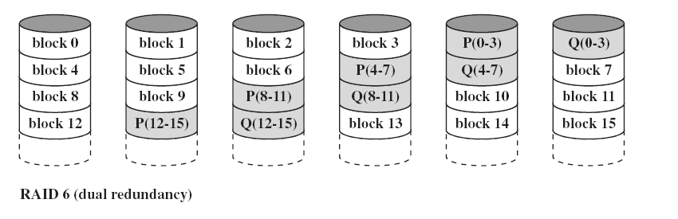
RAID 6 (continued)

Slide 61
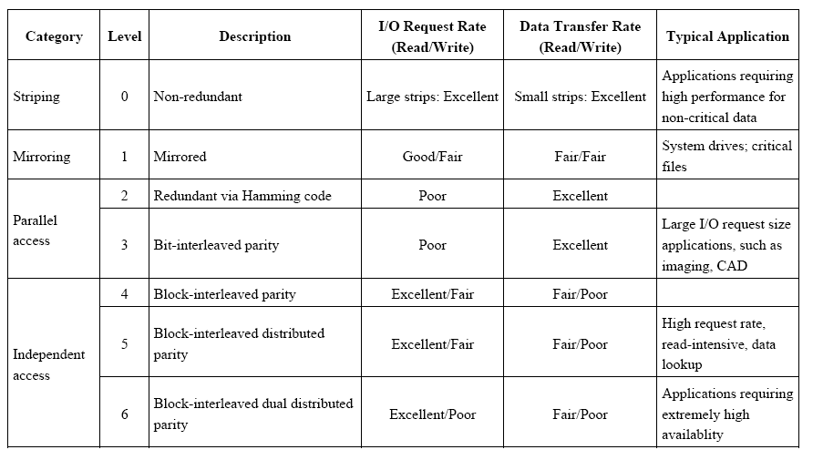
RAID Summary

