Slide 1


Hardware Support for Durable Atomic Instructions for Persistent Parallel Programming
Khan Shaikhul Hadi
ARPERS Research Group

Slide 2
Persistent Memory in memory hierarchy
Register
Byte addressable but volatile
Cache
Increased access latency
DRAM
Persistent Memory
Persistent and byte addressable
SSD, Flash Drive
HDD
Persistent but not byte addressable
Notes:
In memory hierarchy; Register, cache and DRAM is byte addressable meaning you could access them directly, but they are volatile. It also has less access latency.
On the contrary; SSD, Flash Drive and HDD is persistent meaning you will not loss data even after any crash, but they are not byte addressable. As a result, you do not have direct access.
To bridge the gap between this two, persistent memory technology is invented which is persistent and byte addressable. With all the advantages, it has its own issue. One issue is crash recoverability.

Slide 3
PM requires crash consistent programming
core
1
2
3
Cache
DRAM
Notes:
For a program that mapped into volatile memory like DRAM, we do not control when data will be written back to DRAM. As a result, update could be written back out of order. For example, you could update cache block 1, then cache block 2 and three. But cache block 2 could be evicted to DRAM followed by cache block 3 and cache block 1 could be written back last. This is not a problem as cache coherence protocol maintain data is consistent across memory system and upon crash, you lose all update anyway.

Slide 4

PM requires crash consistent programming
core
1
2
3
Cache
PM
Data is not consistent
Notes:
But for persistent memory, it is a problem. Suppose cache block 1,2,3 are mapped to persistent memory. After cache block 2 and 3 evicted to persistent memory, crash happens. Now, upon crash you will lose update of cache block 1 but cache block 2 and 3 resides in persistent memory. So, your data in cache block 2 and 3 is recovered from persistent memory but update in cache block 1 is lost. As a result, you may end up inconsistent data.

Slide 5
Regular write operation in PM
Write
core
FLUSH
FENCE
Read
1
2
Write
Cache
PM
Notes:
To prevent such scenario, programmer has to ensure that update is persisted before following instruction could read data. So, after writing on cache block 1, we execute flush instruction that evicts that cache block to persistent memory. We need to use FENCE to ensure that following read operation could not read cache block 1 before it is persisted. As a result, any read on cache block 1 will read persisted update. write on cache block 2 which may be influenced by update on cache block one will be performed after cache block 1 is persisted.
This may ensure crash consistency on single thread program, but for multithread program it does not provide a feasible solution.

Slide 6

atomic write operation in PM
Atomic
Write
core
core
Read
Atomic
Write
FLUSH
1
2
Private Cache
Private Cache
FENCE
Shared Cache
PM
Notes:
Atomic instruction is used for lock-free read-modify-write operation on shared memory data. It ensures thread do not update value based on wrong value.
Atomic write will update cache block 1. It needs flush to execute to persist data in persistent memory. But before flush could execute, another thread could read cache block 1 and based on that , update cache block 2. Now, flush will persist cache block 1 but following fence failed to ensure that update on cache block 1 is read after persistence is guaranteed. It could result in inconsistent data upon crash recovery.

Slide 7
But multi-thread code is not synchronized for PM
 | T1: insert(x) | T2: insert(y)
 | Node n = new Node(x) while(true): (pred,succ) = find(x) n.next = succ FLUSH(n.next) if(CAS(pred.next, succ, n)): | Node n = new Node(y) while(true): (pred,succ) = find(y) n.next = succ; FLUSH(n.next) if(CAS(pred.next, succ, n)): FLUSH(pred.next)
Unintentional time gap between CAS and FLUSH |  | while(true): (pred,succ) = find(y) n.next = succ; FLUSH(n.next) if(CAS(pred.next, succ, n)): FLUSH(pred.next)
 |  | return
 | FLUSH(pred.next) return

Slide 8
Problem illustration
Volatile Pointer
Durable Pointer
W
Z
Fig : Data structure before node X and Node Y insertion
Notes:
To illustrate the problem, let’s look into a lock-free linked list implementation mapped on persistent memory. Initially node w points to node z . pointer with red color indicate this pointer information is persisted. Pointer with green color indicate pointer is volatile and need flush to persist in persistent memory.

Slide 9
Problem illustration
Volatile Pointer
Durable Pointer
W
Z
T1: creates node X
X
Notes:
Thread 1 and thread 2 both wish to insert node before node z simultaneously. Thread 1 creates node x and persists it’s information.

Slide 10
Problem illustration
Volatile Pointer
Durable Pointer
W
Z
X
Y
T2: creates node Y
T1 : node x point to node Z
Notes:
Then node X next pointer points to node Z. simultaneously thread 2 creates node Y.

Slide 11
Problem illustration
Volatile Pointer
Durable Pointer
W
Z
T1: FLUSH
X
Y
Notes:
Thread one flush to persist pointer pointing to Z from X.

Slide 12
Problem illustration
Volatile Pointer
Durable Pointer
W
Z
T1: CAS()
X
Y
T2 : node Y point to node Z
Notes:
Now thread 1 perform compare-and-swap operation to atomically update next pointer of node W. Now W points to node X in volatile domain. But this does not update information in persistent domain where W still points to Z. Simultaneously thread 2 update node y’s next pointer to node Z.

Slide 13
Problem illustration
Volatile Pointer
Durable Pointer
W
Z
X
Y
T2: FLUSH
T1: unintentional delay
between CAS and FLUSH
Notes:
Due to various circumstance like external interrupt or out-of-order execution or both, flush in thread 1 may not execute immediately. There could be some delay between atomic update and flush. But thread 2 continue it’s execution. It execute FLUSH to persist next pointer of node Y.

Slide 14
Problem illustration
Volatile Pointer
Durable Pointer
W
Z
X
Y
T2: CAS()
Notes:
Then thread 2 atomically update next pointer of node X to point node Y in volatile domain.

Slide 15
Problem illustration
Volatile Pointer
Durable Pointer
W
Z
X
Y
T2: FLUSH
Notes:
thread 2 flush this update to persist.
If we look into this diagram, we see that node W’s next pointer update is still volatile. But based on this volatile update, node Y executed it’s own atomic operation.

Slide 16
Problem illustration
Volatile Pointer
Durable Pointer
W
Z
X
Y
System Crash
Notes:
Now, if crash happen in this state, we will lose all volatile information resulting node W’s next pointer update.

Slide 17
Problem illustration : crash recovery
Volatile Pointer
Durable Pointer
W
Z
X
Y
No pointer to access node X and consequently node Y.
Notes:
Upon crash recovery, node W will points to Node Z and there is no way to access Node X and consequently node Y. Now we have a corrupted data structure where we lost multiple nodes.

Slide 18
Source of the problem
Thread 1
Thread 2
CAS
Visible, not persisted
FLUSH
crash
Visible & persisted
Inconsistent
state
FENCE
Notes:
To visualize the source of the problem, let’s focus on this diagram. Each thread will execute atomic operation followed by flush and fence. But as there are independent instructions, there could be a time gape between two instruction execution. Between CAS and FLUSH , data present in cache for a duration of time when it’s is visible to other threads but not persistent. Time between flush and fence, data is visible and persistent.
To help to visualize, let’s emphasize time gap between CAS and FLUSH. After thread 1 execute CAS, as update is visible, thread 2 could read the update and perform it’s own CAS operation. Then it could execute FLUSH. As a result, between thread 2’s FLUSH and thread 1’s FLUSH there is a time region when data in persistent domain is inconsistent with data in volatile domain. Now, if crash happen within this region, we will have inconsistent data. As persist process is not atomic for atomic operation, it requires another instruction to persist that results in this problem.

Slide 19
Solution
Thread 1
Thread 2
durCAS
Visible & persisted
crash
consistent
state
Notes:
If we could make persist operation also atomic , so that atomic instruction perform read-modify-write-persist in atomic fashion, this problem will be resolved. Let’s assume durCAS is a durable version of compare and swap operation that ensures data is also persisted atomically. Now, this eliminates the time region where data is visible but not persisted. As a result, when thread 2 executes it’s durCAS, data is consistent across the system and if crash happen, we could recover data in consistent state.
Now, question is how could we achieve durable atomicity ?

Slide 20

Regular Atomic Instruction
core
core
Issue PrRdX
Write
Read
Modify
lock
Private Cache
Private Cache
Cache block
with write
permission
Shared cache
Volatile Domain
PM
Persistent Domain
Notes:
Let’s see how atomic instruction perform read-modify-write atomically. First when core issue PrRdX, cache controller bring the cache block with write permission and lock it. It could lock it by locking the bus or making transition to a transient state where it will not response to any external request. Then core read the value, make modification and update the data. After update is complete, it unlock the cache block which give global visibility of the update.

Slide 21
Durable Atomic Instruction
core
core
Write
lock
Private Cache
Private Cache
Shared cache
Volatile Domain
Persist
Acknowledgement
PM
Persistent Domain
Notes:
So, to achieve durable atomicity we need to ensure cache controller do not unlock the cache block after write is performed. Instead , cache controller will send the update data to persistent domain. Upon it receives acknowledgement for persist operation, then it unlocks the cache block.

Slide 22


achieving atomic durability using cache coherence protocol
Read-Modify-Write
PrDurRd
Persist
Stable State
Transient State
**PrDurRd : PrRdX equivalent read request from durable atomic instruction
Notes:
When we explore how to achieve durable atomicity, we were looking solution in existing hardware so that it is easily adoptable. And in our opinion, cache coherence protocol is most suitable to help us durable atomicity. In this scenario, we assume when a cache block in transient state, it does not respond to any external request. When core execute durable atomic instruction, it issue PrDurRd which is equivalent of PrRdX request from regular atomic instruction. We needed different signal to help cache controller circuit to realize, this is part of durable operation.
Upon receiving PrDurRd, coherence protocol bring the cache block with write permission and keep it in transient state to prevent global visibility. Then core perform read-modify-write. When write is complete, cache block sends the write-back of updated block to persistent domain. When cache receives acknowledgement that data is durable, it make transition to stable state. Thus making the update globally visible.

Slide 23
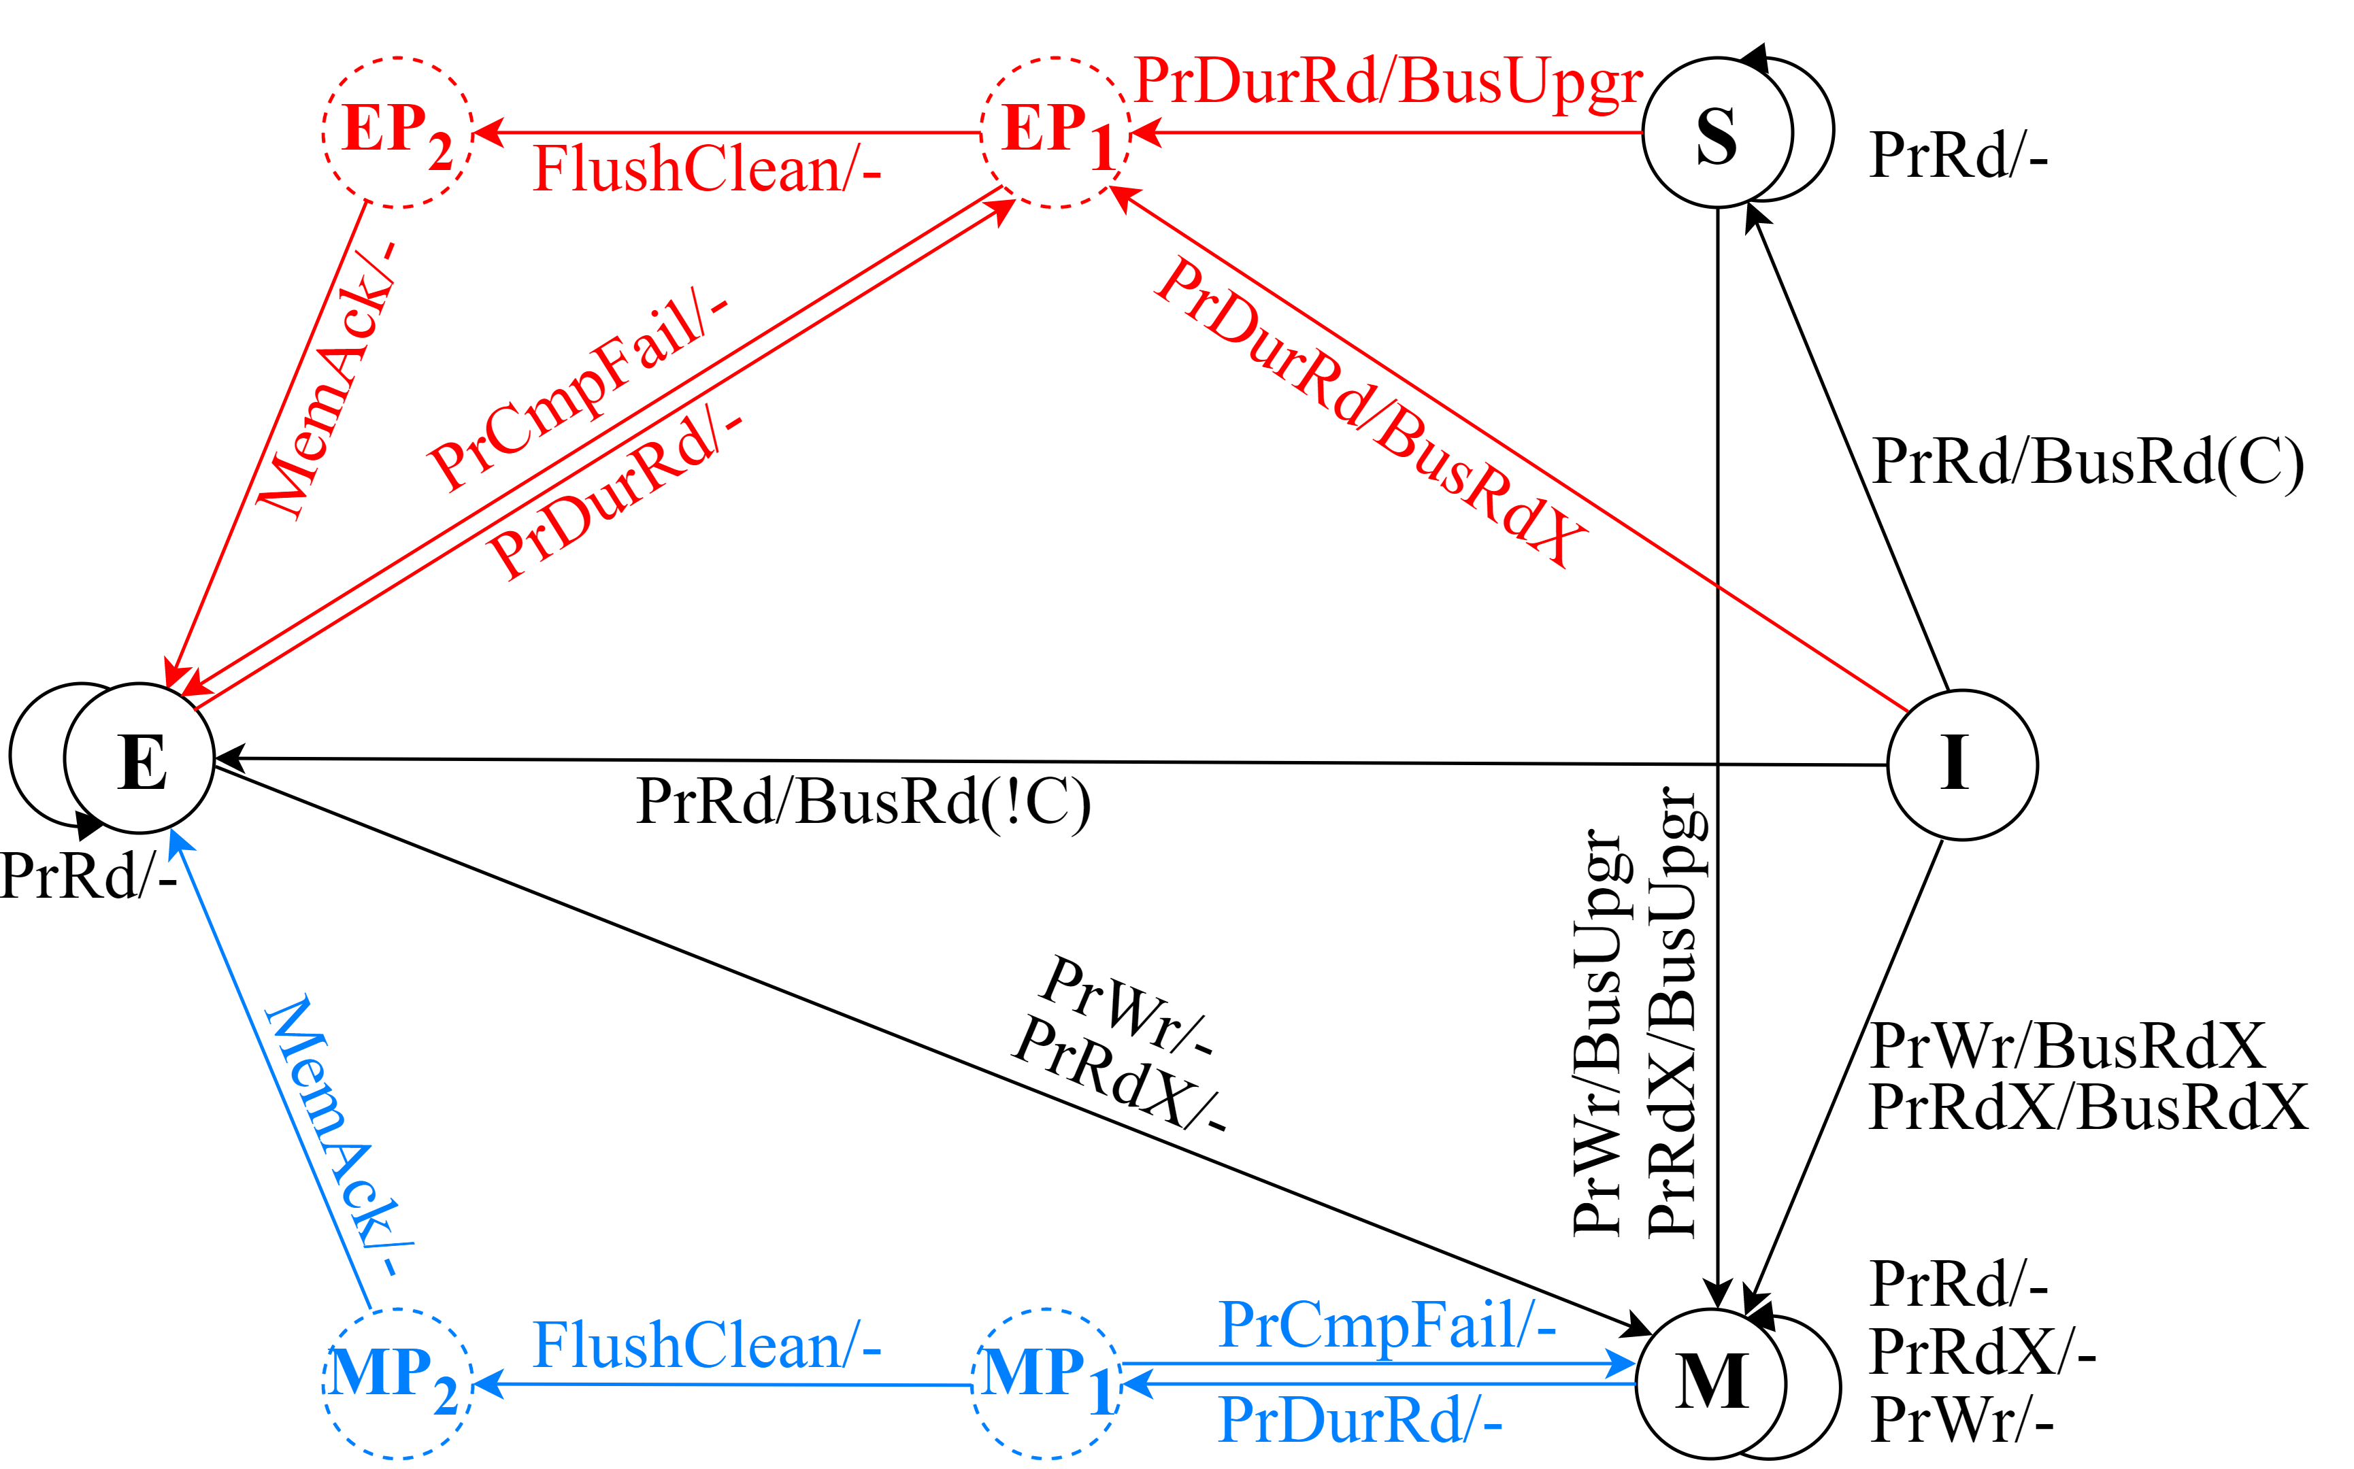
durMESI with respect to process side request
Notes:
To test our idea, we implemented a modified version of MESI protocol that we called durMESI that supports durable atomic instruction. Black portion of the state diagram is part of regular MESI protocol. Red portion and blue portion are our modification to provide support for durable atomic instruction. Due to time constraints, let’s only focus on one of our modification, blue diagram.

Slide 24
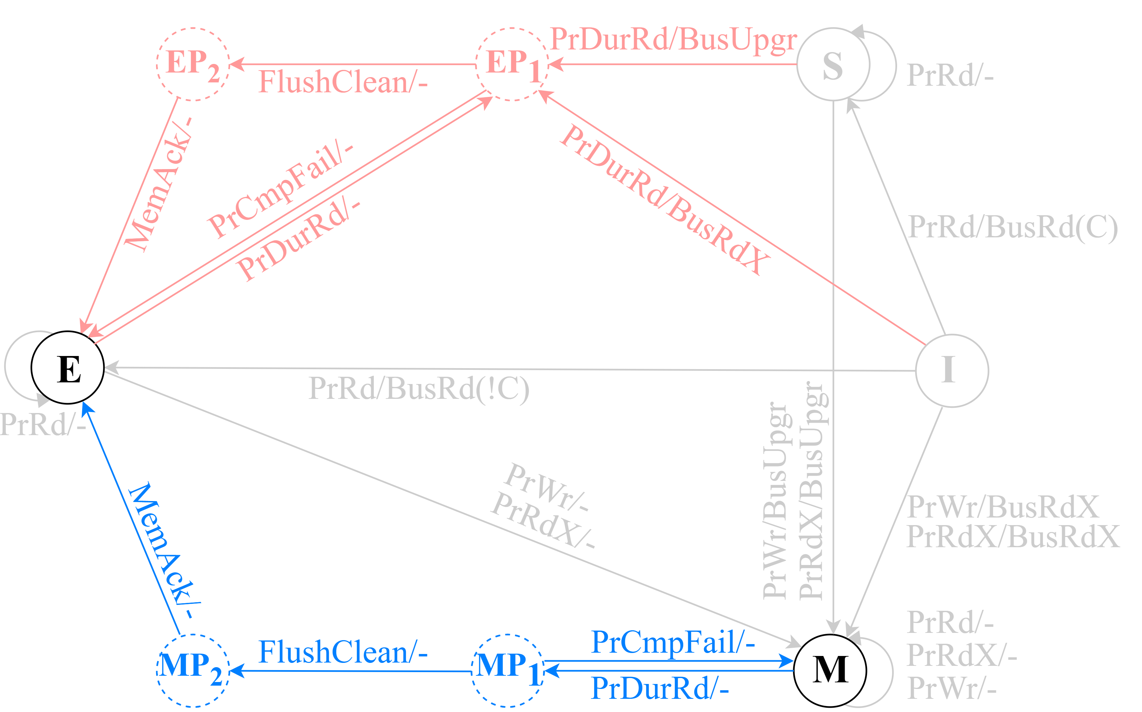
durMESI with respect to process side request
Notes:
Here PrDurRd ( in bottom right ) indicate exclusive read request from core which is part of durable atomic instruction. PrCmpFail indicate signal from core that indicate comparison operation returns false. This will be part of atomic operations that has comparison functionality. FlushClean indicate cache controller sends the update to persistent domain to make it consistent with main memory, but cache block is not evicted. MemAck indicate acknowledgement from persistent domain.
Now when core issue PrDurRd to execute durCAS and cache already have the cache block in Modified state, it make transition to MP1 state and prevents global visibility. Now, if CAS operation fails, core issue PrCmpFail, we do not make any modification on the cache block. But cache block could still have some dirty bit. So, we make transition back to Modified state. If comparison succeeds, processor update the cache block. Then cache controller issue Flush clean and make transition to MP2 state. When it receives MemAck, now you have clean data, so it make transition to exclusive state.
If initial states were exclusive, shared or invalid, cache controller need to get write permission before making transition to transient state and follow same logical progression.

Slide 25
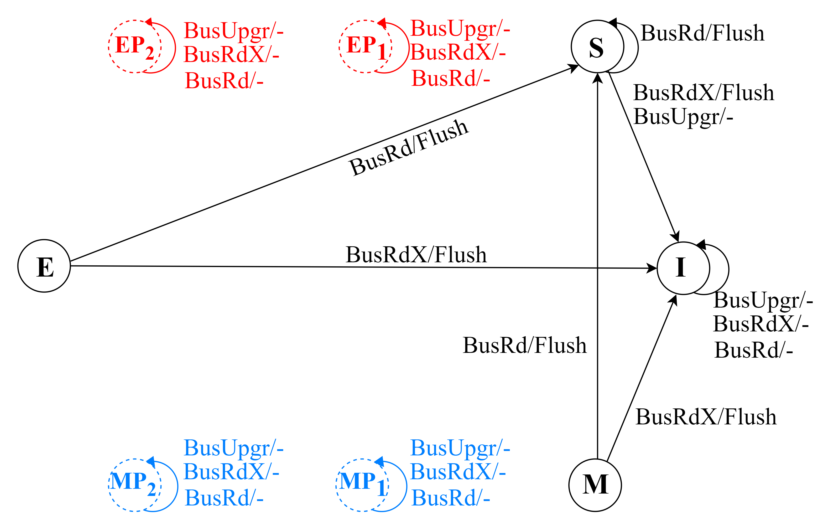
durMESI with respect to bus side request
Notes:
This is the state diagram from bus side request and how cache coherence will respond for different bus request.

Slide 26
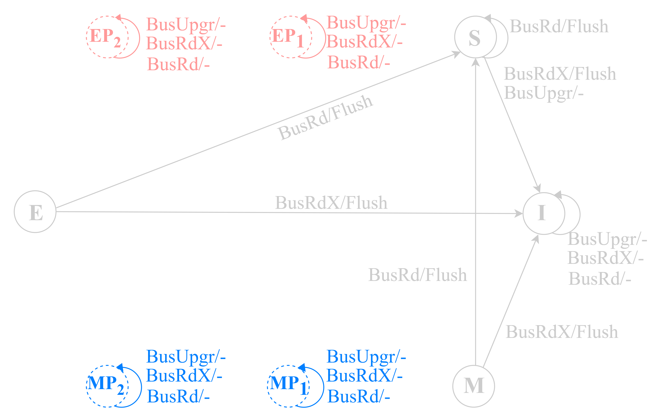
durMESI with respect to bus side request
Notes:
If we focus on MP1 and MP2, we see that it will not respond to any bus request. Thus other thread could not steal it’s cache block.

Slide 27
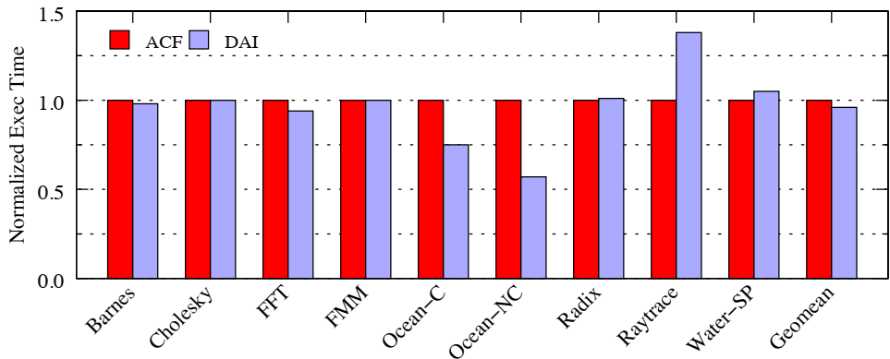
Splash-4 : Execution time
Fig: Execution time of ACF (Atomic+CLFLUSH+FENCE) vs. DAI(Durable Atomic Instruction), normalized to that of ACF
Notes:
We compare our work on Splash 4 benchmark. To adopt this benchmark for persistent memory, we assume all heap memory is mapped to persistent memory and inserted flush and fence accordingly. Here ACF indicates regular atomic operation followed by cache line flush and fence. DAI stands for durable atomic instruction. All bench marks were run in 16 thread configuration. We used sniper sim as our simulator. Data is normalized with respect to ACF.
Performance impact of DAI is not straight forward. Overall performance improvement is 6.4%. But for workload like ocean-contiguous and ocean-non contiguous, execution time reduces more than 25 percent where for raytrace, execution time increases more than 25%. For benchmark like Cholesky and FMM, there is no visible performance influence.
Our analysis shows , if an benchmark has significant number of atomic update compared to regular update , then DAI have visible performance impact like raytrace or ocean. Now, if the performance impact is positive or negative depends on, how frequently multiple thread tries to access same cache block at the same time. We call this scenario, cache block contention. For raytrace, cache block contention is extremely high because durable atomic instructions holds the cache block in transient state for longer amount of time, thus we get negative impact. Where for ocean benchmark, it is low.

Slide 28
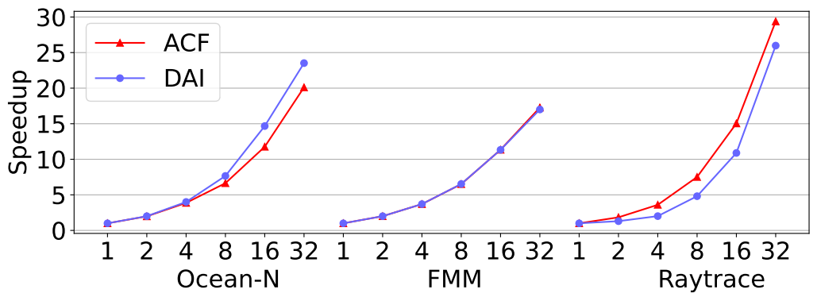
Splash 4: Scalability
Fig: Performance scalability of ACF (Atomic+CLFLUSH+FENCE) vs. DAI(Durable Atomic Instruction with increasing thread count
Notes:
We were also concern about the impact of DAI on the scalability of the workload. As DAI lock the cache block for a longer amount of time compared to regular atomic operation, it may negatively impact the scalability. Our analysis show that, if DAI increase execution time compared to ACF like ray trace, then it also negatively impact scalability of the workload. If DAI improve execution time, then it also improves scalability of the workload like ocean-N.

Slide 29

Thank You

