Slide 1
Azure Serverless End-to-End

Slide 2
Architecture Summary
End-to-end Serverless Architecture on Azure
Services Overview
Cosmos DB Database for storing data
Azure Function (Consumption Plan) to host the JavaScript based API implementation
Azure API management (Consumption Tier) to server as the API broker
Azure Storage (Static Website) to host the React.js based front-end implementation
Azure AD to provide OAuth2 based authentication and authorization

Slide 3
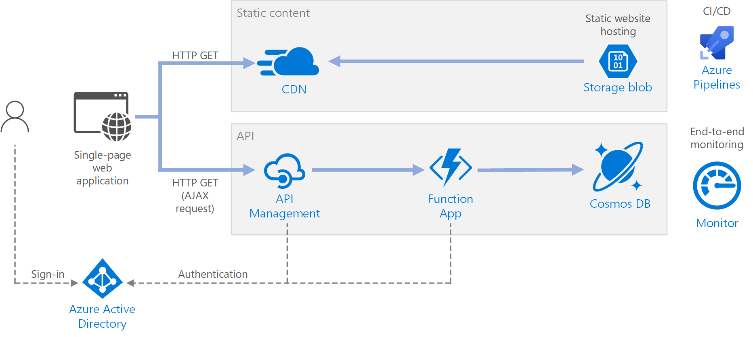

Reference Architecture from Azure Docs

Slide 4






Sample Reference Architecture
Task Logic App
API Management Instance to host Secure and Non-Secure APIs
Task List Data Storage
(SQL API)
Azure Storage (Static Website with React)
Task Function (JavaScript)
OAuth2 Token Validation Flow
OAuth2 Auth Flow
Azure AD to secure APIs and Functions using OAuth2

Slide 5
Artifacts
Azure DevOps Repo located here
Folder Structure
React Web UI project
Javascript Function project
Docs – General documentation
VS Code is used as the primary development tool

Slide 6
Resources
VS Code React Tutorial
Azure Function – JavaScript
Azure Function – Cosmos DB bindings
Create Azure Functions using VS Code

Slide 7
More Resources (1)
https://medium.com/codingthesmartway-com-blog/the-mern-stack-tutorial-building-a-react-crud-application-from-start-to-finish-part-1-d8d701c2995
https://jasonwatmore.com/post/2018/09/11/react-basic-http-authentication-tutorial-example
https://medium.com/@fiqriismail/how-to-secure-your-reactjs-frontend-with-azure-ad-b2c-8fd165f602e8
https://docs.microsoft.com/en-us/azure/api-management/api-management-howto-protect-backend-with-aad
https://docs.microsoft.com/en-us/azure/azure-functions/functions-bindings-cosmosdb-v2#input---examples
https://docs.microsoft.com/en-us/azure/azure-functions/functions-reference-node
https://docs.microsoft.com/en-us/azure/azure-functions/functions-create-first-azure-function-azure-cli
https://liftcodeplay.com/2018/09/10/enabling-cors-for-azure-function-local-development/
https://stackoverflow.com/questions/52852018/use-npm-uuid-in-reactjs

Slide 8
More Resources (2)
https://www.npmjs.com/package/@azure/cosmos
https://reactjs.org/docs/handling-events.html
https://stackoverflow.com/questions/48434897/how-to-have-a-external-json-config-file-in-react-jsx
https://kvaes.wordpress.com/2018/04/04/when-your-single-page-app-needs-cors-and-meets-azure-api-management-with-a-function-backend/
https://itnext.io/a-memo-on-how-to-implement-azure-ad-authentication-using-react-and-net-core-2-0-3fe9bfdf9f36
https://stackoverflow.com/questions/50305568/how-to-integrate-azure-ad-into-a-react-web-app-that-consumes-a-rest-api-in-azure
https://github.com/salvoravida/react-adal
https://simondoy.com/2016/05/16/dev-diary-s01e06-azure-mvc-web-api-angular-and-adal-js-and-401s/
https://blogs.msdn.microsoft.com/ben/2018/11/07/client-app-calling-azure-function-with-aad/
https://adatum.no/azure/azure-ad-authentication-in-azure-functions
https://www.koskila.net/how-to-fix-admin-consent-issues-aadsts65001/

