Slide 1
Summer Internship Presentation
Naveed Ziari, PhD Student
11 August 2022
Clinical Data Science
Notes:
Say PhD student at UC Berkeley, studying endocrinology & computational biology

Slide 2
The Field at a Glance
Historically, the most prevalent pharmaceuticals were accidentally or unintentionally discovered
Widespread use without knowledge of their mechanism of action
E.g. Metformin primarily works by lowering gluconeogenesis
Little knowledge of toxicity at the outset
Such knowledge will allow us to repurpose drugs or more easily discover more drugs using a more scientific approach
New technology exists that generate high-throughput data easily, cost-effectively, and rapidly
RNA-seq Breda, Jérémie, Mihaela Zavolan, and Erik van Nimwegen. "Bayesian inference of gene expression states from single-cell RNA-seq data." Nature Biotechnology 39.8 (2021): 1008-1016.
Orbitrap LC-MS/MS Hu, Qizhi, et al. "The Orbitrap: a new mass spectrometer." Journal of mass spectrometry 40.4 (2005): 430-443.
Drug screening platforms Corsello, Steven M., et al. "Discovering the anticancer potential of non-oncology drugs by systematic viability profiling." Nature cancer 1.2 (2020): 235-248.
Notes:
100 columns, one observation of cell lines
quantile transform

Slide 3
Problem Statement
How can we deduce the mechanism of action of a drug with state-of-the-art high-throughput technology?
Create training dataset
Train a model on the dataset
Use model to predict on testing dataset
Compendium of drugs with known MoA
Obtain signatures of each MoA
Find MoA of new drugs under development
Multi-Label Classification

Slide 4
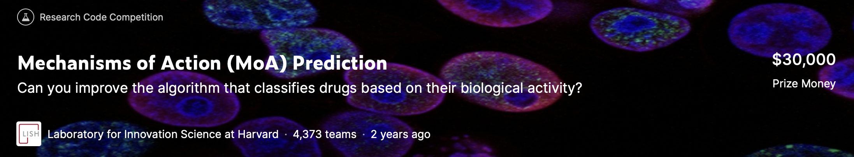
Competition
206 classifications (mechanisms of action)
Training set:
23,814 observations
3289 drugs
Test set:
3982 observations
Feature space:
3 categorical: treatment dose, duration, control/treatment
~800 gene expression measurements
Viability of 100 cell lines

Slide 5
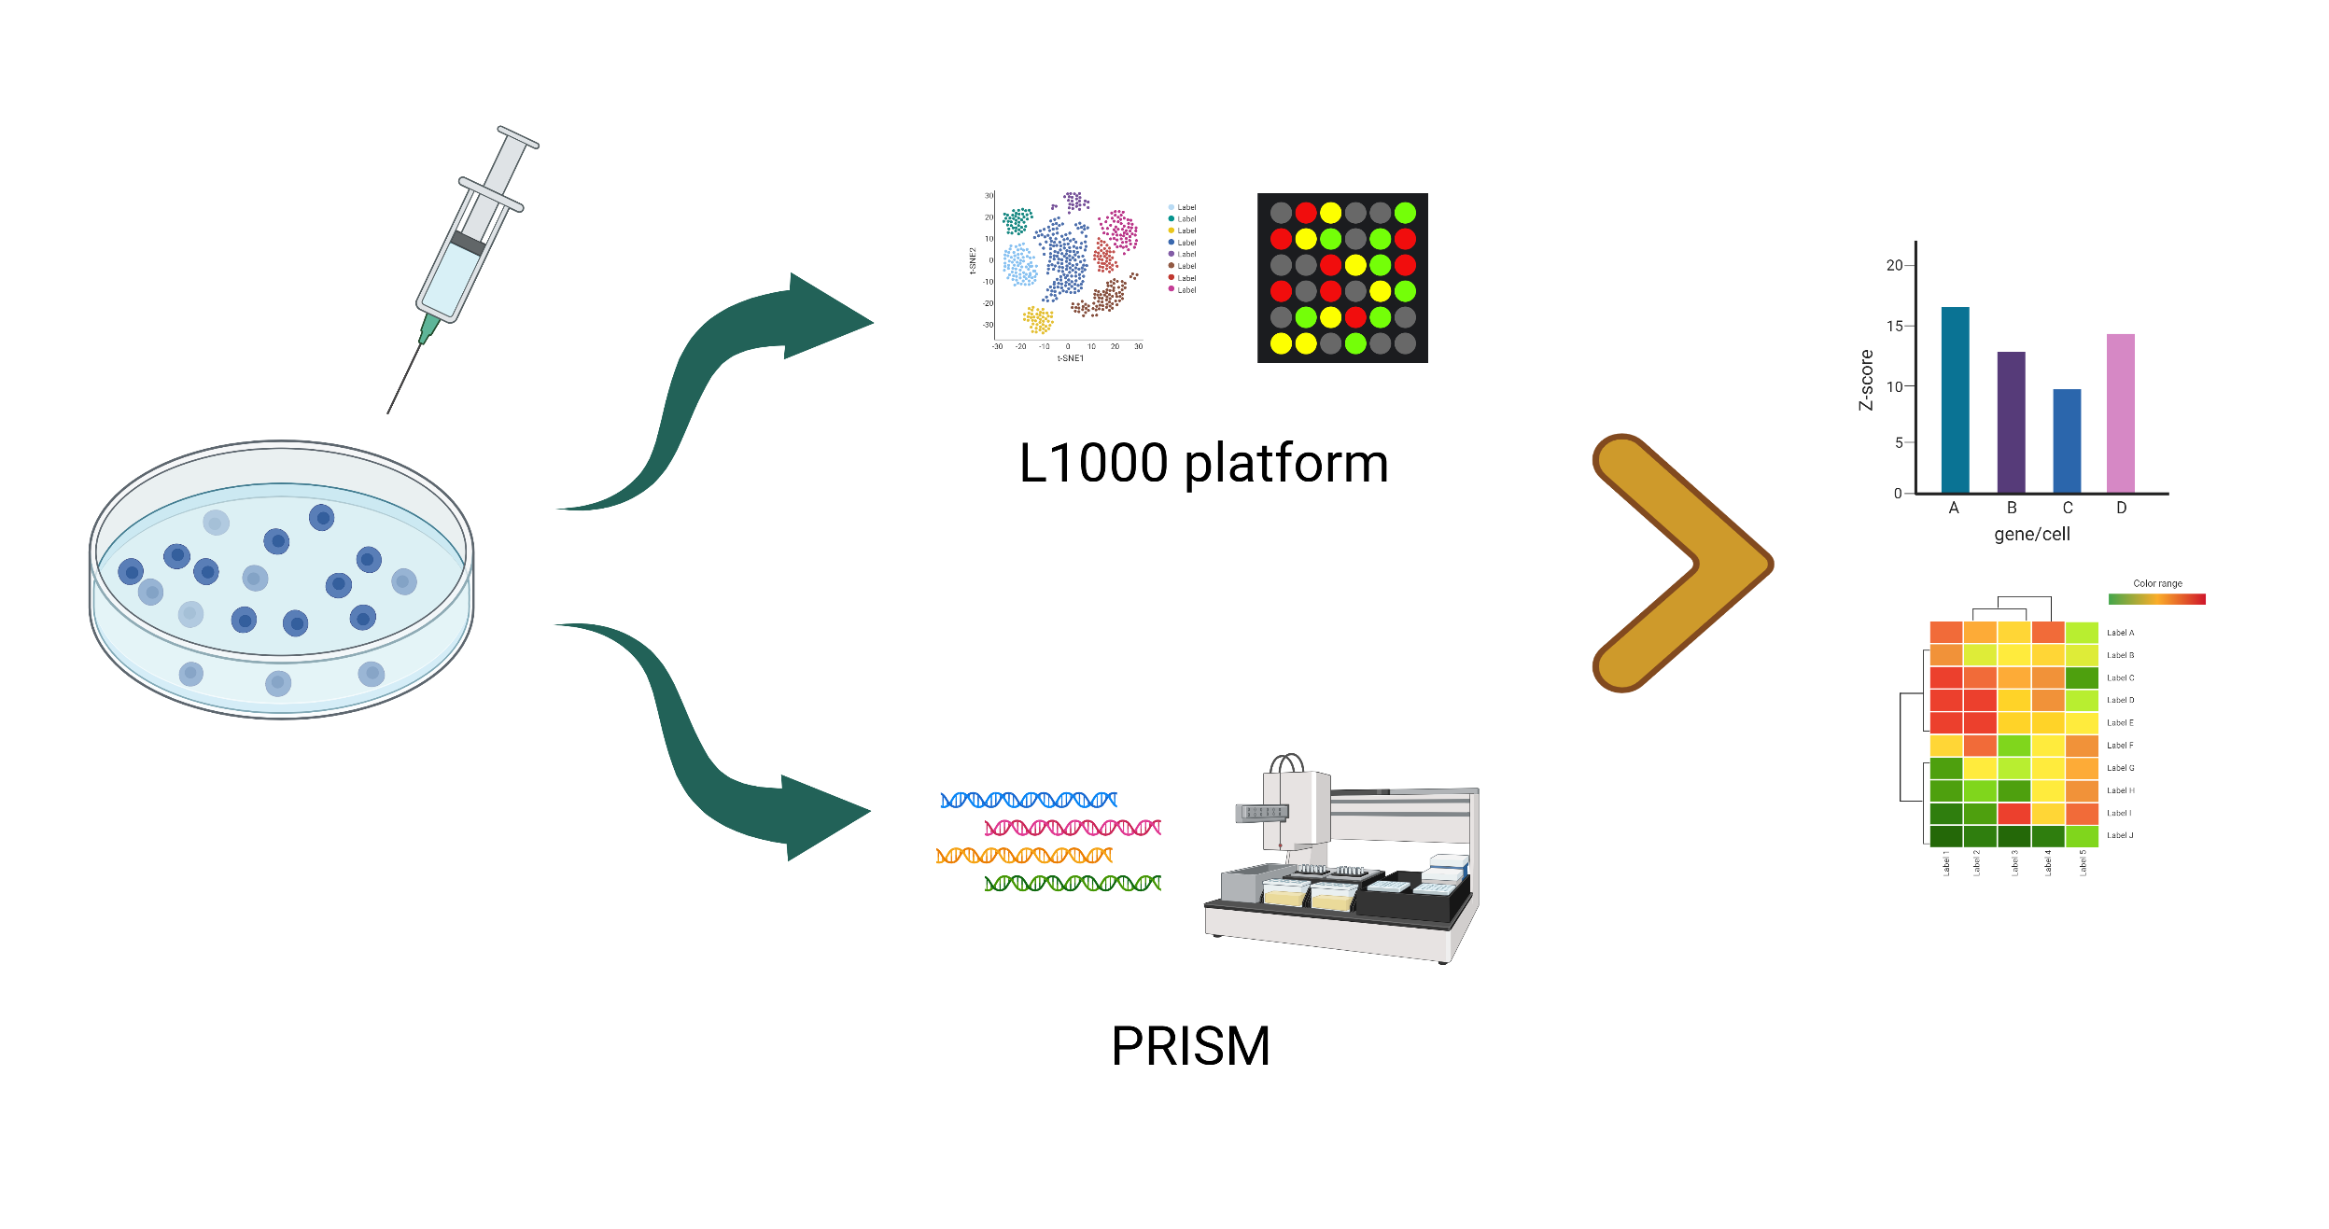
Study Design
Every observation is a separate experiment
Administer drug to all 100 cancer cell lines pooled in aggregate
Measure mRNA levels produced by all cell lines
Measure cell viability of each line using molecular barcoding
Building a model on the training set with very large number of experiments can deconvolve and elucidate gene expression signatures of the MoA

Slide 6
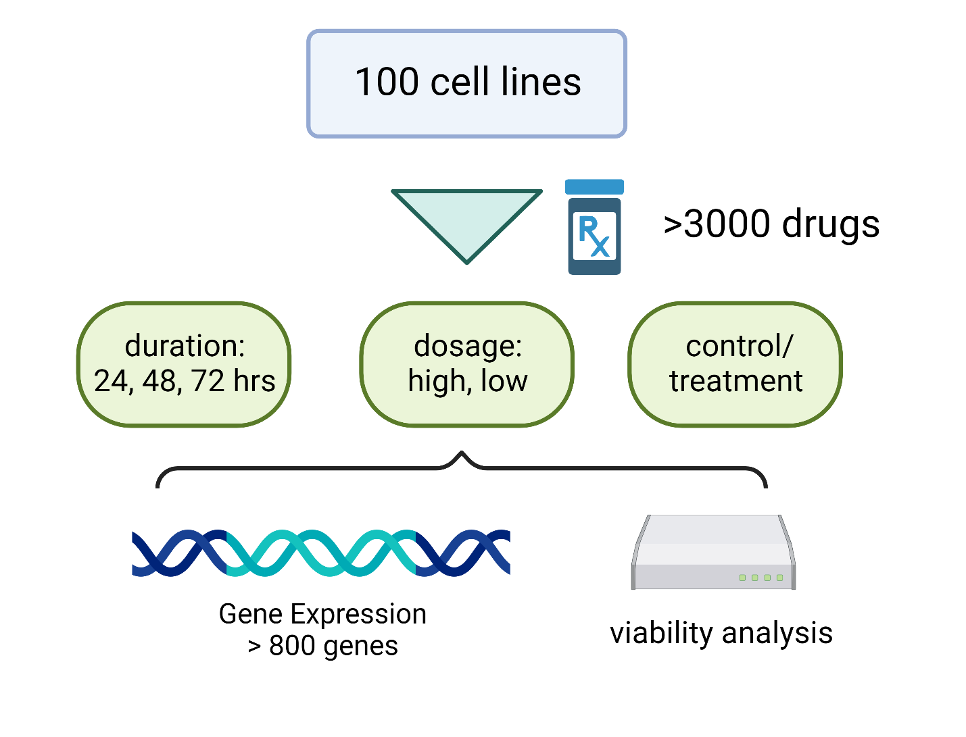
Study Design
Every observation is a separate experiment
Administer drug to all 100 cancer cell lines pooled in aggregate
Measure mRNA levels produced by all cell lines
Measure cell viability of each line using molecular barcoding
Building a model on the training set with very large number of experiments can deconvolve and elucidate gene expression signatures of the MoA

Slide 7
Data Format
Training/Test Features:
observations
categorical features
gene expression
cell viability
sig_id | ctrl/trt | dose | duration | g-1 | g-… | g-800 | c-1 | c-… | c-100
id_000644bb2 | trt | D1 | 24 | -1.022 | -0.0326 | 0.5548 | 0.0495 | 0.4141 | 0.8432
id_000779bfc | trt | D1 | 48 | 0.2341 | 0.3372 | -0.4047 | 0.7639 | 0.5499 | -0.3322
id_000a6266a | trt | D2 | 72 | 0.1715 | 0.2155 | 0.0065 | 0.976 | -0.0427 | -0.1235
id_0015fd391 | ctrl | D1 | 24 | -1.959 | 0.1792 | -0.1321 | -1.081 | -3.052 | -3.447
Targets:
Drug information:
observations
MoA targets
observations
drug administered
sig_id | MoA-1 | MoA-… | MoA-206
id_006fc47b8 | 0 | 1 | 0
id_0071d65a2 | 1 | 0 | 0
id_007a2159c | 0 | 0 | 1
sig_id | drug_id
id_0023f063e | de7583071
id_002452c7e | 89dea2045
id_0024bcd70 | b877aa048

Slide 8
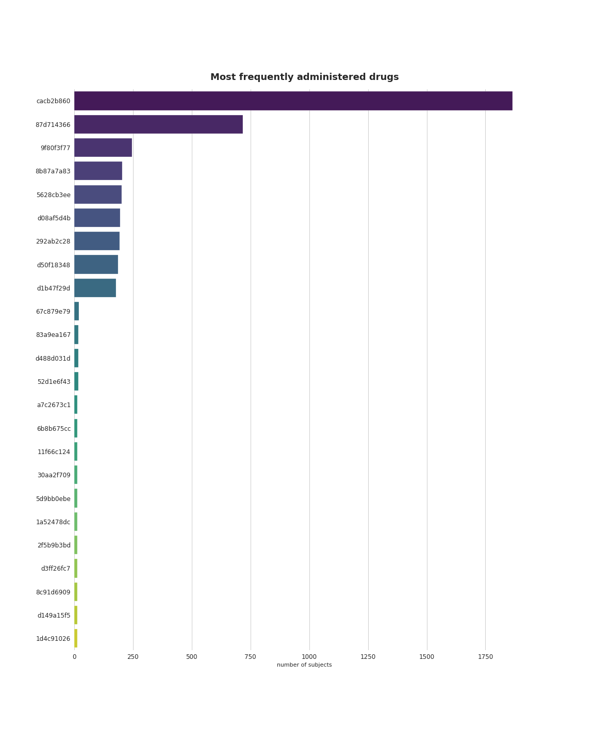
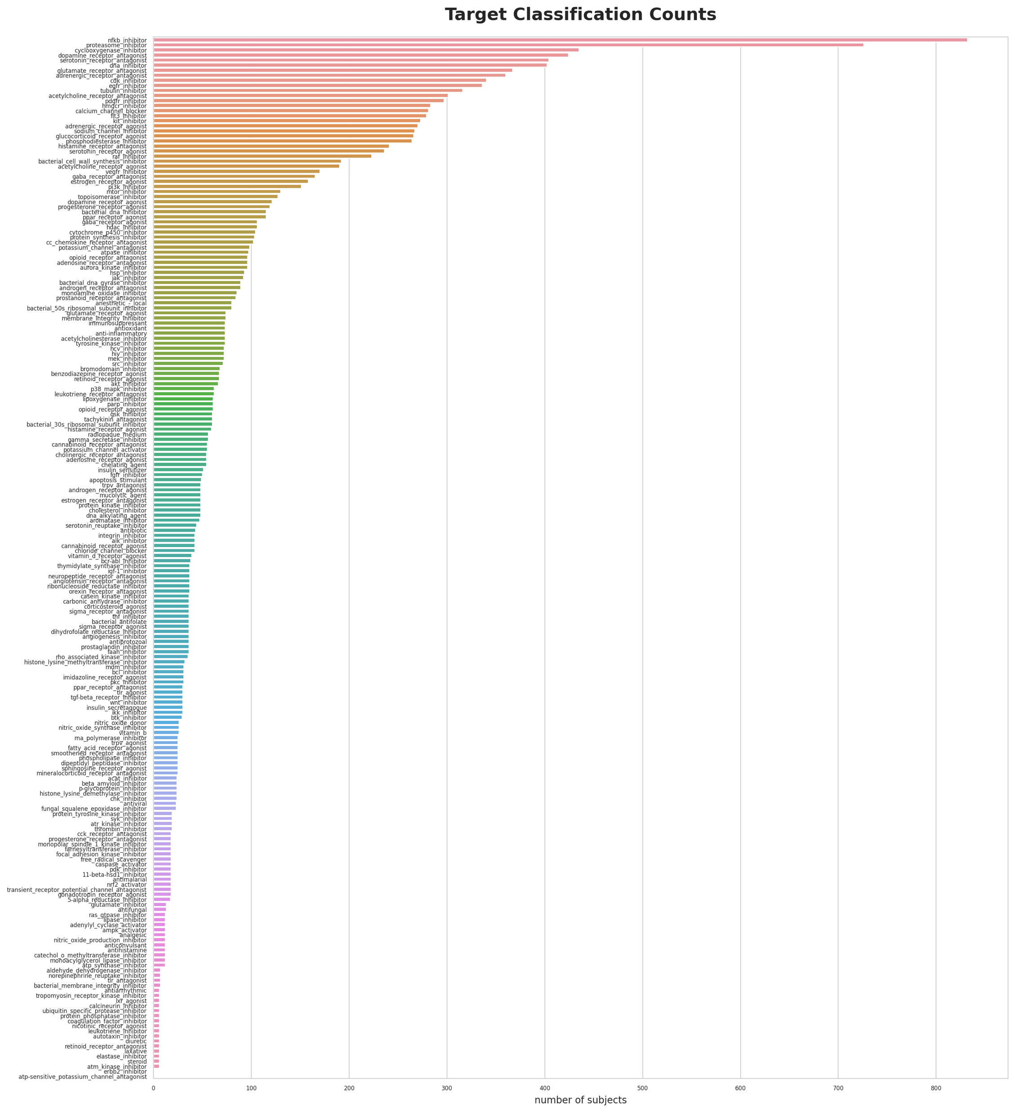
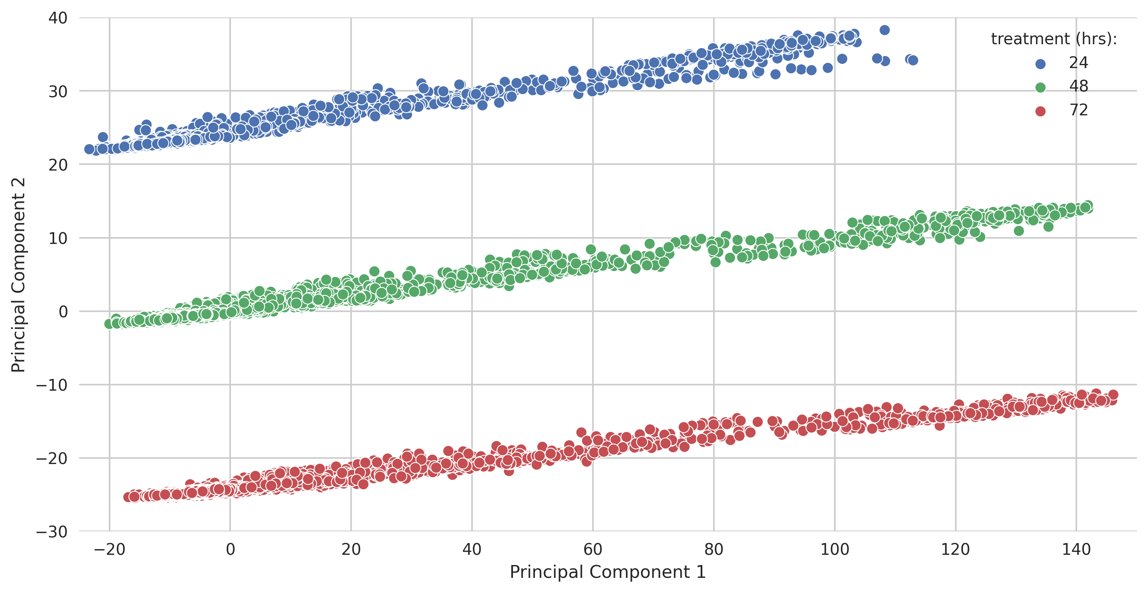
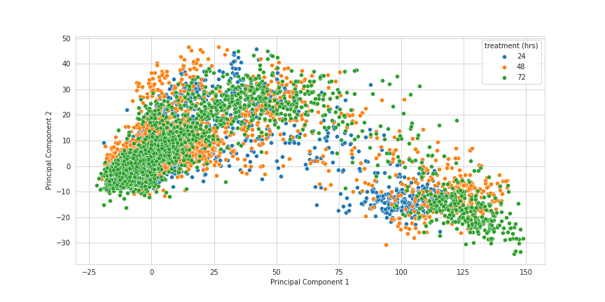
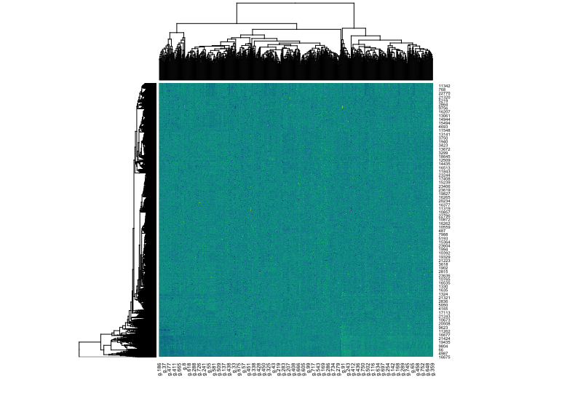
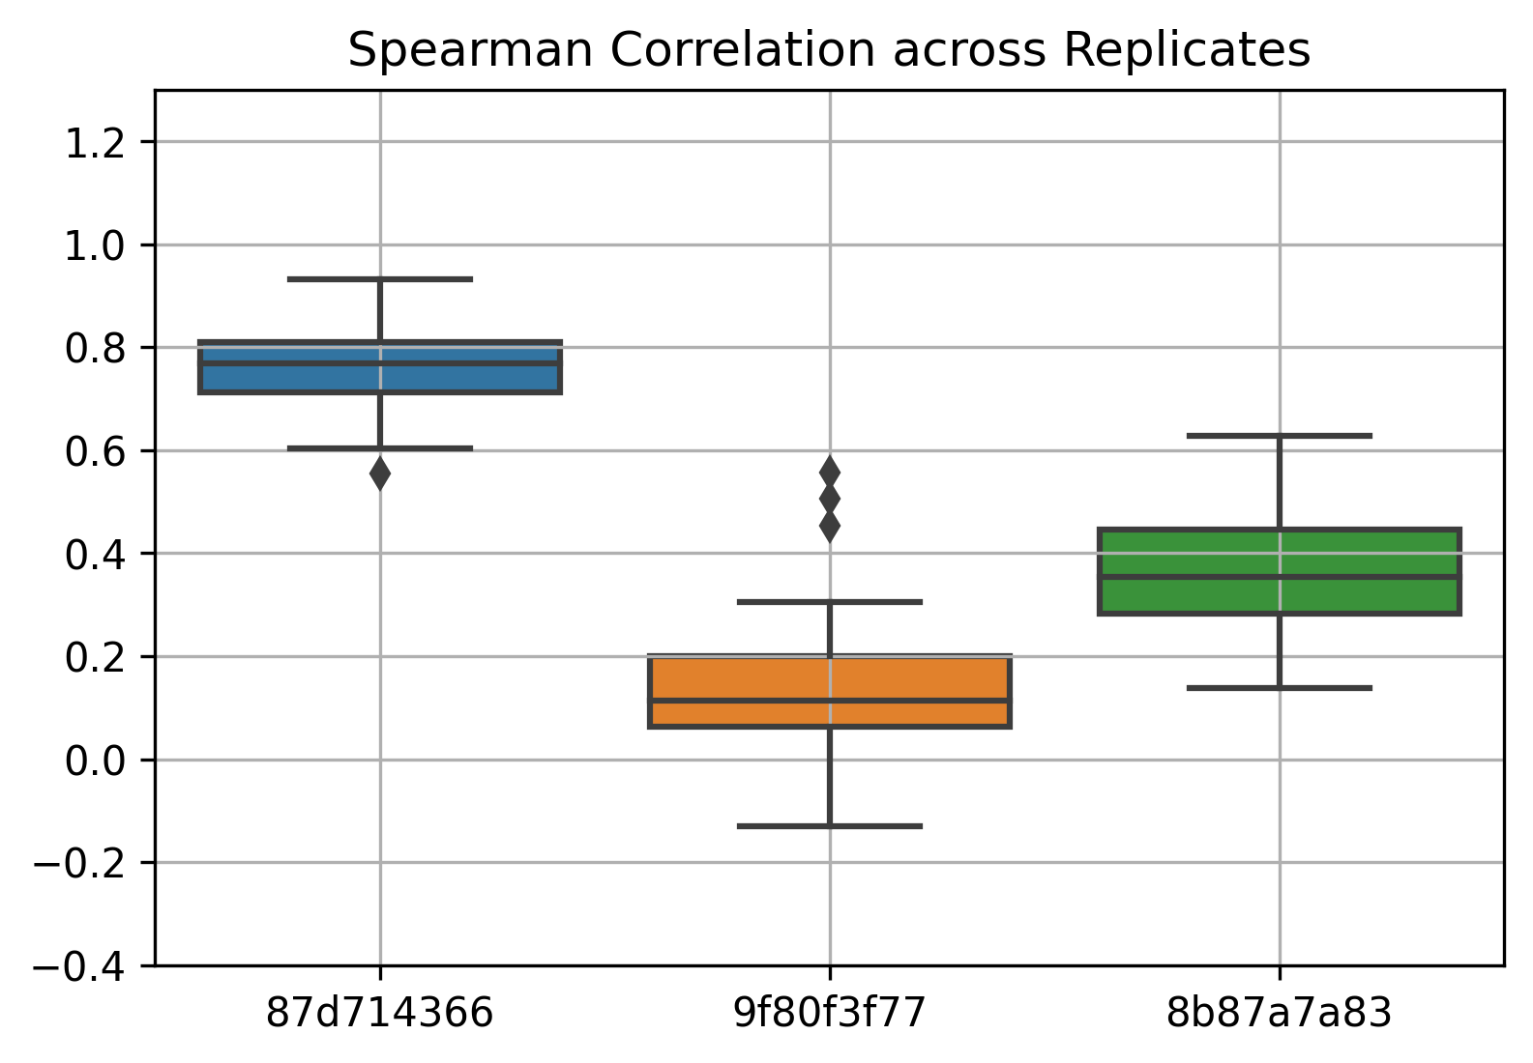
Preliminary Data Analysis
drugs
targets
Checked that all obvservations from one drug all have same MoA annotation
Imbalance in classes and drug administration
Correlation
No clustering of gene expression features
Correlation among replicates of the top 3 drugs
a)
b)
***
***
Clear PCA separation on treatment duration
Shows that mRNA level and cell count is a function of time
***

Slide 9

Neural Network Training
Input
Hidden
Output
Training | Validation | Test
Features
206
MoA
targets
predict
4-fold stratified cross-validation
Scored using negative log-loss
Notes:
Other hyperparameters – batch size, talk about model complexity bias/variance
Show that very complex model overfits model. Training loss and validation loss. Overfit means validation loss increases. Can increase complexity even higher

Slide 10
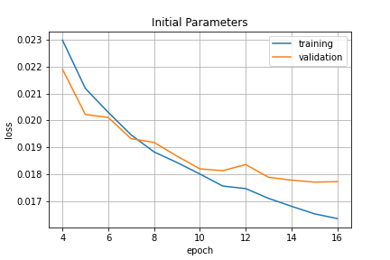
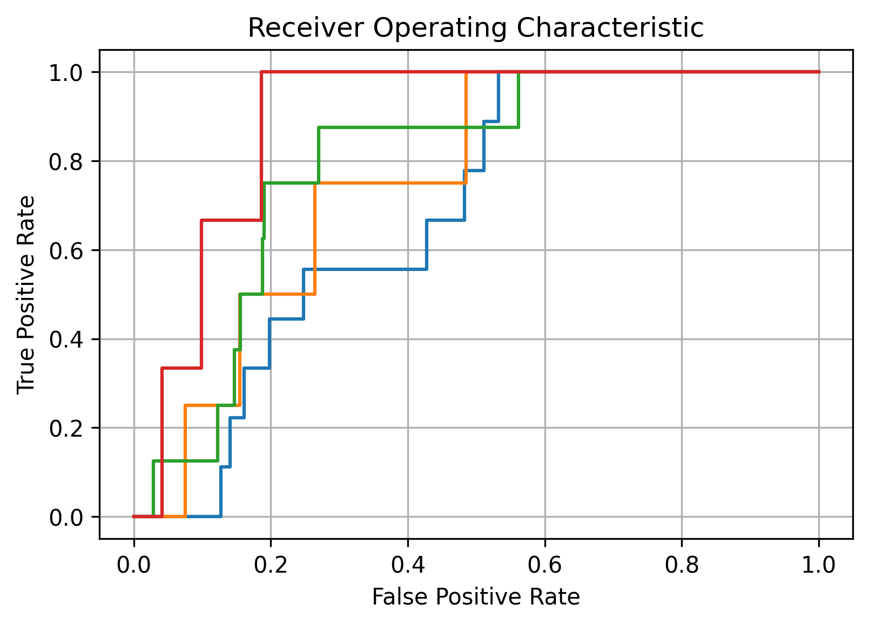
Neural Network Training
Initial Model:
2 hidden layers of 1024 nodes
Batch Normalization and Dropout
Activation
ReLU for hidden layers
Sigmoid for output
Batch size 128
16 epochs
ADAM for stochastic optimization
Score = 0.01973
AUC = 0.65
Notes:
Other hyperparameters – batch size, talk about model complexity bias/variance
Show that very complex model overfits model. Training loss and validation loss. Overfit means validation loss increases. Can increase complexity even higher

Slide 11
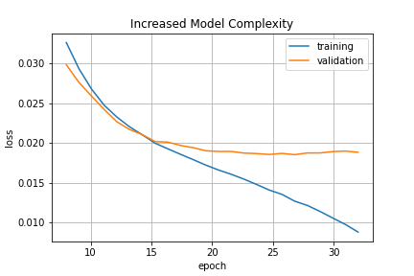
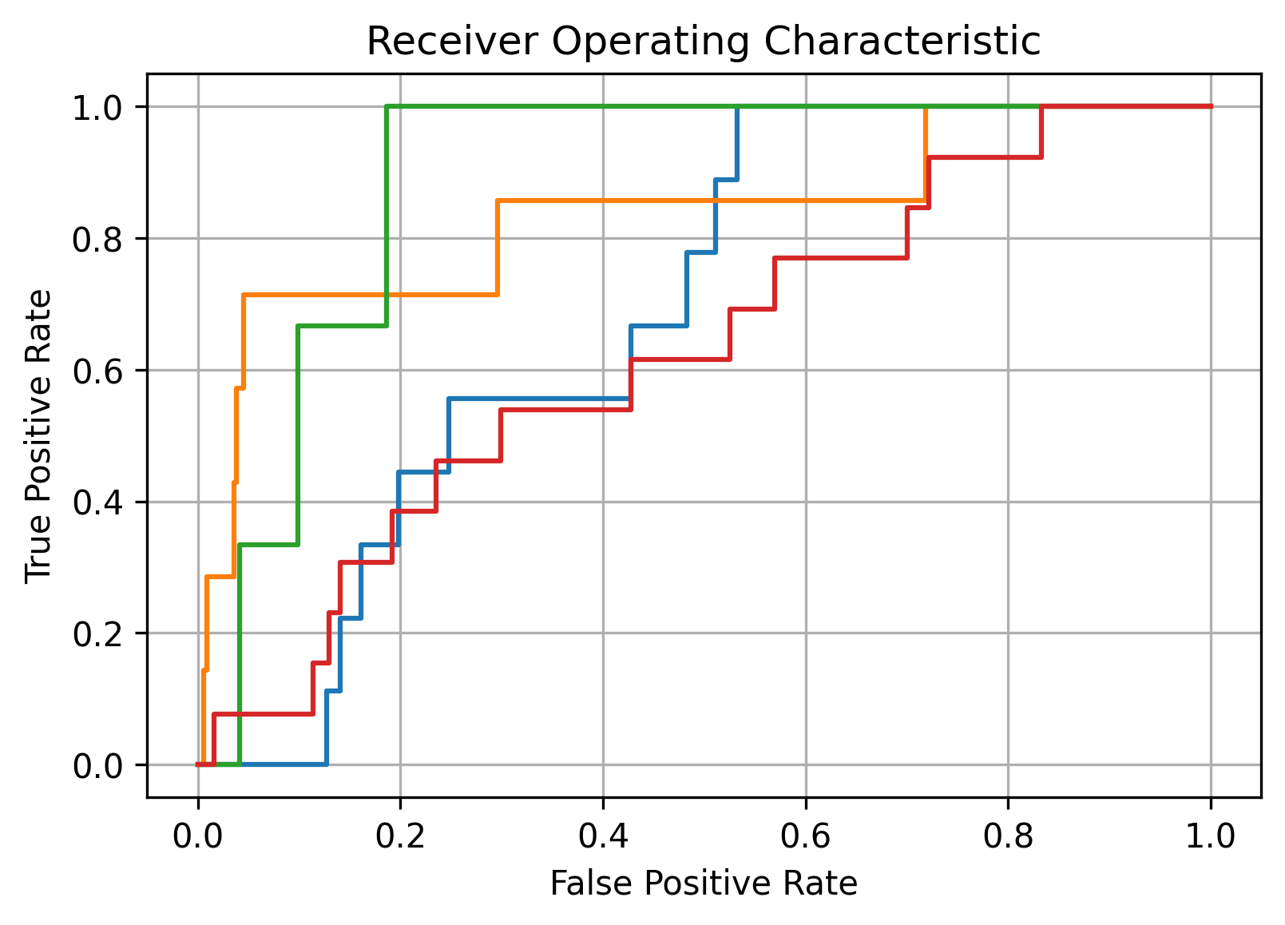
Neural Network Training
Modified Model:
Added hidden layer
Lowered dropout rate
Increased to 32 epochs
Added top 16 principal components as features
Score = 0.02031
AUC = 0.62
Notes:
Other hyperparameters – batch size, talk about model complexity bias/variance
Show that very complex model overfits model. Training loss and validation loss. Overfit means validation loss increases. Can increase complexity even higher

Slide 12
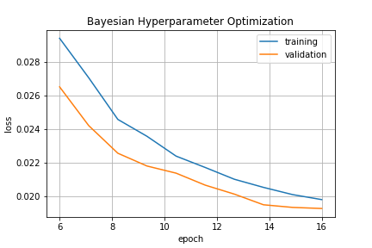
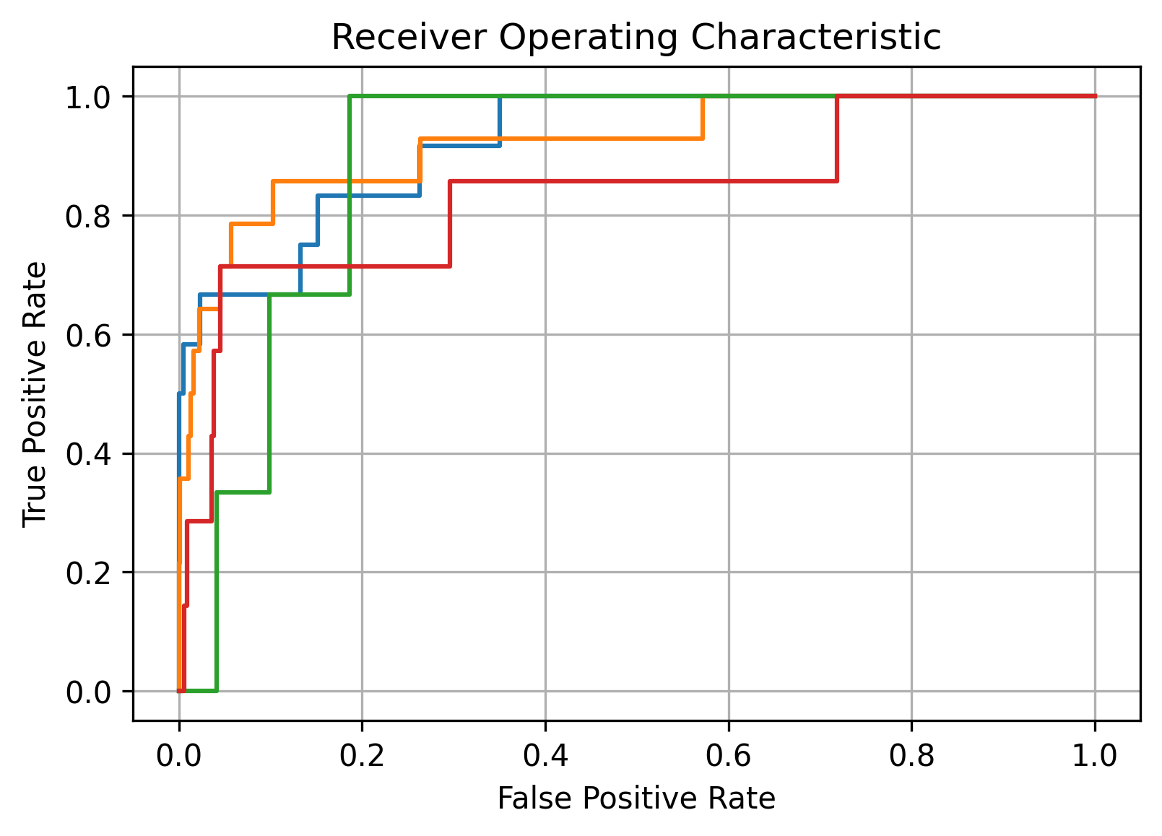
Neural Network Training
Bayesian Hyperparameter Optimization: Gaussian Process models hyperparameter space
Batch size
(Starting) Learning rate
# Epochs
Score = 0.01762
Competition rank:
Highest score = 0.01599
Lowest score = 34.37
Median = 0.01876
AUC = 0.69
Notes:
Other hyperparameters – batch size, talk about model complexity bias/variance
Show that very complex model overfits model. Training loss and validation loss. Overfit means validation loss increases. Can increase complexity even higher

Slide 13
Utility of Project
Having a platform and ML workflow to elucidate such information is of critical importance to drug developers
Offers a new paradigm of drug development
Gilead aims to have 1/3 of revenue from oncology compared <10% currently
Results from this study prove that there already exist numerous candidates of unknown potential Corsello, Steven M., et al. "Discovering the anticancer potential of non-oncology drugs by systematic viability profiling." Nature cancer 1.2 (2020): 235-248.
Offers an effective methodology for extrapolating meaning from drug screens
Notes:
Add reference to papers and use examples

Slide 14
Thank you Any questions?
Notes:
Have to include score
Find other metric
For every observation how many mechanism of actions were predicted

