Slide 1
p

Slide 2
PROBLEMS
Constant threshold
Template matching

Slide 3
PROBLEMS
ISI
Threshold
Cannot isolate from PCA cluster

Slide 4
PROBLEM 1

Slide 5
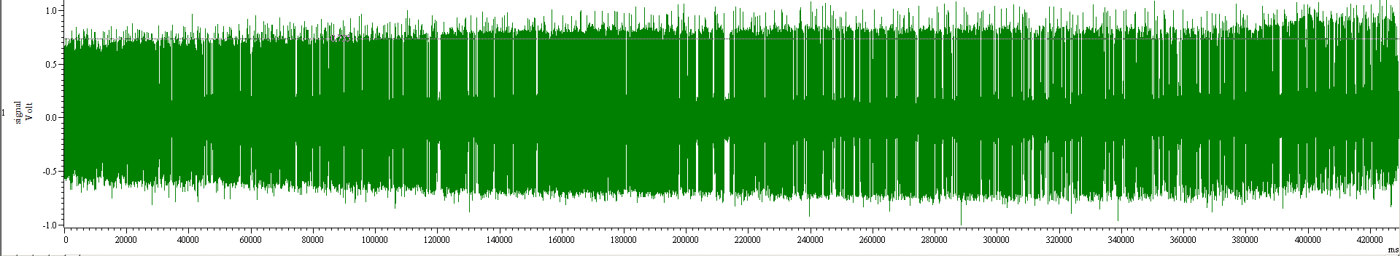
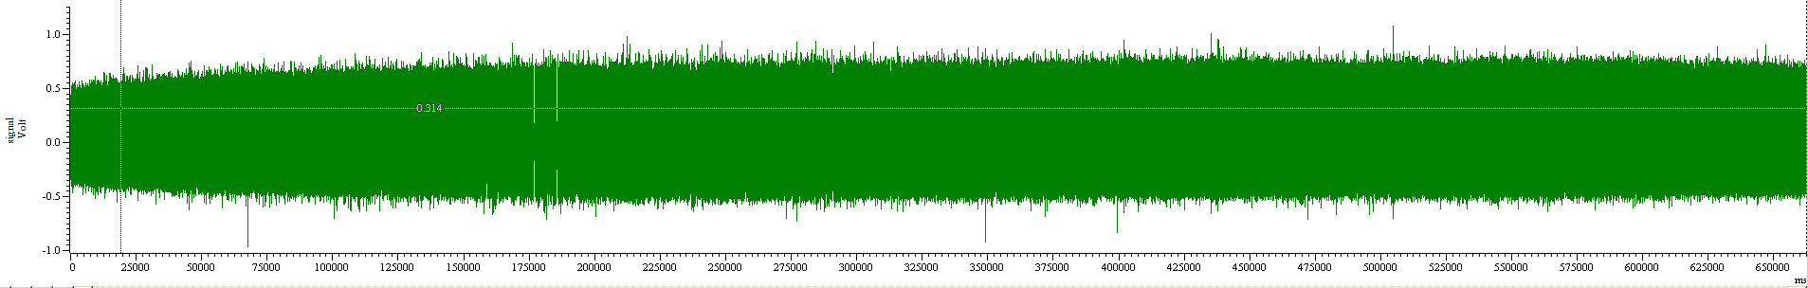

Slide 6
Need to maximize the number of spikes while minimizing the noise.
CALCULUS + INFORMATION THEORY!!!

Slide 7
PROBLEM 2

Slide 8
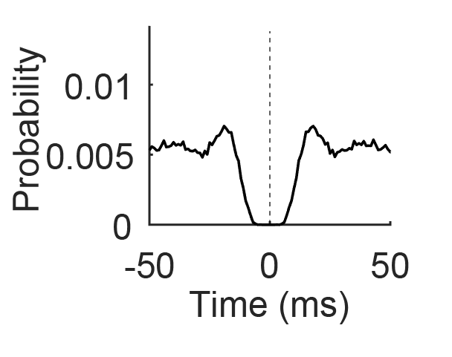
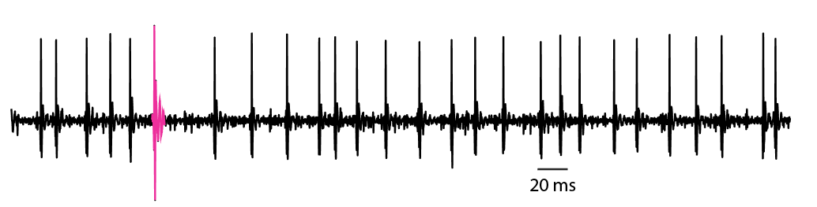
Pr( SS(t) | SS(0) )
Almost symmetrical
BEFORE : Due to refractory period
AFTER : Due to refractory period

Slide 9
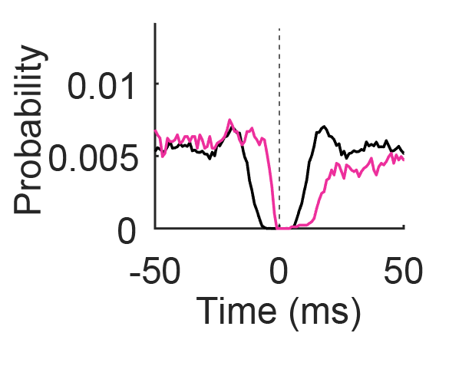
Pr( SS(t) | CS(0) )
Pr( SS(t) | SS(0) )
NOT symmetrical
BEFORE : random event
AFTER : due to to membrane hyperpolarization (refractory period)

Slide 10
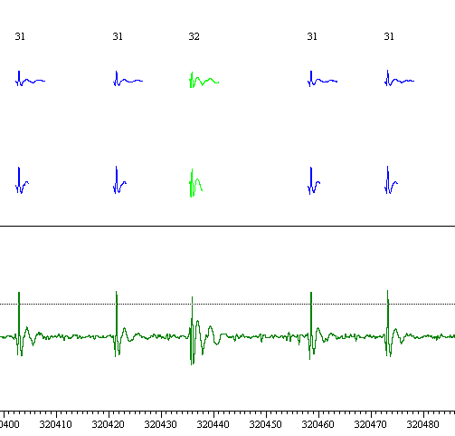
Pr( SS(t) | CS(0) )
Pr( SS(t) | SS(0) )

Slide 11
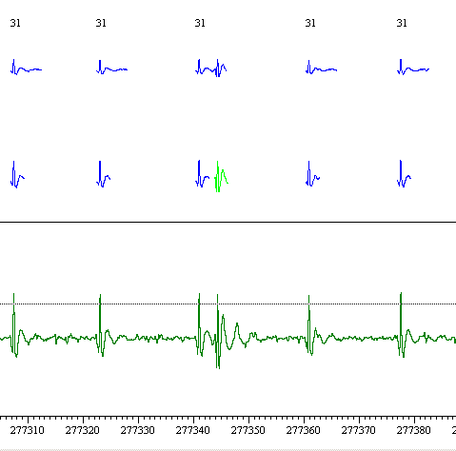
Pr( SS(t) | CS(0) )
Pr( SS(t) | SS(0) )

Slide 12
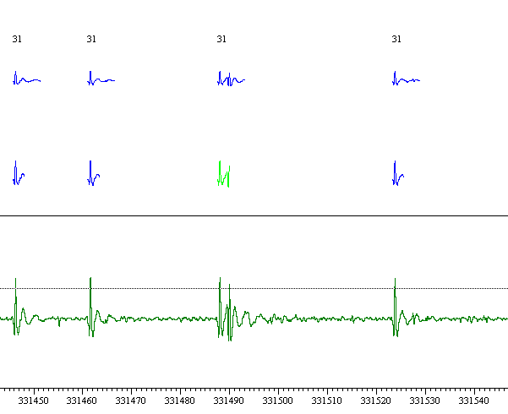
Pr( SS(t) | CS(0) )
Pr( SS(t) | SS(0) )

Slide 13
PROBLEM #1
Simple spikes:
Window size does not matter (no SS 20 ms before, 20 ms after)
BUT, long CS might include succeeding CS
Complex Spikes:
Need long window to isolate spikelets
Long window cannot pick up CS reliably if there is a preceding SS

Slide 14
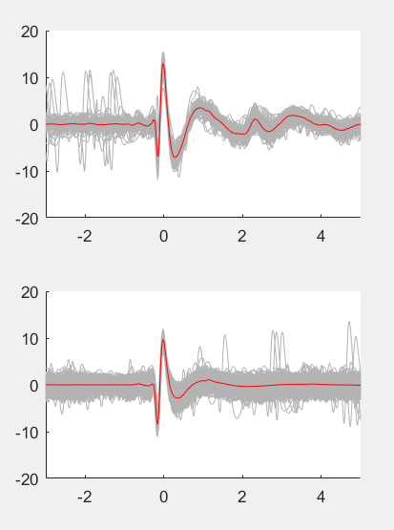

Slide 15
PROBLEM 3

Slide 16
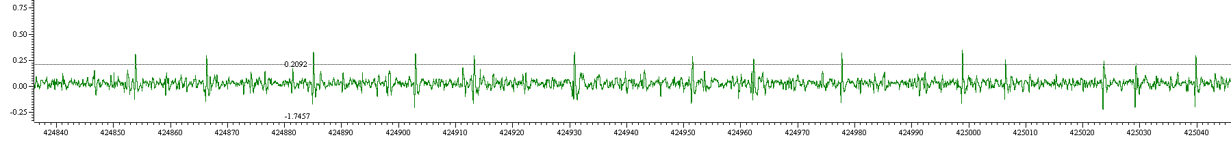
Sl071117_01N

Slide 17
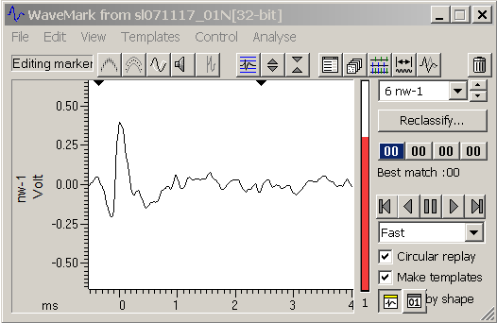
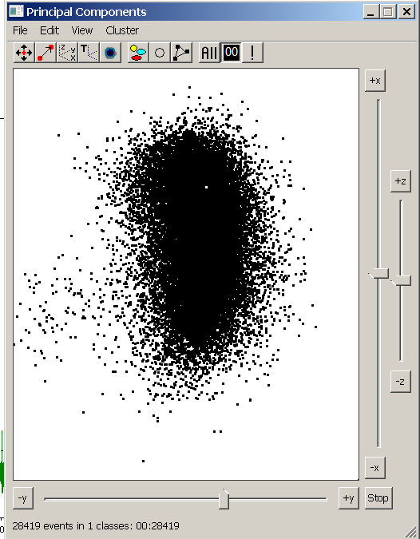
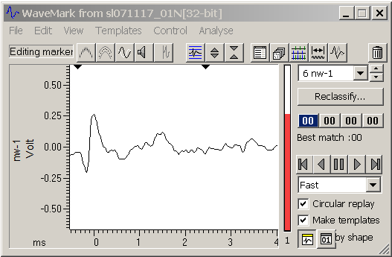
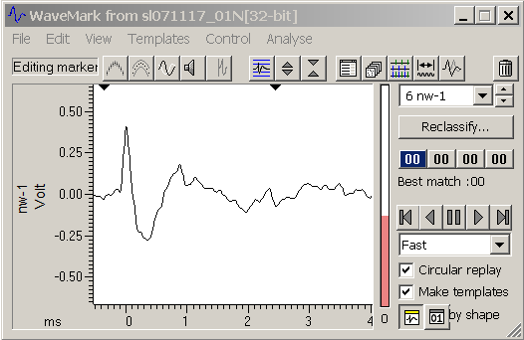

Slide 18
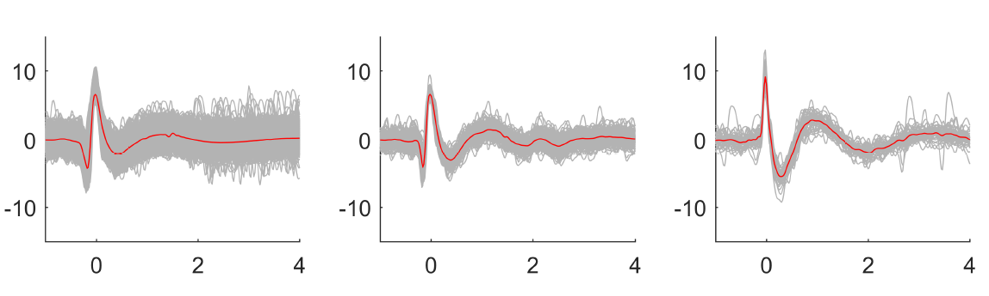
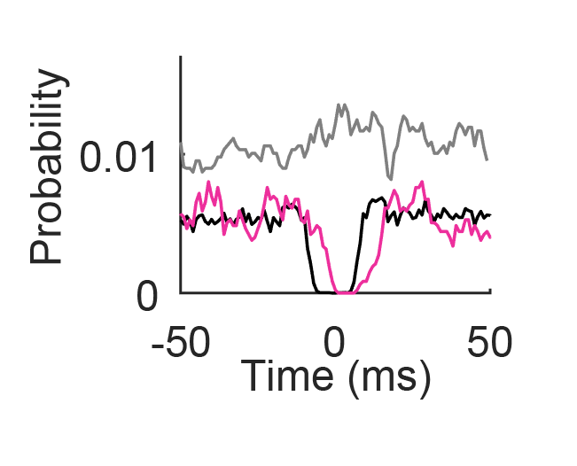

Slide 19
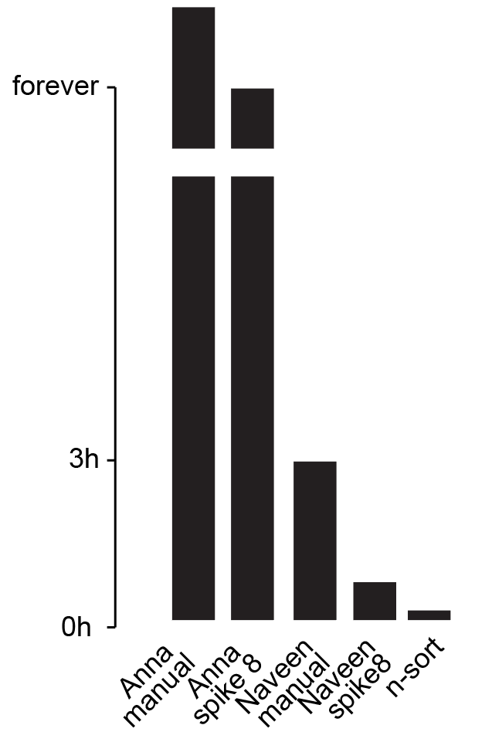

Slide 20
A Supervised-Unsupervised hybrid algorithm

Slide 21
Model comparisons
Random forest
Support machine vectors
Naiive Bayesian
Neural Network with transfer learning

