Slide 1
Cyclistic Bike Share Analysis
How Do Members and Casual Riders Differ?
Prepared by : Naveenkumar K
Google Data Analytics Capstone – May 2026

Slide 2
Business Question: How do annual members and casual riders use Cyclistic bikes differently?
Goal : Identify insights to converts casual riders into annual members

Slide 3
Data Source : Cyclistic Historical Trip Data -12 months of trip data -1,048,575 total rides analyzed -Public dataset by Motivate International Inc. -Variables : ride id ,ride type, start/end time,

Slide 4
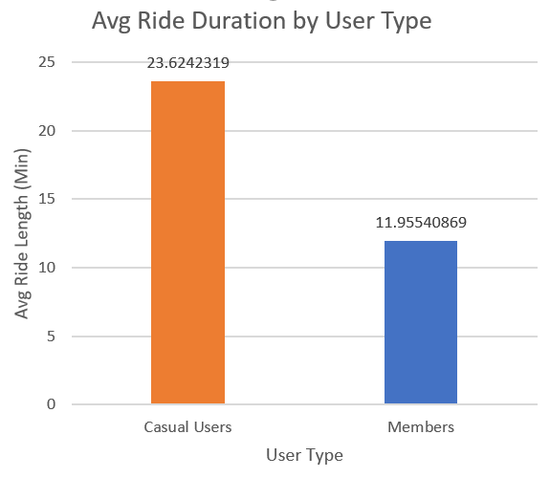
Finding 1:Casual Riders Take Longer Rides
Casual riders average 23.6 minutes per ride
Members average only 12 minutes per ride
Casual riders ride 2x longer than members
Suggests leisure usage vs commuter usage

Slide 5
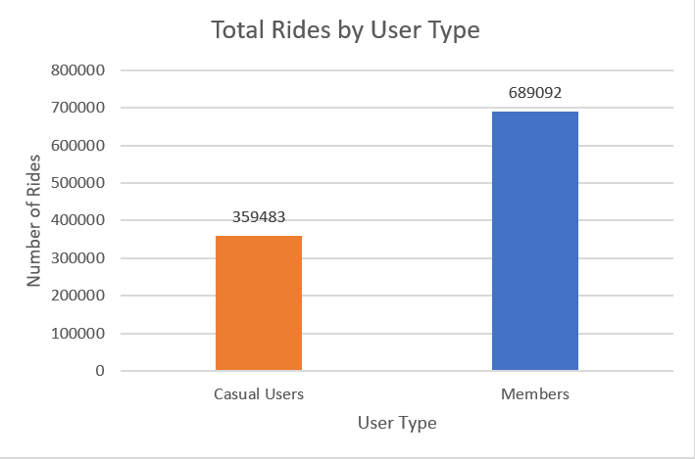
Finding 2: Members Take More Total Rides
Members: 689,092 rides (65.7%)
Casual: 359,483 rides (34.3%)
Members are more frequent and consistent users
→ Annual membership drives higher engagement

Slide 6
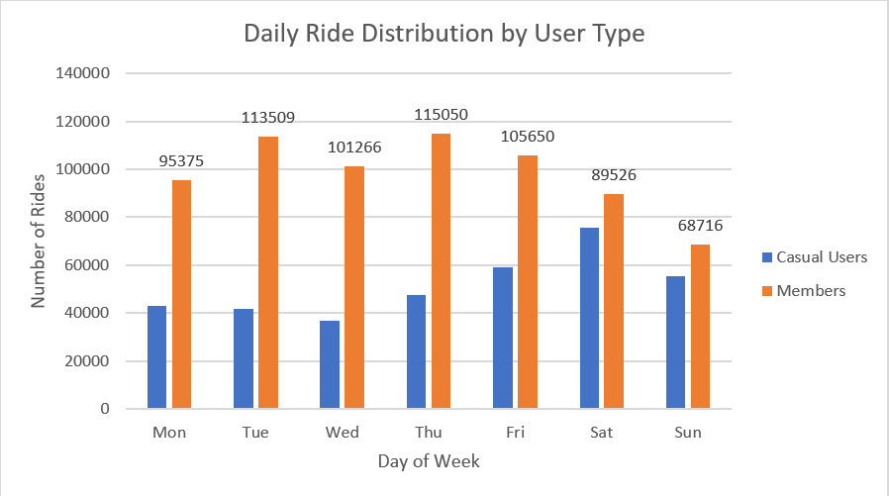
Finding 3: Different Usage Patterns by Day
Members peak Tuesday-Thursday (commuters)
Casual riders peak Saturday-Sunday (leisure) Weekend
casual rides nearly equal members
→ Clear behavioral difference between groups

Slide 7
Recommendation 1:
Weekend Membership Campaign — Target casual
riders on Saturday/Sunday with discounted
annual membership offers at docking stations
Recommendation 2:
Commuter Conversion Campaign — Show casual
riders cost savings of annual membership
vs single ride passes for regular commuters
Recommendation 3:
Digital Media Strategy — Run targeted ads
on Friday evenings and weekends when casual
riders are most active and planning rides

Slide 8
Key Takeaway:
Casual riders and members have distinctly
different usage patterns.
Converting casual weekend leisure riders
into annual members requires targeted
weekend promotions and digital campaigns
highlighting long-term value.
Thank You
Naveenkumar K | Google Data Analytics Certificate

