Slide 1

MATRYOSHKA REPRESENTATION LEARNING FOR MULTIMODAL RECOMMENDATION
EFFICIENT MULTIMODAL SEQUENTIAL RECOMMENDATION WITH FMRLREC
Authors:
Aditya Kusupati
Aniket Rege
Matthew Wallingford
Ali Farhadi
University of Washington, Google Research, Harvard University

Slide 2
STUDENT DETAILS:
NAVEEN INDLURU(700757317)

Slide 3
MOTIVATION:
With the rise of language and vision models, there's a need to integrate multimodal data efficiently into recommendation systems. Current approaches often require multiple training sessions for each configuration, making them resource-intensive and limiting scalability. This paper proposes a solution to address the problem of training once and deploying anywhere with different model sizes.

Slide 4
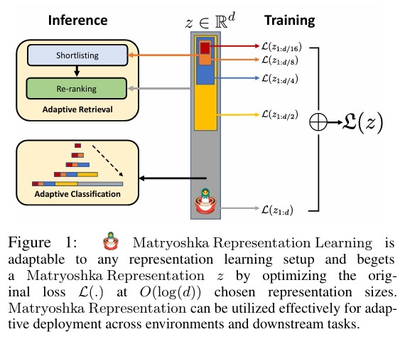

Slide 5
PROBLEM STATEMENT:
Multimodal recommendation systems often require varying model sizes to balance performance and computational cost. Training separate models for each configuration results in high costs and inefficiency. The challenge is to develop a train-once solution that can deploy models of different sizes without additional training.

Slide 6
OBJECTIVE(S):
To create a lightweight multimodal recommendation framework (fMRLRec) that integrates language and vision data and allows for efficient training of models at multiple granularities, reducing memory and computational requirements.

Slide 7
CONTRIBUTIONS:
1. Introduces fMRLRec, a framework that trains models of different sizes in one session.
2. Embeds smaller weights and activations into larger models, reducing memory costs.
3. Outperforms baseline methods in efficiency and performance across multiple benchmark datasets.

Slide 8
METHODOLOGY APPLIED:
Multimodal Sequential Recommendation: Integration of language and image data.
fMRLRec Framework: Embedding smaller models into larger ones to reduce computational costs.
Linear Recurrent Units (LRU): Used for sequential processing, balancing efficiency and accuracy.
Train Once, Deploy Anywhere: A single training session that allows multiple models to be deployed at different granularities.

Slide 9
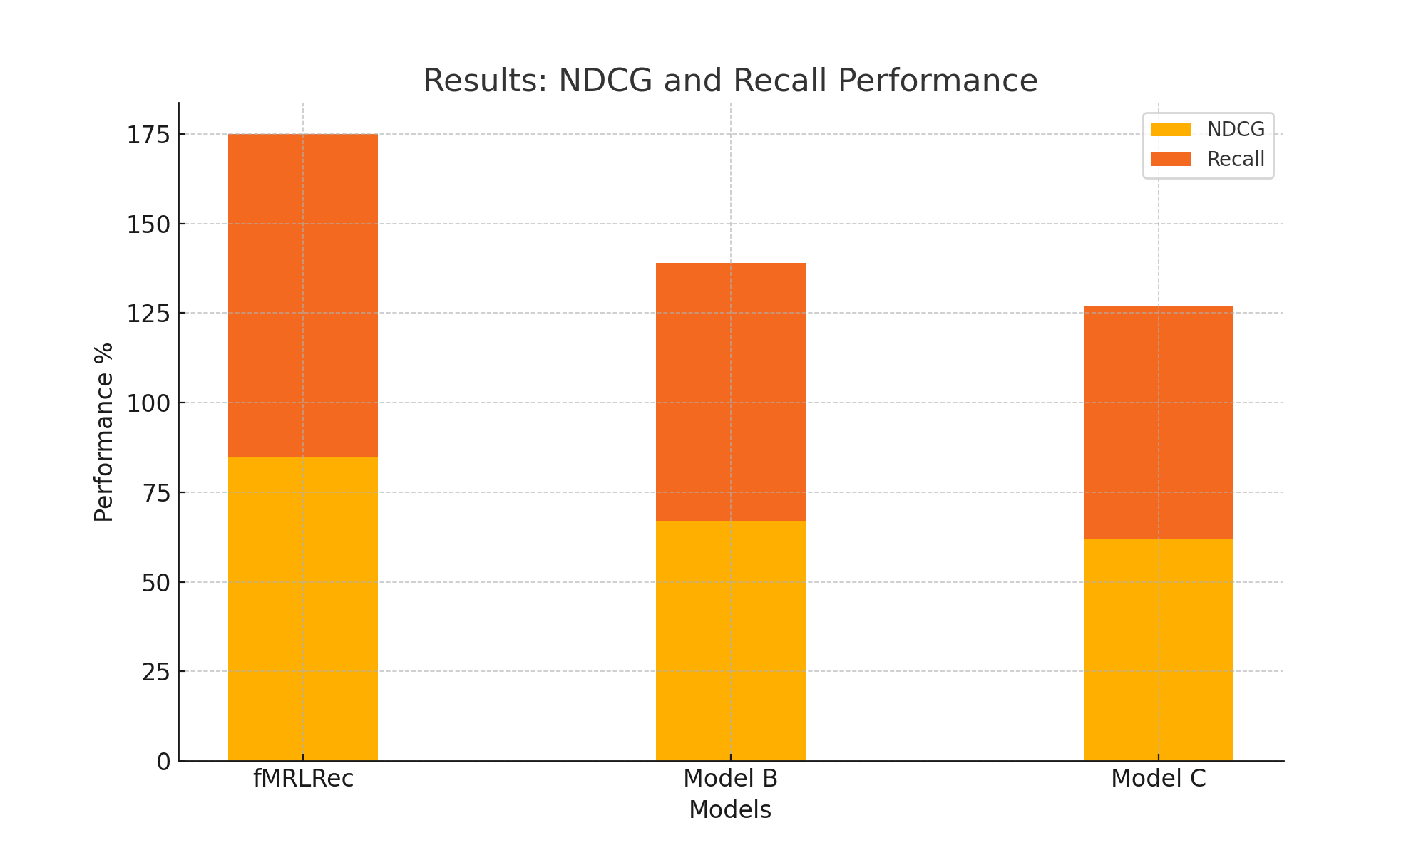
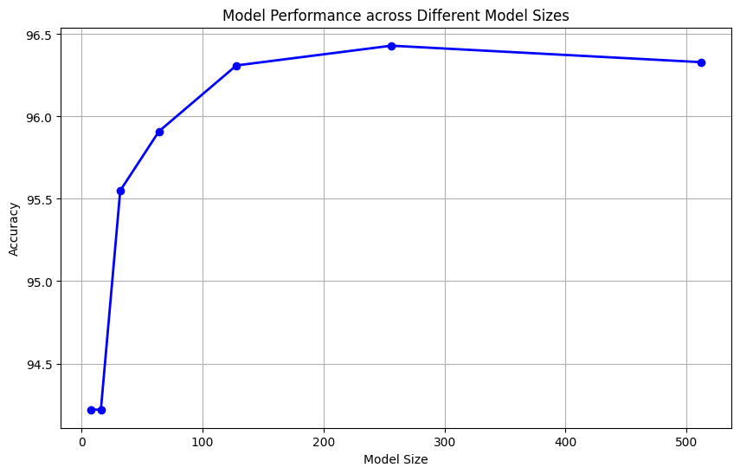
RESULTS:
fMRLRec demonstrated superior performance on several benchmarks, including NDCG and Recall metrics. On average, it outperformed the second-best model by 17.98%, and showed significant gains in sparse datasets. It achieved notable parameter savings while maintaining model performance.

Slide 10

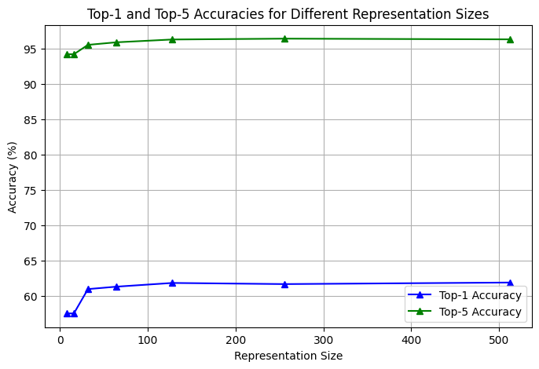
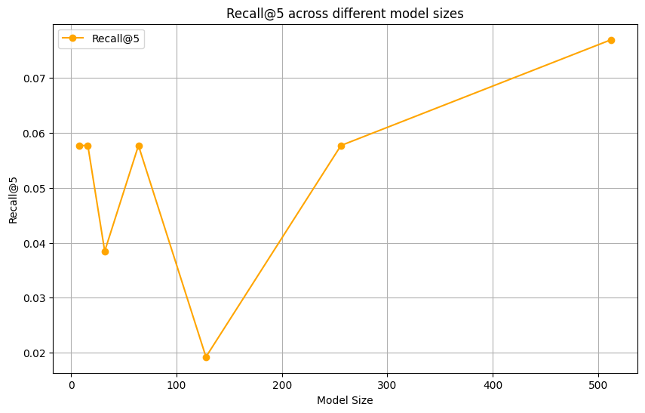
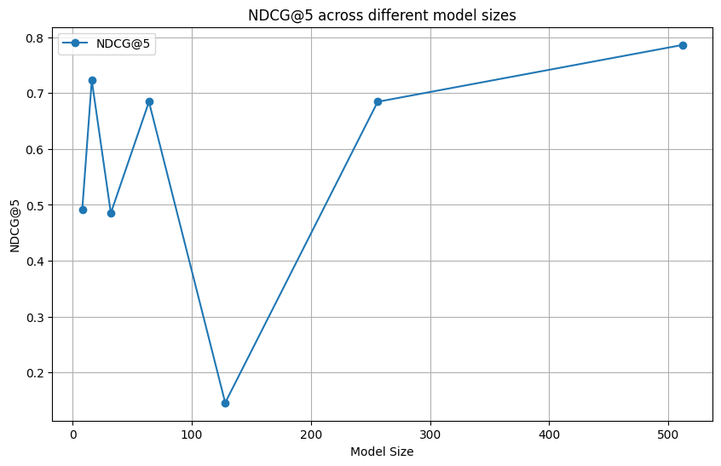

Slide 11
CRITICAL ANALYSIS:
Strengths: Efficient use of memory and computation, adaptable to various model sizes, strong performance.
Weaknesses: Limited to sequential recommendation tasks; future work should explore the scalability of fMRLRec to more diverse tasks, such as handling larger datasets and more complex recommendation scenarios.
Future Work: Future research could explore fMRLRec’s adaptability to more diverse multimodal datasets, such as integrating video data for real-time streaming services. Testing the framework on larger and more complex datasets would also assess its scalability in environments like e-commerce and social media. Additionally, fMRLRec could be applied to new domains like healthcare and finance, where multimodal data is critical. Beyond sequential tasks, the framework could be generalized to other recommendation problems, including collaborative filtering and clustering. Optimizing fMRLRec for on-device deployment would make it practical for real-time mobile and edge computing use cases.

Slide 12
REFERENCES:
[1] Mu Cai, Jianwei Yang, Jianfeng Gao, and Yong Jae Lee. 2024. Matryoshka multimodal models. arXiv preprint arXiv:2405.17430.
[2] Zheng Chen. 2023. Palr: Personalization aware llms for recommendation. arXiv preprint arXiv:2305.07622.
[3] Shijie Geng, Juntao Tan, Shuchang Liu, Zuohui Fu, and Yongfeng Zhang. 2023. Vip5: Towards multi modalfoundation models for recommendation. arXiv preprint arXiv:2305.14302.
[4] Albert Gu and Tri Dao. 2023. Mamba: Linear-time sequence modeling with selective state spaces. arXiv preprint arXiv:2312.00752.
[5] Jialiang Han, Yun Ma, Qiaozhu Mei, and Xuanzhe Liu. 2021. Deeprec: On-device deep learning for privacy preserving sequential recommendation in mobile commerce. In Proceedings of the Web Conference 2021, pages 900–911.

Slide 13
THANK YOU

