Slide 1
Cruise Control System
Naveen Kummar

Slide 2
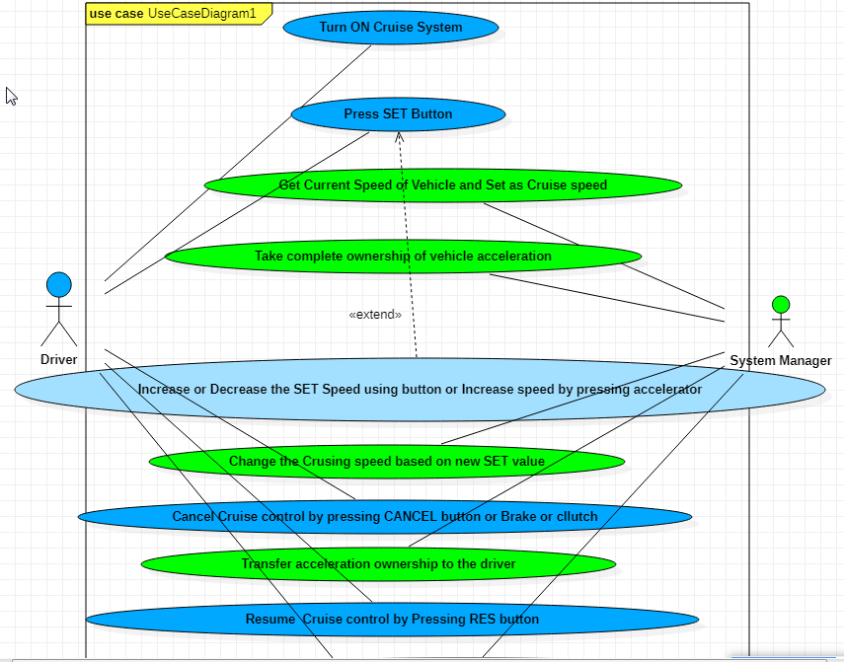
Use Case Diagram

Slide 3
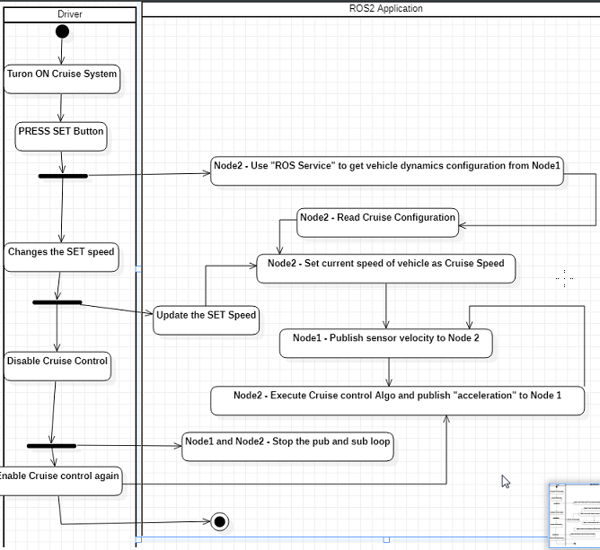
Activity Diagram

Slide 4
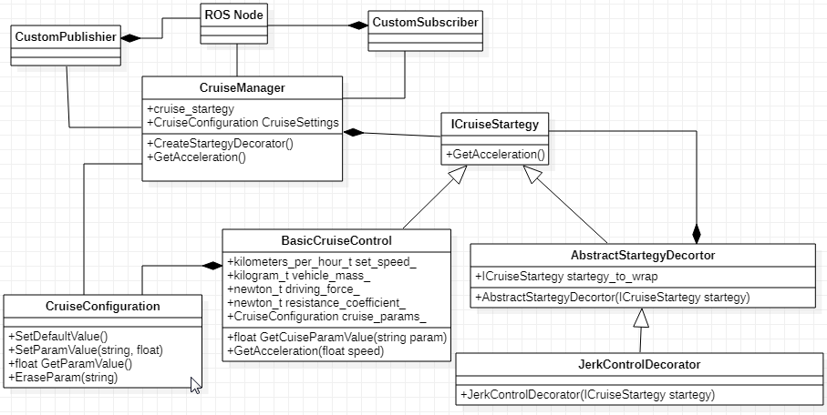
Class Diagram for Cruise Controller Node

Slide 5
What is completed?
Design Documents for Use Case, Activity and Class Diagram
Coding to create two nodes for “Vehicle Node” and “Cruise Node”
Above two nodes will be consumed by “Vehicle Stub” and “Cruise Control” to publish and subscribe in loosely coupled way.
Can create any number of publishers and subscribers with different message type from both nodes as we used Template interface for Ros Publisher and Subscriber
‘Algorithm’ and ‘Cruise Configuration’ are made as library for easy testability and re-use
Gtest done for ‘Algorithm’ and ‘Cruise Configuration’ modules and each have individual CMake.
Used units and literals in for Algorithm module
Added appropriate error handlers

Slide 6
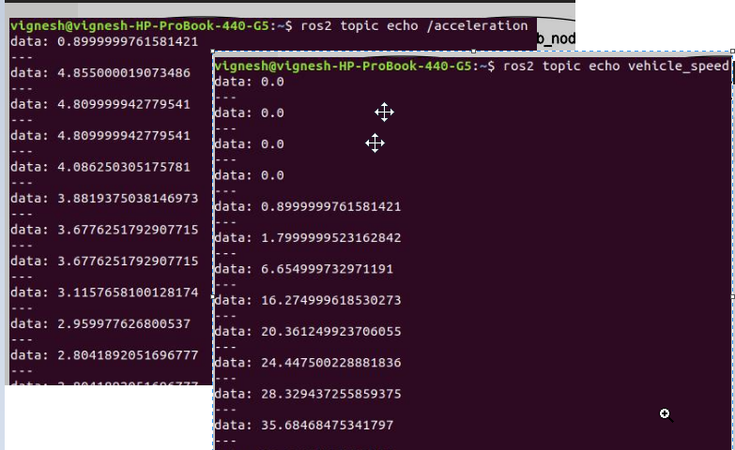
Ros Topic echo of values with existing code

Slide 7
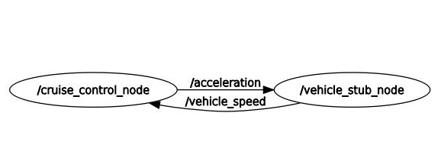
RQT Graph with existing code

Slide 8
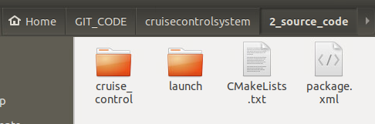
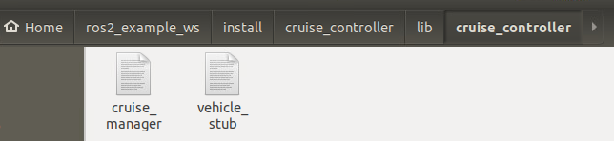
Building package in ROS2 workspace
Clone Git repo https://gitlab.kpit.com/naveenk8/cruisecontrolsystem.git
Copy below directories and files to ‘src’ folder of ROS2 Workspace
Execute the below commands in terminal
source /opt/ros/dashing/setup.bash
colcon build --symlink-install
Execute below deliverables after running “source /opt/ros/dashing/setup.bash” in separate terminal

Slide 9
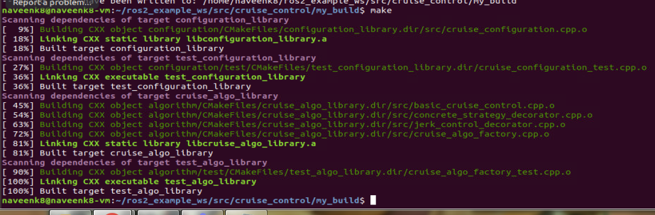
Compilation Algorithm and Configuration Manager as separate library

Slide 10
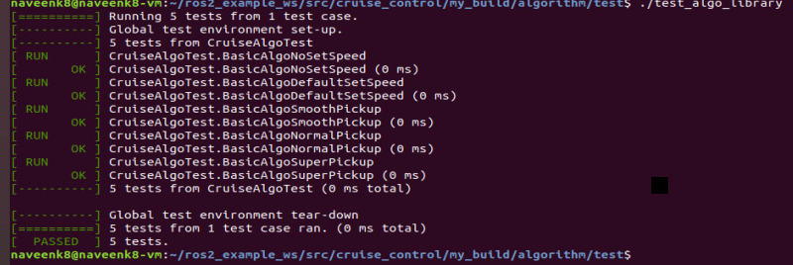
GTest for Algorithm

Slide 11
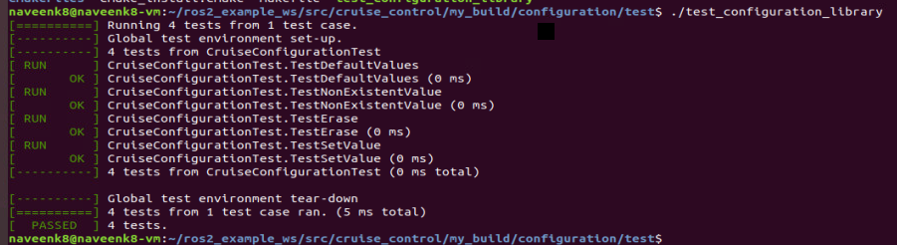
GTest for Cruise Configuration

Slide 12
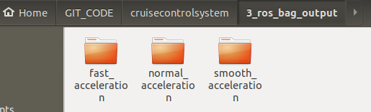
Ros Bag Output
Ros bag output for three type of jerk confioguration smooth, normal and fast available in below paths of git repo.
You can observe increase in speed rate to reach set speed of 80 kmph based on the jerk configuration

Slide 13
Why Docker functionality not completed?
I am using Oracle Virtual Box installed in Windows 10 machine behind KPIT corporate network.
For some unknown reason Docker is not able reach “archive.ubuntu.com/Ubuntu” for ‘apt-get update’ commands though command execute successfully from Host machine.
Because of the above I am not able build Docker image file though able to pull the images
I tried following but still issue not resolved
https://docs.docker.com/engine/install/linux-postinstall/
Stackoverflow article on similar issue
Oracle Virtual Box Network setting guidelines

Slide 14
Thank You

