Slide 1
Fingerprint Sensor Interfacing With Raspberry pi
Batch No: 180513
Team Members
1. Nishant P [18BCN7018]
2. Bharani Nikesh S [18BCN7041]
3. Raviprolu Jishnu Vivaswanth [18BEV7031]
4. Jaswanthi Boppisetty [18BEC7032]
5. Jitendra Prasad K [18BME7039]
6. Ajeeth Paul [18BCD7058]
Guided by
Dr.Ravi Sankar Barpanda
Dept. of CSE

Slide 2
Agenda
Introduction
Raspberry Pi
Abstract
Equipment Identified
Module Identification
Architecture Diagram
Timeline Chart
References

Slide 3
1. Introduction
Raspberry Pi is a credit card sized computer that plugs into your TV and a Keyboard. It is a capable little computer which can be used in electronic projects, and for many of the things that your desktop PC does, like spreadsheets, word processing, browsing the internet, playing games.
It also plays high definition videos.
It is used by adults and kids all over the world to learn programming and digital making.
The official programming language of raspberry pi is python.
Here, in this project we are using raspberry pi with the fingerprint sensor .

Slide 4
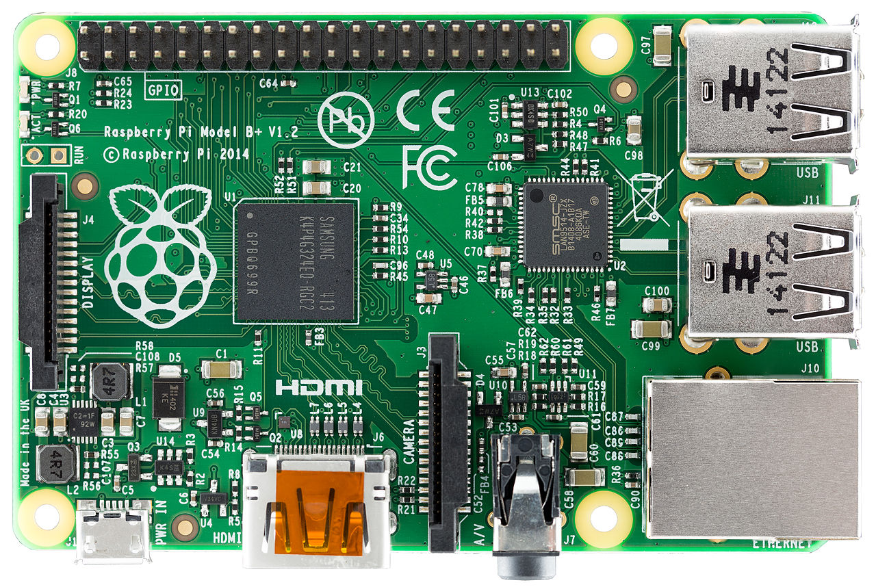
Raspberry Pi

Slide 5
Abstract (Title size24pt)
First point Domain Intro(size 16 pt)
Second Point problem statement

Slide 6
2. Module Identification
Raspberry Pi
USB Serial converter
Robocraze 5 fingerprint module
16x2 lcd display

Slide 7

USB Serial converter
The USB Serial converter is used to interface the fingerprint module with the Raspberry pi

Slide 8
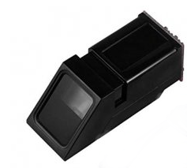
Robocraze 5 Fingerprint Module
The device can communicate with the MCU of 3.3 V or other MCU through the serial port.
The default access voltage of touch-sensitive input power supply is 3.3 V
Semi-duplex asynchronous serial communication is adopted.
The default baud rate is 57600 bps, which can be customized to other baud rates.
After the module is supplied power, about 100mS time is required to initiate the work.

Slide 9
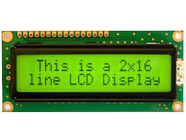
USB Serial converter
LCD (Liquid Crystal Display) screen is an electronic display module and find a wide range of applications.
A 16x2 LCD display is very basic module and is very commonly used in various devices and circuits.
A 16x2 LCD means it can display 16 characters per line and there are 2 such lines.
Here we are using it to know whether the fingerprint kept is correct or not.

Slide 10
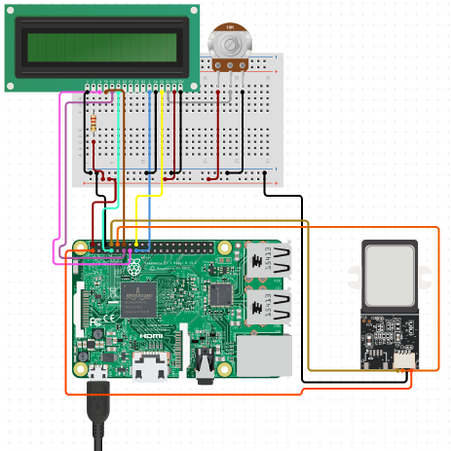
3.Architecture Diagram

Slide 11
4. Equipment Identified
S.No | Name of the Equipment | Quantity
1 | Raspberry Pi | 1
2 | USB to Serial Converter | 1
3 | 16x2 LCD | 1
4 | Fingerprint Module | 1
5 | Female-Female Jumper Wires | 1
6 | Bread board | 1

Slide 12
5.Timeline Chart
Delivery
Testing
Coding – Arduino IDE
Integrating all modules
Hardware Analysis
Collection of Information
Modules | Dec 3rd and 4 th week | First 3 weeks of jan |  | Last week of jan and first week of Feb | First 3 weeks of Feb |  | First week of March | 3rd week of March

Slide 13
6.References
1.https://circuitdigest.com/microcontroller-projects/raspberry-pi-fingerprint-sensor-interfacing
2.https://tutorials-raspberrypi.com/how-to-use-raspberry-pi-fingerprint-sensor-authentication/
3. https://www.circuito.io/app?components=9443,11792,200000,341099

