Slide 1

Mini Project (19AI701) – Review 2
Melanoma Detection Using Machine Learning Techniques
Submitted by:
NAVEEN M (212222110029)
SUDHARASAN RAM (212222110048)
MIGAL G ARUNADANN (212222110025)
2022-2026 Batch
TEAM NO: 152
Under the guidance of:
Dr.S.SELLAKUMAR
  Assistant Professor Department of Mechanical Engineering (SCOFT)
DEPARTMENT OF COMPUTER SCIENCE AND ENGINEERING - IOT
SAVEETHA ENGINEERING COLLEGE
(Autonomous Institution – UGC, Govt. of India)
(Affiliated to Anna University, Approved by AICTE - Accredited by NBA & NAAC – ‘A’ Grade - ISO 9001:2015 Certified)
Saveetha Nagar, Thandalam, Chennai-602 105, TamilNadu, INDIA.

Slide 2
Agenda
Introduction
Statement of the Problem
Scope of the project
Methodology
  Architectural Diagram
  Flow
  Algorithm used
  Design - Use Case Diagram, Class Diagram
  Implementation
  Important code segments
Output, Results
Test Cases
Conclusions
Future work
References

Slide 3
Introduction
Melanoma Prediction
  Melanoma: A type of skin cancer that is often deadly if not detected early.
  Global Impact: Skin cancer, especially melanoma, is increasing due to environmental and genetic factors.
  Early Detection Importance: Using machine learning, early detection can significantly improve survival rates.
  Objective: Develop a machine learning model for accurate and quick melanoma detection using medical image data.

Slide 4
Statement of the Problem
Melanoma Prediction
  Challenge:
  Traditional methods involve manual inspections which can be subjective and time-consuming.
  Delays in Diagnosis:
  Manual inspections delay melanoma treatment.
  Objective:
  Build a machine learning model to detect melanoma accurately from dermatoscopic images.

Slide 5
Scope of the project
Melanoma Prediction
  Scope:
  Focus on using the Flask for the prediction portal.
  Develop a machine learning model to accurately predict melanoma based on images.
  Improve the speed and accuracy of diagnosis.
  Target Audience: Medical professionals, healthcare institutions.
  Deliverables:
  A trained and evaluated machine learning model.
  A user-friendly interface for model deployment.
  Documentation detailing the model's architecture, training process, and performance.

Slide 6
Scope of the project
Melanoma Prediction:
Inclusions:
      Data collection from open medical datasets (e.g., ISIC archive).
      Preprocessing dermatoscopic images.
      Building a classification model using deep learning.
      Target Audience: Dermatologists and healthcare institutions.
      Exclusions:
      Prediction of other types of skin diseases.
      Integration with real-time hospital systems.

Slide 7
Scope of the project
Pneumonia Prediction
  Data:
  Use a publicly available dataset of melanoma images labeled as "pneumonia" or "normal."
  Preprocess the images to enhance quality and consistency.
  Limitations: Data constraints, resource limitations.
  Model Generalizability: The model's performance may vary on unseen data, especially if the distribution differs significantly from the training data.
  Medical Expert Validation: The model's predictions should be validated by medical experts to ensure clinical relevance.
  Computational Resources: The training and deployment of the model may require significant computational resources.

Slide 8
Methodology
Data Collection: Images of skin lesions (melanoma vs non-melanoma).
Data Preprocessing: Techniques like image augmentation, resizing, and normalization.
Model Development: Using Convolutional Neural Networks (CNN) for image classification.
Training and Evaluation: Training the model using labeled data, fine-tuning hyperparameters for accuracy.
Testing and Deployment: Testing model accuracy on unseen data, deploying as a web-based tool.

Slide 9
Methodology
Melanoma Prediction includes
  Collecting the data.
  Choosing a modeling tool.
  Building a strong model.
  Simulating Scenarios.
  Analyzing results.
  Implementing the improvements.

Slide 10
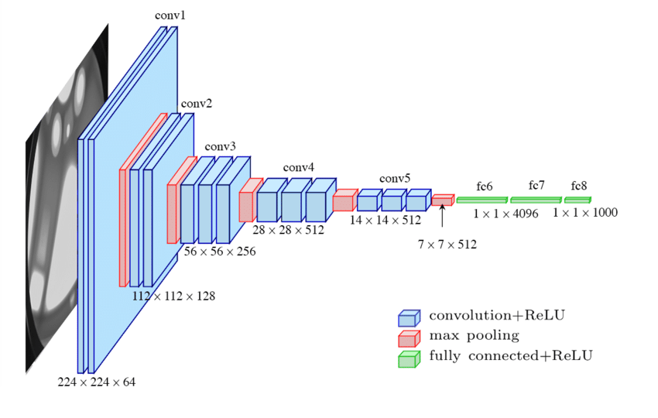
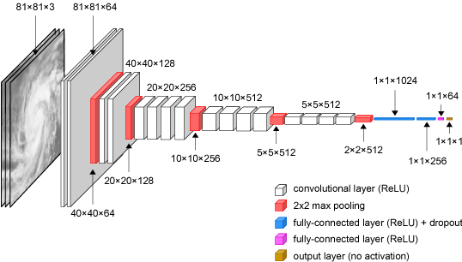
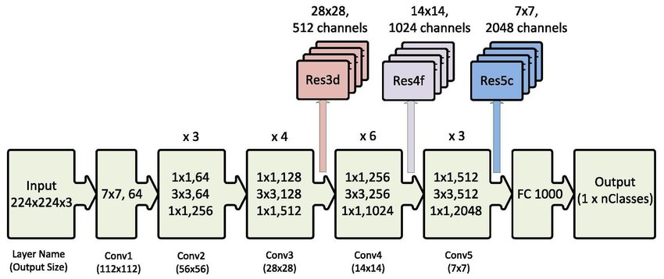
Architecture Diagram/Flow
VGG16
VGG19
Restnet50

Slide 11
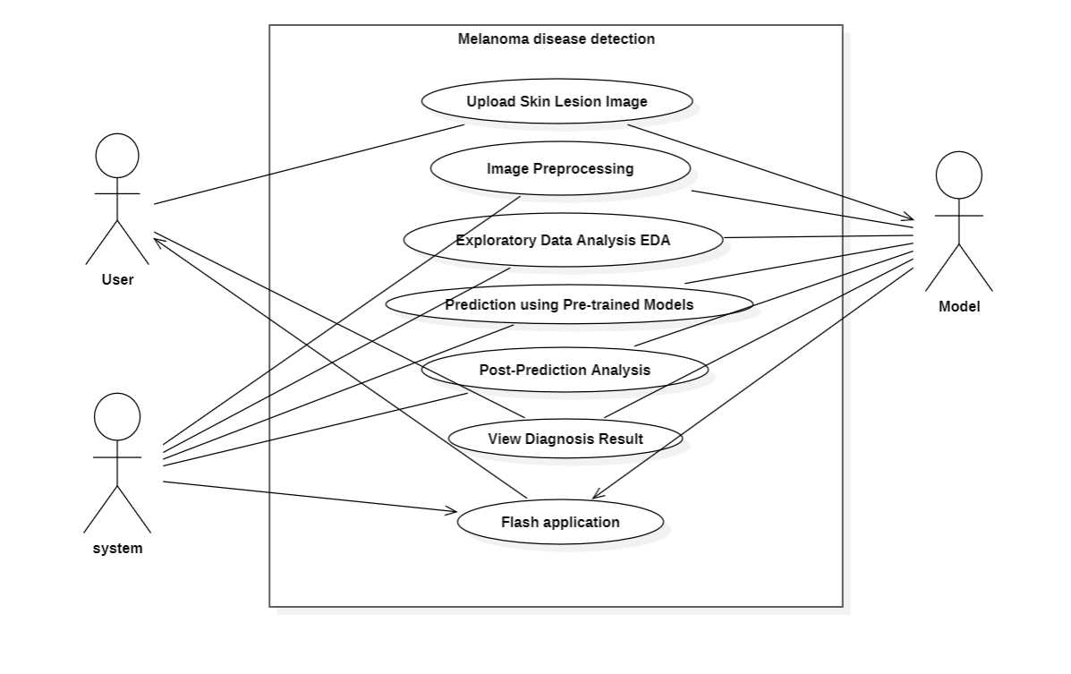
Design-Use Case Diagram

Slide 12
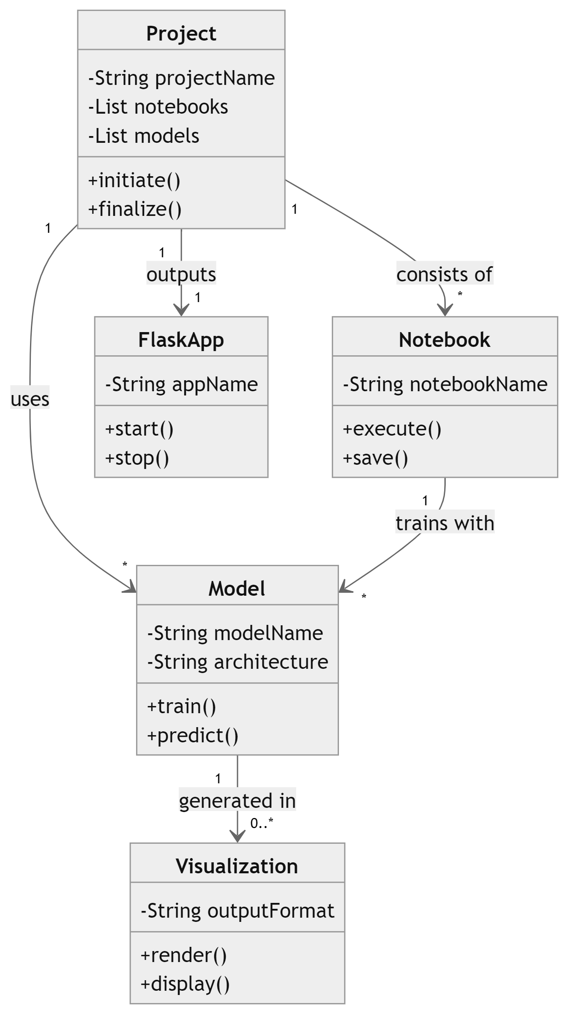
Design-Class Diagram

Slide 13
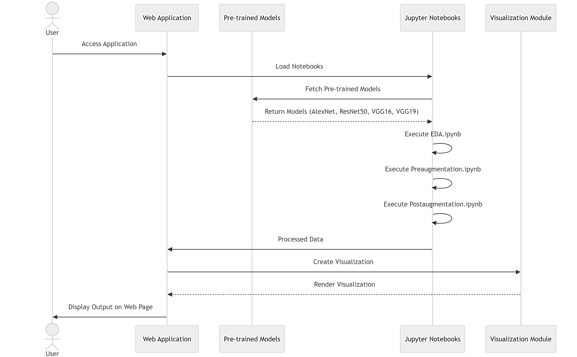
Sequence Diagram

Slide 14
Algorithms used
Algorithm Used:
Convolutional Neural Network (CNN):
Used for images recognition and classification.
Transfer Learning: Pre-trained models like ResNet50, VSS16, and VSS19 used for faster training and higher accuracy.

Slide 15
Implementation
Technologies Used:
  Python: For model development using libraries like TensorFlow, Keras.
  Flask: For building the web interface.
  Database: To store user data and prediction history.

Slide 16
Important Code segments
# import packages for data cleaning and visualization
import numpy as np
import pandas as pd
import matplotlib.pyplot as plt
%matplotlib inline
plt.style.use('seaborn')
import seaborn as sns
# import packages for image processing and management
import pydicom as dicom
from random import randint
import os, sys, time, shutil, scipy, cv2, json, datetime, pydicom
from tqdm.notebook import tqdm
from skimage import io
from glob import glob
import albumentations as A
from PIL import Image
from skimage.color import label2rgb
import random
import warnings
warnings.simplefilter("ignore")
# import packages for modeling
import tensorflow as tf
from tensorflow.keras import models, layers, regularizers, optimizers, Sequential, Model
from tensorflow.keras.models import load_model
from tensorflow.keras.layers import Dense, Activation, Flatten, Dropout, BatchNormalization, Conv2D, MaxPooling2D
from tensorflow.keras.preprocessing.image import ImageDataGenerator
from tensorflow.keras.optimizers import Adam
from tensorflow.keras.callbacks import ModelCheckpoint, EarlyStopping, ReduceLROnPlateau
from tensorflow.keras.applications.vgg16 import VGG16
from sklearn.model_selection import train_test_split
# import functions from utils.py
%reload_ext autoreload
%autoreload 2
from utils import *

Slide 17
Important Code segments
# create visualization for target variable distribution
def barplot(df, xlabel, ylabel, title):
plt.figure(figsize = (7,5))
ax = sns.countplot(x = xlabel, data = df)
plt.title(title, fontsize = 16)
plt.xlabel(xlabel, fontsize = 16)
plt.ylabel(ylabel, fontsize = 16)
total = len(df.target)
for p in ax.patches:
percentage = '{:.1f}%'.format(100 * p.get_height()/total)
x = p.get_x() + p.get_width() / 2 - 0.05
y = p.get_y() + p.get_height()
ax.annotate(percentage, (x, y), size = 16)
plt.show()
barplot(train20, 'target', 'count', 'Distribution of Target Variable’)
# display difference in gender distribution of melanoma vs. non-melanoma patients
def twoplot(data1, data2, xlabel, ylabel, title1, title2):
plt.style.use('ggplot')
f, (ax1, ax2) = plt.subplots(1, 2, figsize=(12, 4))
a = sns.countplot(x=xlabel, data=data1, ax=ax1)
b = sns.countplot(x=xlabel, data=data2, ax=ax2)
ax1.set_title(title1, fontsize=16)
ax2.set_title(title2, fontsize=16)
ax1.set_xlabel(xlabel, size=16)
ax1.set_ylabel(ylabel, size=16)
ax2.set_xlabel(xlabel, size=16)
ax2.set_ylabel(ylabel, size=16)
twoplot(train[train.target == 0], train[train.target == 1], 'gender', 'count', "Gender Distribution of Non-Melanoma Patients", "Gender Distribution of Melanoma Patients")

Slide 18
Important Code segments
# display distribution of age for non-melanoma vs. melanoma patients
f, (ax1, ax2) = plt.subplots(1, 2, figsize=(12, 4))
sns.histplot(x='age', data=train[train.target == 0], kde=True, color='dodgerblue', ax=ax1)
sns.histplot(x='age', data=train[train.target == 1], kde=True, color='tomato', ax=ax2)
ax1.set_title("Age Distribution of Non-Melanoma Patients", fontsize=16)
ax2.set_title("Age Distribution of Melanoma Patients", fontsize=16)
ax1.set_xlabel('Age', size=16)
ax1.set_ylabel('Count', size=16)
ax2.set_xlabel('Age', size=16)
ax2.set_ylabel('Count', size=16)
# display distribution of age between training and testing datasets
test.age = test[~test.age.isna()].age.astype(int)
f, (ax1, ax2) = plt.subplots(1, 2, figsize=(12, 4))
sns.histplot(x='age', data=train, kde=True, color='dodgerblue', ax=ax1)
sns.histplot(x='age', data=test[~test.age.isna()], kde=True, color='tomato', ax=ax2)
ax1.set_title("Age Distribution of Training Set", fontsize=16)
ax2.set_title("Age Distribution of Testing Set", fontsize=16)

Slide 19
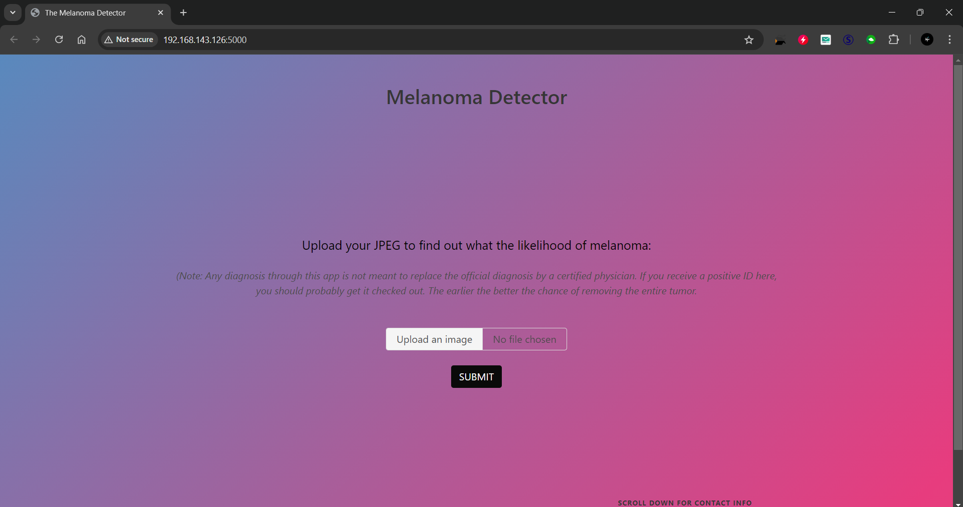
Output
OUTPUT:
After localhost number in browser the home page looks like :

Slide 20
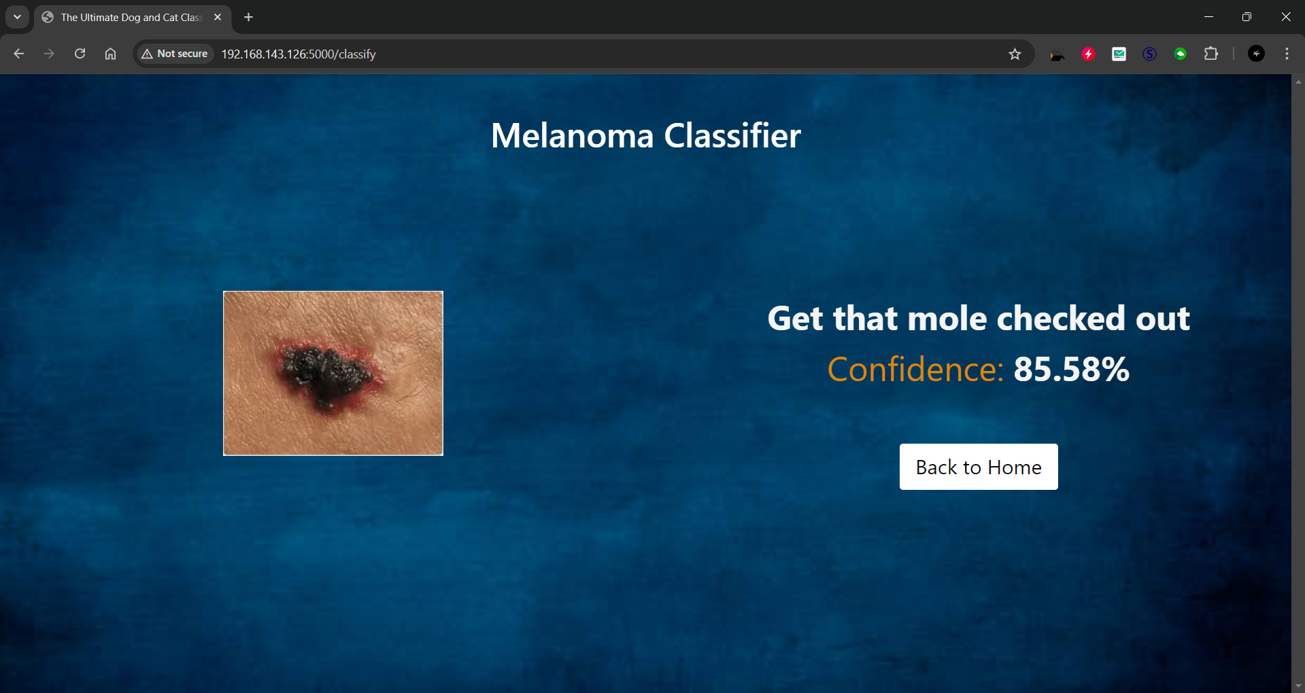
Output
OUTPUT:
After browsing for our website, the following page will be shown first. The user needs to upload the image of the skin which is affected by disease.

Slide 21
Test Cases
Test Cases
S.NO | Action | Input | Expected output | Actual output | Test Result
1 | Test Case 1: Enter the localhost number in the browser | Input: Home page is displayed in the browser | Home page loaded successfully | Displaying the home page | Result: Pass
2 | Test Case 2: Upload image | Input: Image of the skin (the part of the disease) | Expected Output: Successfully uploaded the image | Actual Output: Image Uploaded | Result: Pass
3 | Test Case 3: Submit | Input: model.d5 | Expected Output: Image is uploaded successfully, and process the image to identify the disease | Actual Output: Process the image form the trained dataset | Result: Pass
4 | Test Case 4: Prediction Result Display | Input: Uploaded skin image. | Expected Output: Model processes the image, and the prediction result is displayed on the user’s dashboard. | Actual Output: Result is displayed after prediction. | Result: Pass

Slide 22
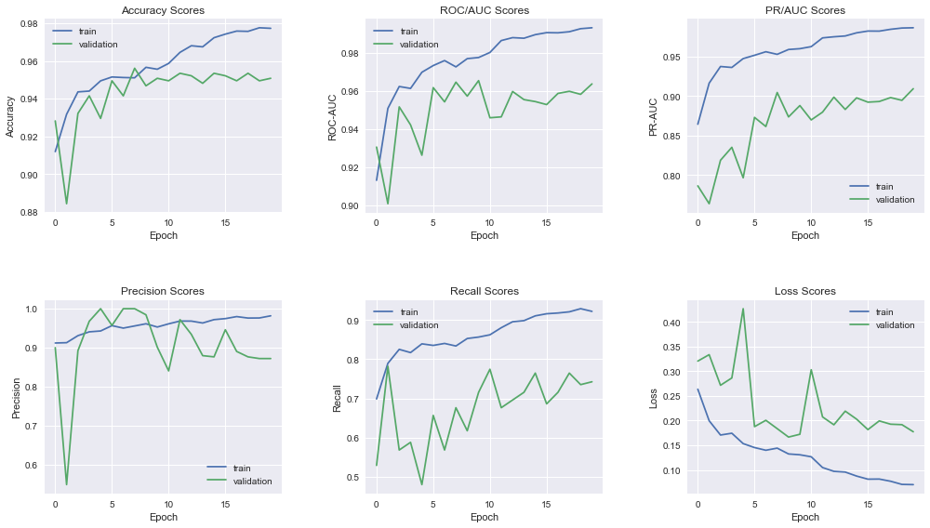
Results
Machine learning

Slide 23
SDG Goal Mapping
Our project focuses on leveraging machine learning and Flask to detect melanoma, a severe skin cancer. This initiative aligns with key Sustainable Development Goals (SDGs) to promote good health, innovation, and sustainable development.
Requirement: Early detection of melanoma to save lives and improve health outcomes.
Scope: Using AI-powered tools to identify melanoma accurately and promote early diagnosis.
Impact: Reducing mortality rates and enabling timely interventions in skin cancer cases.

Slide 24
Conclusion
Melanoma detection using machine learning, especially Convolutional Neural Networks (CNNs), shows great promise for improving diagnostic accuracy and efficiency. By incorporating transfer learning and data augmentation, the project can address challenges like data imbalance and small datasets. Ensemble learning further boosts performance by combining multiple algorithms. The development of a real-time detection app will make early melanoma screening more accessible and efficient. This project has the potential to enhance patient outcomes, reduce healthcare costs, and provide a scalable solution for early skin cancer detection.

Slide 25
Future Work
Incorporate multi-class classification for detecting various skin diseases.
Develop a mobile application to reach more users.
Collaborate with healthcare providers for real-world testing.

Slide 26
References
https://en.wikipedia.org/wiki/Melanoma
https://iopscience.iop.org/article/10.1088/1757-899X/1065/1/012039
https://www.ncbi.nlm.nih.gov/pmc/articles/PMC9777935/
Book Reference:
"Deep Learning for Medical Image Analysis"Authors: Geert Litjens, Thijs Kooi, Babak Bejnordi, et al.
"Skin Cancer: Recognition and Management"Authors: Steven Q. Wang

Slide 27

Questions

Slide 28


