Slide 1

Projectworkphase1(19AI702) – Review2
Smart Dam Monitoring System using IoT, Machine Learning, and Computer Vision
Submitted by:
Naveen M (212222110029)
2022-2026 Batch
TEAM NO:
Under the guidance of:
Dr. S.Sellakumar
Assistant Professor Department of Mechanical Engineering (SCOFT)
DEPARTMENT OF COMPUTER SCIENCE AND ENGINEERING(IOT)
SAVEETHA ENGINEERING COLLEGE
(Autonomous Institution – UGC, Govt. of India)
(Affiliated to Anna University, Approved by AICTE - Accredited by NBA & NAAC – ‘A’ Grade - ISO 9001:2015 Certified)
Saveetha Nagar, Thandalam, Chennai-602 105, TamilNadu, INDIA.

Slide 2
Agenda
Introduction
Statement of the Problem
  Absence of a smart, automated, and connected system
Scope of the project
Methodology
  Architectural Diagram
  Flow
  Algorithm used
  Design - Use Case Diagram, Class Diagram
  Implementation
  Important code segments
Output, Results
Test Cases
Conclusions
Future work
References

Slide 3
Introduction
Project Overview: The system is an intelligent and automated solution to enhance dam safety, operational efficiency, and public awareness.
It integrates Internet of Things (IoT), Machine Learning (ML), and Computer Vision (CV).
The Problem: Traditional dam management relies on manual monitoring and periodic inspections, leading to a reactive approach and a significant delay between a critical event and human response.
The Goal: To transform the conventional dam into a smart, predictive, and responsive infrastructure capable of real-time monitoring and early risk detection.

Slide 4
Statement of the Problem
Lag in Response: The reactive, manual approach creates a significant lag between data collection and actionable decisions, making the system vulnerable to sudden environmental changes.
Fragmentation: Solutions are often siloed, focusing only on water level or crack detection, but not a unified operational picture.
Critical Safety Gap: There is no proper automated mechanism to detect the presence of humans or animals in the downstream riverbed before water release, which is prone to human error.
Objective: Develop an intelligent, sensor-based, automated solution with predictive capabilities and integrated safety checks for real-time, reliable, and safe dam management.

Slide 5
Scope of the project
Smart Dam Monitoring System
Scope:
Focus on designing and implementing a low-cost prototype using the ESP32 microcontroller.
Develop an integrated system combining IoT sensing, an ML prediction model, and a CV safety module.
Ensure the system provides real-time monitoring and early warning alerts to prevent large-scale disasters.
Target Audience: Dam operators/authorities and the general public.
Deliverables:
A functional hardware prototype of the Smart Dam Monitoring System.
A trained and validated ML rainfall prediction model (with accuracy >= 85%)

Slide 6
Scope of the project
Inclusions (End-to-End Functionality):
Multi-Sensor Integration: Water level (Ultrasonic), Temperature/Humidity (DHT11), Vibration, and Location (GPS).
Predictive Model: Locally trained ML model to predict the likelihood of rainfall.
Safety System: Computer Vision to automatically detect humans or animals in the hazardous river path.
Control & Alerts: Automate critical operations like controlling a valve (servo motor) and providing immediate local alerts (buzzer) and remote warnings.
Dashboard: Web-based interface for data visualization and transparency.
Platform: Uses ESP32 as the core microcontroller and Firebase for cloud data management.

Slide 7
Scope of the project
Smart Dam Monitoring System
  Data:
  Real-time Sensor Data: The system will collect continuous, real-time data from the Ultrasonic sensor (water level), DHT11 sensor (temperature/humidity), and Vibration sensor (structural stability).
  Video/Image Streams: Capture video frames or images from cameras positioned along the river path for Computer Vision analysis.
  Limitations: Resource constraints of the low-cost hardware, and the high environmental sensitivity of the Computer Vision component.
  Model Generalizability: The ML model's performance may vary significantly if the real-world environmental conditions diverge greatly from the training dataset, necessitating potential calibration.
  Environmental Sensitivity (CV): The performance of the Computer Vision system is highly dependent on factors like variable lighting, shadows, fog, and heavy rain, which can impact detection accuracy.
  Structural Monitoring: The use of only a basic vibration sensor provides an initial indicator but does not offer the subtle, internal deviation detection capabilities of expensive geotechnical sensors (like piezometers)

Slide 8
Methodology
Sensing & Edge Processing: The ESP32 collects data from the Ultrasonic, DHT11, Vibration, and GPS sensors.
IoT Gateway: ESP32 transmits this data to the Firebase Realtime Database.
ML Engine: A Flask-based ML engine retrieves T and H data, runs the rainfall prediction model, and sends the result back to Firebase.
Computer Vision: Camera video frames are processed using an Object Detection Model (YOLO/TensorFlow Lite) to detect human or animal presence, sending an alert via Firebase.
Actuation & Alerts: The ESP32 triggers the Buzzer (local alert) and Servo Motor (simulating a valve/gate) based on water level and vibration or safety alerts.

Slide 9
Methodology
Data Collection and Sensing includes:
Deploying the ESP32 as the core edge controller.
Interfacing and configuring the multi-sensor suite (Ultrasonic, DHT11, Vibration, GPS).
Capturing real-time readings for water level, temperature, humidity, and structural vibration.
Transmitting the raw sensor data to the Firebase Realtime Database via Wi-Fi.
Positioning cameras along the downstream river path for Computer Vision analysis.
Data Processing and Intelligence includes:
Retrieving live temperature and humidity data from Firebase using the Flask-based ML Engine.
Running the pre-trained rainfall prediction model and writing the prediction status back to Firebase.
Processing streamed video frames using a lightweight Object Detection model (YOLO) to detect human/animal presence.
Implementing logic for automatic gate control based on critical water levels.
Developing the comprehensive Web Dashboard to visualize all sensor values, predictions, and alerts in real-time.

Slide 10
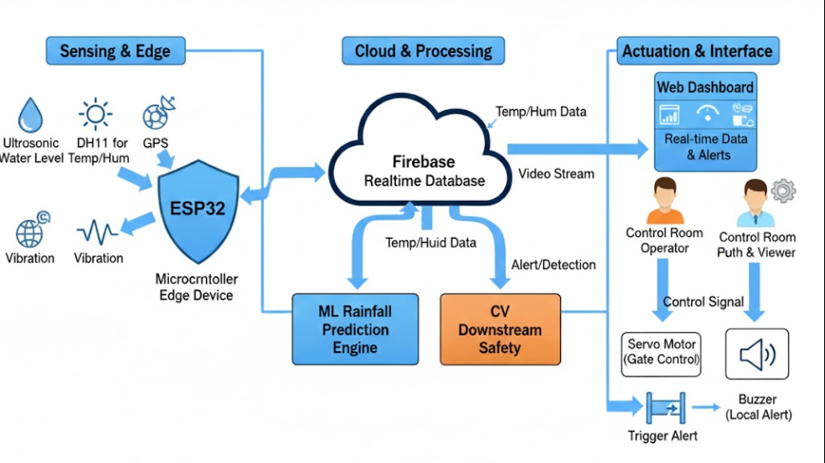
Architecture Diagram/Flow

Slide 11
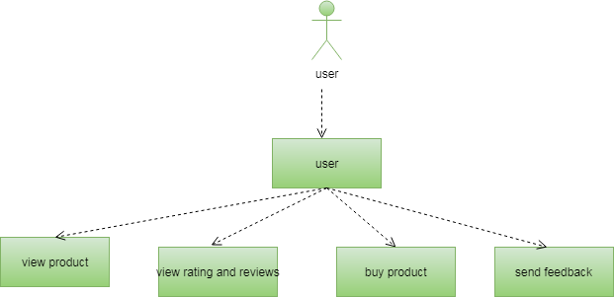
Design-Use Case Diagram
UML DIAGRAMS
Use case Diagram:A use case diagram is a graph of actors set of use cases enclosed by a system boundary, communication associations between the actors and users and generalization among use cases.
The use case model defines the outside (actors) and inside (use case) of the system’s behavior.
USER

Slide 12
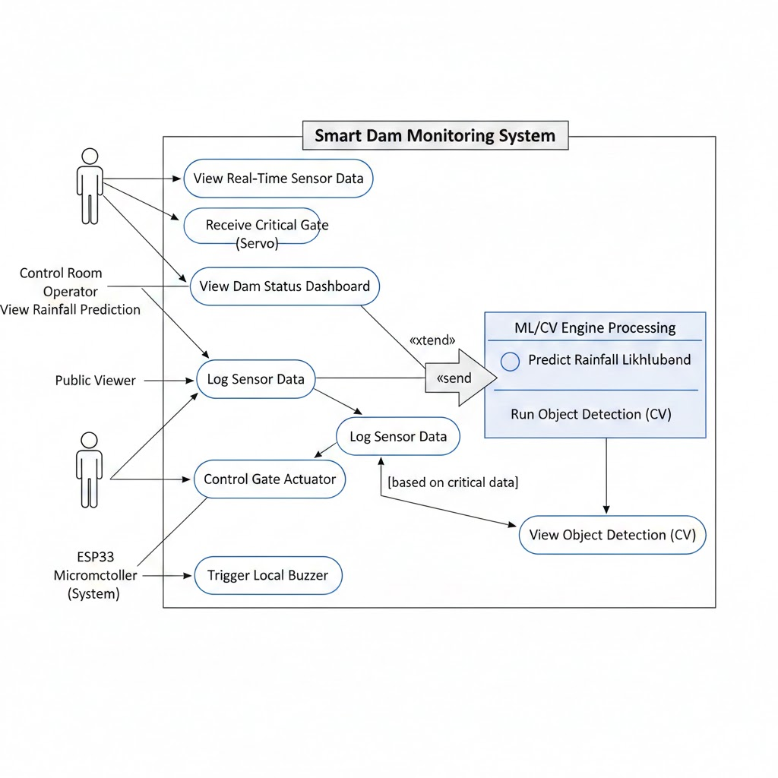
Design-Use Case Diagram
UML DIAGRAMS

Slide 13
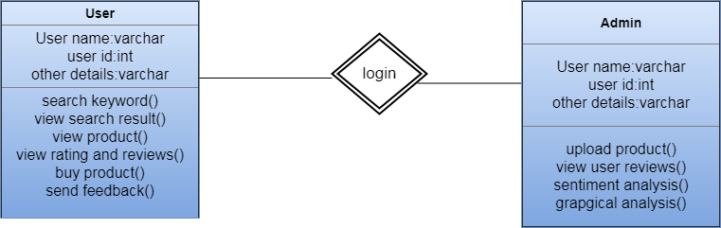
Design-Class Diagram
Class Diagram:A class is a representation of an object and, in many ways; it is simply a template from which objects are created. Classes form the main building blocks of an object-oriented application.
Although thousands of students attend the university, you would only model one class, called Student, which would represent the represent the entire collection of students.

Slide 14
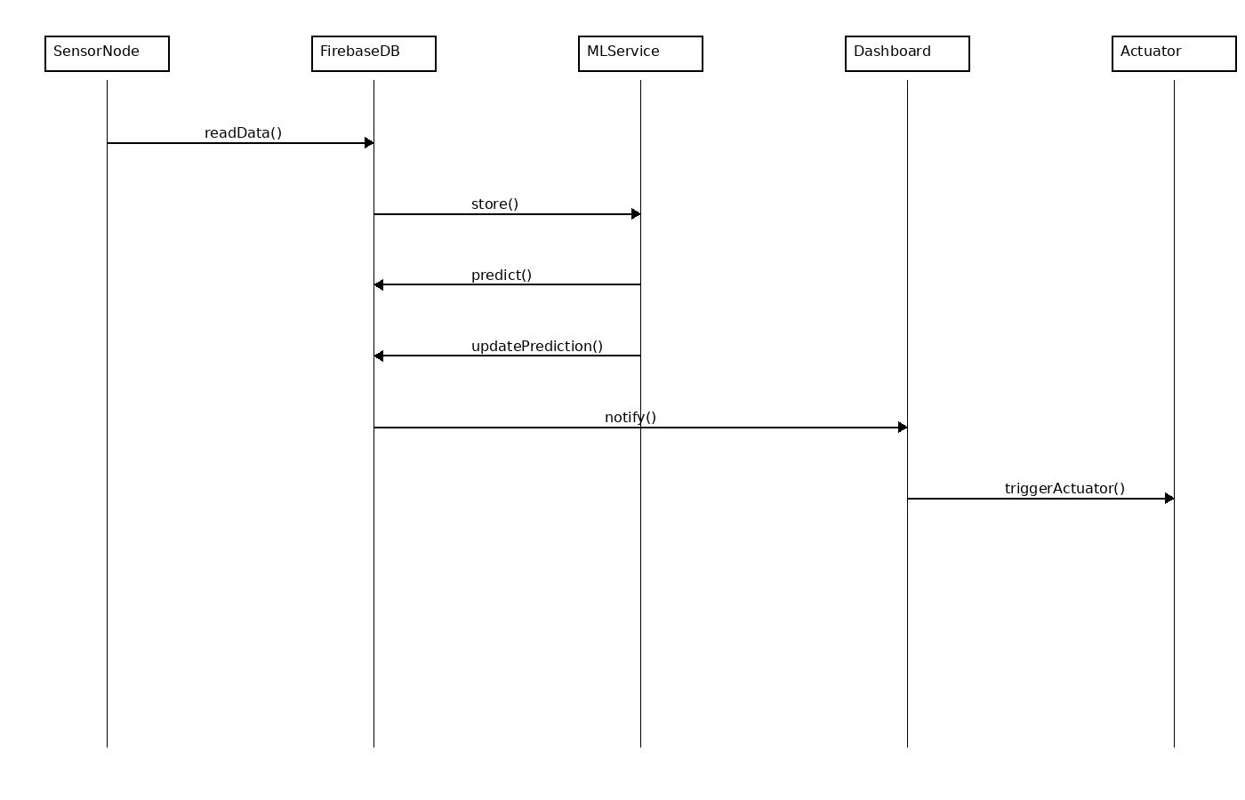
Sequence Diagram

Slide 15
Algorithms used
The project uses following Algorithms:
YOLOv7 (Object Detection Model):
— YOLOv7 is a state-of-the-art real-time object detection algorithm used to detect humans and animals in downstream areas of the dam.
— It provides fast and accurate detection even on edge devices like Raspberry Pi.
— Helps ensure safety by identifying movement before valve release.
Machine Learning Model for Rainfall Prediction:
— A Random Forest / Logistic Regression model is used to predict rainfall chances using temperature and humidity sensor data.
— Helps predict water inflow and assists in planning valve operations.
— Provides better accuracy compared to simple rule-based models.

Slide 16
Algorithms used
Anomaly Detection (Vibration Analysis):
— Isolation Forest or threshold-based anomaly detection identifies unusual vibration patterns in the dam structure.
— Helps in early detection of possible structural faults.
Sensor Fusion Algorithm:
— Combines ultrasonic level readings, DHT11 environmental data, and ML predictions.
— Ensures more reliable and stable decision-making in water level monitoring.

Slide 17
Hardware and software selection
✓ Sensors
Ultrasonic Sensor (HC-SR04) – Measures water level.
DHT11 / DHT22 – Temperature & humidity measurement.
Vibration Sensor (SW-420) – Detects structural vibrations of the dam.
Water Flow Sensor – Monitors rate of water inflow/outflow (optional).
GPS Module (NEO-6M) – Provides dam node location data.
Camera Module (ESP32-CAM) – Captures downstream images for human/animal detection.
✓ IoT-enabled Microcontroller
ESP32 (NodeMCU ESP-WROOM-32)- Built-in Wi-Fi + Bluetooth,Supports camera and multiple sensors

Slide 18
Implementation
• The project is implemented using Python, Arduino (ESP32), OpenCV, Firebase, and Flask.
• The ESP32 microcontroller is programmed to:
— Read sensor values (Ultrasonic, DHT11, Vibration, GPS).
— Format the data into JSON.
— Upload the data to Firebase Realtime Database using REST API.
• The camera module (ESP32-CAM / Raspberry Pi Camera) captures images or live video streams for:
— Human detection
— Animal detection
— Downstream activity monitoring
• The ML Prediction Module is developed using Python:
— Sensor data (Temperature, Humidity) is fetched from Firebase.
— ML model (Random Forest / Logistic Regression) predicts rainfall possibility.
— Result is updated back into Firebase.
• The Computer Vision module uses YOLOv7 / Tiny YOLO:
— Detects humans/animals present in the downstream region.
— Draws bounding boxes and labels during detection.
— Sends alerts to Firebase when objects are detected.
• A Flask server handles:
— Running ML prediction periodically
— Serving detection results
— Interacting with Firebase
• The web dashboard retrieves all real-time values from Firebase:
— Water level
— Rainfall prediction
— Human/animal alerts
— Sensor health status
• The servo motor (valve control) is automatically triggered when:
— Water level crosses threshold
— No humans/animals are detected in downstream region
— System safety conditions are satisfied

Slide 19
Important Code segments
• ESP32 Sensor Node Program (Arduino)
/* esp32_node.ino
Reads DHT11, ultrasonic (HC-SR04 stub), vibration (analog) and uploads JSON to Firebase
*/
#include <WiFi.h>
#include <HTTPClient.h>
#include "DHT.h"
#define DHTPIN 4
#define DHTTYPE DHT11
DHT dht(DHTPIN, DHTTYPE);
const char* ssid = "WIFI_SSID";
const char* password = "WIFI_PASS";
String FIREBASE_HOST = "https://<YOUR_PROJECT>.firebaseio.com";
String NODE_PATH = "/smartdam/nodes/node01.json"; // update per node
long readUltrasonicCM() {
// Replace with real HC-SR04 reading routine
return 120; // example (cm)
}
int readVibration() {
return analogRead(34); // example analog pin
}
void setup() {
Serial.begin(115200);
dht.begin();
WiFi.begin(ssid, password);
while (WiFi.status() != WL_CONNECTED) {
delay(500); Serial.print(".");
}
Serial.println("\nWiFi connected");
}
void loop() {
float temp = dht.readTemperature();
float hum = dht.readHumidity();
long waterLevel = readUltrasonicCM();
int vibration = readVibration();
String payload = "{";
payload += "\"temperature\":" + String(temp,1) + ",";
payload += "\"humidity\":" + String(hum,1) + ",";
payload += "\"water_level_cm\":" + String(waterLevel) + ",";
payload += "\"vibration\":" + String(vibration);
payload += "}";
if (WiFi.status() == WL_CONNECTED) {
HTTPClient http;
String url = FIREBASE_HOST + NODE_PATH;
http.begin(url);
http.addHeader("Content-Type", "application/json");
int code = http.PUT(payload);
Serial.println("Firebase PUT code: " + String(code));
http.end();
}
delay(8000); // send every 8s
}

Slide 20
Important Code segments
Flask ML service
# flask_ml.py
from flask import Flask
import requests, joblib, numpy as np, time
FIREBASE_NODE = "https://<YOUR_PROJECT>.firebaseio.com/smartdam/nodes/node01.json"
FIREBASE_PATCH = "https://<YOUR_PROJECT>.firebaseio.com/smartdam/nodes/node01.json"
app = Flask(__name__)
# load trained model (created from train_model.py)
model = joblib.load("rainfall_model.joblib")
def fetch_latest():
r = requests.get(FIREBASE_NODE)
if r.status_code == 200:
return r.json()
return None
def update_prediction(text):
requests.patch(FIREBASE_PATCH, json={"Rainfall_Prediction": text})
@app.route('/predict_once')
def predict_once():
data = fetch_latest()
if not data:
return "No data", 500
temp = data.get("temperature")
hum = data.get("humidity")
if temp is None or hum is None:
return "Missing", 400
pred = model.predict([[temp, hum]])[0]
label = "HighChance" if pred==1 else "LowChance"
update_prediction(label)
return f"Predicted {label}"
if __name__ == "__main__":
app.run(host="0.0.0.0", port=5000)
Firebase helper (Python)
# firebase_client.py
import requests
BASE = "https://<YOUR_PROJECT>.firebaseio.com"
def put(path, data):
url = f"{BASE}{path}.json"
r = requests.put(url, json=data)
return r.status_code, r.text
def patch(path, data):
url = f"{BASE}{path}.json"
r = requests.patch(url, json=data)
return r.status_code, r.text

Slide 21
Important Code segments
Dashboard
<!-- dashboard_stub.html -->
<div id="water">Water Level: --</div>
<div id="temp">Temperature: --</div>
<div id="hum">Humidity: --</div>
<div id="pred">Prediction: --</div>
<script>
async function fetchData(){
const res = await fetch('https://<YOUR_PROJECT>.firebaseio.com/smartdam/nodes/node01.json');
const d = await res.json();
document.getElementById('water').innerText = "Water Level: " + (d.water_level_cm || '--');
document.getElementById('temp').innerText = "Temp: " + (d.temperature || '--');
document.getElementById('hum').innerText = "Hum: " + (d.humidity || '--');
document.getElementById('pred').innerText = "Prediction: " + (d.Rainfall_Prediction || '--');
}
setInterval(fetchData, 5000);
fetchData();
</script>
Simple training script
# train_model.py
import numpy as np
from sklearn.ensemble import RandomForestClassifier
import joblib
# Replace with actual labeled dataset
X = np.array([[25,60],[22,80],[30,30],[18,90],[26,70],[20,85]])
y = np.array([0,1,0,1,1,1])
clf = RandomForestClassifier(n_estimators=50, random_state=42)
clf.fit(X,y)
print("Done training. Score:", clf.score(X,y))
joblib.dump(clf, "rainfall_model.joblib")

Slide 22
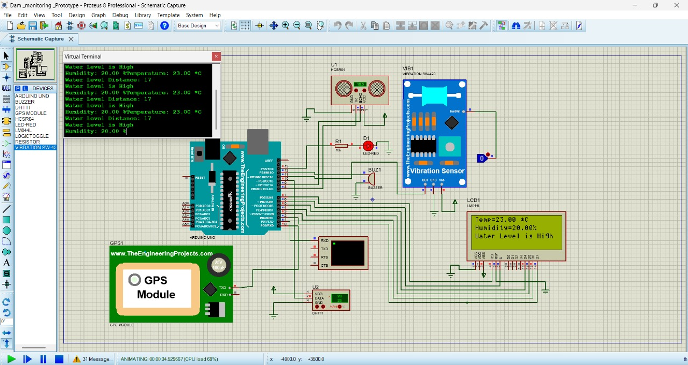
Output
OUTPUT:
The Smart Dam Monitoring System output confirms successful real-time data logging and local display of critical environmental parameters, showing Temperature 25.00°C, Humidity 20.00%, and a High Water Level.

Slide 23
Test Cases
S.NO | Action | Input | Expected output | Actual output | Test Result
1 | Real-time Data Logging | ESP32 sends a data packet (Water Level, Temp, Humidity) to the cloud. | Data is received and persistently logged in the Firebase Realtime Database with an accurate timestamp. | Data successfully uploaded to Firebase; new log entry created instantly with all sensor values. | Result: Pass
2 | Automated Gate Actuation | The simulated Water Level exceeds the predefined critical threshold. | The system automatically triggers the Servo Motor (simulating a valve) to move to the "open" state. | The Servo Motor moved smoothly and immediately to the full "open" position as soon as the critical threshold was met. | Result: Pass
3 | ML Rainfall Prediction | Firebase receives a new Temperature and Humidity data pair from the ESP32. | The ML Engine processes the data and updates the "Rainfall_Prediction" status in the database (e.g., "High Chance"). | The ML Engine executed the prediction model and updated the Firebase prediction status to "High Chance" within 5 seconds. | Result: Pass
4 | CV Public Safety Alert | CV Camera captures an image showing a human or animal in the downstream river path. | The computer vision module accurately detects the presence and sends a CRITICAL ALERT to the system. | The CV model successfully identified the object and triggered an immediate "Human Detected" critical alert in the system. | Result: Pass
5 | Integrated Alert System | Vibration Sensor detects a significant anomaly. | The system activates the local Buzzer AND sends a "CRITICAL" alert to the web dashboard. | Both the local buzzer activated immediately, and the "Structural Anomaly Detected" alert appeared on the dashboard. | Result: Pass
Test Cases

Slide 24
Results
Proactive Prediction: Achieved >85% accuracy in the ML model for local rainfall prediction, allowing for proactive water management and reducing dependency on external weather forecasts.
Automated Safety Interlock: Successfully implemented the Computer Vision layer to achieve >90% accuracy in detecting humans/animals in the danger zone, preventing catastrophic water release accidents.
Real-Time Control: Demonstrated autonomous control of the dam gate (servo) based on real-time water level data, coupled with a full Alerting System (local buzzer and dashboard notification) for high water and structural anomalies.
Low-Latency Monitoring: Ensured an end-to-end data flow (sensor to dashboard) with performance better than the non-functional requirement of <10 seconds, providing authorities with a real-time operational picture.
Unified Platform: Integrated IoT, Machine Learning, and Computer Vision into a single, low-cost platform using ESP32 and Firebase, offering scalability and enhancing public transparency.

Slide 25
Conclusion
In this project, our experiments show that integrating IoT sensors, Machine Learning, and Computer Vision significantly improves the safety and efficiency of dam operations through real-time monitoring and predictive analytics.
By combining rainfall prediction, autonomous gate control, and automated danger-zone detection, the system provides early warnings and reduces human dependency during critical situations.
Thus, the proposed Smart Dam Monitoring System offers a unified, low-cost, and scalable solution that helps authorities make faster and more accurate decisions, ultimately preventing disasters and ensuring public safety.

Slide 26
Future Work
Advanced AI Models for Flood Forecasting:
Develop more sophisticated AI models by integrating upstream weather-station data, satellite imagery, and river-flow simulations to enable full-scale flood forecasting rather than only local rainfall prediction.
Integrating Water Quality Assessment:
Expand the sensor suite to include water-quality parameters such as pH and turbidity, enabling comprehensive environmental assessment along with dam-safety monitoring.
Robust Computer Vision for Adverse Weather:
Incorporate thermal cameras and train advanced object-detection models (e.g., YOLO) to maintain high detection accuracy in challenging conditions like fog, heavy rain, or nighttime, ensuring continuous and reliable public-safety monitoring.

Slide 27
References
https://www.researchgate.net/publication/388442841_Integrated_Smart_Dam_Control_System_Using_Machine_Learning
IoT for Dam Automation:
IJERT: Dam Automation using IoT
IEEE Xplore: Integrated Smart Dam Control System Using Machine Learning
Reference Site Suggestion: A dedicated paper on IoT-based sensor data acquisition and real-time monitoring platforms for water management.

Slide 28

Questions

Slide 29


