Slide 1
MEAN Workshop
Naveen Pete
naveen.shenoy.blr@gmail.com
Saturday, Apr 22, 2017

Slide 2
Agenda
Traditional Web Development
Full Stack Development
Introducing MEAN Stack

Slide 3
Traditional Web Development
Followed Three-Tier architecture
Presentation Layer - UI design and development
Business Logic Layer - Data validation, data processing, application logic
Data Layer - Data persistence, data access through API
Traditional web application technologies
Client-side - HTML, CSS and JavaScript
Server-side - C#, Java, PHP, ASP.NET, Ruby, Python
Database - SQL Server, MySQL, Oracle
Web Server - IIS, Apache, Tomcat

Slide 4
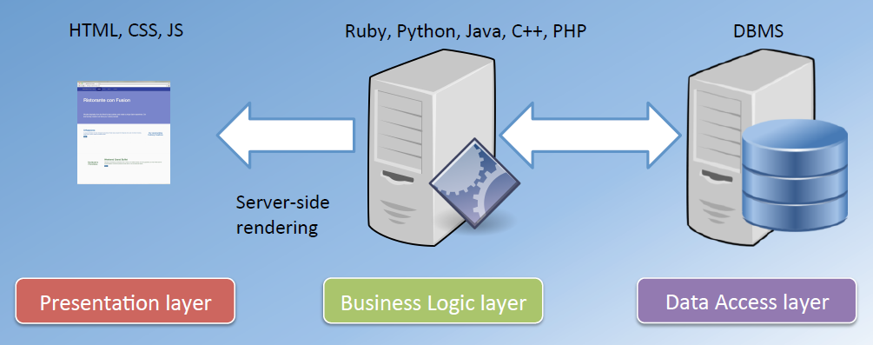
Traditional Web Development

Slide 5
Traditional Web Development
Front-end complexity
Front-end developers
Time
Back-end developers
Back-end complexity
Divergence of front-end and back-end developers over time

Slide 6
Full Stack Development
During the 2000s, libraries and frameworks started to become popular and prevalent
A Library or Framework
Abstracts complexities of development
Increases developer productivity
Requires less in-depth expertise
Resurgence of full-stack developers
Moving the application code forward in the stack
Reduces server load, thus reducing cost
Crowd-sourcing of computational power

Slide 7
Full Stack Development
Benefits
Provide greater value to your clients
More skills, services and capabilities
Build applications end-to-end, no dependency
Have a better view of the bigger picture of an application
Understand how different components fit together
Better overall control
Team members can move around more freely (Agile teams)
Learning new technologies
Rewarding and satisfying experience

Slide 8
Full Stack Development
Front-end complexity
Front-end developers
Full-stack developers
Time
Back-end developers
Back-end complexity
Impact of frameworks

Slide 9
Introducing MEAN Stack
MongoDB - the database
Has been around since 2007
By MongoDB Inc. (10gen)
NoSQL, Document database
JSON like documents, dynamic schemas
Express - the web framework
First released in 2009
Web application framework
Minimal, flexible, extensible
Build web applications and API
Angular - the front-end framework
Has been around since 2010
Maintained by Google
Front-end, SPA framework
Build highly interactive, responsive and dynamic web applications
Node - the platform
Created in 2009 by Ryan Dahl
Sponsored by Joyent
It is a platform, neither a language nor a web server
Uses Google’s Chrome V8 JavaScript engine at its core
“Best-of-Breed” modern web technologies
Very powerful and flexible stack
Uses JavaScript throughout

Slide 10
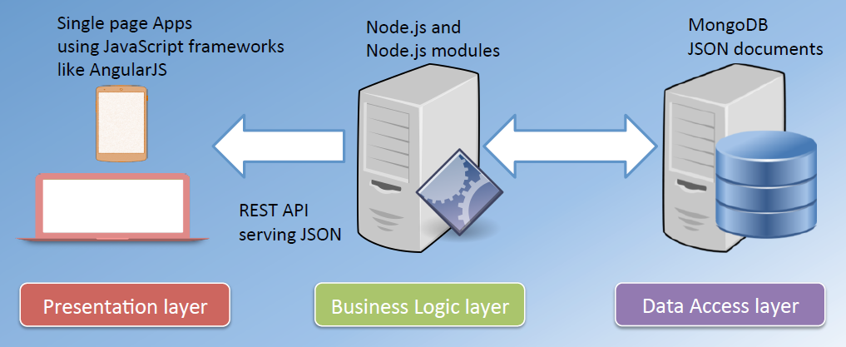
Introducing MEAN Stack

Slide 11
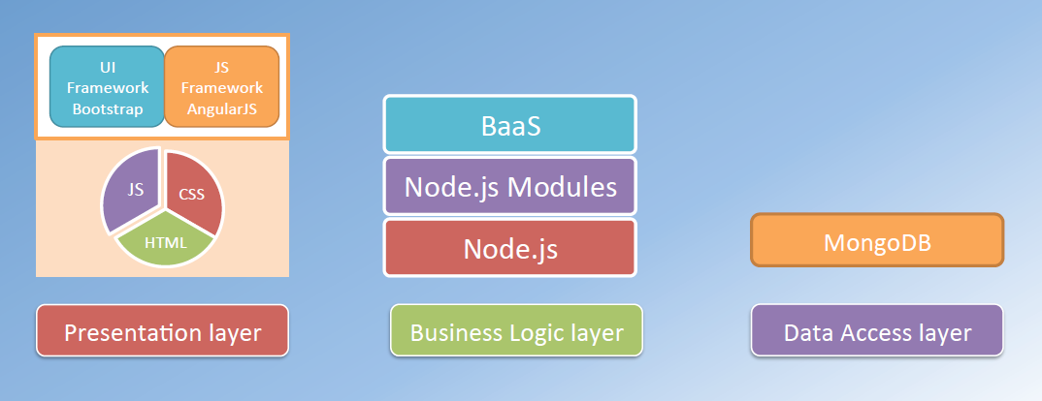
Introducing MEAN Stack

Slide 12
Traditional Page Refresh
Web Server
Web Browser
URL Request to server
HTML
JavaScript
Response with Web page & Assets
Browser loads up entire web page
User clicks on link, new Request
HTML
JavaScript
Response with Web page & Assets
Browser loads up entire web page

Slide 13
Introducing Angular
Developed in 2009 by Misko Hevery
Structural framework for dynamic web apps
Front-end SPA, RIA framework
Uses HTML as the template language
Lets you extend HTML’s syntax
Declarative programming
Not every app is a good fit for Angular
Best suited for building CRUD applications
Games and GUI editors – not a good fit

Slide 14
Angular - Advantages
Helps you organize your JavaScript code
Helps create responsive web apps
Data Binding and Dependency Injection eliminates much of the manual code
Decouple DOM manipulation from app logic
Improves testability
Decouple client side of an app from the server side
Allows reuse
Allows parallel development

Slide 15
Responsive Page using Angular
Web Server
Web Browser
URL Request to server
HTML
JavaScript
Response with Web page & Assets
Browser loads up entire web page
User clicks on link, new Request
DATA
Response with JSON Data
Data is loaded into existing page

Slide 16


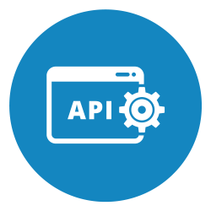


API Driven Approach
Angular app
SERVER
Some other app
API
Database
Mobile app

Slide 17
Directives
A marker on a HTML tag that tells Angular to run or reference some JavaScript code
Binds behavior to HTML
Custom attribute / element
Helps you to extend HTML to support dynamic behavior
Syntax: ng-<directive>
Examples: ng-app, ng-bind, ng-model, ng-init, ng-repeat, etc.
Declarative programming in action
Specifying what Angular needs to do

Slide 18
Expressions, Data Binding
Expressions
Simple JavaScript expressions
Allow you to insert dynamic values into your HTML
No conditionals, loops or exceptions
Syntax: {{ <expression> }}
Data Binding
Binding an HTML or CSS property to a JavaScript variable
Automatic synchronization of data between the model and view components

Slide 19
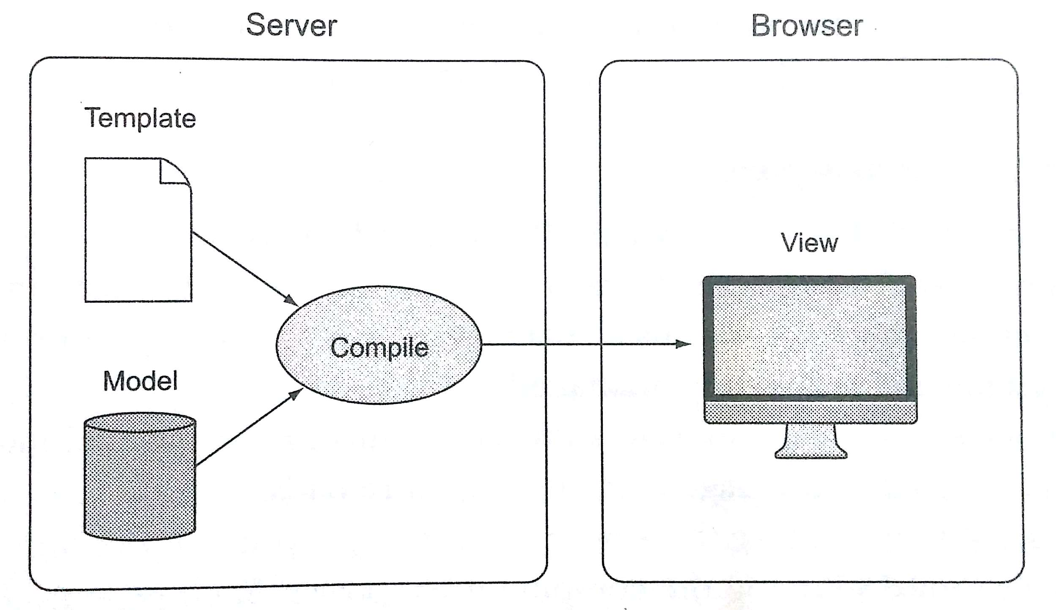
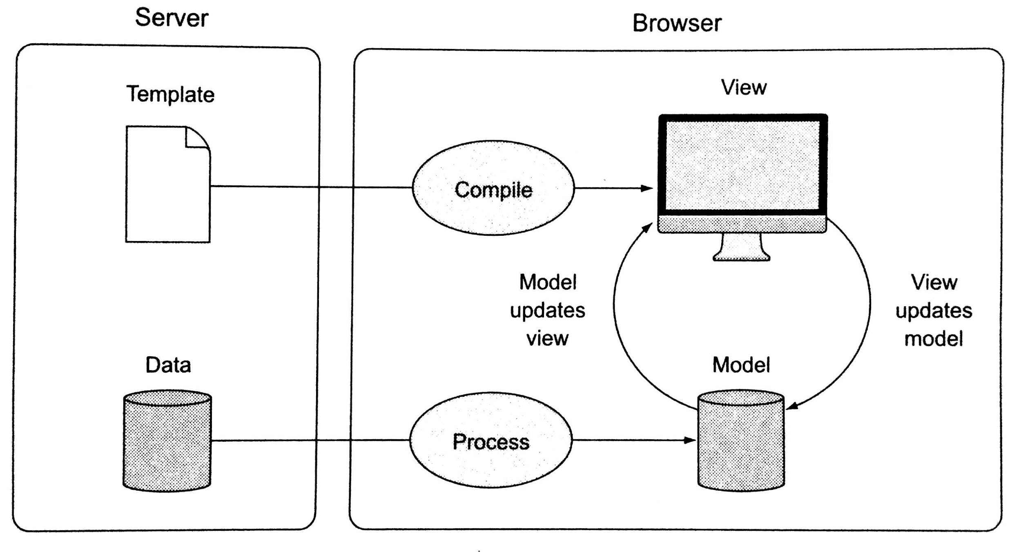
Data Binding
Two-way data binding
The model and the view are processed in the browser and bound together, each instantly updating the other
One-way data binding
The template and model are compiled on the server before being sent to the browser

Slide 20
MVC / MVVM
Refer to my blog – MVC, MVVM and Angular
URL:
https://naveenpete.wordpress.com/2016/09/07/mvc-mvvm-and-angular/

Slide 21
Module
Where we write pieces of our Angular app
Makes our code more maintainable, testable and readable
Where we define dependencies for our app
A collection of:
Controllers
Directives
Filters
Services
Other config information
Usage
angular.module(‘store’, []);
<html ng-app=‘store’></html>

Slide 22
Pipe
Format the value of an expression for display
Does not modify underlying data
Angular comes with many built-in filters
uppercase
lowercase
currency
date
filter
orderBy
limitTo
Custom pipes

Slide 23
Dependency Injection (DI)
Software design pattern that implements Inversion of Control (IoC) for resolving dependencies
Coined by Martin Fowler in 2004
Dependency: An object that can be used (a service)
Injection: Passing of a dependency to a dependent object so that it can use it. The client does not need to build the object
Three ways
Create dependency using new operator
Look up dependency using a global variable
Have dependency passed to it where needed
Third approach is most flexible
Four Roles
The Service
The Client
The Interfaces
The Injector

Slide 24
Service
Substitutable object wired together using DI
Allows organizing and sharing code across an app
AJAX calls
Business rules
Calculations
Share data between controllers

Slide 25
Angular Template
Written in HTML
Contains Angular specific elements and attributes
Dynamic View = Template + Controller + Model
Angular elements and attributes
Directives
Markup
Filters
Form Controls
ng-include directive
Used to fetch, compile and include an Angular template
Creates a new scope

Slide 26
SPA
Web application that fits in a single web page
No need to reload entire page, redraw parts of the page when needed
UX like a desktop / native application
Most assets / resources are retrieved during the initial page load
Challenges
Search engine optimization
Analytics
Initial page load
History

Slide 27
SPA
Role of Server
Serves data using REST API
Supplies static HTML pages, Angular templates and other assets
Role of Client
Rendering of view - Templating
Routing
Deep linking
The use of a hyperlink that links to a specific, generally searchable or indexed, piece of web content on a website
E.g. http://example.com/path/page.html

Slide 28
Client Server Communication
Web applications are not stand-alone
Network operations cause unexpected delays
Data is not instantly available
HTTP – A client-server communication protocol
HTTP response format
XML
JSON
JSON
Lightweight data interchange format
Language independent
Self-describing, easy to understand
Data is structured as a collection of name-value pairs

Slide 29
$http
Core Angular service to communicate with remote servers using HTTP protocol
Uses browser’s XmlHttpRequest object
Asynchronous in nature
Based on promise API exposed by $q service
Returns a promise
Usage
$http( { method: ‘GET’, url: ‘http://server/api’ } )
.then(
function(response) { // success },
function(error) { // error }
);

Slide 30
Custom Directives
What is a Directive?
Markers on a DOM element that tell Angular’s HTML compiler to attach a specified behavior to that DOM element
Teaches HTML new tricks
Makes HTML more expressive
What can a directive do? Some examples
Manipulate the DOM
Iterate through data
Handle Events
Modify CSS
Validate data
Data binding

Slide 31
Angular 2
An integrated ecosystem that covers all of the concerns in building web apps
Better performance, 5x faster than Angular 1.x
Component based UI, controllers and directives are eliminated
Uses Microsoft TypeScript as main programming language
Meets ES6 specification
Built for mobile, greatly simplifies app development on all mobile platforms
Allows reuse of components across multiple platforms
Controllers are replaced with Components
$scope has been removed
Directly uses valid HTML element properties and events. Built-in directives (ng-src, ng-show, ng-hide, etc.) of Angular 1.x are no more available

Slide 32
Angular 2
Angular Architecture Overview
Check Angular 2 web site – Architecture Overview
URL
https://angular.io/docs/ts/latest/guide/architecture.html

Slide 33
Q & A
Thank you

