Slide 1
DevCon 2016 – Bangalore
Date – 30th Nov – 2nd Dec
Introduction to Angular 2
Name of the Speaker : Naveen Pete
Place: Bengaluru
http://www.unicomlearning.com/2016/DevCon/

Slide 2

Agenda
DevCon 2016 – Bangalore
Why Library or Framework?
Introducing Angular
TypeScript
Setting up Angular 2
Angular 2 Building Blocks
Code Walk-thru & Demo
Q & A
http://www.unicomlearning.com/2016/DevCon/

Slide 3
1. Why Library or Framework?
DevCon 2016 – Bangalore
http://www.unicomlearning.com/2016/DevCon/

Slide 4
Traditional Page Refresh
DevCon 2016 – Bangalore
Web Server
Web Browser
URL Request to server
HTML
JavaScript
Response with Web page & Assets
Browser loads up entire web page
User clicks on link, new Request
HTML
JavaScript
Response with Web page & Assets
Browser loads up entire web page
http://www.unicomlearning.com/2016/DevCon/

Slide 5
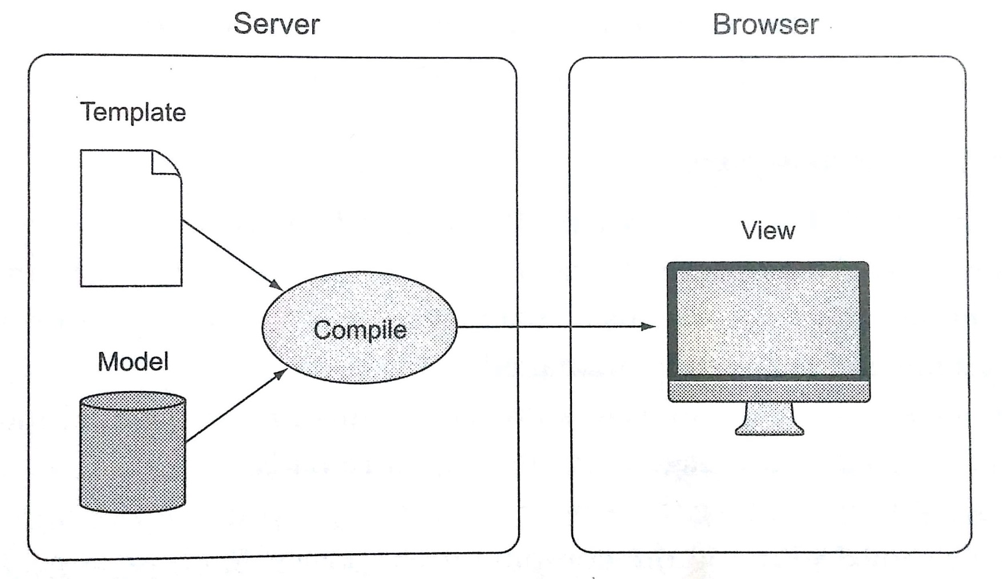
Data Binding
DevCon 2016 – Bangalore
http://www.unicomlearning.com/2016/DevCon/

Slide 6
Benefits of Library or Framework
DevCon 2016 – Bangalore
Abstracts complexities of development
Increases developer productivity
Moving the application code forward in the stack
Reduces server load, thus reducing cost
Crowd-sourcing of computational power
http://www.unicomlearning.com/2016/DevCon/

Slide 7
2. Introducing Angular
DevCon 2016 – Bangalore
http://www.unicomlearning.com/2016/DevCon/

Slide 8
Introducing Angular
DevCon 2016 – Bangalore
Developed in 2009 by Misko Hevery
Structural framework for building dynamic web apps
Front-end SPA, RIA framework
Build modular, maintainable and testable apps
Current Release Versions
Angular 1.5.9
Angular 2.2
http://www.unicomlearning.com/2016/DevCon/

Slide 9
Angular Benefits
DevCon 2016 – Bangalore
Build responsive apps for different platforms
Helps you organize your code
Data Binding and Dependency Injection eliminates much of the manual code
Decouple DOM manipulation from app logic
Improves testability
Decouple client side of an app from the server side
Allows reuse
Allows parallel development
http://www.unicomlearning.com/2016/DevCon/

Slide 10
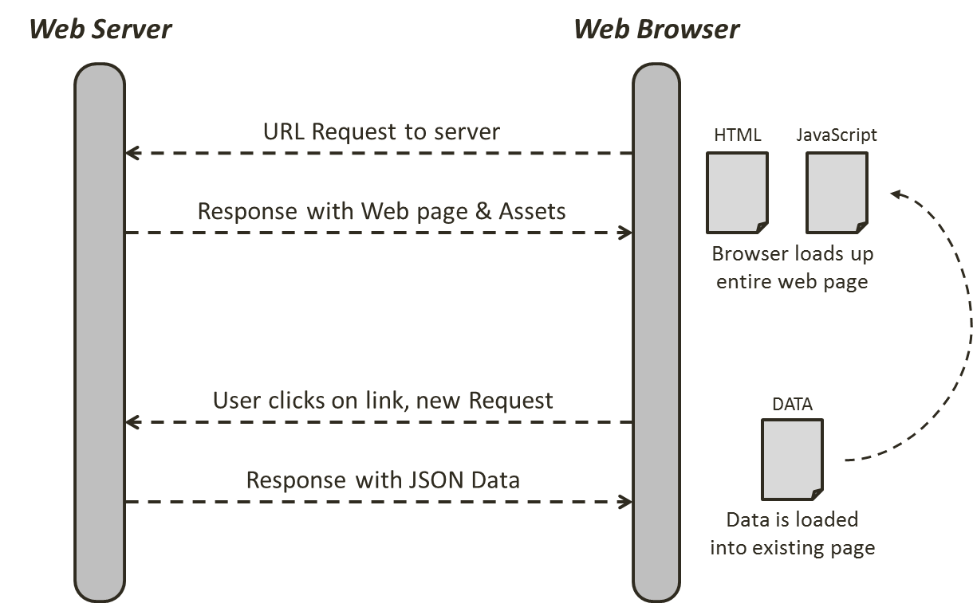
Responsive Page using Angular (or any other framework)
DevCon 2016 – Bangalore
http://www.unicomlearning.com/2016/DevCon/

Slide 11
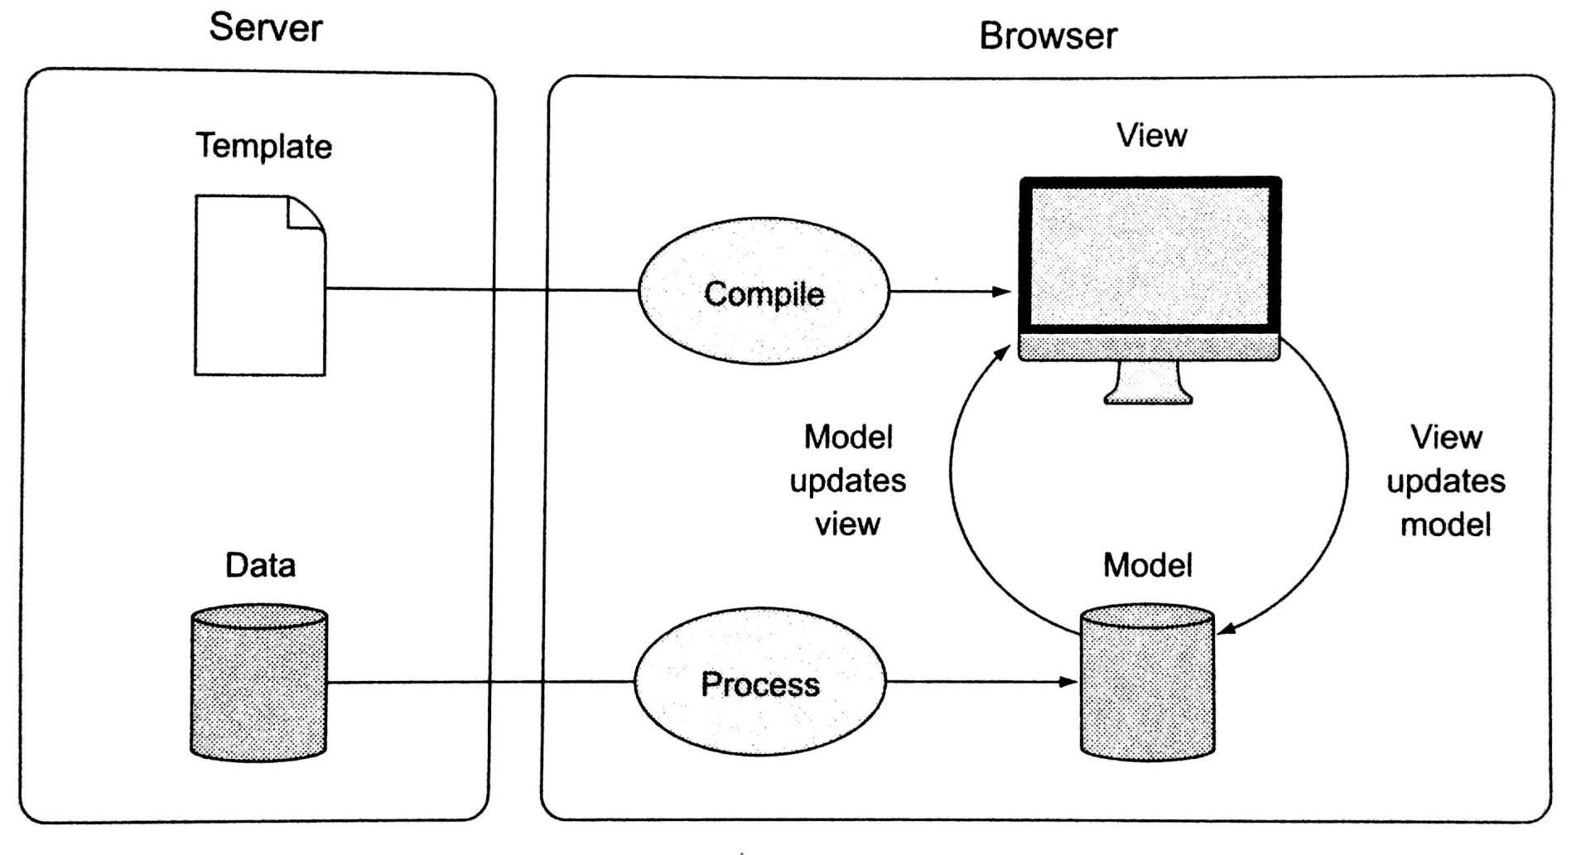
Two-Way Data Binding
DevCon 2016 – Bangalore
http://www.unicomlearning.com/2016/DevCon/

Slide 12
3. TypeScript
DevCon 2016 – Bangalore
http://www.unicomlearning.com/2016/DevCon/

Slide 13
TypeScript
DevCon 2016 – Bangalore
Superset of JavaScript
Chosen as main language by Angular 2
By far most documentation & example-base uses TypeScript
Why TypeScript?
Strong Typing
reduces compile-time errors, provides IDE support
Next Gen JS Features
Modules, Classes, Import, Export, …
Missing JS Features
Interfaces, Generics, …
Install TypeScript
[sudo] npm install –g typescript
http://www.unicomlearning.com/2016/DevCon/

Slide 14
4. Setting up Angular 2
DevCon 2016 – Bangalore
http://www.unicomlearning.com/2016/DevCon/

Slide 15
Setting up Angular
DevCon 2016 – Bangalore
Install Node (https://nodejs.org/en/)
Install TypeScript – This is optional
Install Angular CLI (https://cli.angular.io/)
Create new Angular App
Start the app
ng serve
Starts up development server
Builds the app
> npm install –g typescript
> npm install –g angular-cli
> ng new first-app
> cd first-app
> ng serve
http://www.unicomlearning.com/2016/DevCon/

Slide 16
5. Angular 2 Building Blocks
DevCon 2016 – Bangalore
http://www.unicomlearning.com/2016/DevCon/

Slide 17

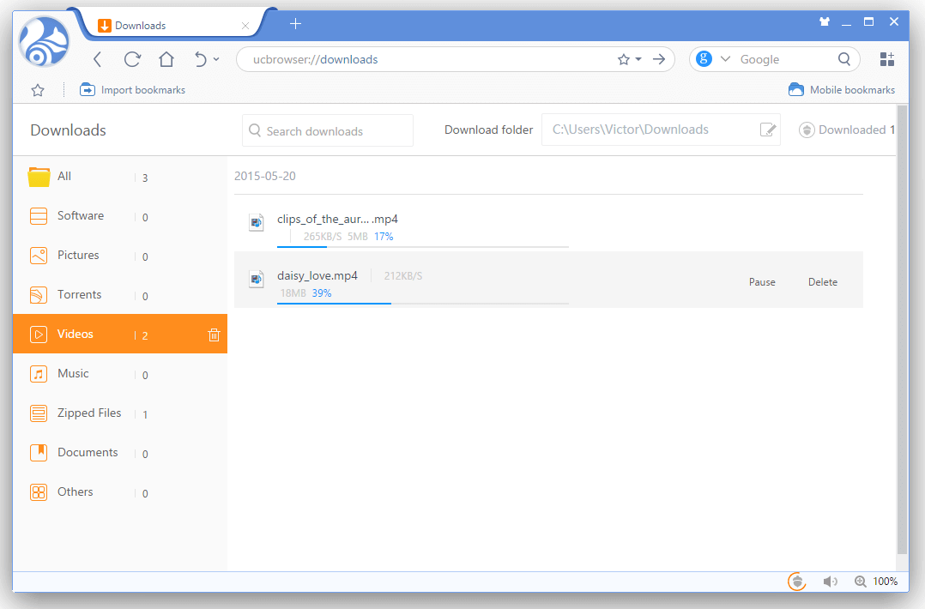
DevCon 2016 – Bangalore
Module
Directive
Template
Component
Service
Browser / View
Server
Pipe
Router
http://www.unicomlearning.com/2016/DevCon/

Slide 18
Module (NgModule)
DevCon 2016 – Bangalore
A block of highly related classes
Organizes an application into cohesive blocks of functionality
Every app has at least one module, called AppModule
@NgModule({
imports: [module1, module2, ...],
declarations: [
component(s), directive(s), pipe(s), ...
],
exports: [class1, class2, ...],
providers: [service1, service2, ...]
})
export class AppModule{ }
AppModule
http://www.unicomlearning.com/2016/DevCon/

Slide 19
Component
DevCon 2016 – Bangalore
Encapsulates the template, data and the behavior of a view
Every app has at least one component, called AppComponent
Completely decoupled from the DOM
@Component({
selector: ‘rating’,
templateUrl: ‘./rating.component.html’,
styleUrls: [‘./rating.component.css’]
})
export class RatingComponent {
averageRating: number;
setRating(value) {
...
}
}
Creating Component
> ng g c product
AppComponent
HeaderComponent
RecipesComponent
ShoppingListComponent
http://www.unicomlearning.com/2016/DevCon/

Slide 20
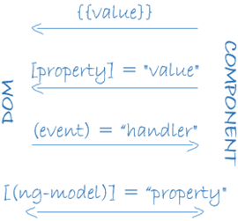
Template & Data Binding
DevCon 2016 – Bangalore
Defines component’s view
Uses HTML and Angular’s template elements & attributes
Data Binding
Interpolation
<h1>{{hero.name}}</h1>
Property binding
<img [src]=“heroImageUrl”>
Event binding
<li (click)=“selectHero(hero)”></li>
Two-way data binding
<input [(ngModel)]="hero.name">
http://www.unicomlearning.com/2016/DevCon/

Slide 21
Template & Data Binding
DevCon 2016 – Bangalore
Examples:
ShoppingListComponent
RecipeItemComponent
RecipeDetailComponent
http://www.unicomlearning.com/2016/DevCon/

Slide 22
Directive
DevCon 2016 – Bangalore
Helps you to extend HTML to support dynamic behavior
Transforms the DOM according to instructions given
Can be built-in or custom
Two kinds
Structural – alter the layout. E.g. *ngFor, *ngIf
Attribute – alter the appearance or behavior. E.g. ngModel, ngClass
Creating Custom Directive
> ng g d rating
@Directive({
selector: '[appRating]‘
})
export class RatingDirective {
...
}
ShoppingListComponent
ShoppingListAddComponent
http://www.unicomlearning.com/2016/DevCon/

Slide 23
Service
DevCon 2016 – Bangalore
Allows organizing and sharing code across an app
AJAX calls
Business rules
Calculations
Share data between components
Creating Service
> ng g s product
@Injectable()
export class ProductService {
...
}
RecipeService
ShoppingListService
http://www.unicomlearning.com/2016/DevCon/

Slide 24
Dependency Injection
DevCon 2016 – Bangalore
Dependency: An object that can be used (a service)
Injection: Passing of a dependency to a dependent object so that it can use it. The client does not need to build the object
Angular 2 uses constructor injection
@Component({
selector: 'rb-recipe-list',
templateUrl: './recipe-list.component.html‘,
providers: [RecipeService]
})
export class RecipeListComponent implements OnInit {
constructor(private recipeService: RecipeService) { }
}
RecipeListComponent
ShoppingListComponent
http://www.unicomlearning.com/2016/DevCon/

Slide 25
Pipe
DevCon 2016 – Bangalore
Transforms displayed values within a template
Does not modify underlying data
Built-in pipes
CurrencyPipe, DatePipe, JsonPipe, LowerCasePipe, UpperCasePipe
Creating Custom Pipe
> ng g p my-currency
http://www.unicomlearning.com/2016/DevCon/

Slide 26
Router
DevCon 2016 – Bangalore
Enables navigation from one view to the next as users perform application tasks
Maps a URL path to a component
Steps
Define array of routes using ‘Routes’
Register routes with router module using ‘Router.forRoot()’
Add the resulting module to ‘imports’ array of ‘AppModule’
Add <router-outlet> element to the template
Use ‘routerLink’ attribute directive in <a> tag to navigate to a specific route
<a [routerLink]="['/recipes']">Recipes</a>
app.routing.ts
app.module.ts
app.component.html
header.component.html
recipe-item.component.html
recipe-detail.component.ts
http://www.unicomlearning.com/2016/DevCon/

Slide 27
Server Communication – Angular Http Client
DevCon 2016 – Bangalore
Communicates with remote servers using HTTP protocol
Uses browser’s XmlHttpRequest object
Methods
get()
post()
put()
delete()
Methods return Observable<Response>
RecipeService
http://www.unicomlearning.com/2016/DevCon/

Slide 28
6. Code Walk-thru & Demo
DevCon 2016 – Bangalore
http://www.unicomlearning.com/2016/DevCon/

Slide 29
Recipe Book App
DevCon 2016 – Bangalore
AppComponent
(rb-root)
HeaderComponent
(rb-header)
RecipesComponent
(rb-recipes)
ShoppingListComponent
(rb-shopping-list)
RecipeListComponent
(rb-recipe-list)
ShoppingListAddComponent
(rb-shopping-list-add)
RecipeStartComponent
(rb-recipe-start)
RecipeItemComponent
(rb-recipe-item)
RecipeDetailComponent
(rb-recipe-detail)
RecipeEditComponent
(rb-recipe-edit)
https://github.com/naveen-pete/ng-2 (Project: recipe-book)
http://www.unicomlearning.com/2016/DevCon/

Slide 30
7. Q & A
DevCon 2016 – Bangalore
http://www.unicomlearning.com/2016/DevCon/

Slide 31
DevCon 2016 – Bangalore
World Conference Next Generation Testing 2015
THANK YOU
Speaker Name: Naveen Pete
Linked In: https://www.linkedin.com/in/naveen-pete
Organized by
UNICOM Trainings & Seminars Pvt. Ltd. contact@unicomlearning.com
http://www.unicomlearning.com/2016/DevCon/

