Slide 1
Angular Bootcamp
Naveen Pete
naveen.shenoy.blr@gmail.com
Saturday, Oct 22, 2016 (10 am – 6 pm)

Slide 2
Agenda
Front-end JavaScript Frameworks
Introducing Angular
Angular Vocabulary
Angular Building Blocks
Directives
Expressions, Data Binding
MVC / MVVM
Module
Controller
Filter
Scope
Forms
Dependency Injection
Service
Template
SPA
Routing
Client Server Communication - $http, $resource
Custom Directives
Q & A

Slide 3
Need for JavaScript Frameworks
HTML – good for static documents
Dynamic Apps – DOM manipulation and data updates
Impedance mismatch
Library
A collection of reusable functions
Your code is in charge, calls into the library when it sees fit
E.g. jQuery
Framework
A particular implementation of a web application
Provides generic functionality
Your code fills in details
Framework is in charge, it calls into your code, when it needs something
E.g. Backbone, Ember, Meteor

Slide 4
Need for JavaScript Frameworks
Benefits:
Abstracts complexities of development
Increases developer productivity
Requires less in-depth expertise
Moving the application code forward in the stack
Reduces server load, thus reducing cost
Crowd-sourcing of computational power

Slide 5
Traditional Page Refresh
Web Server
Web Browser
URL Request to server
HTML
JavaScript
Response with Web page & Assets
Browser loads up entire web page
User clicks on link, new Request
HTML
JavaScript
Response with Web page & Assets
Browser loads up entire web page

Slide 6
Introducing Angular
Developed in 2009 by Misko Hevery
Structural framework for dynamic web apps
Front-end SPA, RIA framework
Uses HTML as the template language
Lets you extend HTML’s syntax
Declarative programming
Not every app is a good fit for Angular
Best suited for building CRUD applications
Games and GUI editors – not a good fit

Slide 7
Angular - Advantages
Helps you organize your JavaScript code
Helps create responsive web apps
Data Binding and Dependency Injection eliminates much of the manual code
Decouple DOM manipulation from app logic
Improves testability
Decouple client side of an app from the server side
Allows reuse
Allows parallel development

Slide 8
Responsive Page using Angular
Web Server
Web Browser
URL Request to server
HTML
JavaScript
Response with Web page & Assets
Browser loads up entire web page
User clicks on link, new Request
DATA
Response with JSON Data
Data is loaded into existing page

Slide 9
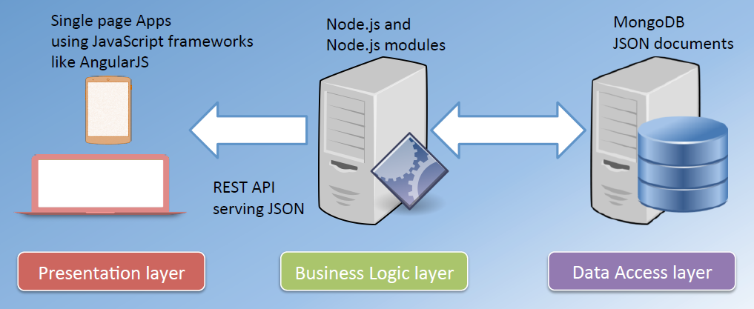
Where does Angular fit?

Slide 10


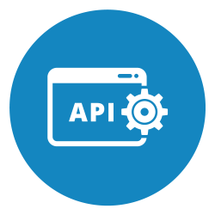


API Driven Approach
Angular app
SERVER
Some other app
API
Database
Mobile app

Slide 11
Angular Vocabulary
Data binding
Scope
Directives
Templates
Routing
Testing
Modules
Controllers
Filters
Services
Views
Form Validation
MVC, ViewModel
Dependency Injection

Slide 12
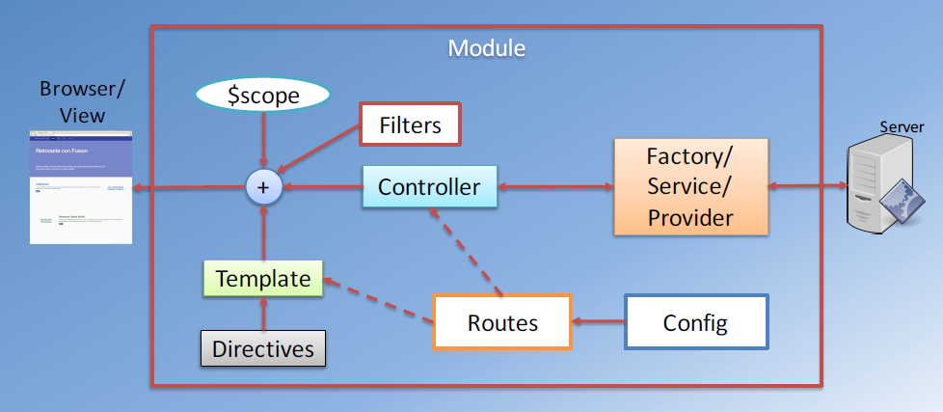
Angular Building Blocks

Slide 13
Getting Started
Download Angular
http://angularjs.org/
angular.min.js
Download Twitter Bootstrap
http://getbootstrap.com/
Bootstrap.min.css

Slide 14
Directives
A marker on a HTML tag that tells Angular to run or reference some JavaScript code
Binds behavior to HTML
Custom attribute / element
Helps you to extend HTML to support dynamic behavior
Syntax: ng-<directive>
Examples: ng-app, ng-bind, ng-model, ng-init, ng-repeat, etc.
Declarative programming in action
Specifying what Angular needs to do

Slide 15
Directives
ng-app
Runs the module when the document loads
Applied to specify the root of the application
Can be applied to any tag, typically applied to <html> tag
ng-init
Used to evaluate an expression
Used to initialize a JavaScript variable
ng-model
Binds an input value to a variable within the scope
ng-repeat
Is a looping construct
Loops over items in a collection
Instantiates a template for each item

Slide 16
Expressions, Data Binding
Expressions
Simple JavaScript expressions
Allow you to insert dynamic values into your HTML
No conditionals, loops or exceptions
Syntax: {{ <expression> }}
Data Binding
Binding an HTML or CSS property to a JavaScript variable
Automatic synchronization of data between the model and view components

Slide 17
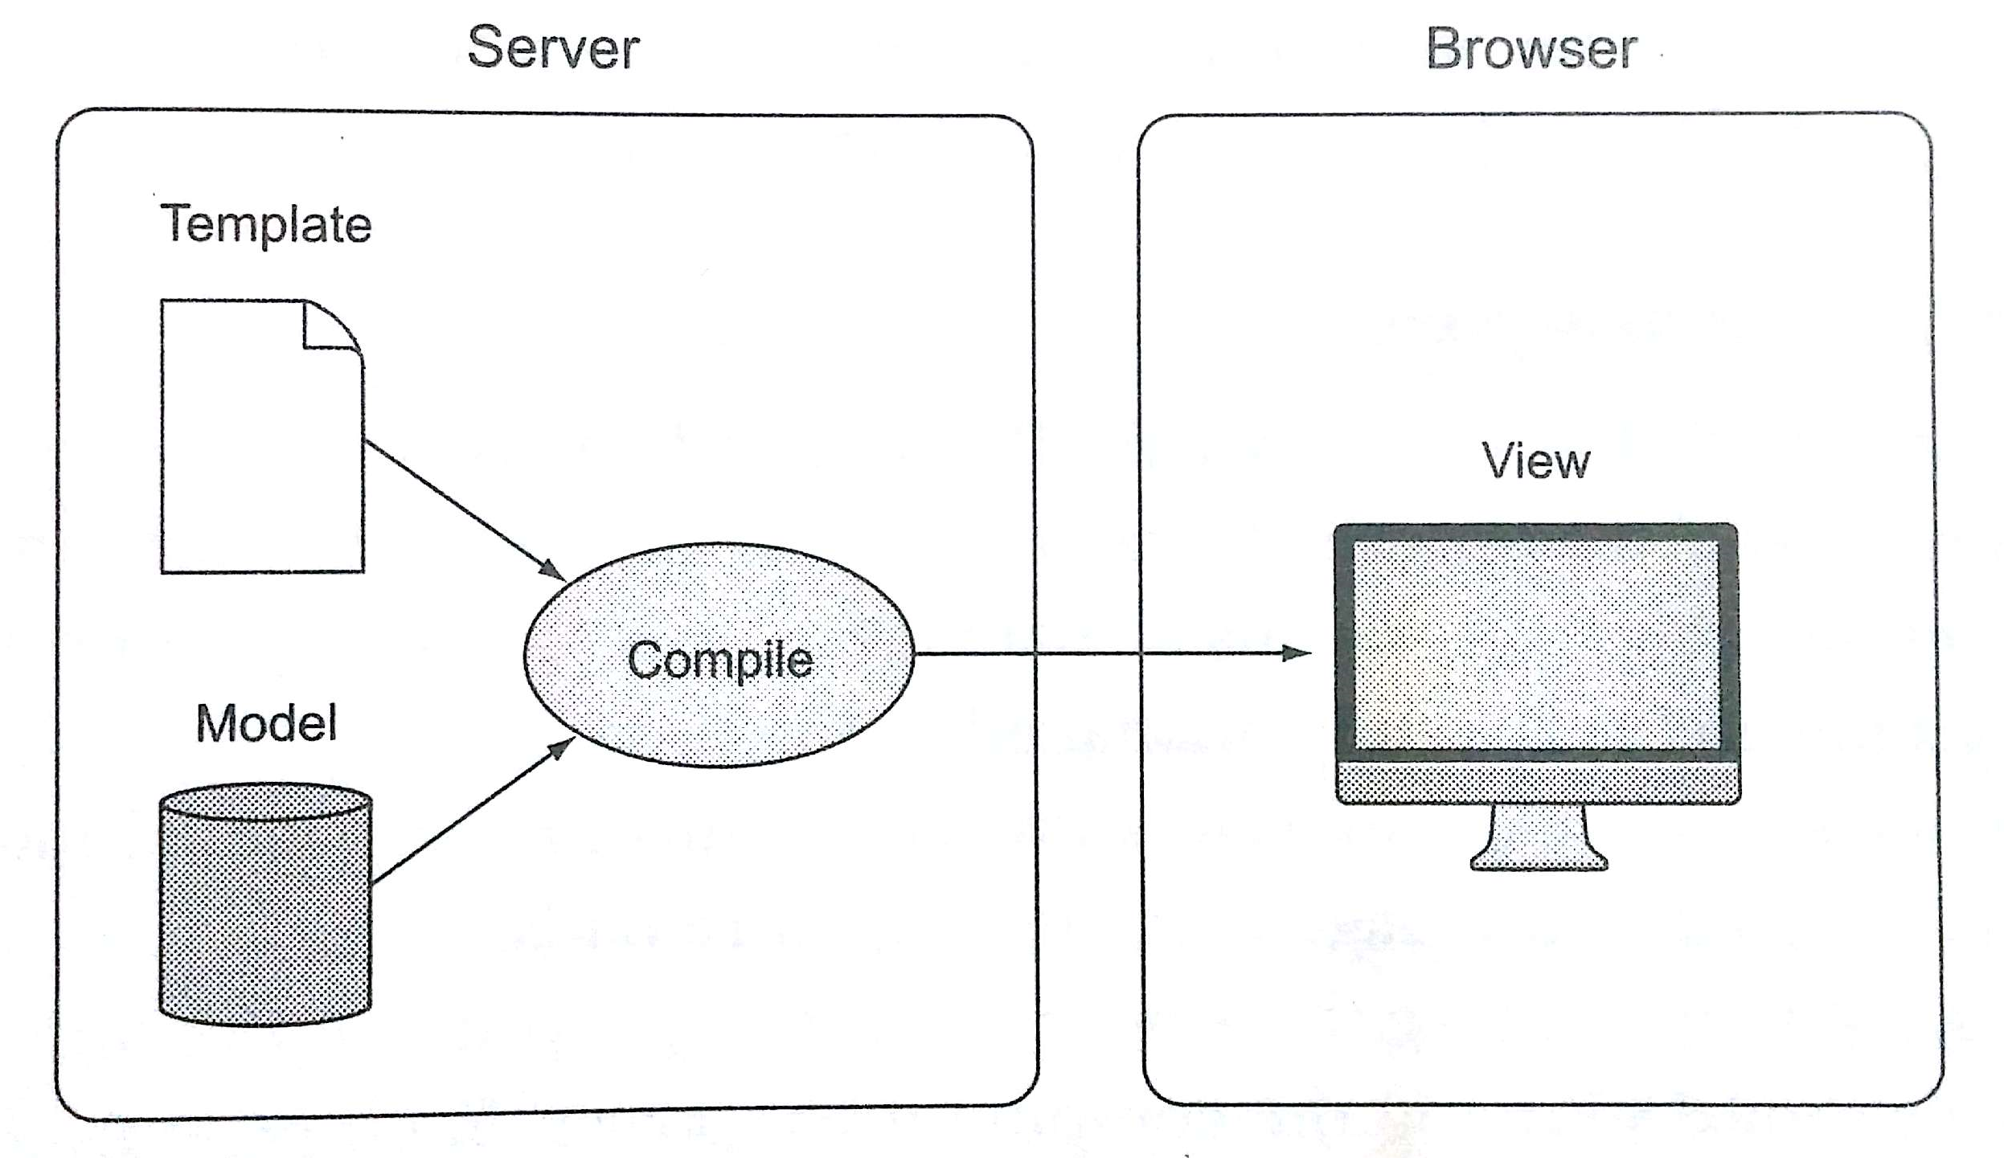
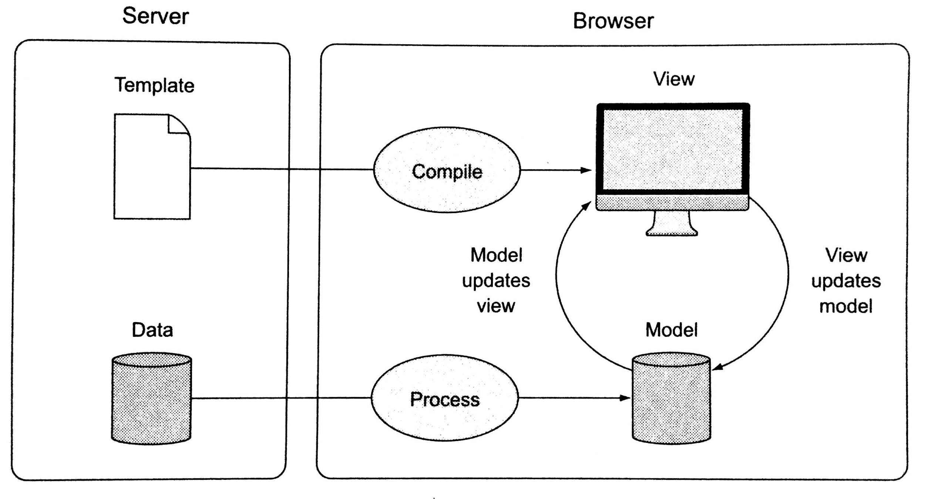
Data Binding
Two-way data binding
The model and the view are processed in the browser and bound together, each instantly updating the other
One-way data binding
The template and model are compiled on the server before being sent to the browser

Slide 18
MVC / MVVM
Refer to my blog – MVC, MVVM and Angular
URL:
https://naveenpete.wordpress.com/2016/09/07/mvc-mvvm-and-angular/

Slide 19
Module
Where we write pieces of our Angular app
Makes our code more maintainable, testable and readable
Where we define dependencies for our app
A collection of:
Controllers
Directives
Filters
Services
Other config information
Usage
angular.module(‘store’, []);
<html ng-app=‘store’></html>

Slide 20
Controller
JavaScript object containing properties and methods
Defines app’s behavior by defining functions and values
Usage:
var app = angular.module(‘store’);
app.controller(‘StoreController’, function() {
…
})
<div ng-controller=“StoreController as storeCtrl”>
…
</div>

Slide 21
Filter
Format the value of an expression for display
Does not modify underlying data
Angular comes with many built-in filters
uppercase
lowercase
currency
date
filter
orderBy
limitTo
Custom filters

Slide 22
Scope
An object that refers to the application model
Core of two-way data binding
Glue between the view and the controller
Controller sets properties on the scope
View binds to the properties set by the controller
Angular keeps the two in sync
$rootScope – topmost scope
Created by Angular when your app starts
As Angular traverses the DOM, new scopes are created when it encounters some directives
ng-controller, ng-repeat
Scope tree similar to DOM tree
A new scope is created as a child of a parent scope
Child has access to properties in the parent scope

Slide 23
Forms
Two-way data binding
Define a JavaScript object on the $scope
Use ng-model directive on form fields
Binding <SELECT>: ng-options directive
Form validation
Turn off HTML5 validation: novalidate
Make sure to give the form a name
Form submit: ng-submit
Field Properties
$pristine – true if form / field has not been changed
$dirty – reverse of $pristine
$valid – true if form / field is valid
$invalid – reverse of $valid
Bootstrap classes
has-error, has-warning, has-success
help-block

Slide 24
Dependency Injection (DI)
Software design pattern that implements Inversion of Control (IoC) for resolving dependencies
Coined by Martin Fowler in 2004
Dependency: An object that can be used (a service)
Injection: Passing of a dependency to a dependent object so that it can use it. The client does not need to build the object
Three ways
Create dependency using new operator
Look up dependency using a global variable
Have dependency passed to it where needed
Third approach is most flexible
Four Roles
The Service
The Client
The Interfaces
The Injector

Slide 25
Angular and DI
Separation of business logic and dependency construction
Dependency is passed to consuming object where needed
Angular injector subsystem
DI is extensively used in Angular
Services, Factories
Filters
Controllers
Dependency Annotations
Inline Array
$inject property
Implicit
Refer to my blog – Dependency Injection in Angular apps
URL:
https://naveenpete.wordpress.com/2016/10/24/dependency-injection-in-angular-apps/

Slide 26
Service
Substitutable object wired together using DI
Allows organizing and sharing code across an app
Lazily instantiated
Singleton
Angular includes several built-in services
$http, $timeout, $window, $location, $rootScope, $log, $filter
Five ways
service()
factory()
provider()
value()
constant()
AJAX calls
Business rules
Calculations
Share data between controllers

Slide 27
Angular Template
Written in HTML
Contains Angular specific elements and attributes
Dynamic View = Template + Controller + Model
Angular elements and attributes
Directives
Markup
Filters
Form Controls
ng-include directive
Used to fetch, compile and include an Angular template
Creates a new scope

Slide 28
SPA
Web application that fits in a single web page
No need to reload entire page, redraw parts of the page when needed
UX like a desktop / native application
Most assets / resources are retrieved during the initial page load
Challenges
Search engine optimization
Analytics
Initial page load
History

Slide 29
SPA
Role of Server
Serves data using REST API
Supplies static HTML pages, Angular templates and other assets
Role of Client
Rendering of view - Templating
Routing
Deep linking
The use of a hyperlink that links to a specific, generally searchable or indexed, piece of web content on a website
E.g. http://example.com/path/page.html

Slide 30
SPA
The $location service
Exposes the current URL in the browser address bar
Watch and observe the URL
Change the URL
Maintains synchronization between itself and the browser's URL when the user
Changes the address in the browser's address bar
Clicks the back or forward button in the browser
Clicks on a link in the page

Slide 31
Routing - ngRoute
Associate a template and a controller with a specific URL
In SPA, hash portion of the URL is used
ngRoute module
Separate module: angular-route.js
Dependency Injection
angular.module(‘app-name', ['ngRoute']);
$routeProvider
Used for configuring routes
Wires together controller, view template and the current URL
$routeParams
Allows you to retrieve the current set of route parameters
ngView directive
Complements route service by including the rendered template of the current route into the main layout file (index.html)

Slide 32
Routing – UI Router
Limitations
Only one view is allowed per page
Views are tied to URL
Introducing UI Router
View are based on states instead of URL
Can change parts of the application even if the URL does not change
Multiple views
Nested views
Download: https://github.com/angular-ui/ui-router
Separate module: angular-ui-router.js
Dependency Injection
angular.module('app-name', ['ui.router']);

Slide 33
Routing – UI Router
$stateProvider
Manages state definitions
$stateParams
Object that will have one key per URL parameter
A perfect way to provide your controller with the individual parts of the navigated URL
ui-sref directive
Equivalent to href or ng-href in <a /> elements except the target value is a state name
ui-view directive
Renders views defined in the current state

Slide 34
Client Server Communication
Web applications are not stand-alone
Network operations cause unexpected delays
Data is not instantly available
HTTP – A client-server communication protocol
HTTP response format
XML
JSON
JSON
Lightweight data interchange format
Language independent
Self-describing, easy to understand
Data is structured as a collection of name-value pairs

Slide 35
$http
Core Angular service to communicate with remote servers using HTTP protocol
Uses browser’s XmlHttpRequest object
Asynchronous in nature
Based on promise API exposed by $q service
Returns a promise
Usage
$http( { method: ‘GET’, url: ‘http://server/api’ } )
.then(
function(response) { // success },
function(error) { // error }
);

Slide 36
$http
Shortcut methods
$http.get()
$http.post()
$http.put()
$http.delete()
Response
response.data – string / object containing the body of the message
response.status – HTTP status code
response.headers – HTTP response header information
response.statusText – HTTP status text of the response

Slide 37
$resource
Provides a higher level abstraction than $http
Useful for interacting with a RESTful API server
Wrapper around a REST API to perform CRUD operations
Not part of Angular core
Separate module: angular-resource.js
Dependency Injection
angular.module(‘app-name’, [‘ngResource’]);
Usage
$resource('http://localhost:3000/movies/:id',
{ id: '@id' },
{ update: { method: 'PUT' } }
);

Slide 38
$resource
$resource Methods
.query()
.get()
.save()
.remove()
.delete()

Slide 39
Custom Directives
What is a Directive?
Markers on a DOM element that tell Angular’s HTML compiler to attach a specified behavior to that DOM element
Teaches HTML new tricks
Makes HTML more expressive
What can a directive do? Some examples
Manipulate the DOM
Iterate through data
Handle Events
Modify CSS
Validate data
Data binding

Slide 40
Custom Directives
3rd Party Directives
UI Bootstrap
AngularStrap
Angular UI Grid
Angular Translate
Directive Types
Attribute directives
<div my-dir=“value”></div>
Element directives
<my-dir></my-dir>
CSS class directives
<div class=“my-dir: value;”><div>
Comment directives
<!-- directive: my-dir value -->

Slide 41
Custom Directives
Directive Building Blocks
$compile
Directive Definition Object (DDO)
Template
Scope
Features of DDO
Defines the template for the directive
Can include DOM manipulation code
Can define a controller for the directive
Controls the directive’s scope
Defines how the directive can be used

Slide 42
Custom Directives
Key DDO Properties
restrict | scope
template | controller
templateUrl | link
angular.module('myApp')
.directive('myDirective', function() {
return {
restrict: 'EA',
scope: {},
template: '<div>{{ myVal }}</div>',
controller: MyController,
link: function(scope, element, attrs) { }
};
});

Slide 43
Custom Directives
Shared Scope
Isolate Scope

Slide 44
Angular 2
An integrated ecosystem that covers all of the concerns in building web apps
Better performance, 5x faster than Angular 1.x
Component based UI, controllers and directives are eliminated
Uses Microsoft TypeScript as main programming language
Meets ES6 specification
Built for mobile, greatly simplifies app development on all mobile platforms
Allows reuse of components across multiple platforms
Controllers are replaced with Components
$scope has been removed
Directly uses valid HTML element properties and events. Built-in directives (ng-src, ng-show, ng-hide, etc.) of Angular 1.x are no more available

Slide 45
Angular 2
Angular Architecture Overview
Check Angular 2 web site – Architecture Overview
URL
https://angular.io/docs/ts/latest/guide/architecture.html

Slide 46
Q & A
Thank you

