Slide 1
Angular workshop
Naveen Pete
Wednesday, July 5, 2017

Slide 2
Agenda
Need for Frameworks
Introducing Angular
Angular Building Blocks
TypeScript
Setting up Dev Environment
Components & Templates
Data Binding
Directives
Services
Building SPAs using Routing
Understanding Observables
Forms & Validation
Pipes
Server Communication

Slide 3
Why Frameworks?
Software Library
Collection of functions
Has well-defined interface
Reuse of behavior
Modular
Software Framework
Provides
generic functionality
you the ability to customize the functionality according to your app needs
reusable environment
broad generic structure for your app

Slide 4
Why Frameworks?
Library vs Framework
Library
Your code is in charge
Calls into the library when necessary
Framework
Framework is in charge
Calls into your code when needed
Hollywood Principle
Do not call us, we will call you
Inversion of Control

Slide 5
Why Frameworks?
Single Page Apps (SPA)
Rich Internet Apps (RiA)
Model-View-Controller (MVC) / Model-View-ViewModel (MVVM)
Data Binding
Scalable, reusable, maintainable code
Test Driven Development (TDD)
Declarative programming

Slide 6
What is Angular?
Developed in 2009 by Misko Hevery
Framework for building dynamic apps for different platforms – Web, Mobile, Desktop
Create JS apps that are modular, maintainable, testable
Angular 1
AngularJS, quite popular JS framework
Angular 2
Complete re-write of Angular 1
Future of Angular
Angular 4
Not a complete re-write of Angular 2
It is simply an update to Angular 2
No breaking changes

Slide 7
Angular Benefits
Component based
Reusable
Structures app code
Modular, Maintainable
Mobile support
Target multiple devices & platforms
Decouples DOM manipulation from app logic
Testable
Increased developer productivity
Build apps faster
Move app code forward in the stack
Reduces server load, reduces cost
Crowd sourcing of computational power

Slide 8
Traditional Web App Request & Response
Web Server
Web Browser
URL Request to server
HTML
JavaScript
Response with Web page & Assets
Browser loads up entire web page
User clicks on link, new Request
HTML
JavaScript
Response with Web page & Assets
Browser loads up entire web page

Slide 9
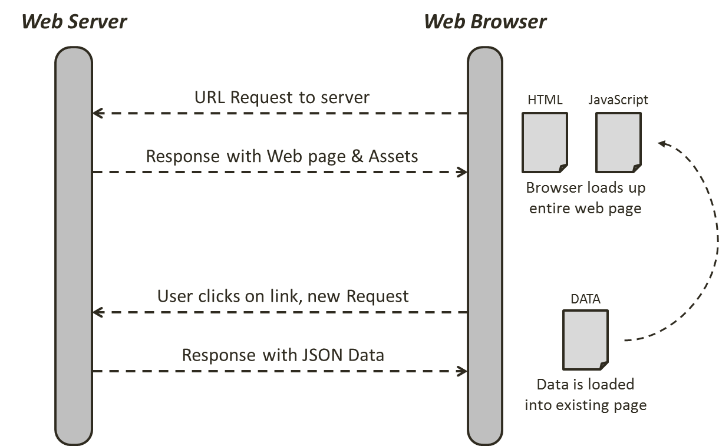
Angular App Request & Response

Slide 10
Angular CLI
Toolset that makes creating, managing and building Angular apps very simple
Great tool for big Angular projects
Website: https://cli.angular.io
Wiki: https://github.com/angular/angular-cli/wiki
Requires Node.js
https://nodejs.org
> npm install –g @angular/cli
> ng new my-first-app
> cd my-first-app
> ng serve

Slide 11
TypeScript
Superset of JavaScript
Offers more features over vanilla JavaScript
Types, Classes, Interfaces, Modules, etc.
TypeScript does not run in the browser, it is compiled to JavaScript (by CLI)
Chosen as main language by Angular
By far most documentation & example-base uses TypeScript
Why TypeScript?
Strong Typing
reduces compile-time errors, provides IDE support
Next Gen JS Features
Modules, Classes, Import, Export, …
Missing JS Features
Interfaces, Generics, …

Slide 12
Bootstrap
Add Bootstrap to the project
npm install --save bootstrap
Add reference to bootstrap.css
.angular-cli.json
In “styles” array, add a reference to “bootstrap.min.css”
For e.g., "../node_modules/bootstrap/dist/css/bootstrap.css"
How does an Angular app gets started?
index.html – Served by the server
main.ts – First file that gets executed
app.module.ts – Main loads this module
app.component.ts
Root component of the app
App module loads this component at the startup

Slide 13
Angular Building Blocks
Components
Encapsulates the template, data and the behavior of a view
Completely decoupled from DOM
Services
Encapsulates any non UI logic
Http calls, logging, business logic, etc
Any logic not related to a view is delegated to a service
Routers
Responsible for navigation from one view to another
Directives
To modify DOM elements and/or extend their behavior
Built-in or custom
Modules
A block of highly related classes

Slide 14
Components
App
NavBar
Sidebar
Products
Search
Product List
Product Form
Product Detail
Rating

Slide 15
Components
Key feature of Angular
Encapsulate the template, data and the behavior of a view
Allows you to break a complex web page into smaller, manageable & reusable parts
Plain TypeScript class
App component
Root component
Holds our entire application
Other components are added to App component
A Component has its own
Template – HTML markup
Style – CSS styles
Business logic (data and behavior) – TypeScript code
Promotes
Reusability
Maintainability
Testability

Slide 16
Decorators
Extends the behavior of a class / function without explicitly modifying it
Attaches metadata to classes
import { Component } from '@angular/core';
@Component({
selector: 'app-server',
templateUrl: 'server.component.html'
})
export class ServerComponent {
}

Slide 17
Modules
Organizes an app into cohesive blocks of functionality
A class decorated with @NgModule metadata
Every Angular app has at least one module class, the root module
@NgModule({
imports: [module1, module2, ...],
declarations: [
component(s), directive(s), pipe(s), ...
],
providers: [service1, service2, ...],
bootstrap: [AppComponent]
})
export class AppModule{ }

Slide 18
Exercise
Create a component – Product
Add a reference to Product component in App component
Check the output
Create another component – Products
Use Angular CLI command to create component
ng generate component products
Add 2 references of Product component within Products component
Add reference to Products component in App component
Check the output

Slide 19
Exercise
Creating a new component
Create a new file, for e.g., product.component.ts
Create a class – ProductComponent
Understanding Decorator
Add decorator - @Component()
import { Component } from ‘@angular/core’;
Provide metadata within @Component decorator
selector, templateUrl
Understanding AppModule
Register ProductComponent within ‘declarations’ array
Import ProductComponent into AppModule
Using a component
Use the selector <app-product></app-product> within app component template
Notes:
Generally, it is a good practice to create a folder for each component.

Slide 20
Exercise
Creating a component with CLI
ng generate component products
ng g c products

Slide 21
Component Templates & Styles
Templates
templateUrl property – external template file
template property – inline template
Styles
styleUrls property – external stylesheet file(s)
styles property – inline styles

Slide 22
Data Binding
Communication between the TypeScript code and the HTML template
TypeScript Code
(Business Logic)
Output data
Template
(HTML)
String Interpolation: {{ value }}
Property Binding: [property]=“value”
User events
Event Binding: (event)=“handler”
Two-way Binding: [(ngModel)]=“property”

Slide 23
Data Binding
String Interpolation
{{ }}
Property Binding
[]
Event Binding
()
$event – Passing event data
Two-way Data Binding
[(ngModel)]
Note: FormsModule should be imported in AppModule (imports[] array) to use ngModel

Slide 24
Directives
Instructions in the DOM
Components are directives with template
Can be built-in or custom
Built-in directives
Structural directives
Have a leading *
Alter the structure of DOM, i.e., elements get added / removed
E.g. *ngIf, *ngFor
Attribute directives
Look like a normal HTML attribute
Only affect / change the element they are added to
E.g. ngStyle, ngClass

Slide 25
Component Interaction
Splitting app into multiple components
App
App
Products
Products
Product Form
Product

Slide 26
Component Interaction
Overview
App
Event Binding
“productCreated” event
Products
Product
Product Form
Property Binding
“product” property

Slide 27
Component Interaction
Binding to Custom Properties
Pass data from parent to child component
@Input() decorator
Binding to Custom Events
Emitting event from child component
@Output() decorator
EventEmitter<T>
eventEmitterObj.emit()

Slide 28
Services
AJAX Request
CLIENT
Shopping Cart
Quick Look
SERVER
(Products API)
App
Products
Product Detail
Product Form
Orders

Slide 29
Services
AJAX Request
CLIENT
Shopping Cart
ProductsService
SERVER (Products API)
Quick Look
App
Products
Product Detail
Product Form
Orders

Slide 30
Services
A class with a narrow, well-defined purpose
For e.g.
Logging service
Data service
Tax calculator
App configuration
Message bus
Acts as a central repository/business unit
Creating a service
Injecting a service into a component
Constructor
Providers
Component level
Module level
Injecting a service into another service
@Injectable()

Slide 31
Services
How to create?
Understanding
Dependency Injection
Injector
Injector
Provider
ProductsService
LoggerService
Products Service
Logger Service
app.component.html
Angular
<app-products></app-products>
<app-product-form></app-product-form>
What to create?
ProductsComponent
Constructor(ProductsService)
ProductFormComponent
Constructor(ProductsService)

Slide 32
Services
Controlling the creation of instances of a Service
AppModule
Same instance of Service is available Application wide
AppComponent
Same instance of Service is available for all Components (but not for other services)
Any other Component
Same instance of Service is available for the Component and all its child Components

Slide 33
Services
Cross component communication using a service
In the service, expose an event object of type EventEmitter
From the source component, invoke emit() method, pass necessary data as an argument
From the destination component subscribe to the service’s event object using subscribe() method, pass callback function as an argument
App
myService.someEvent.subscribe(
(data) => console.log(data)
);
C1
C2
C3
C4
C5
MyService
someEvent: EventEmitter<T>
C6
C7
C8
myService.someEvent.emit(data);

Slide 34
View Encapsulation
Understanding View Encapsulation
@Component()
encapsulation: ViewEncapsulation.None
ViewEncapsulation
Emulated – default
Native
None

Slide 35
Routing
Setting up routes (@angular/router module)
Routes
Define a constant appRoutes of type Routes
RouterModule.forRoot()
Register the routes with RouterModule.forRoot()
Include this in imports array of app module
Loading Routes
<router-outlet> directive
Navigating with Router Links
routerLink directive
Styling active links
routerLinkActive=“active”
[routerLinkActiveOptions]=“{exact: true}”
Navigating Programmatically
Import Router from @angular/router
Inject Router within the constructor
Router.navigate([‘/products’])

Slide 36
Routing
Passing Parameters to Routes
[routerLink] = “[‘/servers’, 10]”
Fetching Route Parameters
ActivatedRoute.snapshot.params[‘id’]
ActivatedRoute.params.subscribe()
Passing Query Parameters
[queryParams] = “{allowEdit: true}”
Retrieving Query Parameters
ActivatedRoute.snapshot.queryParams[]
ActivatedRoute.queryParams.subscribe()
Setting up Child Routes
Redirecting and Wildcard Routes
Outsourcing the Route Configuration

Slide 37
Observables
Can be thought of as a data source
E.g. User input event, Http requests
Used to handle asynchronous tasks
Object we import from a third-party package – rxjs
Follows Observable pattern
Observable
Stream – timeline
Multiple events/data packages emitted by the observable, depending on the data source
Observer – your code
3 ways of handling data packages
Handle Data
Handle Error
Handle Completion

Slide 38
Observables
Observable – rxjs/Observable
Observable.interval()
Observable.create()
Observer - rxjs/Observer
Observer.next()
Observer.error()
Observer.complete()
Observable.subscribe() – returns Subscription (rxjs/Subscription)
Subject
Subject.next()
Subject.subscribe()
http://reactivex.io/rxjs/

Slide 39
Forms
FormsModule should be imported
Creating a form
Registering the controls
ngModel
name attribute
Submitting the form
ngSubmit
<form (ngSubmit)="onSubmit(f)" #f="ngForm">
Accessing the form with @ViewChild
@ViewChild(‘f’) form: NgForm;
User Input Validation
required
email
valid / invalid attribute
ng-valid / ng-invalid attribute

Slide 40
Forms
Using form state
Disable Submit button
[disabled]="!f.valid”
Add local reference to controls
#username=“ngModel”
Display error message based on ‘valid’ and ‘touched’ attributes
Set default values
[ngModel]="defaultSecret“
ngModel and Two-Way binding
[(ngModel)]="answer"
Grouping Form Controls
ngModelGroup="userData“
#userData="ngModelGroup“
Handling Radio Buttons
Using Form Data
Resetting Forms

Slide 41
Pipes
Transform output, do not modify the underlying data
Format the value of an expression for display
Built-in pipes
uppercase
date
Using pipes
Parameterizing pipes
Chaining multiple pipes
Creating a custom pipe
Parameterizing a custom pipe

Slide 42
Server Communication

Slide 43
Q & A
Thank you!

