Slide 1
MicroServices
Group 11

Slide 2
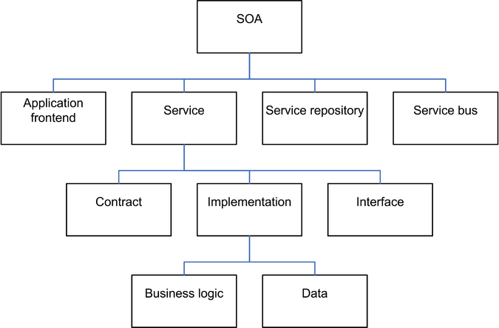
SOA(Service Oriented Architecture)
Business value is given more importance than technical strategy.
Strategic goals are given more importance than project-specific benefits.
Intrinsic interoperability is given more importance than custom integration.
Shared services are given more importance than specific-purpose implementations.
Flexibility is given more importance than optimization.
Evolutionary refinement is given more importance than pursuit of initial perfection.
Notes:
In SOA, the concept basically follows build on top format, where existing services would not change. If additional functionality is needed, a programmer would need to build on top rather than changing the pre-existing implementation.
"If it ain't broke, don't fix it." T. Bert (Thomas Bertram) Lance, the Director of the Office of Management and Budget in Jimmy Carter's 1977 administration.

Slide 3
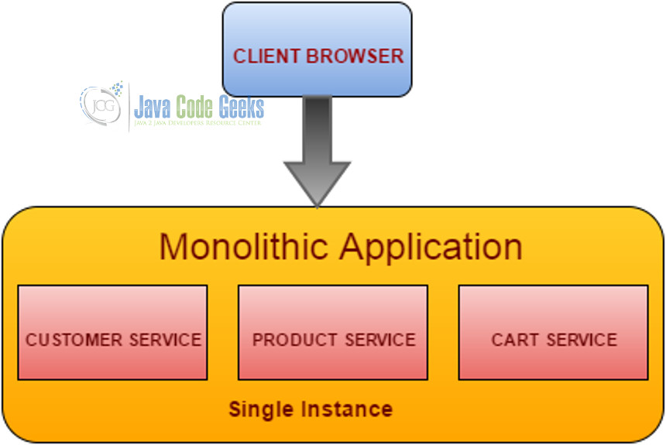
Monolithic Apps
End-to-End functionality
Independent from other services
Usually not enhanced, instead rewritten
Most likely following FRD/BRD project structure
Single deployed unit
Easily handled by a Central operations team
Notes:
https://www.javacodegeeks.com/2016/05/limitations-monolithic-application-need-adapting-micro-services-architecture.html

Slide 4
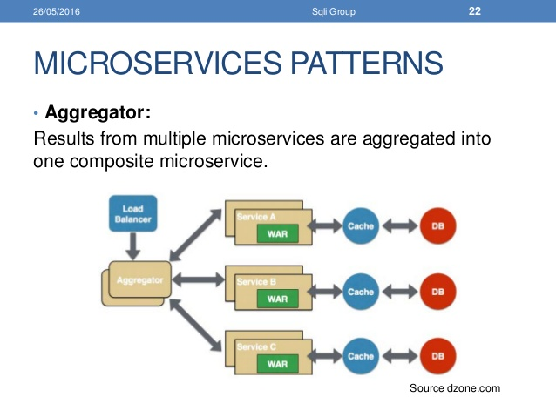
MicroServices
Single function per service
Easily testable, usually through automation e2e testing.
Seamless to patch and deploy independently without having to restart the entire app/ other services
Can easily aggregate multiple services for business functionality

Slide 5
Communication Methods
Each service instance is typically a process, therefore services must interact using an inter-process communication protocol: HTTP, AMQP, TCP
Synchronous Protocol: Client code can only continue its task when it receives a response. Example HTTP
Asynchronous Protocol: Client code or message sender usually does not wait for a response Example AMQP
Communication can have either a single or multiple receivers
Single Receiver: Each request must be processed by exactly one receiver or service. Example Command pattern
Multiple receivers: Each request must be processes by zero to multiple receivers (must be asynchronous). Example: Publish/subscribe
Notes:
Describe the communication methods used in microservices architecture.
https://docs.microsoft.com/en-us/dotnet/standard/microservices-architecture/architect-microservice-container-applications/communication-in-microservice-architecture
https://www.nginx.com/blog/building-microservices-inter-process-communication/

Slide 6
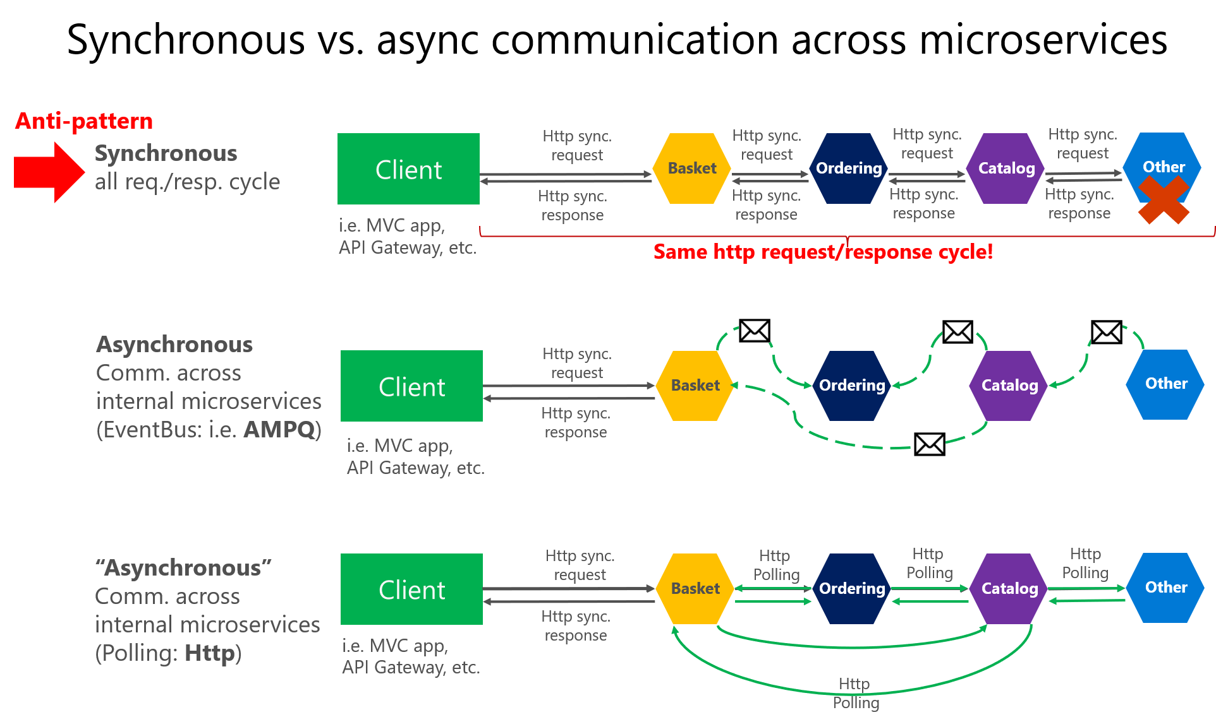

Slide 7
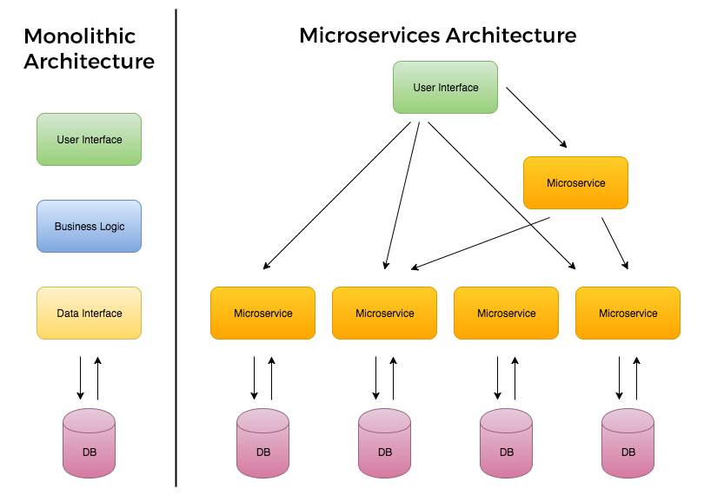
Scalability
Scale only those services that need scaling as load demand increases
Docker, Kunernetes
Deploy each service instance as a container
Notes:
What are some of the techniques used to scale in microservices architecture?
https://supergiant.io/blog/microservices-supergiant-architecture-stability-scale
https://techbeacon.com/challenges-scaling-microservices

