Slide 1
Variable-sized blocks for locality-aware SPMV
Naveen Namashivayam*, Sanyam Mehta*, Pen-Chung Yew†
* Hewlett Packard Enterprise † University of Minnesota, Twin Cities
CGO 2021
Notes:
Hello, My name is Naveen – I work for Hewlett Packard Enterprise.
This is a presentation about an effective blocking scheme that we designed to optimize the sparse matric-vector multiplication kernel.

Slide 2

Sparse Matrix Vector Multiplication (SpMV)
Ubiquitous sparse BLAS kernel
Achieves only 10% of the system peak performance
Optimizations through data formats
$$y ←Ax$$
8
8
0
0
0
0
1
5
0
5
0
0
0
1
0
0
0
0
0
0
1
3
0
3
0
0
0
1
1
0
0
0
0
1
1
y
Sparse Matrix A
x
csrVal
8 5 3 1
cooVal
8 5 3 1
csrCol
0 1 1 4
cooCol
0 1 1 4
csrRowPtr
0 1 1 2 3 4
cooRowIdx
0 1 3 4
Representing Sparse Matrix A in CSR Format
Representing Sparse Matrix A in COO Format
Notes:
To provide a brief back ground on SpMV
<press>
SpMV is an ubiquitous sparse BLAS kernel
<press> It is a very simple kernel
It performs a multiplication between a sparse marix A (which is occupied by large number of zeros) and a dense vector x – while storing the results back into a dense vector y <press> though it is a well known and important kernel – it achieves only 10% of the system peak performance –
The performance bottleneck can be attributed to accessing the sparsely distributed non-zero elements in the matrix A <press> there have been multiple HW and SW based solutions to improve the performance
to implement these optimization – multiple compressed sparse matrix storage representations were introduced – (1) this reduces the memory storage space and (2) also allows us to order the non-zero elements to incorporate any SW and HW optimizations
we have shown two such popular sparse storage representations – CSR and COO
Both these representations use three different arrays to represent the sparse matrix A

Slide 3
Problem statement
Contributions:
Optimize SpMV for scale-free datasets
Propose effective blocking solution
HPC Datasets | Scale-free Datasets
Predictable pattern | Highly Irregular
Helpful HW schemes (Prefetching) | Ineffective HW and SW schemes
HPC Datasets
Scale-free Datasets
SpMV Intel Skylake-X processor using Intel MKL library
Notes:
We are broadly classifying the sparse matrix into two types <press>
HPC datasets and Scale-free datasets
- the non-zero elements in HPC datasets have a predicatable pattern, meaning they have a uniform regular dirtibution - this allows the usage of HW options like prefeetching to optimize the SpMV computation - on the other end are the scale-free matrices where the non-zero elements are randomly or irregualrly distributed - which renders all the known HW and SW optimization techniques ineffective <press>
the graph shows the SpMV performance of sample HPC and scale-free datasets on Intel Skylake-X processors using Intel MKL libraru
we can see that if a vendor optimized SpMV kernel doesn't show performance on scale-free datasets, it means the datasets are hard to tune<press>
The main contribution of our work is
To optimize SpMV for scale-free matrices
we do that by introducing a new blocking scheme

Slide 4
Need for blocking – 1: Hardware prefetching
SpMV with and without HW PF
Observation:
Prefetching is more effective for HPC datasets
Predictable access pattern
HPC Datasets (Average Speedup – 3.54X)
Scale-free Datasets (Average Speedup – 1.72X)
Notes:
For the next few slides - we will be looking at the reason for considering blocking as an optimization scheme for scale-free matrices<press> first - let us look at the impact of HW prefetching we measured the SpMV performance with and without enabling the HW prefetcher on Intel SKL-X processors<press>
The graphs here shows the SpMV speedup by using HW prefetcher against the baseline of disabling the prefetcher in different HPC and scale-free datasets
<press>
from these tests - we can observe that
(1) HW PF is essential for both HPC and scale-free datasets (2) but the performance impact of PF in HPC datasets are much higher than scale-free datasets (3) this can be attributed to regular memory references in HPC datasets

Slide 5
Need for blocking – 2: Cache hierarchy
Changes in cache hierarchy
Private L2 cache Intel BDW – 256KB vs. Intel SKL – 1 MB
Shared L3 cache per core Intel BDW – 2.5 MB/core vs. Intel SKL – 1.375 MB/core
Observation: No change in cache misses
L2 Cache Miss in HPC Datasets
L2 Cache Miss in Scale-free Datasets
Notes:
In this slide, we look at the performance impact from updates in cache hierarchy in modern multicore processors <press> The major change in the cache hierarchy is the ratio of the L2 and L3 cache sizes
Consider Intel BDW as an example of older processors and Intel SKL as newer Xeon processors
<press>
We can see that the L2 cache size is increased and L3 size is reduced for the newer processors
<press> With this information - we measured the number of L2 cache misses in HPC and scale-free matrices in Intel BDW and SKL processors <press>
our expectation was - with the increase in size of L2 cache - the number of cache misses should reduce on modern Intel SKL when compared to Intel BDW but -we observed no such huge change

Slide 6
Need for blocking
Observation:
No effect of L2 cache size increase
Prefetching is not very effective for scale-free datasets
General Requirement:
Increase reusability
Improve temporal locality
Our Contribution:
New column-wise variable sized blocking scheme
Analytical model to determine block sizes
Notes:
To summarize our observation from the tests
<press> there is no effect on SPMV performance with increase in L2 cache size
Also prefetching is not that effective for scale-free matrices
<press>
The general requirement is to increase the reusability and temporal locality
<press>
Our contribution is introducing a new column-wise variable size blocking scheme and analytical model to determine the block sizes

Slide 7
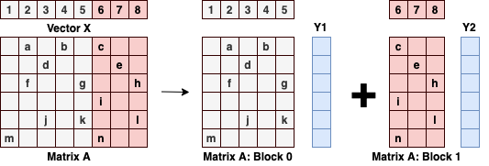
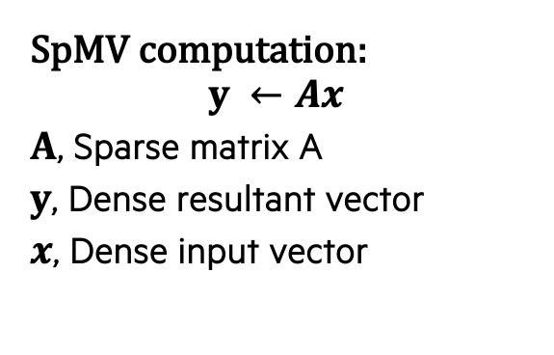
column-wise variable sized blocking scheme
SpMV computation:
$$y ←Ax$$
$A$, Sparse matrix A
$y$, Dense resultant vector
$x$, Dense input vector
Core principle:
Improve temporal locality
Fit effective working set in the cache
Cannot reuse Matrix A
Reuse dense x and y vector
Column-wise blocking
Provides maximum reuse opportunity
Working Set: 1
Working Set: 2
Notes:
In this slide, we are introducing our new column-wise blocking scheme <press>
The core principle of our blocking scheme is to improve the temporal locality by trying to fit the effective working set of the SpMV computation in the cache
<press><press>
In the SpMV computation, we cannot reuse the elements in Matrix A, hence the elements are streamed into the cache for computation While the elements from the dense vector x and y are reusable – hence optimizing and increasing its reusability by determining the effective working set is important and that's the focus our approach <press><press>
An example of our column-wise blocking scheme we use a sample Matrix A
A column-wise block consists of a set of columns grouped together with all the rows in the matrix as part of the block In this example - We have split the matrix into two different blocks – also shown the elements in each working set <press><press>
The elements in each working set consists of three items: - all the non-zero elements in the block - all corresponding elements in dense vector x - and finally all the elements in dense vector y
<press> We can see that with the proposed column-wise scheme all elements in x have maximum reuse opportunity

Slide 8
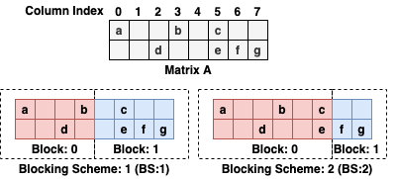
variable-sized blocks using reuse index
Determining effective working set
Reuse index
What? Number of times a value from x is used for SpMV
How? Number of non-zero elements in a column
Empty
Empty
Empty
Constant-sized Blocking (BS:1) | Variable-sized Blocking (BS:2)
Micro-architecture parameter | Reuse index
Size is constant | Sized based effective working set
Notes:
In this slide - we show how to determine the effective working set
<press>
We have used a sample Matrix A and shown two types of block schemes <press> Both BS:1 and BS:2 have the same number of blocks, but different block sizes In BS:1 - we have used a constant size to determine the blocks - we have used the block size as 4 - hence 4 columns are blocked
<press><press> The problem with this approach is that - we would be bringing unnecessary elements from vector x – for example, it is unnecessary to bring elements from x corresponding to column 1 in matrix a - which has no non-zero elements If you look at BS:2 - we have identified this with column 1 and 4 and correctly choosen the next usable x element as part of the working set <press> Essentially - this is the core part of our approach – determining the effective working set
We use a parameter called Reuse Index to determine whether a given column can be part of the block Reuse index - is basically the number of times a value from x is used for SpMV And it can be calculated by counting the number of non-zero elements in a given column <press> While the block sizes in BS:1 depends on some micro-architecture parameters like cache/ register size - the BS:2 blocks are determined using the reuse index and incidentally the blocks are variably-sized

Slide 9
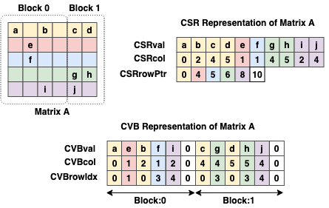
variable-sized blocks in CVB
Suitable for any column-wise formats
CVB – Compressed Vector Blocks
Simple column-wise format
Based on Compressed Vectorization-oriented Sparse Row (CVR*)
Characteristics
Low cache miss & low pre-processing overhead
Efficient SIMD vector utilization
Example:
CVB for an arbitrary SIMD processor with 2 lanes
*Refer CVR: Efficient Vectorization of SpMV on X86 Processors from Xie et al.
CVBval – array storing non-zero values
CVBcol – array storing column indexes
CVBrowIdx – array storing row indexes
Notes:
<press>
Generally – our blocking approach is suitable to be implemented across different column-wise data formats <press> For this work, we have specifically used a new column-based format called CVB
<press>
CVB is based on an existing CVR format <press> It inherits the low cache-miss and low pre-processing overhead feature from its parent CVR format
More details on the format are available in the paper <press>
An example of our CVB format with a sample Matrix A is shown <press> We can see that similar to CSR format – it has three arrays to represent the sparse matrix <press> All elements in a block are grouped together before the next block Also it is SIMD friendly – such that each lane in a SIMD register processes independent row – here we have created the CVB format for Matrix A with a SIMD register of two lanes in mind

Slide 10
Analytical model for variable block sIZES
CVB creation:
Step:1 – Determine variable-sized blocks
Step:2 – Preprocess CSR to CVB
Analytical model
User input:
Minimum number of columns per block
Can a column can be part of a block
Check Reuse Index (RI) and Average Reuse Index (ARI)
RI – number of non-zero elements in the column
ARI – average number of non-zero element in the column
Minimum number of columns per block = 2
Column Index
0 1 2 3 4
8
0
0
0
0
0
0
0
0
0
0
0
5
1
0
0
0
0
0
0
0
0
3
0
1
Sparse Matrix A
Step: 1 - Calculate ARI
- ARI = 1 for Sparse Matrix A
Step: 2
Check whether column:0 can be part of blk:1
RI for column:0 is >= ARI
Include column:0 as part of blk:1
Step: 3
Check whether column:1 can be part of blk:1
RI for column:1 is <= ARI
Don’t Include column:1 as part of blk:1
Step: 4
Check whether column:2 can be part of blk:1
RI for column:2 is >= ARI
Include column:1 as part of blk:1 and we have reached the max blk size – start next block
Step: 4 and beyond
Start next block blk:2 and perform similar RI, ARI checks
Last two columns are part of the second block
Notes:
We can briefly see the analytical model to determine the blocks for CVB <press>
While converting the matrix from CSR to CVB – there are two basic steps involved Step:1 determines the size of the variable-sized blocks and Step:2 uses the determined block sizes and converts the CSR to CVB <press> Our analytical model takes in two inputs from the users to calculate the block sizes
<press>
One the sparse matrix itself and the other is minimum number of columns per block
<press> In this example, we have shown a sample matrix A with 5 columns and user input for minimum number of columns per block as 2 <press> We iterate through each column and check whether the reuse index of the column is larger than the average reuse index If the RI is larger than ARI – we include that column as part of the block We do this until the block size becomes equal to the size of the user provided minimum block size value and then start the next block <press>
Lets show this with an example -
Step:1 shows the ARI calculation which is just the average of all RIs
<press><press>
In Step:2 we check whether RI for column 0 is greater than equal to ARI Since, it is true – we include this column as part of the block <press><press> In Step:3 we check the same for column:1 - - as this check fails – we avoid including this column a part of the block <press><press> In Step:4 we check the same for the next column:2 – as it passes – we include the column a part of block:1
Since block:1 has reached its limit for the number of columns provided by the user – we move on to create a new block <press><press>
Similarly, we determine the columns for the remaining block
<press><press>

Slide 11
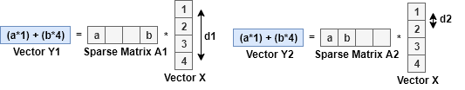
test bed and test set
Test bed overview
Intel Xeon Skylake-X
24 cores per socket
Intel compiler version 19.0.5.281
Used 8-byte double-precision floating point elements
Used AVX-512 intrinsics
Test set overview
Problems in identifying scale-free dataset
Existing concepts are not suitable
Example:
Sparsity for Matrix A1 and Matrix A2 is same
Consider an arbitrary system with cache size of 2 words
No clear analytical model to differentiate datasets
Need for Access Range
Notes:
We have provided a brief background on our blocking scheme – let us now look at its performance benefits <press> For our performance analysis, we used Intel SKL-X processors with 24 cores per socket We implemented the CVB based variable-sized blocking scheme and compiled the SpMV kernel with Intel compiler for evaluation <press><press> The problem with test set is that it is hard to analytically determine the datasets that are suitable for our blocking scheme Existing approaches like sparsity are not suitable for identifying scale-free matrices <press><press>
For example, consider Marix A1 and Matrix A2 – the sparsity (ratio of zero elements to total number of elements) is same For an arbitaty cache size of 2 words – A1 takes 2 reads to perform the SPMV, while A2 takes just one read <press> This clearly shows – sparsity doesn’t understand the non-zero distribution and it is not suitable for identifying the scale-free matrices

Slide 12
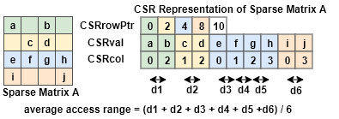
Dataset identification
Introducing Access Range to identify scale-free datasets
Access Range:
Distance between two elements in the dense vector (x)
Average Access Range:
Average of all access range values
Average access range for scale-free datasets is high
Calculating Access Range using CSR Format
Average Access Range for HPC and Scale-free datasets
Notes:
<press> We are introducing a parameter called access range to identify the scale-free matrices <press> Access range is just the distance between two elements in dense vector x which will gather as input for SpMV computation <press>
Consider the previous example with matrix A1 and A2 – Acess range for A1 is 3, which A2 it is 1 <press> With this we could calculate the average access range – which is access range across different rows <press> In this figure – we show average access range calculation on sample matrix A Also, we can use the col index from CSR format to perform this calculation <press> We performed an average access range calculation across different datasets from HPC and scale-free domain
<press>
We identified that average access range for scale-free datasets are much higher This we could use the average acess range as a parameter for determining the datasets for our performance analysis

Slide 13
Standard CSR vs. Non-blocking CVB
Setting Base Line
Non-blocking variant of CVB (CVB-NB) vs. CSR
CVB-NB has a single block
Observation:
CVB-NB 1.23X better speedup than CSR
Some datasets show poor performance
Inference:
Processing multiple rows not always suitable
Negative impact on large average access range datasets
Benefits of blocking
Benefits of variable-sized blocking
Comparing with vendor-tuned SpMV
Hand-tuning performance
Notes:
<press> We set the baseline with this performance analysis We compare the performance of Non-blocking variant of CVB against the standard CSR The non-blocking variant just has one single block consisting of all columns <press> The speedup data of using CVB-NB is shown <press> We can observe that – CVB-NB shows close 1.2X improvement over CSR This can be attributed purely to the properties that CVB inherits from its parent CVR format <press>
But, also we can see that some datasets like orkut and pokec are not optimized <press>
From this we can understand that – processing multiple rows concurrently can have a negative impact on datasets with large access range

Slide 14
VARIABLE_SIZED vs. non-blocking CVB
Setting Base Line
Benefits of blocking
Benefits of variable-sized blocking
Comparing with vendor-tuned SpMV
Hand-tuning performance
Variable-sized blocked (CVB-VAR) vs. CVB-NB
Observation:
Uniform performance benefits
CVB-VAR 1.44X speedup than CVB-NB
Orkut (1.99X) and Pokec (2.10X)
Inference:
Benefits large average access range datasets
Notes:
<press> Here, we show the benefits of blocking with variable-sized blocks We compared the CVB-NB against the variable-sized blocked CVB <press><press> Unformaly CVB-VAR shows performance improvements over CVB-NB <press> Also, on datasets where we previously saw some degradation –like orkut the performance it highly improved with blocking <press> With this we can see that – large access range datasets are showing improvements with blocking

Slide 15
variable-sized vs. constant-sized CVB
Setting Base Line
Benefits of blocking
Benefits of variable-sized blocking
Comparing with vendor-tuned SpMV
Hand-tuning performance
CVB-VAR vs. constant-sized (CVB-CONST) CVB
Observation
CVB-VAR 1.20X speedup than CVB-CONST
Better temporal locality
Notes:
<press> Here, we try to show the benefits of variable-sized blocks vs constan-sized blocks <press><press> Again, we can see that effective working identification using our simple analytical model provides uniform benefits for most dataset

Slide 16
Variable-sized vs. vendor tuned SpMV
Setting Base Line
Benefits of blocking
Benefits of variable-sized blocking
Comparing with vendor-tuned SpMV
Hand-tuning performance
CVB-VAR vs. highly optimized vendor-tuned Intel MKL
Observation
CVB-VAR 1.73X speedup Intel MKL
Inference
Analytical model provides effective working set
Notes:
<press><press> The final analysis – shows the comparison with the highly vendor tuned SpMV kernel with Intel MKL library <press><press> We can observe that the variable-sized blocking prpvides on average 1.73X better performance than the Intel MKL library <press> Which proves our analytical model determined effective working set provides better temporal locality than highly vendor tuned MKL kernel

Slide 17
Performance tuning
Setting Base Line
Benefits of blocking
Benefits of variable-sized blocking
Comparing with vendor-tuned SpMV
Hand-tuning performance
Suggestions for Hand-tuning:
Look at the average access range (AAR)
General observation
Analytical model provides the best possible performance
Amazon shows 1.66X improvements
Notes:
<press> In general, our analytical model identifies the correct working set for a dataset <press>
For example, we show the different number of columns in each block on three separate datasets We can see that on roadNet dataset – it correctly identifies that there is no effect in blocking <press> That said, there is always a chance for further tuning <press> While for most datasets the hand tuned variant shows the same performance as the analytical model determined blocks
<press> Some datasets like Amazon shows benefits We suggest looking at the access range for CVB format to determine whether further tuning is required

Slide 18
conclusion
Optimize SpMV for Scale-free Matrices
Introduce Access Range to classify Scale-free Matrices
Propose an effective variable-sized blocking solution
Provide an analytical model to determine block sizes
Performance evaluation
Used CVB format
2.62X (average 1.73X) better than Intel MKL – single threaded
2.02X (average 1.18X) better than Intel MKL – multithreaded
Provided hints for hand tuning block sizes
Notes:
To conclude <press> We have optimized the SpMV kernel for scale-free matrices
And introduced a new parameter called access range to determine the datasets that are suitable for our optimization
<press> We proposed an effective variable-sized blocking scheme as our optimization solutions Also, provided an analytical model to derermine the block sizes for our proposed solution
<press> Our performance evaluation by implementing our blocking solution on a new data format called CVB shows huge speedups over vendor tuned Intel MKL Also, we have provided hints for users to further tune our blocking approach if needed

Slide 19
Thank you
naveen.ravi@hpe.com
This presentation and recording belong to the authors. No distribution is allowed without the authors' permission.
Notes:
The concludes our presentation – thanks for listening

