Slide 1


Wolfgang Unger 3.2019

Slide 2
Amazon Relational Database Service (Amazon RDS) makes it easy to set up, operate, and scale a relational database in the cloud.
AWS RDS

Slide 3




Database Services on AWS
RDS
Relational database services
Dynamo
key-value & document database
ElastiCache
Managed, Redis or Memcached-compatible in-memory data store.
Redshift
data warehouse
DocumentDB
MongoDB compatible document database
Neptune
graph database

Slide 4
Content
RDS (& Aurora)
Setup RDS database (public & private)
Connect to databases
Setup RDS database with terraform

Slide 5
RDS
Github:
https://github.com/wolfgangunger
https://github.com/wolfgangunger/aws-basics/tree/master/RDS
AWS Documentation
https://aws.amazon.com/rds/?nc1=h_ls
Setup Scenarios:
https://docs.aws.amazon.com/AmazonRDS/latest/UserGuide/USER_VPC.Scenarios.html
Costs of a RDS database:
General calculator:
http://calculator.s3.amazonaws.com/index.html
RDS Calculator:
https://aws.amazon.com/rds/pricing/
Example PostgreSQL
https://aws.amazon.com/rds/postgresql/pricing/
Aurora Calculator:
https://aws.amazon.com/rds/aurora/pricing/

Slide 6
RDS
Supported Databases:
RDS: Aurora:
PostgreSQL PostgreSQL
MySQL MySQL
MariaDB
Oracle
MS SQLServer

Slide 7
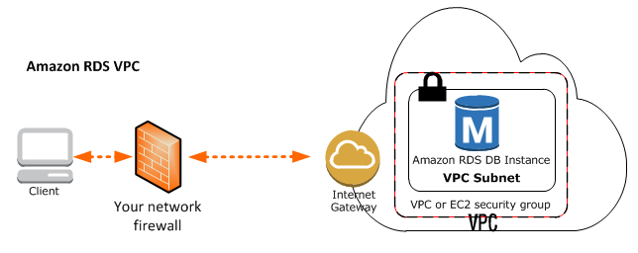
RDS Setup Scenarios
A DB Instance in a VPC Accessed by a Client Application Through the Internet (public Subnet)
To access a DB instance in a VPC from a client application through the internet, you configure a VPC with a single public subnet, and an Internet gateway to enable communication over the Internet.
The following diagram shows this scenario.

Slide 8
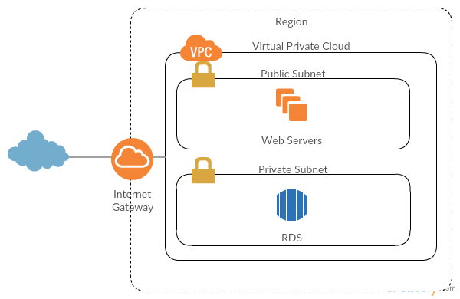
RDS Setup Scenarios
A DB Instance in a VPC Accessed by a Client Application Through the Internet (private Subnet)
You have web servers on a public subnet that you can connect and your RDS instance is hosted on a private subnet. This way, your database instance is not publicly accessible through the internet and you can’t connect your local client with it.

Slide 9
RDS – Setup a DB
Launching a RDS Database
Select Database
Select Stage ( Prod/Dev)
Select engine ( for example MySQL 8.0.13)
Select DB instance class *
Select Multi-AZ ( replica in different zone)
Select Storage ( Type & size)
See estimated costs
Select db identifier and admin user
Select VPC & Subnet, SecurityGroup
Select database options, encryption, backup & monitoring
* https://docs.aws.amazon.com/AmazonRDS/latest/UserGuide/Concepts.DBInstanceClass.html

Slide 10
RDS : Connect to your database
How to connect to a RDS database in a public subnet:
You need endpoint, port, user and password:
ungerw-aws-training.ckz0x47ylciu.eu-west-2.rds.amazonaws.com
3306
bobafett
KillHan-9
MySQL :
mysql -u bobafett -p -h ungerw-aws-training.ckz0x47ylciu.eu-west-2.rds.amazonaws.com
Troubleshooting :
RDS Security group: Is traffic from (and to) your client machine allowed?
NTT/BMW/Network: Do the network settings allow to connect to the db ? For example, in the NTT net, the port must be opened with a Helpdesk Ticket
DNS: If you have problems resolving the hostname, you might create a recordset (CNAME) to connect with a (sub)domain name.

Slide 11
RDS : Connect to your database
How to connect to a RDS database in a private subnet:
You can not connect directly from your client machine to the database.
You need a EC2 instance (for example a bastian host ) in the public subnet to connect via this proxy/bridge .
Command:
Example:
Now you can connect over your local IP:
For MySQL :
mysql -h 127.0.0.1 -P9000 -u bobafett –p (database = awstraining)
Troubleshooting :
RDS & EC2 Security group: Is traffic from your client machine allowed?
NTT/BMW/Network: Do the network settings allow to connect to the db ? For example, in the NTT net, the port must be opened with a Helpdesk Ticket
Other: If you use the same db port locally ( 3306 for mysql or 5432 for postgres) , stop the local server, if you have
one running
ssh -i /path/to/keypair.pem -NL 9000:RDS_ENDPOINT:3306 ec2-user@EC2_HOST –v
ssh -i "ungerw-london.pem" -NL 9000:ungerw-aws-training.ckz0x47ylciu.eu-west-2.rds.amazonaws.com:3306 ec2-user@ec2-35-178-148-152.eu-west-2.compute.amazonaws.com -v

