Slide 1
OPTIMIZING TRANSPORTATION BUSINESS DECISIONS USING SIMPLE MATH&STATS FOR SMARTER LOGISTICS(UBER, LYFT AND DELIVERY FLEETS)
PRESENTATION BY
NAVEEN

Slide 2
Introduction
Goal: Solve transport issues using math & stats
Topics: Probability, Random Variables, Matrices, Vectors, Graphs
Case: Uber routing, Lyft delays, fleet optimization

Slide 3
Probability Basics in Transportation
Random Experiment: An action or process that leads to uncertain outcomes.
Example: A customer books a ride through Uber or Lyft — the result (on-time, delayed, or canceled) is not known in advance.
Outcomes: on-time, delayed, canceled
Sample Space (S): All possible outcomes of the experiment.
S = {On-Time, Delayed, Canceled}
Events: rain, traffic jams, high-demand
Event rules to adjust driver routes and timing
Example: If it’s raining, add buffer time or assign more drivers

Slide 4
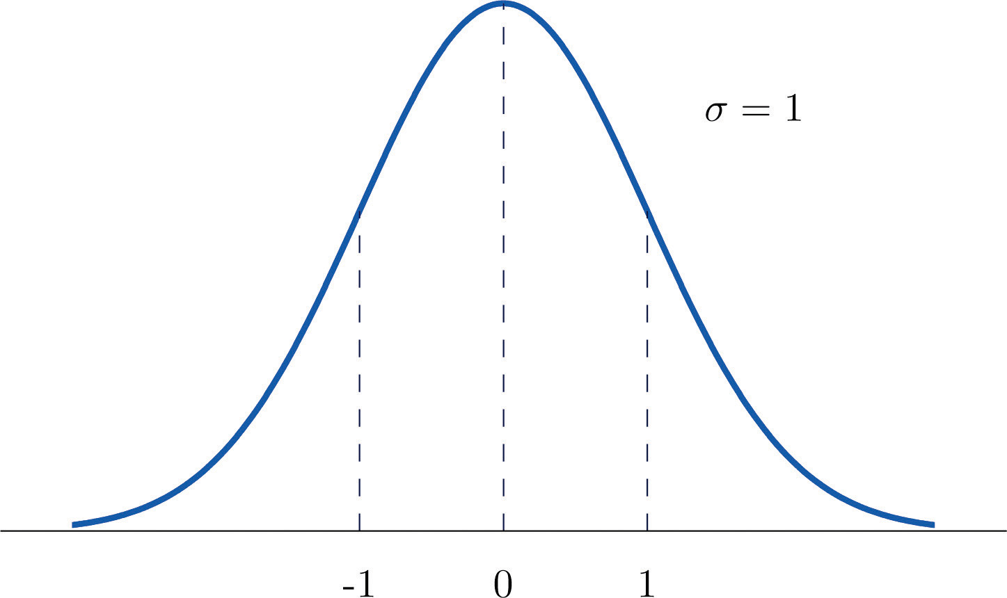
Random Variables & Distributions
Ride time = random variable
Probability Distribution Models :
Trip times (Normal distribution)
Travel time from A to B typically averages 30 mins with some variation.
Driver acceptance (Bernoulli)
A driver either accepts (1) or rejects (0) a ride request.
Pickup Success in Multiple Attempts(Binomial)
Out of 8 ride requests, how many times does a driver accept the ride?

Slide 5
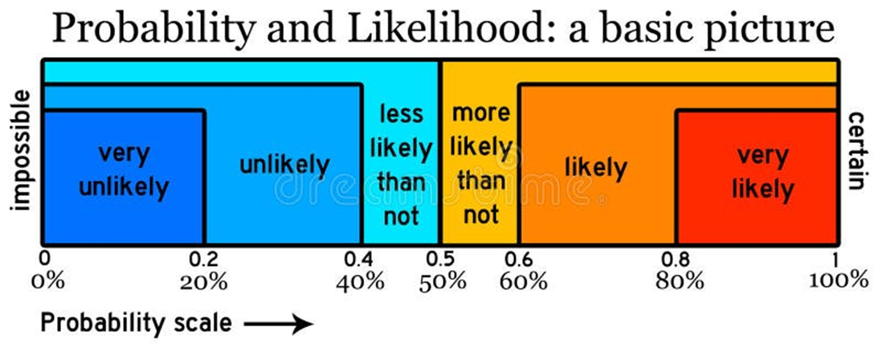
Event | Outcome | Estimated Probability
No rain, no traffic | On-time | Very likely (80–100%)
Rain only | Delayed | Likely (60–80%)
Traffic jam + rain | Canceled or Delayed | More likely than not (~60%)
High demand only | Delayed | Unlikely to be on-time (~30%)
All 3 together | Canceled | Very likely (~80%)

Slide 6
SET THEORY
Term | Meaning | Uber Example
Set | A collection of elements | Set A = All Uber drivers in Zone A
Union (A ∪ B) | All elements from both sets | All drivers from Zone A or B
Intersection (A ∩ B) | Common elements in both sets | Drivers working in both zones
Complement (Aᶜ) | Everything not in set A | Drivers not available in Zone A
Subset (A ⊆ B) | Set A is part of Set B | Morning shift ⊆ All daily drivers

Slide 7
Descriptive Statistics
Mean, Median, Mode = average service times
Standard Deviation = consistency of service
Spot peak hours/zones
Mean: The average time taken for trips (in minutes).
Median: Shows the middle value, not affected by very long or short trips.
Mode: Most common delay reason or duration.

Slide 8
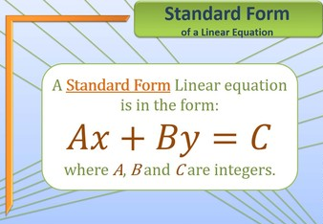
Systems of Linear Equations
Balance fuel, time, rides
Solve for efficient operations
Total Cost= aF+bT+cR Where:
F = Fuel used (liters or gallons)
T = Time taken (minutes or hours)
R = Number of rides completed
a, b, c = Cost weights per unit of fuel, time, and rides

Slide 9
Matrices in Routing and Scheduling
Matrix = travel times between locations
Used in route optimization (Uber maps)
Uber looks at all possible drop-off points and chooses the shortest time path.
Matrix helps it recalculate in real time during traffic.
When we use traffic matrices,
eigenvectors show the most-used routes.
Eigenvalues tell us how strong or weak the system is.

Slide 10
Vectors in Fleet Management
Vector = [miles, fuel, time, passengers]
Compare & optimize ride patterns
Vector A:
📍 Miles: 8
⛽ Fuel: 1.5 gallons
⏱️ Time: 25 mins
👤 Passengers: 1
Vector B (More Efficient):
📍 Miles: 10
⛽ Fuel: 1.8 gallons
⏱️ Time: 22 mins
👥 Passengers: 2 ✅ More efficient (less time, more passengers)

Slide 11
Linear Independence, Basis, Rank
Remove duplicate driver routes
Improves route planning
Rank = network efficiency
Linear Independence: Each route is unique (not a combination of others)
Basis: Smallest set of unique routes that cover the whole system
Rank: Number of independent (efficient) routes

Slide 12
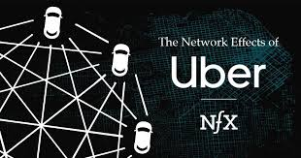
Social Networks & Random Graphs
City = graph (nodes = locations, edges = roads)
Analyze path & central areas
Assign the closest driver
Re-route around traffic
Avoid delays and missed pickups

Slide 13
Integrated Problem Solving
Issue: Ride cancellations in Downtown
Apply Probability, Matrices, Vectors, Graphs
Probability | Estimate risk based on conditions
Matrices | Optimize travel time & route
Vectors | Match right drivers to riders
Graphs | Visualize & improve route network

Slide 14
Conclusion
Math enables smarter business decisions
Turns trip data into clear insights
Predicts ride demand and delays
Optimizes pricing and planning
Data science improves logistics efficiency
Finds fastest, cheapest routes
Reduces fuel and wait time
Powers real-time ride decisions

Slide 15

Any
Thank you!

