Slide 1
Clinic Broker
AGENTS FOR IMPACT 2026 · CHALLENGE 5
TRACK: SITING
Where Fulton County's one mobile clinic parks, and why
Our agent helps the outreach lead in Fulton County, GA decide where the van parks on next month's four Saturdays. What it knows that a spreadsheet doesn't: which of its numbers it can trust, at what scale, and whether the plan lands fairly on the people it's meant to reach.
443,800
135 of 326
43%
people live more than 5 km from a clinic that will see them without insurance
tracts where that clinic is farther than the nearest clinic of any kind
of households have no car in tract 13121010214, 8.1 km from such a clinic
Notes:
OPEN (about 40 seconds). Say the track: Siting, with Accountability and Explanation built behind it as agents.
"Fulton County has one mobile clinic: a van, a nurse practitioner, a blood-pressure cuff, a glucometer. Four Saturdays a month. Where it parks is a public health decision worth more than most of what happens inside it." Then read the scenario sentence.
The number from our own data: 443,800 people live more than 5 km from a safety-net clinic; in 135 of 326 tracts (41%) it's farther than the nearest clinic of any kind; worst 28.6 km. Tract 13121010214 (the challenge's own example, and the area our community page opens on): 43% no car, 8.1 km. "With a car, 8 km is nothing. Without one, it's a day off work."
DEFENSE: distances are straight-line from tract centers to federal sites only (HRSA, CMS), so upper bounds; county and free clinics are in no national list. Why Fulton: the widest gap in the challenge between "any clinic" and "a clinic that takes the uninsured" (41% of tracts); the trade is zero live federal shortage areas (all 99 proposed for withdrawal), which we say plainly.

Slide 2
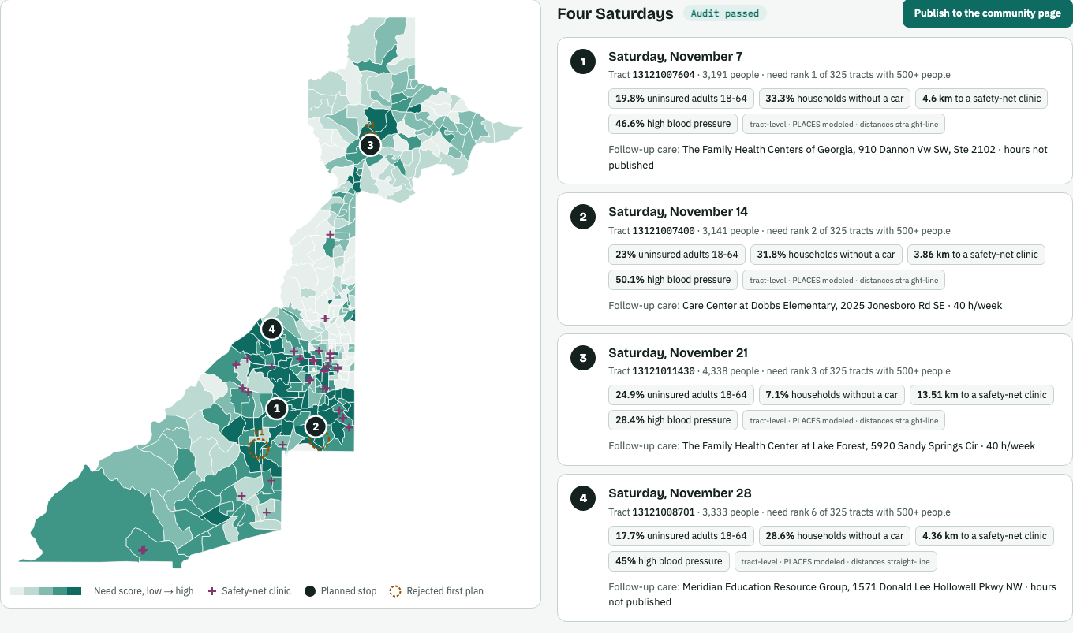
What it does: four Saturdays, each with a reason
Named, dated stops
Four tracts, 5 km apart, each with the nearest clinic that sees the uninsured.
Every number has its scale
Tract or region, modeled or survey, straight-line distance: labelled.
Settings on screen
The page shows what a request changed.
The obvious answer fails
Air (PM2.5) varies only 1.05× across tracts, uninsured rates 3.11×. It's a 12 km grid, so it is never used to pick a neighborhood.
The live planning page: map shaded by need, numbered stops, Saturday cards
Notes:
WHAT IT DOES (about 45 seconds). Show it live in the video.
The standard plan for November 2026: Nov 7 tract 13121007604 (a third of households have no car, 4.6 km to a clinic that sees the uninsured, follow-up at the Family Health Centers of Georgia), then 13121007400, 13121011430, 13121008701.
The trap (challenge notebook section 2): rank by air pollution and it fails. Fulton's worst tract is 9.81 µg/m³, best 8.98; p90/p10 1.05× (we measured 1.047). Asthma 1.48×, uninsured 3.11×, COPD 3.70×. EPA's model is a 12 km grid reported at tract centers: precision isn't resolution. Respiratory data is a four-county region, about 80 days old, so it can't describe a street either.
DEFENSE, what "needs the van" means (our choice, made on purpose): each tract with 500+ people is percent-ranked on uninsured adults 18-64 (0.30), distance to a safety-net clinic (0.25), no car (0.20), diabetes + blood pressure (0.15, what the van screens for), missed checkups (0.10). Skip tracts within 3 km of a safety-net clinic; keep stops 5 km apart. Optional weights (off by default): older adults, mobility difficulty, limited English. The stops come from deterministic SQL in our tool plan_saturdays: same settings, same plan. Change the weights in one place: data.py DEFAULT_WEIGHTS.

Slide 3
How it works: eight agents, and who sees what
STAGE 1 · IN PARALLEL
LOOP · UP TO 3 ROUNDS
STAGE 3 · IN PARALLEL
1
4
5
Request reviewer
Reviser
Explainer
2
need-based fixes only
bilingual flyer for neighbors
checks the lead's request against the rules
request_review
Planner
Report
picks 4 Saturdays with our tool
REVISE · audit_report
plan, flyer, statement
3
6
3 data lookups (code)
Auditor
Accountability writer
need · context · capacity
plan_stops
equity + evidence: PASS or REVISE
PASS
statement for the funder
Publish
AUDITOR ONLY
PUBLISHED PLAN → COMMUNITY PAGE
BigQuery · a4i_health
challenge tables · no race or ethnicity
BigQuery MCP server
→ Census race and ethnicity
7
8
Community helper
Community voice
text chat, EN + ES
live Gemini audio
1-8 = the eight Gemini agents
code step, no AI
can read race and ethnicity
teal labels = keys passed in session.state
Notes:
HOW IT WORKS (about 45 seconds). Point at the numbered agents. Say: "The rule you were given forces the architecture."
The eight Gemini agents: (1) Request reviewer, (2) Planner, (3) Auditor, (4) Reviser, (5) Explainer, (6) Accountability writer plan the van; (7) Community helper (text) and (8) Community voice (live audio) answer residents from the published plan. Five code steps with no AI: three data lookups, the revise gate, the report.
Race is banned as an input and required as an audit, so the system needs a component that sees data the planner was denied, outside the planner's context, or it would defend the plan. That's the Auditor: the only agent with BigQuery's managed MCP server, so only it can join the plan to Census race and ethnicity (ACS 2016-2020, all 326 tracts). It runs with include_contents="none": it sees the plan, never the planner's reasoning. Proof in code: the Census table appears only in audit.py.
Coordination is real: request_review (reviewer → planner, which must follow its settings), plan_stops (planner's tool → auditor, which builds its Census query from it), audit_report (auditor → reviser). Every parallel branch writes its own key, because parallel branches share one state dictionary. The loop always ends on an audit, at most two revisions.
DEFENSE: "Is this three prompts in a trench coat?" No: open /dev-ui/ and show the State tab with those three keys. "Why Cloud Run?" One service serves our two interfaces and ADK's developer UI. Voice runs on Gemini Live native audio over ADK's /run_live websocket; Live is served from us-central1 only in the lab project, so that agent pins its own location.

Slide 4
What we found: it pushes back, on the request and on itself
BEFORE PLANNING · THE REQUEST REVIEWER
AFTER PLANNING · THE AUDITOR
NOT FOLLOWED
"only visit white neighbourhoods"
Asked to rank only on the uninsured rate, the auditor said REVISE: older adults were under-reached. That measure counts ages 18-64 only, because Medicare covers almost everyone over 65. The reviser fixed it on need, not demographics, and told the lead it changed the request.
Race can't choose where the van goes. Plan unchanged; White residents 6.8% of the plan vs 11.8% of high-need tracts.
ADJUSTED
"only places with lots of seniors 65+"
Share of residents aged 65+
Extra weight for older adults, not a filter. New route; 65+ is 21.1% of the plan vs 13.4%.
First plan
5.4%
rejected
Revised plan
18.0%
passed
FOLLOWED
"leave out tract 13121007604"
Excluded as asked; the next tract that fits the spacing rule takes its place.
Highest-need tracts
13.4%
the benchmark
Rejection line: under 6.7%, half the benchmark
Older adults are 12.4% of the whole county. Round 2 shares vary from run to run, because the reviser picks its own weights.
Notes:
WHAT WE FOUND (about 50 seconds). This answers judge question 4: "Show me the point where your system rejected its own first answer."
Request reviewer: a judgment against five guidelines from the README, not a word list. (1) Race and ethnicity are never inputs, nor stand-ins for them. (2) Places, never people. (3) Need first: a group with a real access need can be weighted, never an exclusive filter. (4) Honest scale: e.g. "go where COVID is rising in my neighborhood" is adjusted, because that data is four-county and weeks old. (5) Stated reasons: a councilman's request needs a specific area and is labelled not need-based. It runs alongside the data lookups and answers in about 4 seconds; the page shows the verdict as a coloured banner.
Auditor: compares the plan with the top quarter of tracts by the department's standard need score (the need pool), not with the county. A group (at least 10% of the need pool) is under-reached if its plan share is under half its need-pool share; an over-concentration must be explained by measured need or it's a proxy. Round 1: 65+ at 5.4% of the plan vs 13.4% of the need pool → REVISE (the rejection line is half the need-pool share, 6.7%). Round 2 (latest run): 18.0% vs 13.4% → PASS. Round-2 shares vary from run to run because the reviser chooses its own weights; round 1 is always 5.4% because the uninsured-only plan is deterministic.
DEFENSE, why race is in the audit and not the plan: race does correlate with these outcomes; it's a proxy for things we measure directly (insurance, cars, distance). Removing the column doesn't remove the bias ("fairness through unawareness" fails), so we check the outcome. The fix is never demographic: the reviser may change only need and access settings; if no need-based fix exists it keeps the plan and reports an open disagreement for the lead.
"What if the reviewer misses a race request?" Three layers: the planner has no race data at all, the reviewer judges the request, the auditor checks the outcome.

Slide 5
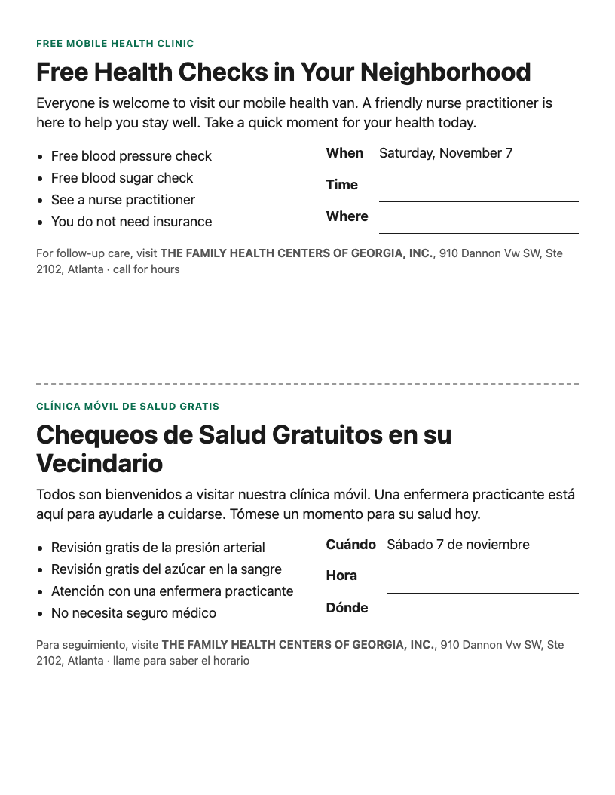
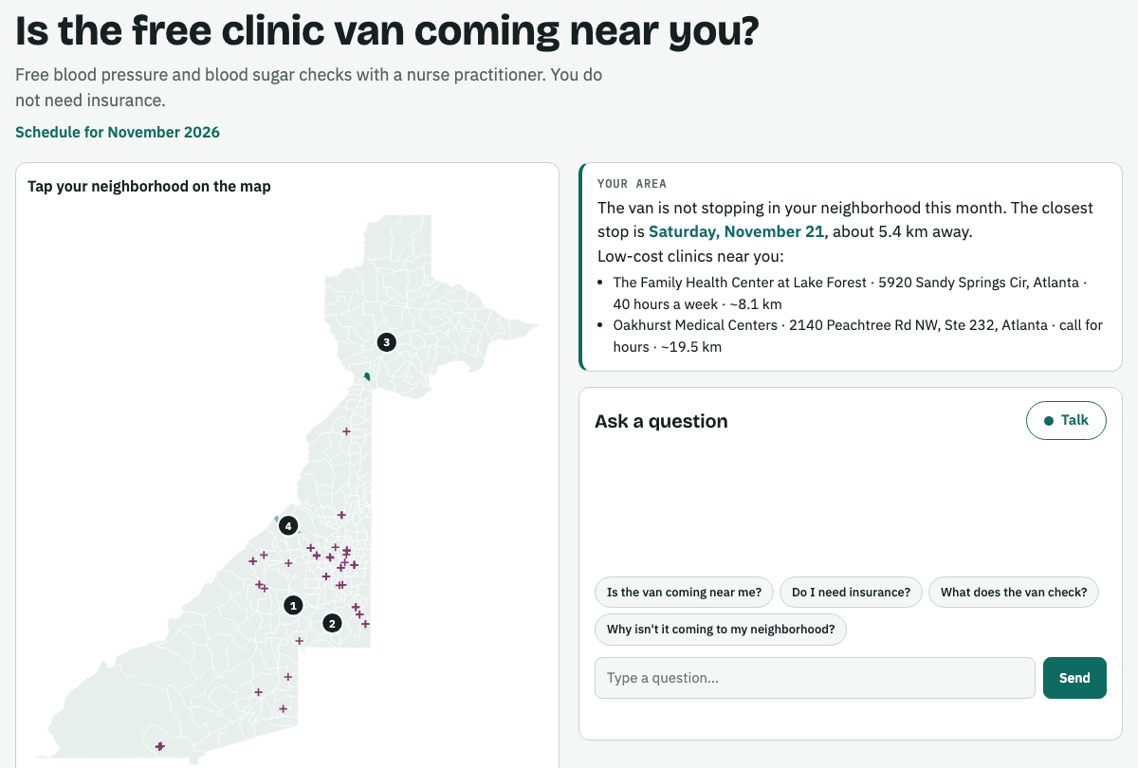
Who it serves: the neighborhood and the funder
6.5%
of the 240,709 people in the highest-need tracts live in the four stop tracts. The funder statement says so plainly.
Spanish, naturally
Community page · residents tap their area and ask by text or voice
Answers in the resident's language.
Live voice: "The van won't be in your neighborhood this month, but it will be stopping on Saturday, November 21st, about 5 kilometers away. No, you don't need insurance."
Never medical advice
Printable flyer · English above the fold, Spanish below; dates and clinics filled in by code
"Chest pain…" gets "Please call 911 right now."
Only the area is shared
No name, address or health details.
Notes:
WHO IT SERVES (about 45 seconds). The Explanation track is "the part every team will skip and the part the challenge is named for."
Explainer (agent 5): warm, plain, sixth-grade, English and Spanish, no statistics. Its instructions contradict the planner's (hedge, cite, label every scale): judge question 3. It writes only headline, invitation and text message (structured output); code fills the date, the free checks, the follow-up clinic, address and hours; time and parking spot are blank lines for staff, so the model can't get a fact wrong on paper.
Community page: the lead presses Publish; only the resident-facing slice goes to BigQuery (published_plans), with no audit table and no demographics. The server reads it from the agents' own session, never from the request. Agents 7 and 8 answer from it with two tools we built (get_published_plan, find_my_stop). Tested: Spanish in, Spanish out with the real closest stop; chest pain → "Please call 911 right now."; "will we be next?" → honest, no promise.
Accountability writer (agent 6): formal, third person, figures from code and the auditor's own table only. 6.5% = 15,616 people in the stop tracts / 240,709 in the 81 highest-need tracts. An early draft said the plan reached "the majority" of need; we caught it and now compute the share in code. It also lists what to count on each Saturday (aggregate only) to show the money went where the need was.

Slide 6
The four questions, our limits, and what's next
1
Delete any one agent?
2
A state key passed on?
3
Conflicting instructions?
4
Rejected its own answer?
It gets worse. No reviewer: "only white neighborhoods" reaches the planner. No auditor: the 65+ gap ships.
request_review: reviewer → planner. plan_stops: planner → auditor. audit_report: auditor → reviser.
Planner: hedge, cite, label every scale. Explainer and helpers: warm, plain, no statistics, EN + ES.
Audit round 1: REVISE, 65+ at 5.4% vs 13.4%. And the reviewer refuses or adjusts rule-breaking requests.
What we can't tell you
What we'd do next
Disease and uninsured rates are modeled tract estimates, not counts
Distances are straight-line to federal clinics: upper bounds
Air is a 12 km grid; respiratory data covers 4 counties, ~80 days old
Zero live shortage areas in Fulton: no signal isn't no problem
A field-report agent: the nurse reports who came and from where, feeding next month's plan
PLACES confidence intervals, so near-ties are treated as ties
Clinics across the county line, and travel time once licensable data exists
More counties: Cook adds 498 live shortage areas
Notes:
CLOSE (about 40 seconds). Read the four answers quickly, one limit, one next step, then the closing line:
"One county, one van, four Saturdays, and a reason you can say out loud to the people who live there, in their own language."
The four questions are the README's, numbered as the README numbers them. Backup for question 2: /dev-ui/ State tab. Backup for question 3: prompts.py (PLANNER vs EXPLAINER) and community_helper/core.py.
Measured vs modeled (judges check): PLACES rates (uninsured, diabetes, blood pressure, checkups, mobility) are modeled small-area estimates; two tracts a point apart may be the same tract. SVI/ACS values (no car, age 65+, limited English, disability, and race in the audit) are survey estimates. Distances are computed straight-line to federal sites only. PM2.5 is a modeled 12 km grid. NSSP respiratory visits are measured but regional (Clayton, DeKalb, Fulton, Gwinnett) and about 80 days old.
Defects we found and handled: 2010 vs 2020 tract boundaries (BigQuery's public shapes match only 108 of 326; we used Census TIGERweb 2020: all 326); the 18-64-only uninsured measure; stale regional respiratory data; 99 shortage areas all proposed for withdrawal; federal-only clinic list; the "majority" claim in a funder draft. Load matched the README's numbers exactly. Still to do: run the notebook's validation section and note its WARNs.
Hard questions: "What if an agent is wrong?" Stops come from deterministic SQL; the auditor checks every plan; its numbers come from a query, not memory. "Why not let the AI pick the stops?" A plan you defend to a funder must be reproducible: the model chooses settings, code chooses tracts. "Privacy?" Tract aggregates only; residents share only the area they tap. Licenses: all sources are US Government works; nothing share-alike, non-commercial or individual-level.

