Slide 1
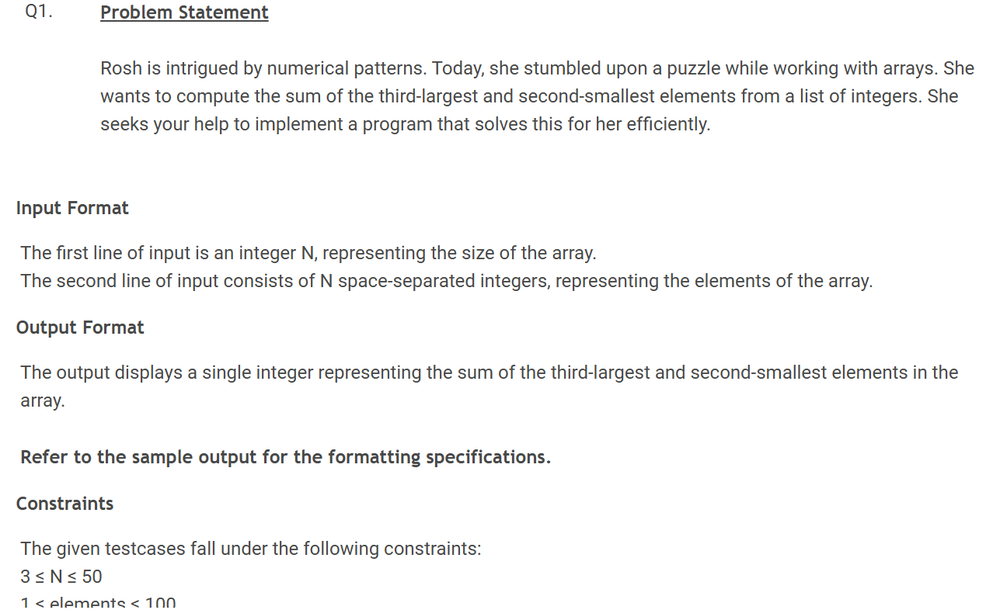


Slide 2
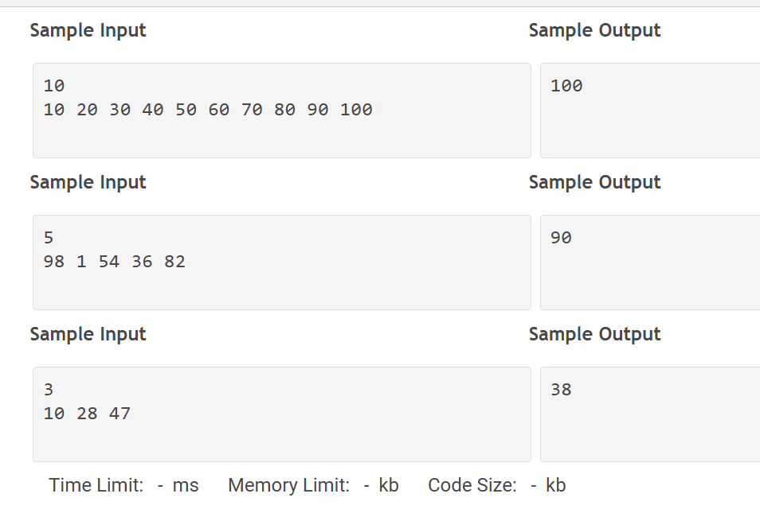

Slide 3
Problem Understanding
We are given:
An array of N integers
We need to find:
Third Largest element
Second Smallest element
Then add both and print the result.

Slide 4
Example
Array:
10 20 30 40 50 60 70 80 90 100
Sorted → 10 20 30 40 50 60 70 80 90 100
Second smallest → 20
Third largest → 80
Sum = 20 + 80 = 100

Slide 5
Algorithm
Read input N
Read array elements
Sort the array in ascending order
Find:
Second smallest → arr[1]
Third largest → arr[n-3]
Add both values
Print result

Slide 6
LOGIC:
Position | Meaning
arr[0] | Smallest
arr[1] | Second Smallest
arr[n-1] | Largest
arr[n-2] arr[n-3] | Second Largest Third largest
 | Final Answer = arr[1] + arr[n-3]

Slide 7
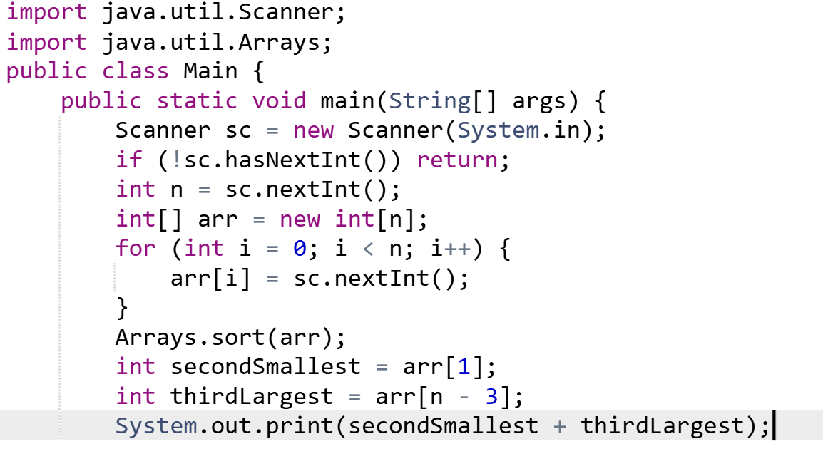

Slide 8
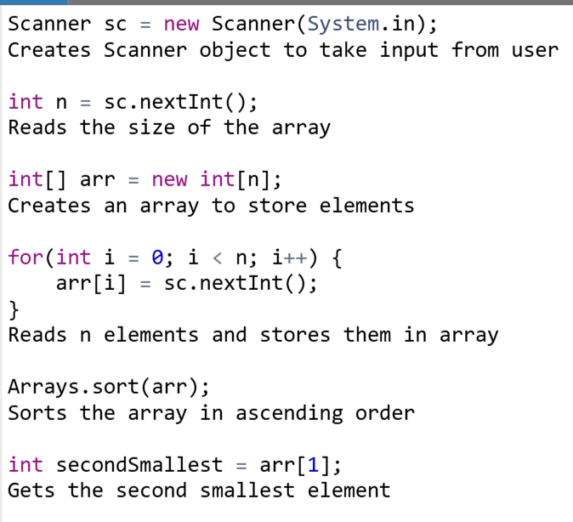
CODE EXPLANATION (LINE-BY-LINE):

Slide 9
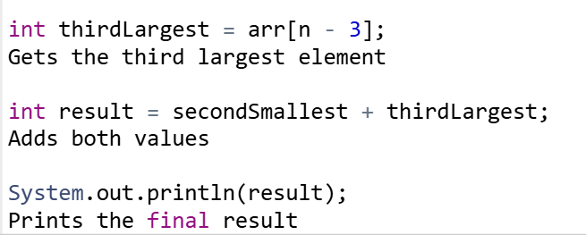

Slide 10
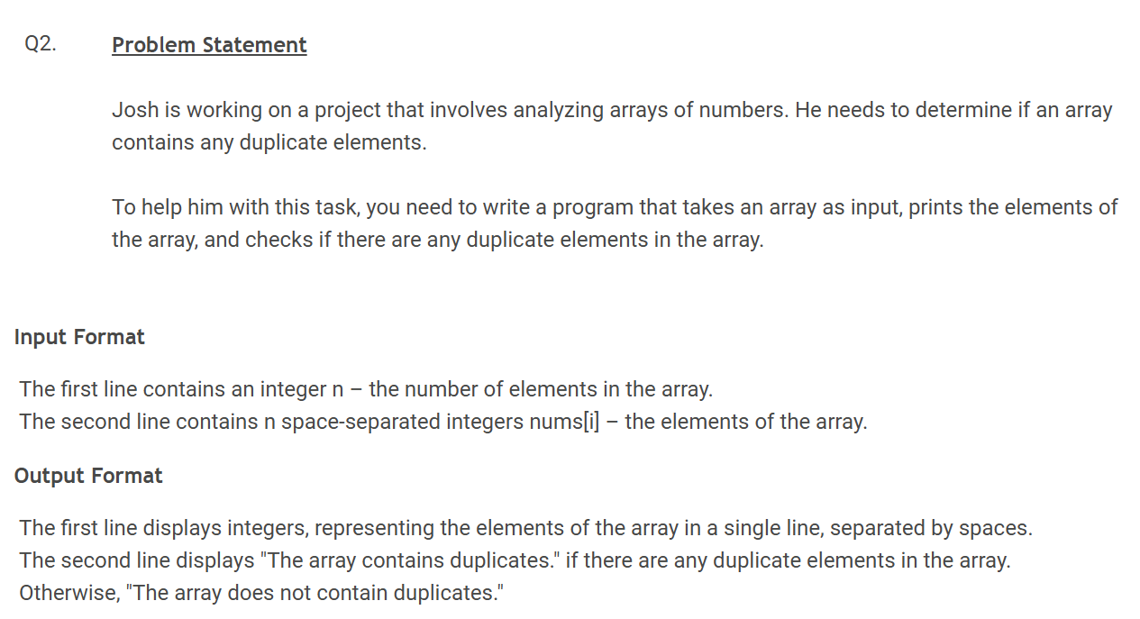

Slide 11
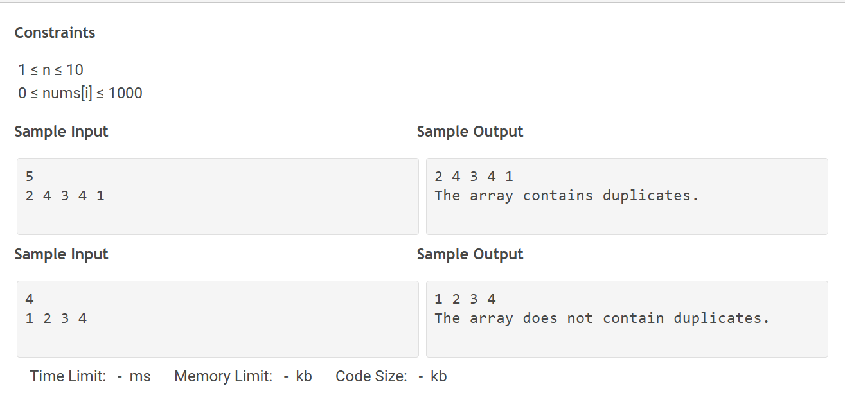

Slide 12
PROBLEM UNDERSTANDING
We are given an array of n integers.
We need to:
1. Print all elements of the array
2. Check if any element appears more than once (duplicate)
If duplicate exists → print "The array contains duplicates."
Else → print "The array does not contain duplicates."

Slide 13
ALGORITHM
1. Read input n
2. Read array elements
3. Print all elements
4. Compare each element with others
5. If any duplicate found → mark as true
6. Print result based on condition

Slide 14
LOGIC (Simple Trick)
Use two loops:
- Outer loop picks one element
- Inner loop checks remaining elements
If arr[i] == arr[j] → duplicate found

Slide 15
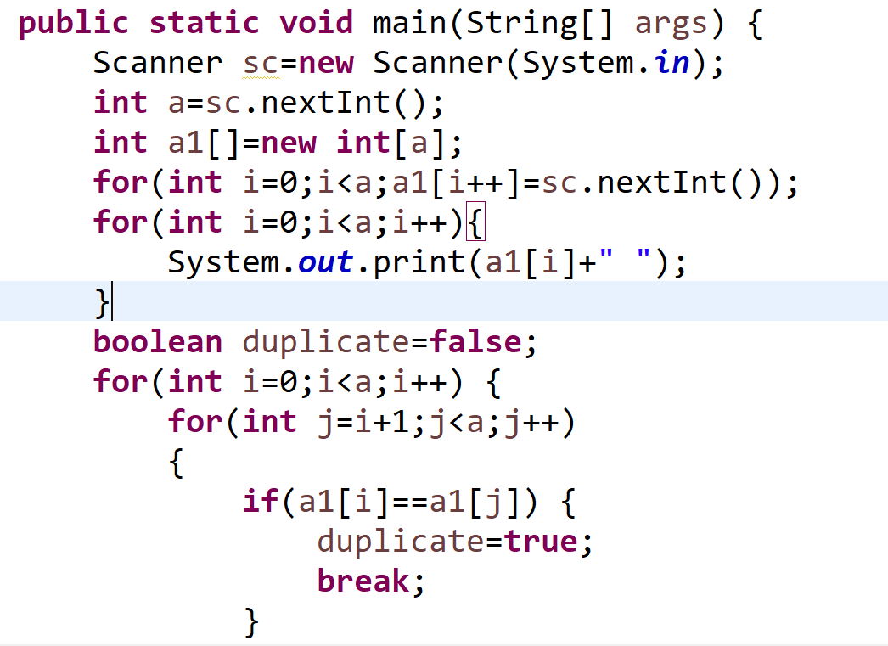
JAVA CODE

Slide 16
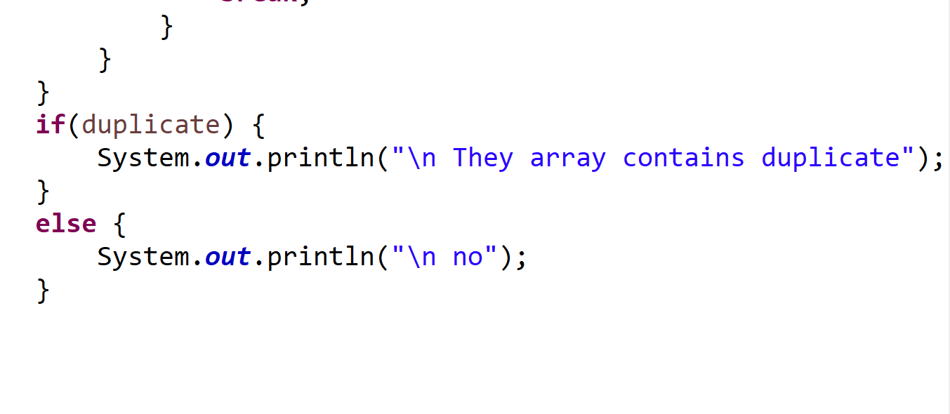

Slide 17
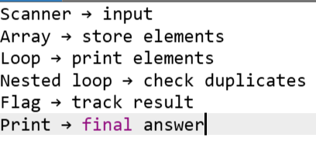
CODE EXPLANATION (LINE-BY-LINE):

Slide 18
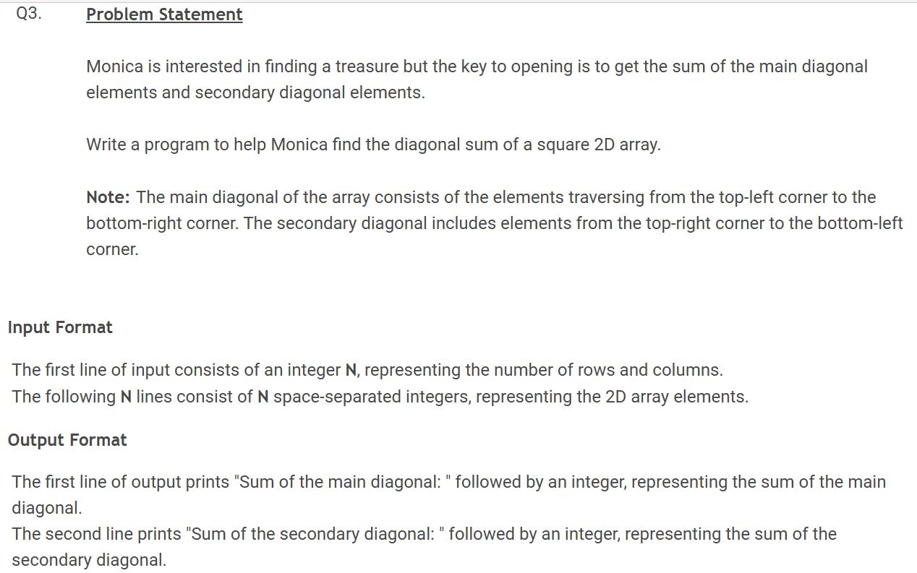

Slide 19
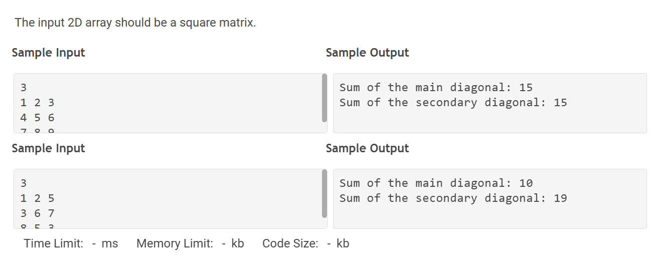

Slide 20
PROBLEM UNDERSTANDING
Given a square matrix, find:
1. Sum of main diagonal
2. Sum of secondary diagonal
ALGORITHM
1. Read n
2. Read matrix
3. Traverse matrix
4. Add:
- Main diagonal → i == j
- Secondary diagonal → i + j == n - 1
5. Print both sums

Slide 21
LOGIC
Main diagonal → arr[i][i]
Secondary diagonal → arr[i][n - i - 1]

Slide 22
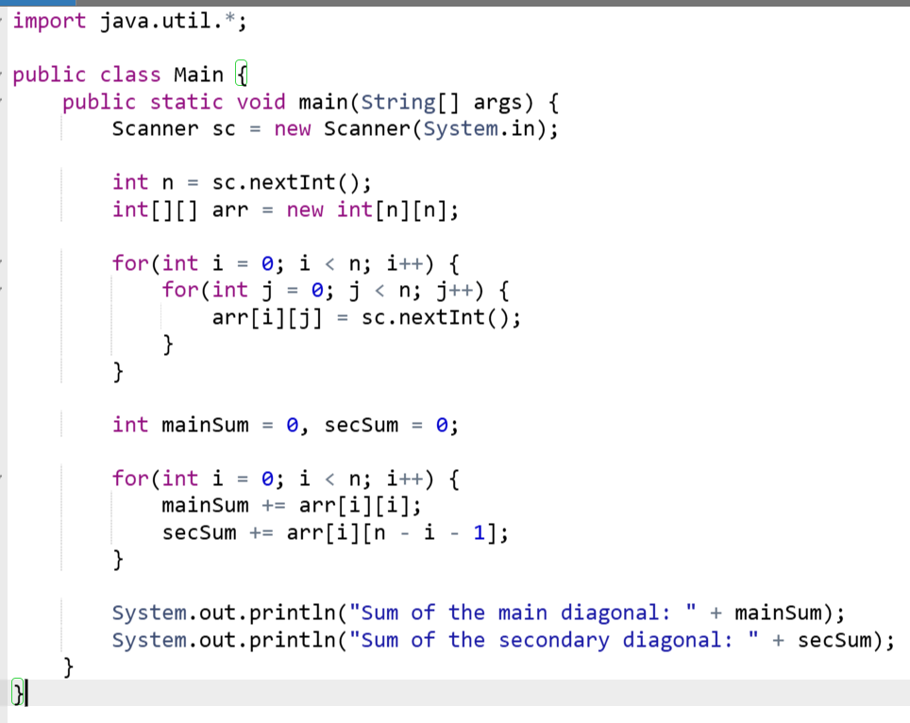
JAVA CODE:

Slide 23
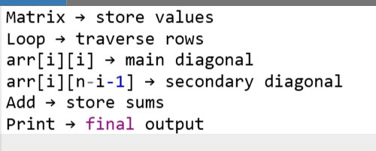
CODE EXPLANATION

Slide 24
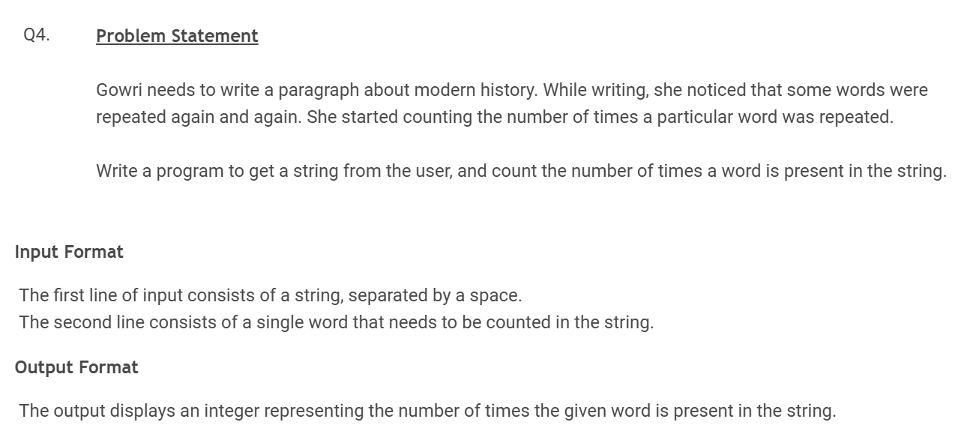

Slide 25
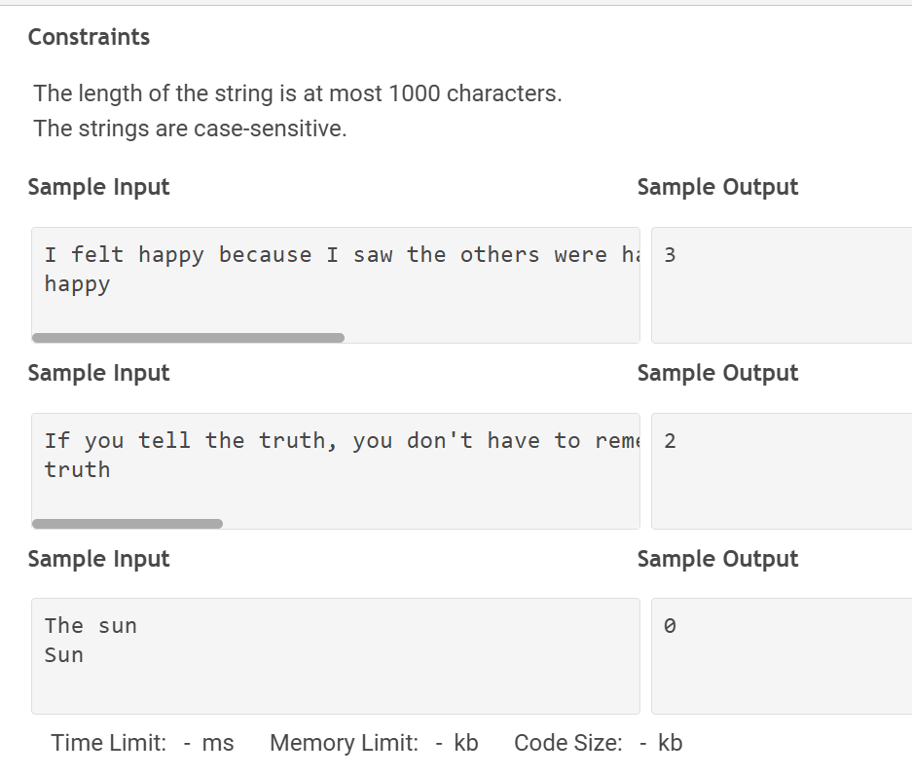

Slide 26
PROBLEM UNDERSTANDING
Given a sentence and a word, count how many times the word appears.
(Note: Case-sensitive)
ALGORITHM
1. Read full sentence
2. Read target word
3. Split sentence into words
4. Compare each word with target
5. Count matches
6. Print count

Slide 27
LOGIC
Use split(" ") → convert sentence to array
Check → if(word.equals(target)) → count++

Slide 28
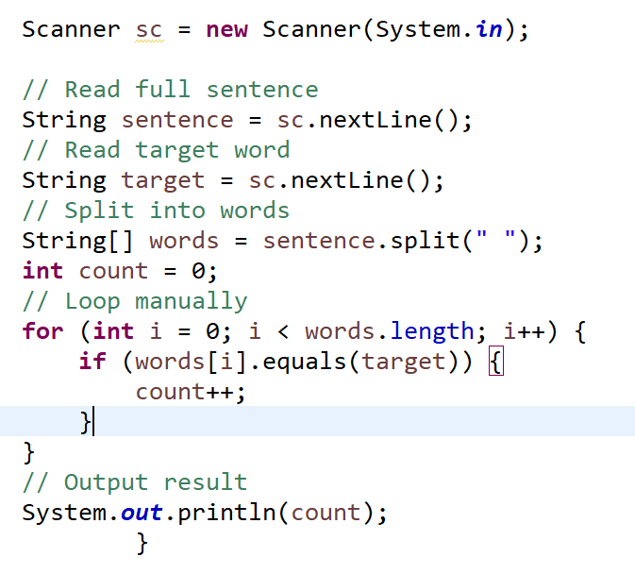

Slide 29
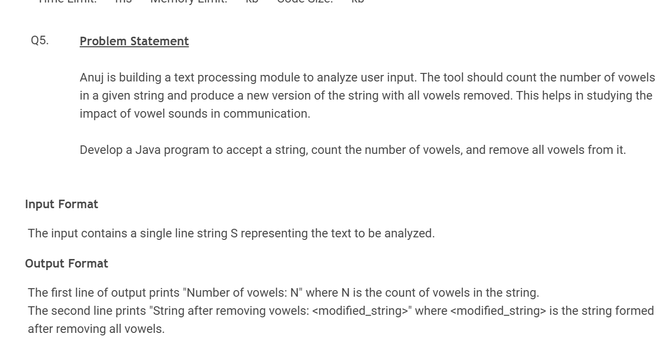

Slide 30
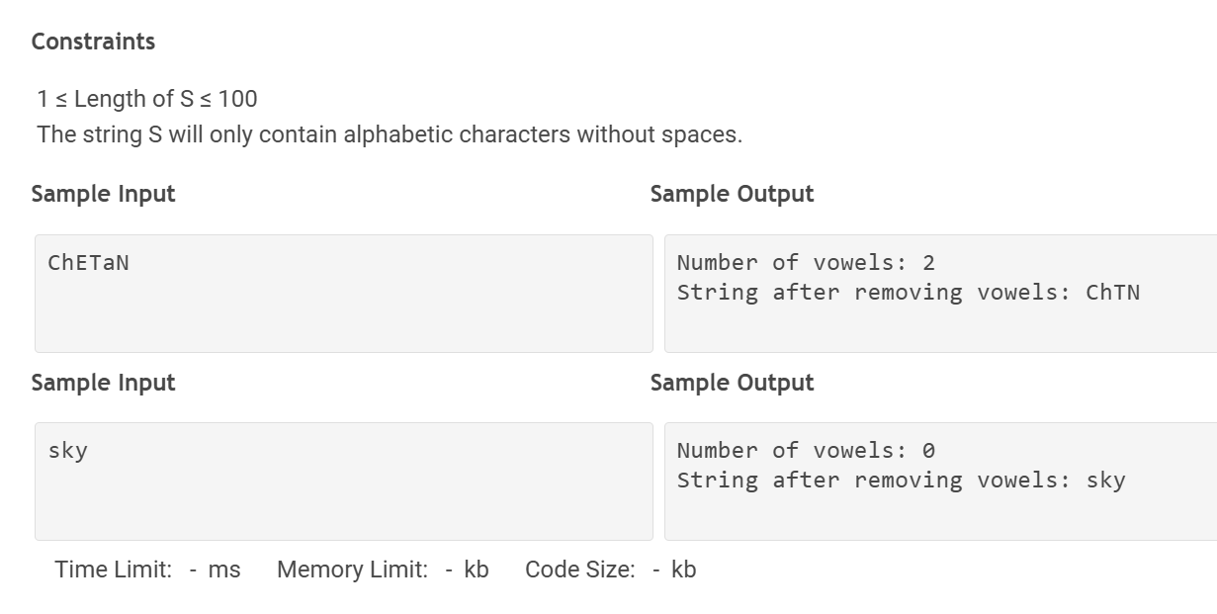

Slide 31
PROBLEM UNDERSTANDING
Given a string, count vowels and remove them.
ALGORITHM
1. Read string
2. Traverse each character
3. If vowel → count++
4. Else → add to new string
5. Print count and modified string
LOGIC
Check vowel → a, e, i, o, u (both cases)
If vowel → skip
Else → keep

Slide 32
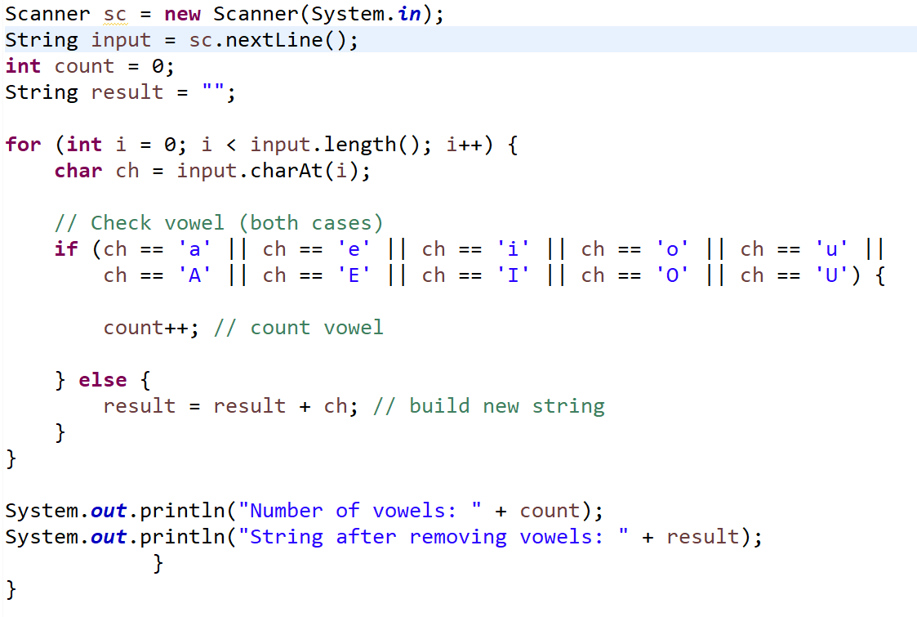

Slide 33

Learn. Practice. Improve.
Java | Aptitude | Coding Problems Explained in Tamil
YouTube: HRC Tech https://youtube.com/@hrctechinsights

