Slide 1

HR Analytics Case Study
Submitted by
Vinay R M
Pallavy Vyas
Naveen Kumar Chittipolu
Madhusudhan C

Slide 2
Business Understanding & Problem statement
XYZ is a large company which has around 4000 employees.
The percentage of attrition in this company is around 15% hindering the efficiency of the company.
We need to analyze the data given to understand why the company loses employees so that the HR department can work on decreasing the rate of attrition.
Objective is to model the attrition rate and find out the deriving factors leading to employee attrition

Slide 3
Data sets and Data dictionary
We have given with four data sets and the primary linkage between all the dataset is based on “EmployeeID”
In-time & Out-time data
Manager survey data
Survey done by managers on “Job Involvement” and “Performance Rating” of the employees.
Employee survey data
Survey done by employees on “Job Satisfaction” and “Work Life Balance”
General data about Employees
Note: We have used R v3.4.4 (2018-03-15) for modelling the problem in R.

Slide 4
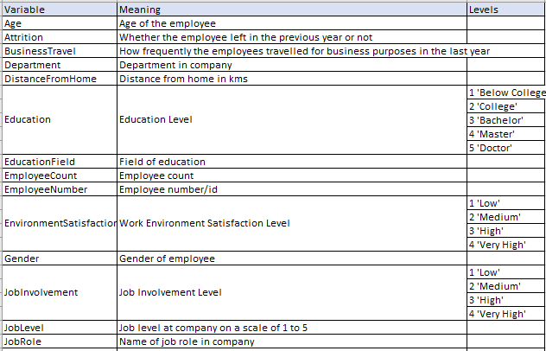
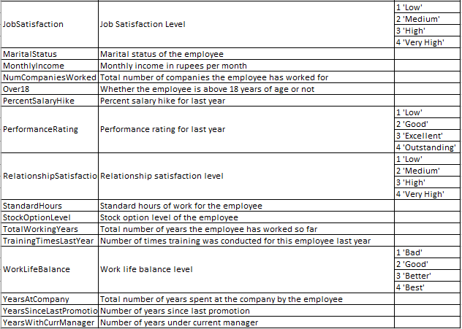
Data sets and Data dictionary Cont..

Slide 5
Data clean-up and Preparation
Derived Metrics
Average work duration based on Employee Intime and out-time
Assumptions:
If the in-time is NA considering them as Leave
If the in-time is NA for all users then considering them as public holiday and removing it from the analysis.
Employee annual leaves
Count of annual leaves employee takes based on above assumptions.
NA Value treatment
We are considering all the NA values as ‘Unknow’ category and including them in the analyse.
Master dataset preparation – (employee_data)
Created master dataset by merging all the four datasets and derived datasets based on “EmployeeId”

Slide 6
Data clean-up and Preparation Cont..
Convert the categorical variables to factors
To get the numerical significance of the metric
Scale all the continuous variables
To get the all numerical variables on the same scale.
employee_data has the final dataset which is ready for modelling

Slide 7
Data Modelling
Since it is predictive analysis – We are modelling using Logistic Regression Algorithm.
We have removed all insignificant variables using stepAIC() and found following significant metrics
Age
MonthlyIncome
NumCompaniesWorked
StockOptionLevel
TotalWorkingYears
TrainingTimesLastYear
YearsAtCompany
YearsSinceLastPromotion
YearsWithCurrManager
work_duration
BusinessTravelTravel_Frequently
BusinessTravelTravel_Rarely
`DepartmentResearch & Development`
DepartmentSales
Education5
`EducationFieldLife Sciences`
EducationFieldMarketing
EducationFieldMedical
EducationFieldOther
`EducationFieldTechnical Degree`
JobRoleManager
`JobRoleManufacturing Director`
`JobRoleResearch Director`
`JobRoleSales Executive`
MaritalStatusMarried
MaritalStatusSingle
EnvironmentSatisfaction2
EnvironmentSatisfaction3
EnvironmentSatisfaction4
JobSatisfaction2
JobSatisfaction3
JobSatisfaction4
WorkLifeBalance2
WorkLifeBalance3
WorkLifeBalance4
WorkLifeBalanceunknown
JobInvolvement3
JobLevel5

Slide 8
Data Modelling Cont..
After removing all the insignificant variables based on p-value and vif we left with following major metrics which are majorly responsible for attrition rate
NumCompaniesWorked
TotalWorkingYears
YearsSinceLastPromotion
YearsWithCurrManager
work_duration
BusinessTravelTravel_Frequently
`DepartmentResearch & Development`
DepartmentSales
`JobRoleManufacturing Director`
MaritalStatusSingle
EnvironmentSatisfaction4
JobSatisfaction4

Slide 9
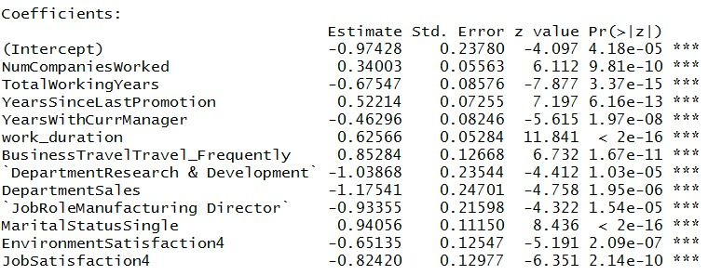
Data Modelling p-value & VIF for final metrics Cont..
VIF
p-Value
NumCompaniesWorked - 1.193153
TotalWorkingYears - 1.725248
YearsSinceLastPromotion - 1.805324
YearsWithCurrManager - 1.740295
work_duration - 1.058570
BusinessTravelTravel_Frequently - 1.033562
DepartmentResearch & Development - 4.338506
DepartmentSales - 4.348257
JobRoleManufacturing Director - 1.021507
MaritalStatusSingle - 1.039754
EnvironmentSatisfaction4 - 1.028495
JobSatisfaction4 - 1.028165

Slide 10
Model evaluation
We have taken 0.4 probability as the cut-off benchmark and arrived with following metrics
Confusion matrix
Accuracy
0.8359788
Sensitivity
0.3398058
Specificity
0.9341749
 | Yes | No
Yes | 1036 | 76
No | 136 | 70

Slide 11
Summary
Following are the major driving factors in Employee attrition rate.
TotalWorkingYears
YearsSinceLastPromotion
YearsWithCurrManager
work_duration
BusinessTravelTravel_Frequently
DepartmentResearch & Development
DepartmentSales
JobRoleManufacturing Director
MaritalStatusSingle
EnvironmentSatisfaction4
JobSatisfaction4

Slide 12
Thank you!

