Slide 1

Capstone Project
Carbon Footprint Tracking and Sustainability Management System
CSA1008-Software Engineering
Presented By:
Course Faculty:
Dr.K.C.Sharmili

Slide 2


Introduction
The Carbon Footprint Tracking and Sustainability Management System is a software solution designed to monitor, calculate, and manage carbon emissions generated by individuals, organizations, or institutions.
Traditional carbon tracking methods often depend on manual calculations and scattered data, making it difficult to accurately monitor emissions and identify areas for improvement.
The proposed system collects information related to electricity consumption, transportation, fuel usage, waste generation, and other activities and converts this information into estimated CO₂ emissions.
The system provides dashboards, reports, and recommendations to help users understand their environmental impact and adopt more sustainable practices.

Slide 3
Objectives
Primary Objective
To develop a system that calculates, tracks, analyzes, and helps reduce carbon emissions by providing users with meaningful sustainability insights.
Key Objectives
Calculate carbon emissions from different activities.
Track individual or organizational carbon footprint over time.
Identify major sources of CO₂ emissions.
Provide sustainability recommendations.
Generate carbon footprint reports and analytics.
Monitor progress toward emission-reduction goals.
Encourage environmentally responsible practices.

Slide 4
Techniques Used:
Technique / Technology | Where Used in Project
Carbon Emission Factor Calculation | Convert activity data into CO₂ emissions
Data Processing | Clean and process user activity data
Database Management | Store activity, emission, and sustainability data
Data Visualization | Display emission trends and category-wise analysis
Analytics | Identify major sources of carbon emissions
Recommendation System | Suggest methods to reduce emissions
Goal Tracking | Monitor sustainability and emission-reduction targets
Basic Calculation
Carbon Emission = Activity Data × Emission Factor
Example:
Electricity Consumption × Electricity Emission Factor = CO₂ Emission

Slide 5
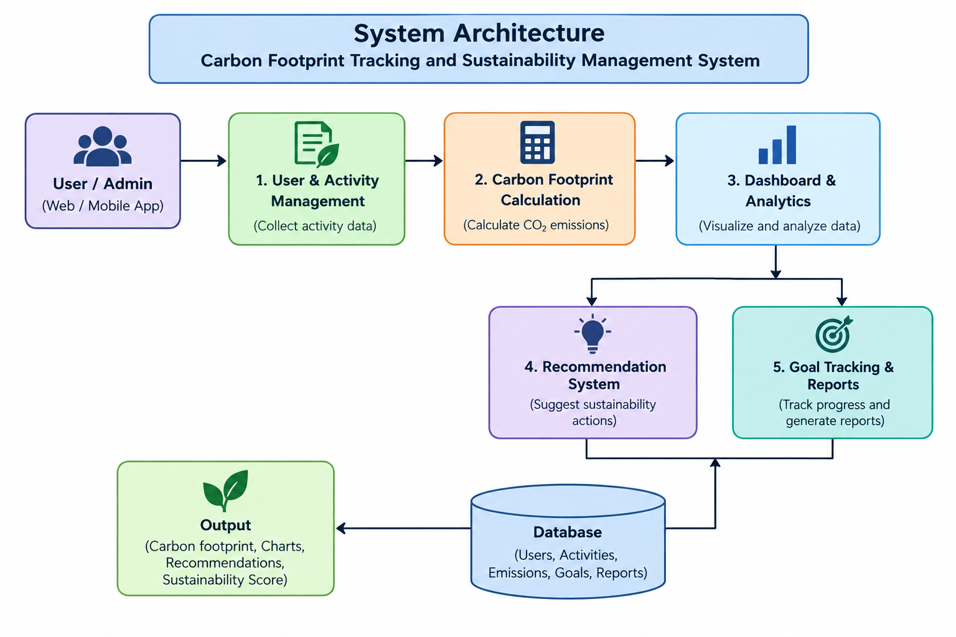

Slide 6
Module 1: User & Activity Management
Description
This module allows users to create profiles and enter their daily or periodic activities that contribute to carbon emissions.
Functions
User registration and login.
Manage user profile.
Enter electricity consumption.
Enter transportation details.
Enter fuel consumption.
Enter waste-generation information.
Record other carbon-producing activities.
Edit or update activity records.
Outcome
This module provides the system with the basic activity data required for calculating the user's carbon footprint.

Slide 7
Module 2: carbon Footprint Calculation
Description
This module calculates the estimated carbon emissions generated from the activities entered by the user.
Functions
Process activity data.
Apply appropriate emission factors.
Calculate CO₂ emissions.
Calculate category-wise emissions.
Calculate total carbon footprint.
Generate daily, monthly, and yearly emission values.
Store calculated emission results.
Outcome
The module converts user activity data into a measurable carbon footprint.

Slide 8
Module 3: Sustainability Dashboard & Analytics
Description
The Sustainability Dashboard provides a centralized interface for monitoring carbon emissions and understanding environmental impact.
Functions
Display total carbon footprint.
Show category-wise emissions.
Display emission trends.
Compare monthly/yearly emissions.
Identify the highest emission source.
Display sustainability statistics.
Generate visual charts and graphs.
Outcome
Users can easily understand their carbon footprint and identify activities responsible for the highest emissions.

Slide 9
Module 4: Sustainability Recommendation System
Description
This module provides personalized recommendations based on the user's major sources of carbon emissions.
Functions
Identify high-emission activities.
Suggest energy-saving practices.
Recommend sustainable transportation options.
Suggest waste-reduction methods.
Provide renewable-energy recommendations.
Recommend methods to reduce fuel consumption.
Display personalized sustainability tips.
Outcome
The module helps users take practical actions to reduce their carbon footprint.

Slide 10
Module 5: Goal Tracking & Sustainability Reports
Description
This module allows users or organizations to set emission-reduction targets and monitor their sustainability progress.
Functions
Set carbon-reduction goals.
Define target emission levels.
Track progress toward goals.
Compare current emissions with previous periods.
Generate sustainability reports.
Display achieved reduction percentage.
Outcome
Users can continuously monitor their sustainability performance and measure progress toward carbon-reduction goals.

Slide 11
Dataset Explanation
Column Name | Description | Example
User_ID | Unique user identifier | U001
Activity_Date | Date of activity | 2026-08-31
Electricity_Usage | Electricity consumed | 120 kWh
Fuel_Consumption | Fuel consumed | 20 L
Transport_Distance | Distance travelled | 150 km
Transport_Mode | Type of transportation | Car
Waste_Generated | Waste produced | 5 kg
Electricity_CO2 | Electricity emissions | 72 kg CO₂
Transport_CO2 | Transport emissions | 30 kg CO₂
Fuel_CO2 | Fuel emissions | 46 kg CO₂
Waste_CO2 | Waste emissions | 3 kg CO₂
Total_CO2 | Total emissions | 151 kg CO₂
Reduction_Target | Target reduction | 10%
Sustainability_Score | Sustainability performance | 78

Slide 12
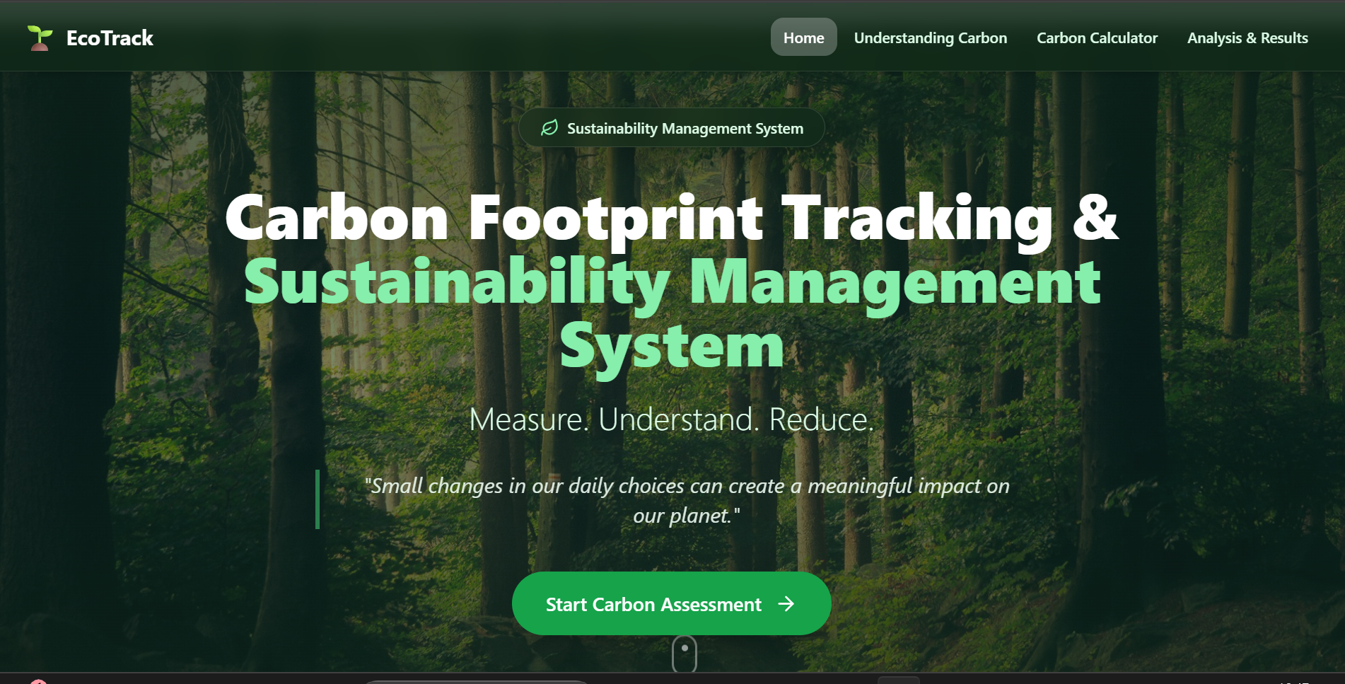
Implementation

Slide 13
Result
The Carbon Footprint Tracking and Sustainability Management System successfully provides a structured approach for monitoring and managing carbon emissions.
The system:
Collects activity-related data.
Calculates estimated carbon emissions.
Categorizes emissions by source.
Displays emission trends through dashboards.
Identifies major contributors to carbon footprint.
The system helps users understand their environmental impact, make informed decisions, and work toward reducing their carbon footprint.

Slide 14
Conclusion
The Carbon Footprint Tracking and Sustainability Management System provides an integrated solution for monitoring and managing carbon emissions.
By combining activity tracking, carbon calculation, analytics, recommendations, and goal tracking, the system makes sustainability management easier and more organized.
The project demonstrates how software-based monitoring can help individuals and organizations measure their environmental impact, identify high-emission activities, and adopt more sustainable practices.

Slide 15


