Slide 1

DEPARTMENT OF CSE
Web Based Data Retrieval and
Manipulation System for multiple databases
Project Mentor Name:
Mr. P. DASTAGIRI REDDY, M. Tech
Team Members:
1)A. NAVEEN : 16091A0577
2)K. RAVI TEJA : 16091A05A3
3)A. MOUNIKA : 16091A0571
4)K. RAJENDRA : 16091A0595

Slide 2
List of contents
Abstract
Existing System
Disadvantages
Proposed System
Advantages
Software and Hardware requirements
Modules
Design
Screenshots
Conclusion

Slide 3
abstract
The Database interface is designed and developed to test the database connectivity features of JDBC drivers and their supported databases.
The DBI covers all methods defined in the JDBC specification.
DBI provides facility for processing queries.
The DBI provides an abstract format and interface to submit an SQL statement and view the results.
When different companies provide different drivers to connect to their databases, we seldom found a server side application to interact with any database like Oracle, My-SQL offered by a database providers.

Slide 4
Existing system
User needs to make queries on his own.
With current existing systems we can interact with only one type of database.
Current systems have an UI where the user forms a query based on his requirement.

Slide 5
disadvantages
Heavy load on memory to remember syntaxes.
User sometimes may not form correct query for requirement.
Different consoles for different databases.
Different syntaxes for different databases.
User feels uneasy to shift between databases to meet his requirements.

Slide 6
Proposed system
The proposed system provides a single interface to interact with different databases.
We can run different SQL statements from the browser.
The results will be displayed on the user interface.
User is able to create his own account to utilize the services.
User feels easy to perform tasks while using the user interface.

Slide 7
advantages
No need to remember queries to perform operations on databases.
User friendly interface.
We can handle multiple databases using a single console.
Only registered users can utilize the website.
The results will be displayed on the user interface (UI).

Slide 8
software requirements
Web Presentation : HTML
Client Side Validation : JAVASCRIPT
Programming Language : Java
Database Connectivity API : JDBC
Backend Database : Oracle, My-SQL
Operating System : Windows XP/2000/2003
Web Server : Tomcat
Browser : IE/Mozilla/Opera

Slide 9
hardware requirements
System RAM : 3 Gb
Hard disk : 20Gb
Processor : Intel Pentium-IV based

Slide 10
modules
The system after analysis has been found to have the following modules.
Connection module: This module specifically provides the Connection form Database by getting the values from page.
DB Operations module: This module maintains the information specific to all the Operations of Database.
Create module: This module creates the tables by getting the values from create page.

Slide 11
Drop module: The module maintains the information related to the total sales that are executed upon the system by the sales people as part of their marketing activity. The total atomic information related to the sales is maintained here along with the technical and non-technical information that becomes more important for future reference.
Insert module: This module allows to insert the values into tables created by the users.
Select module: This module displays the user table values on the browser.
Delete module: This module allows the user to delete table rows in the DB from browser.

Slide 12
Design
Class diagram

Slide 13
sequence diagram

Slide 14
Collaboration diagram

Slide 15
Use case diagram

Slide 16
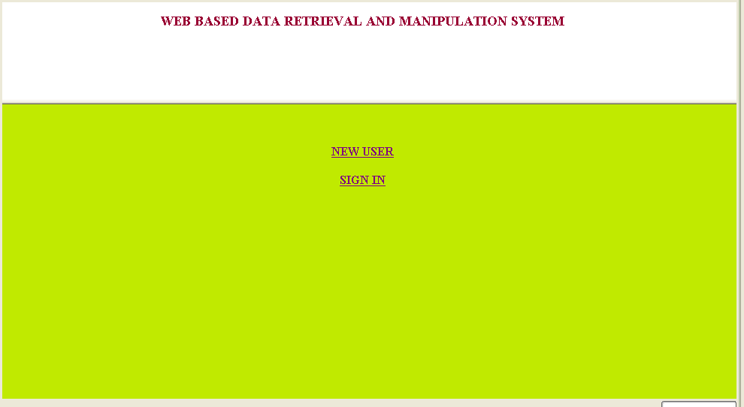
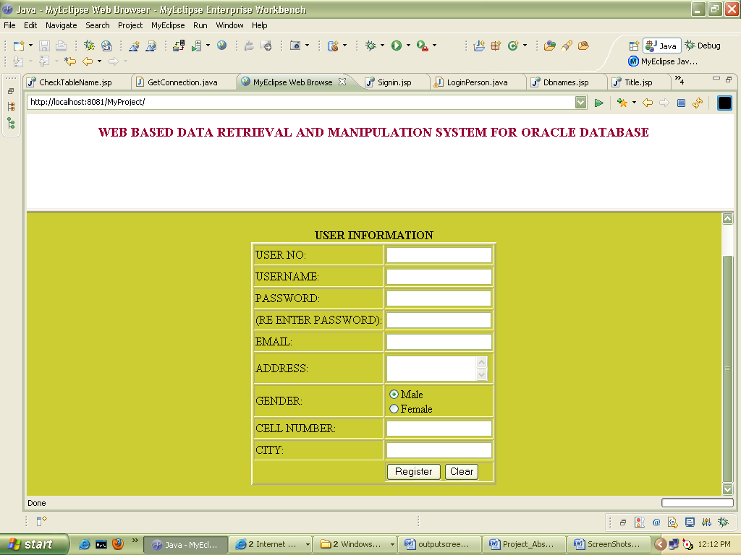
screenshots
Home Page
New User Registration

Slide 17
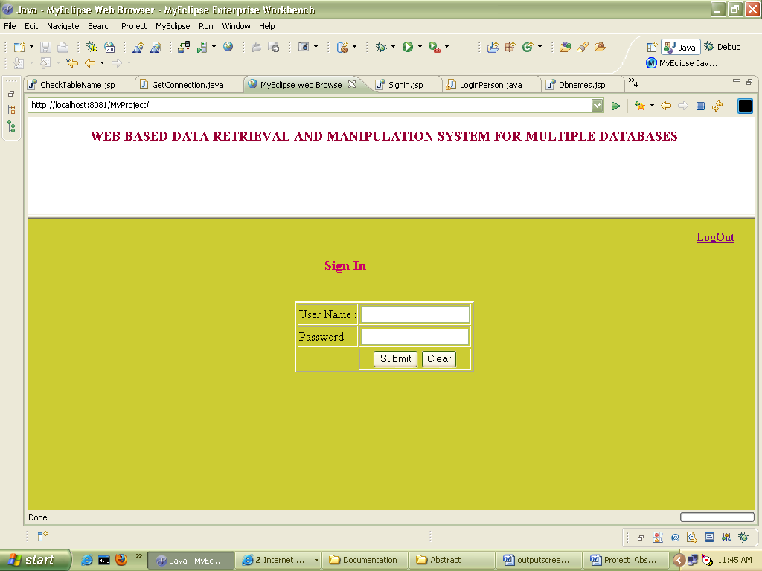
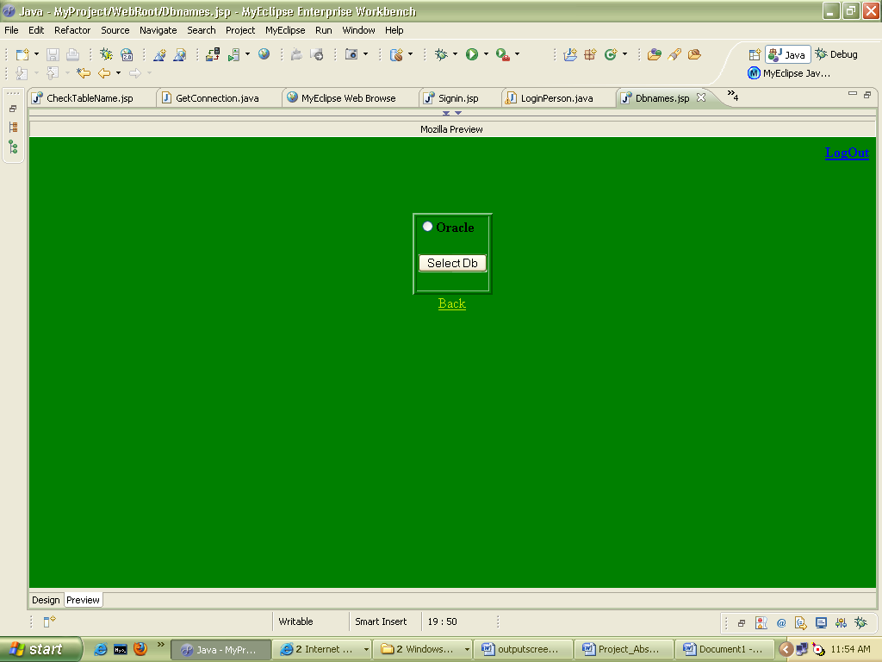
Sign-in Page
Select Database

Slide 18
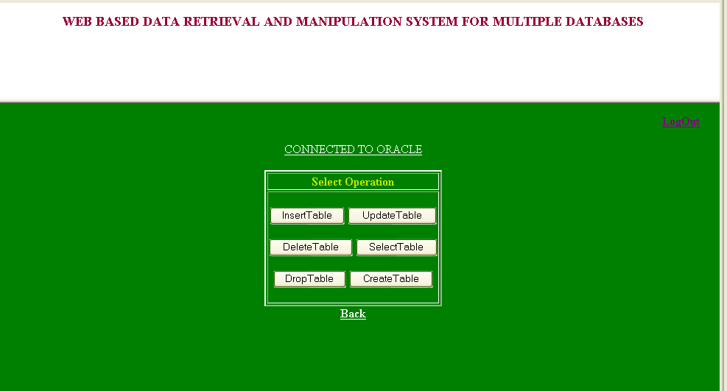
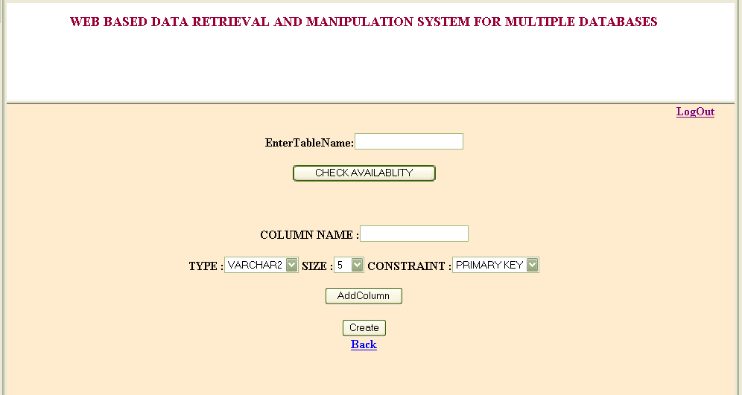
Select Operation
Create Table

Slide 19
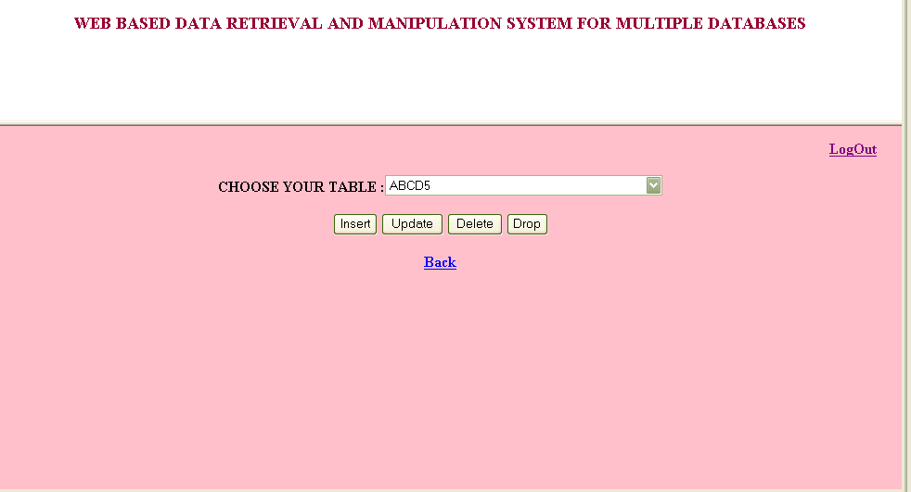
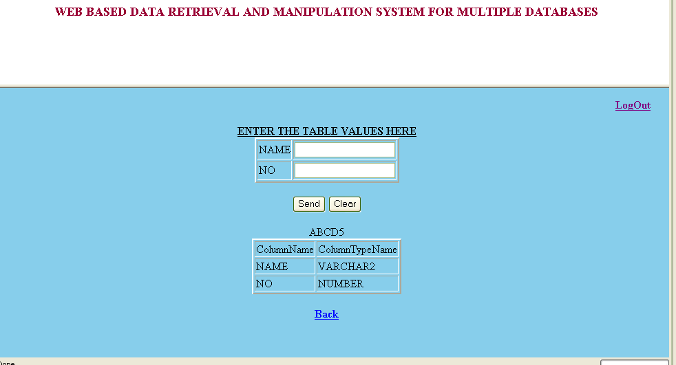
Select Table
Insert into Table

Slide 20
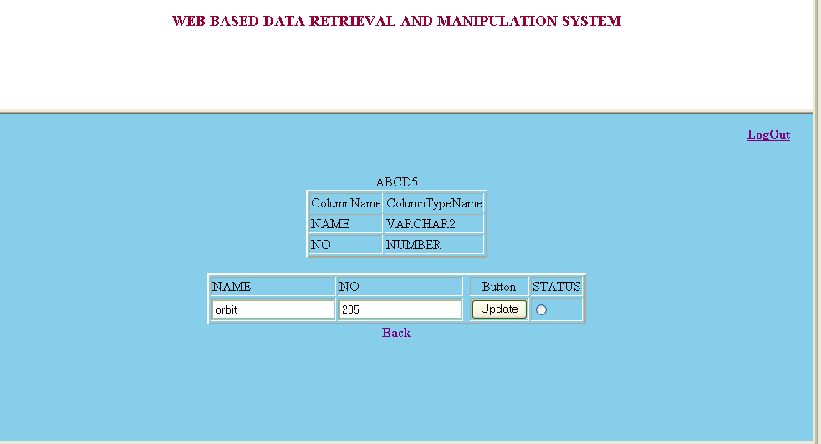
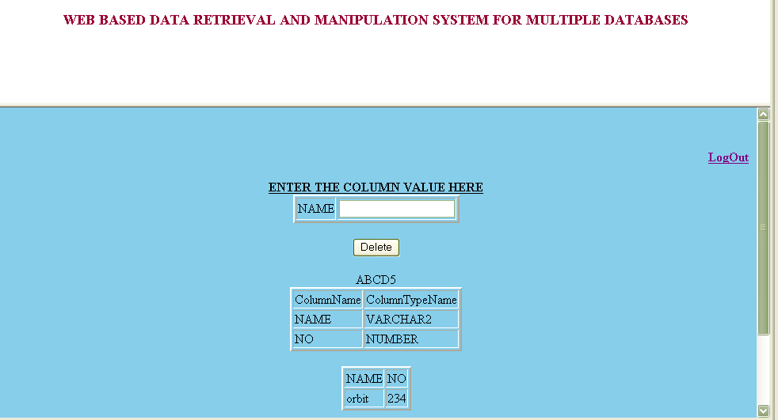
Update Table
Delete Table Values

Slide 21
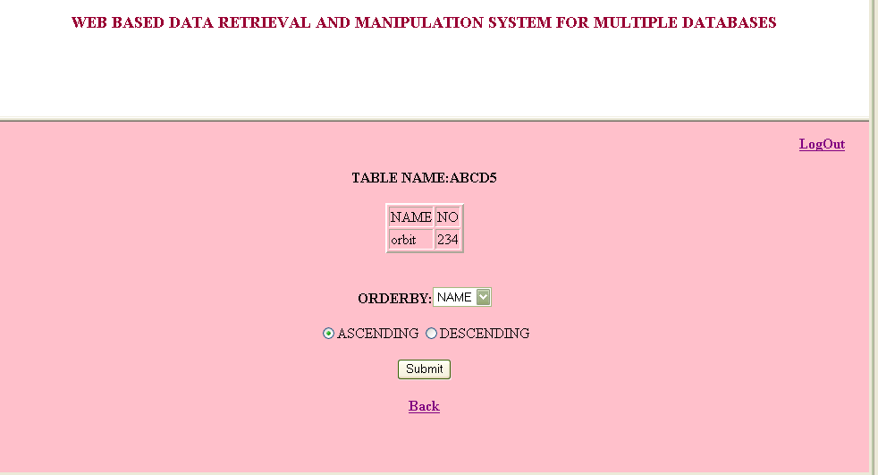

Display Table Values
Drop Table

Slide 22
Future enhancement
With the current project we can just perform the basic queries regarding the database. As a future enhancement this project can be further extended to perform various operations that can be performed in a database. With in this project we have just used two different databases that can be accessed from an interface, this can be further extended for multiple databases.

Slide 23
conclusion
We conclude here by that this website is very useful to those who needs to perform the basic operations in the database in different databases.

Slide 24


Slide 25
ThanQ

