Slide 1
DEVU SURESHMITHA
Final Project
3/21/2024 Annual Review

Slide 2
PROJECT TITLE
KEY LOGGER AND SECURITY
3/21/2024 Annual Review

Slide 3


AGENDA
Introduction
Problem statement
Project Overview
Who are the end users
Solution
Wow In your solution
Modelling
Results
Project Link
3/21/2024 Annual Review

Slide 4

PROBLEM STATEMENT
Key loggers are tools that record the keystrokes of a user, capturing sensitive information such as passwords, credit card numbers, and private messages. While keyloggers can be used for legitimate purposes, such as monitoring employee activity or recovering lost data, they are often associated with malicious activities, such as identity theft and unauthorized access to personal and corporate information. The increasing sophistication of keyloggers poses a significant threat to cybersecurity.
3/21/2024 Annual Review

Slide 5

PROJECT OVERVIEW
This project aims to explore the functionality of keyloggers and develop robust security measures to detect and prevent such threats. The increasing sophistication of keylogging techniques poses significant risks to cybersecurity, necessitating a comprehensive approach to understanding and countering these threats.
3/21/2024 Annual Review

Slide 6

WHO ARE THE END USERS?
The primary end users of this project include a diverse group of stakeholders who will benefit from the educational insights, practical applications, and enhanced security measures developed. Here are the key end users:
Cybersecurity professionals
IT Administrators
Software Developers
Government and Law Enforcement Agencies
3/21/2024 Annual Review

Slide 7

YOUR SOLUTION AND ITS VALUE PROPOSITION
Keylogger Development
Design: Create a blueprint for a basic keylogger, defining its core functionalities, such as keystroke capture, data storage, and optional data transmission.
Implementation: Develop the keylogger using a programming language (e.g., Python). Ensure it can log keystrokes efficiently and securely.
Testing: Validate the keylogger’s performance and accuracy in capturing keystrokes without affecting system performance.
3/21/2024 Annual Review

Slide 8
VALUE PROPOSITION
Provides an in-depth understanding of keyloggers, their functionalities, and potential threats, contributing to the knowledge base of cybersecurity professionals and researchers.
Develops advanced behavior-based and signature-based detection techniques that enhance the ability of existing security systems to identify and neutralize keyloggers.
Provides valuable educational resources for cybersecurity students, educators, and professionals. Facilitates hands-on learning experiences and enhances cybersecurity training programs.
Promotes awareness of the ethical implications of keylogger development and use, ensuring that all activities are conducted responsibly and legally.

Slide 9

THE WOW IN YOUR SOLUTION
Hands-On Learning: The project provides a practical, hands-on experience that goes beyond theoretical knowledge.
Behavior-BasedDetection: Our solution employs sophisticated behavior-based detection methods that identify keyloggers based on their activities and patterns, rather than just known signatures.
Ethical Considerations: A strong emphasis on ethical use and legal compliance ensures that the project is conducted responsibly.
3/21/2024 Annual Review
9

Slide 10
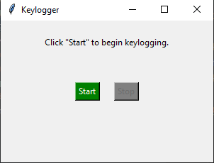
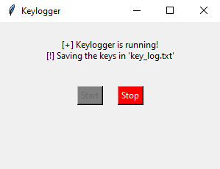
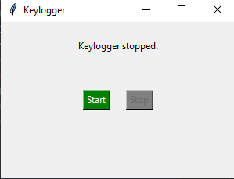
MODELLING
Step 1
Step 2
Step 3
3/21/2024 Annual Review
10

Slide 11
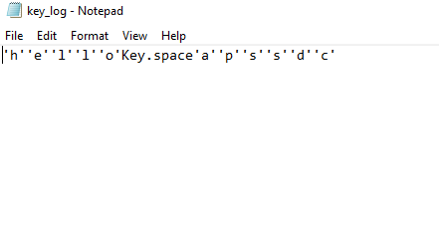
RESULTS
CONCLUSION
The keylogger project demonstrates a practical implementation of capturing and recording keyboard input while utilizing effective GUI design principles for user interaction.
3/21/2024 Annual Review
11

Slide 12
PROJECT LINK
https://github.com/Sureshmitha/reshmitha_project.git

