Slide 1
Android Jetpack

Slide 2
Base ideas
Separation of concerns – Separating into distinct sections. Each section addresses a separate concern
Single Responsibility Principle – Each class/function has a single responsibility

Slide 3
MVC
Activity_userlist.xml
UserListActivity
User
View
Controller
Model

Slide 4
MVP
View
Presenter
Model
Activity_userlist.xml
UserListActivity
UserListPresenter
User
Presenter.getUsers()
Call localDB or API
On Receiving users – view.update()

Slide 5
Scenario
After presenter calls API and before response is returned if user rotates screen:
If we keep presenter in memory and call view.update() – application crash
If we destroy presenter along with activity and create new presenter when activity is recreated – multiple network calls
What if presenter behaved like a fragment? i.e reattach to activity when user rotates screen

Slide 6
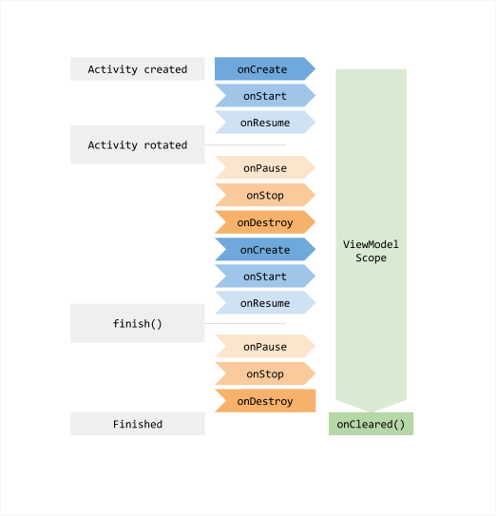
ViewModel

Slide 7
Everything alright?
Why should viewModel have to decide whether to call API or localDB and also parse JSON response ?
What if we had a simple interface to get the data? – UsersRepository

Slide 8
Do we really need a Repository class ?
UserListActivity
UserDetailActivity
UserListViewModel
UserDetailViewModel
UsersRepository

Slide 9
Single Source Of Truth (Drive UI from a model)
UserList screen – we show data from localDB (name and email)
User goes to UserDetail screen – we call API to get details (email has been changed)
If user goes back to UserList screen - inconsistent data
Solution – UI should always reflect data in the localDB. localDB is the single source of truth. When we call the API, we can immediately update localDB.
App continues to work in cases when a network connection is flaky or not available.

Slide 10
What if UI could observe localDB? Can UI be updated whenever there is a change in localDB?

Slide 11
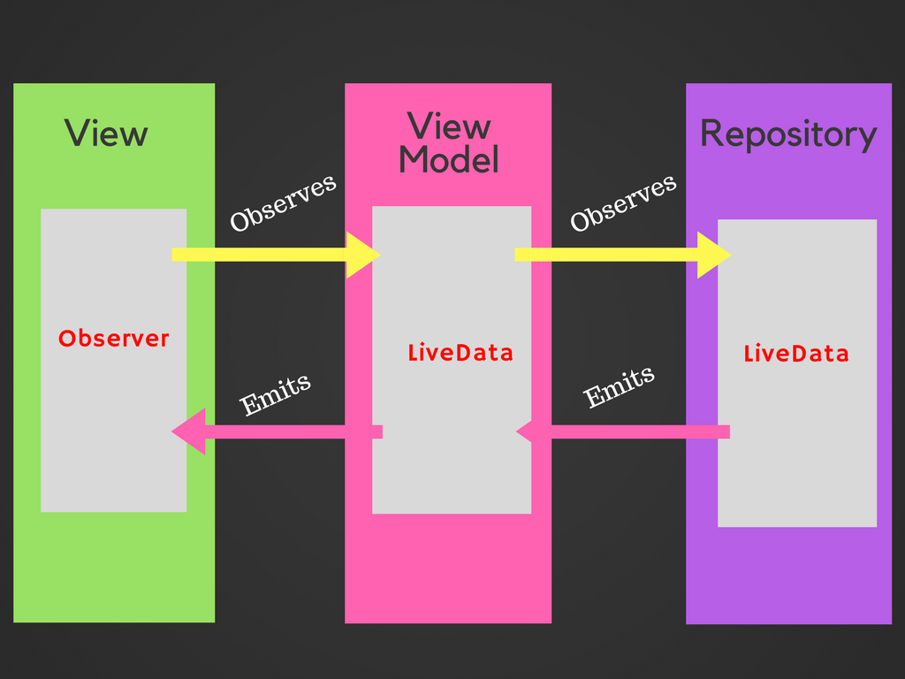
LiveData
Observable data holder
(wrapper around data)
Lifecycle aware
Reduces callback code

Slide 12
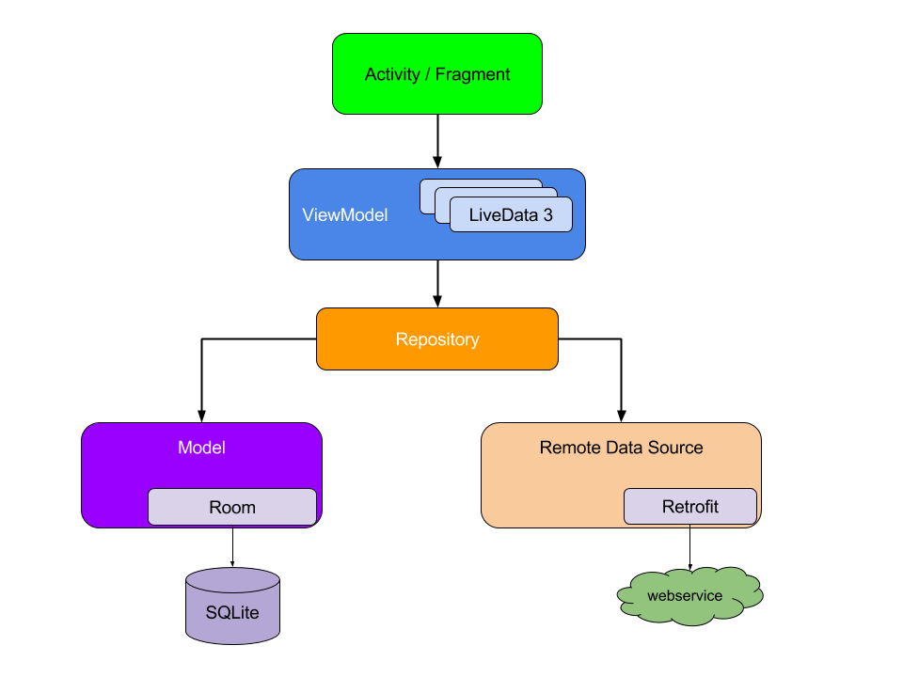
Overall architecture

Slide 13
Now for some code?
https://randomuser.me/api/?seed=abc&results=10
Returns random users. If we give a seed and count as 10 – always returns same 10 users.

Slide 14
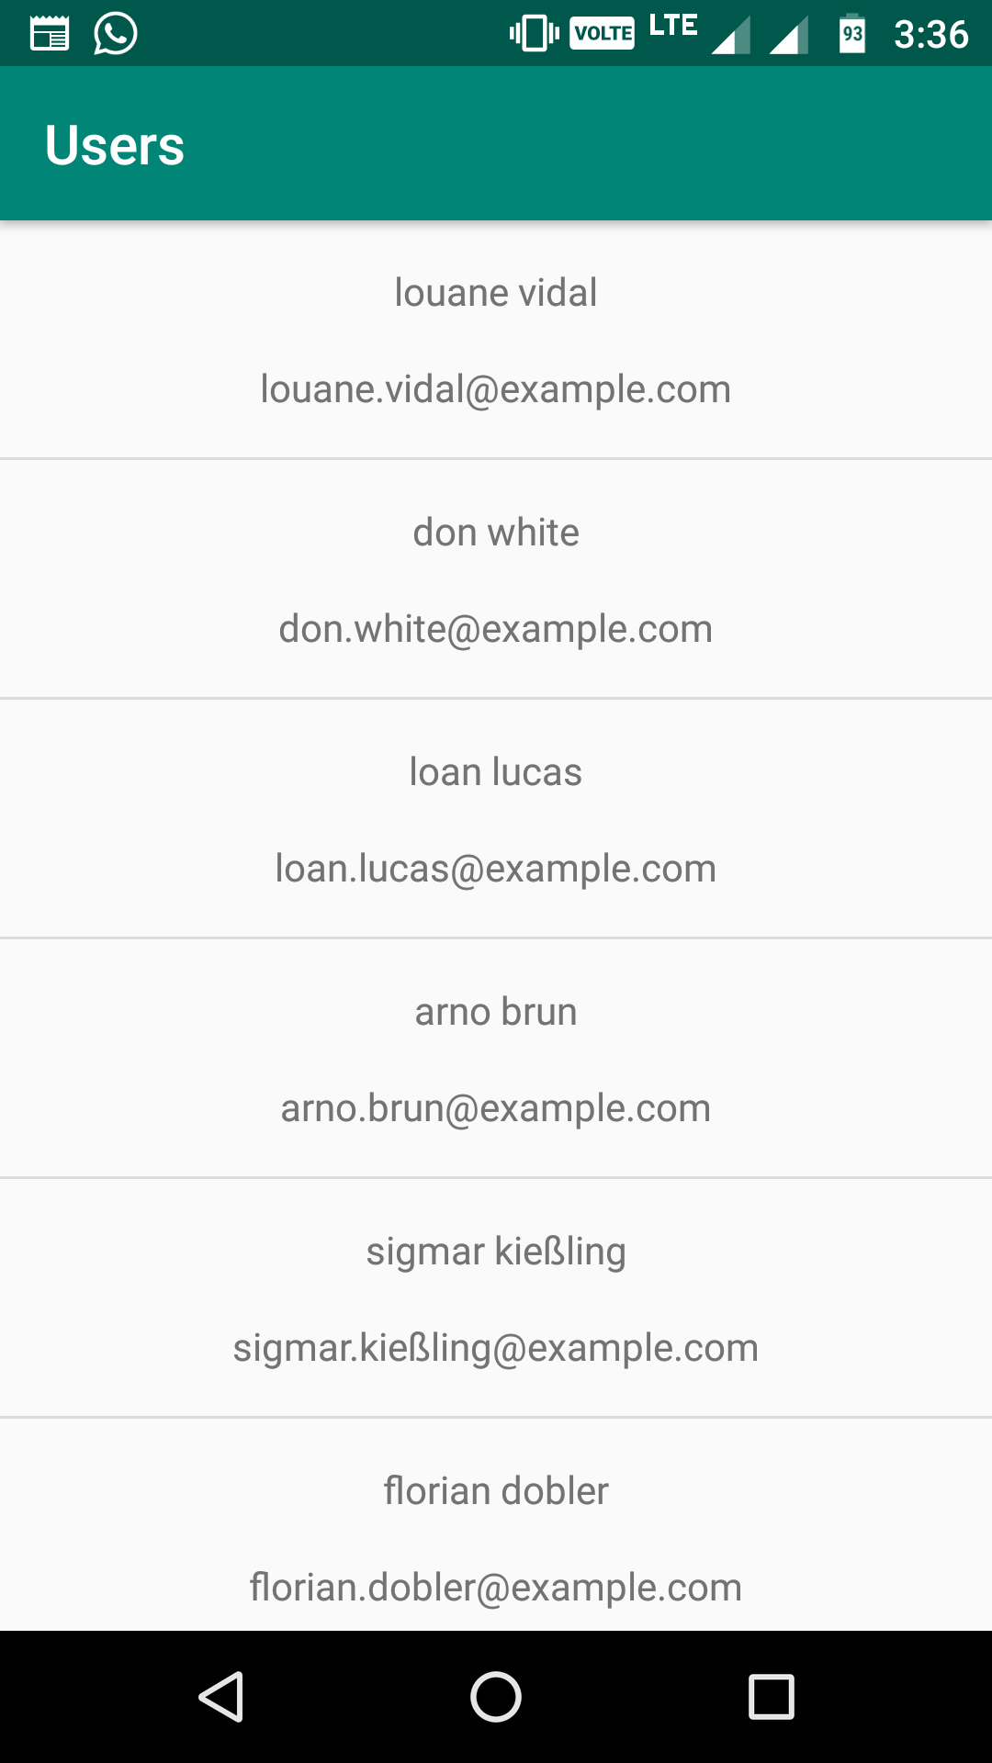
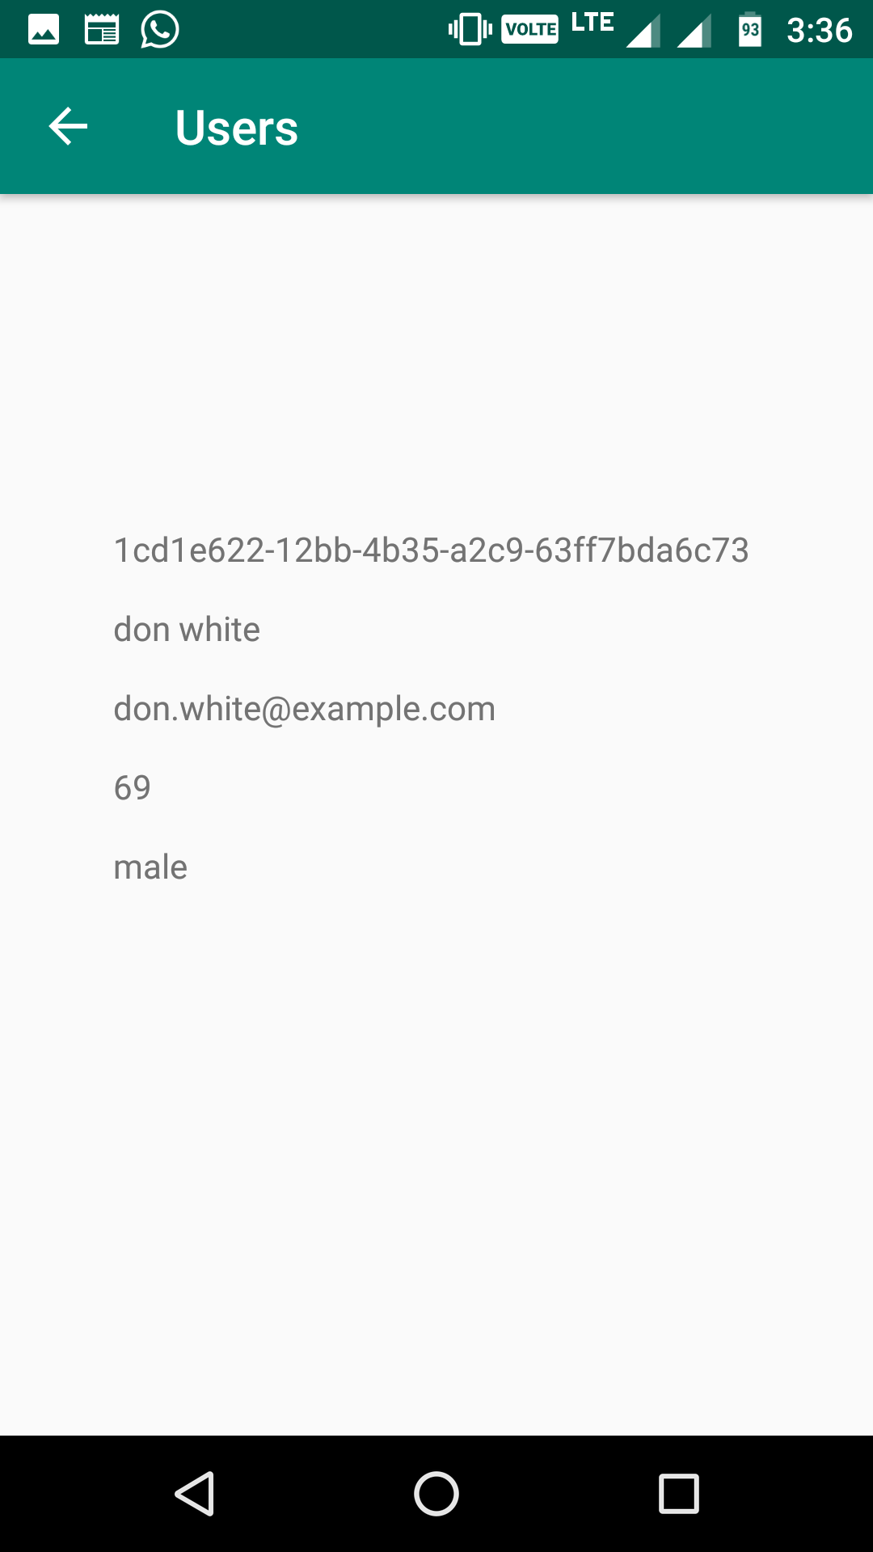

Slide 15
The end?
DI, Dagger ?

