Slide 1
Android Jetpack

Slide 2
Jetpack ?
Jetpack is a collection of libraries.
These components help you follow best practices, free you from writing boilerplate code.
Jetpack comprises the androidx.* package libraries, unbundled from the platform APIs.
Not mandatory, can mix and match.

Slide 3
Base ideas
Separation of concerns – Separating program into distinct sections. Each section addresses a separate concern
Single Responsibility Principle – Each class/function has a single responsibility

Slide 4
MVC
activity_userlist.xml
UserListActivity
User
View
Controller
Model

Slide 5
Controller
Has view related code.
Has code to call API or localDB to update the views.
Is there a better way ?

Slide 6
MVP
View
Presenter
Model
activity_userlist.xml
UserListActivity
UserListPresenter
User
Presenter.getUsers()
Call localDB or API
On Receiving users – view.update()

Slide 7
Scenario
After presenter calls API and before response is returned if user rotates screen:
If we keep presenter in memory and call view.update() – application crash
If we destroy presenter along with activity and create new presenter when activity is recreated – multiple network calls
What if presenter behaved like a fragment? i.e reattach to activity when user rotates screen

Slide 8
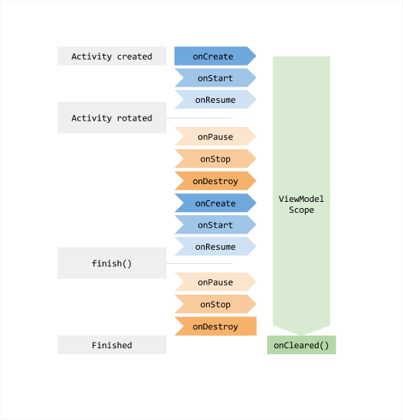
ViewModel

Slide 9
MVVM
View
ViewModel
Model
activity_userlist.xml
UserListActivity
UserListViewModel
User

Slide 10
Everything alright?
Why should viewModel have to decide whether to call API or localDB and also parse JSON response ?
What if we had a simple interface to get the data? – UsersRepository

Slide 11
Do we really need a Repository class ?
All viewModels can delegate getting data and parsing response to repository class
UserListActivity
UserDetailActivity
UserListViewModel
UserDetailViewModel
UsersRepository

Slide 12
Scenario
UserList screen – we show data from localDB (name and lastLoginTime)
User goes to UserDetail screen – we call API to get details (lastLoginTime has been changed)
If user goes back to UserList screen - inconsistent data

Slide 13
Single Source Of Truth (Drive UI from a model)
UI should always reflect data in the localDB. localDB is the single source of truth. When we call the API, we can immediately update localDB.
App continues to work in cases when a network connection is flaky or not available.
Is this enough ?

Slide 14
Observer pattern
What if UI could observe localDB?
Can UI be updated whenever there is a change in localDB?

Slide 15
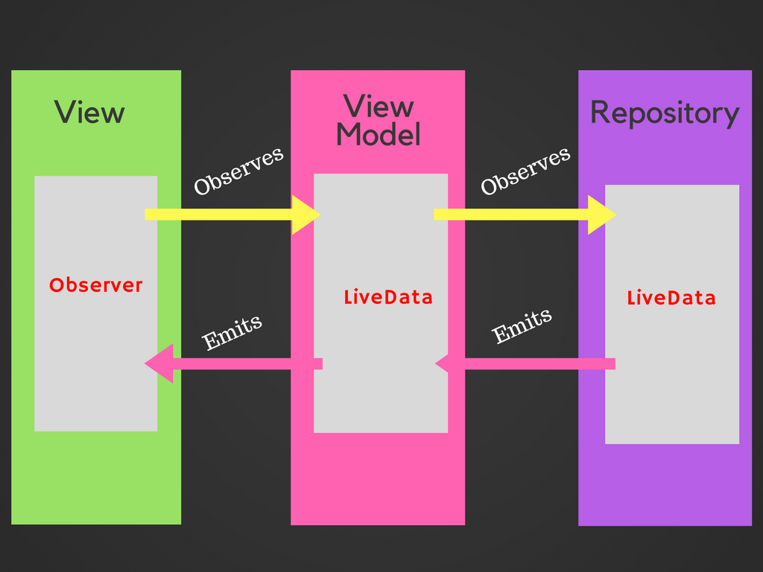
LiveData
Observable data holder
(wrapper around data)
Lifecycle aware
Reduces callback code
Eg. LiveData<List<User>> livedata;
livedata.observe(this, users ->
updateView(users));

Slide 16
Room
Abstraction over Sqlite
3 main components:
Entity/Table,
DAO,
Database

Slide 17
Table
@Entity(tableName = "user") public class User { @PrimaryKey @NonNull private String id;
}
DAO
@Dao public interface UserDao { @Query("SELECT * FROM user") LiveData<List<User>> getUsers();
}
Database
@Database(entities = {User.class}, version = 1) public abstract class AppDatabase extends RoomDatabase { public abstract UserDao userDao(); }

Slide 18
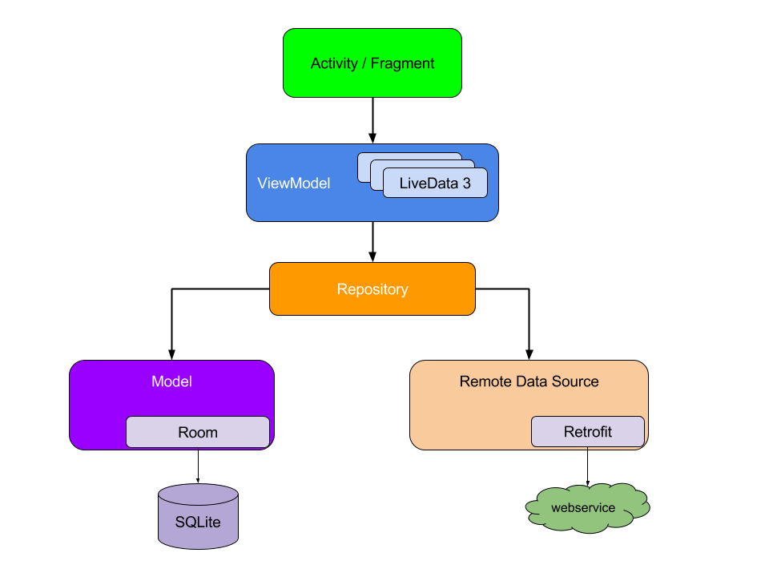
Overall architecture

Slide 19
Now for some code?
https://randomuser.me/api/?seed=abc&results=10
Returns random users. If we give a seed and count as 10 – always returns same 10 users.

Slide 20
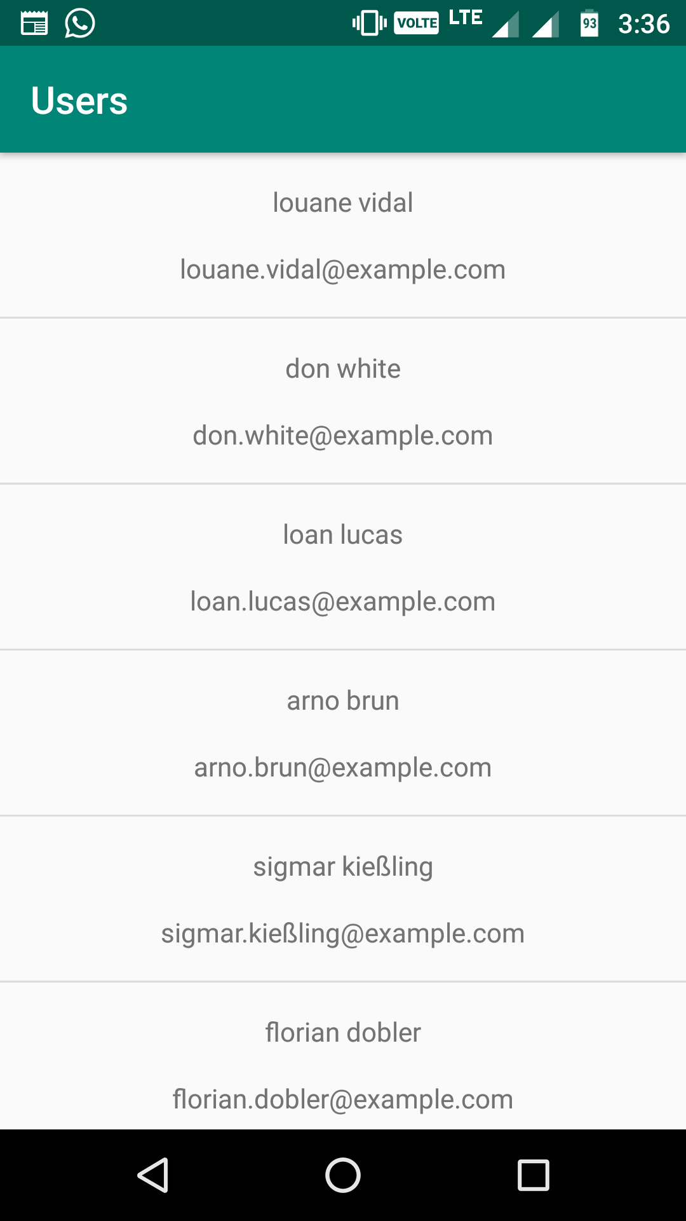
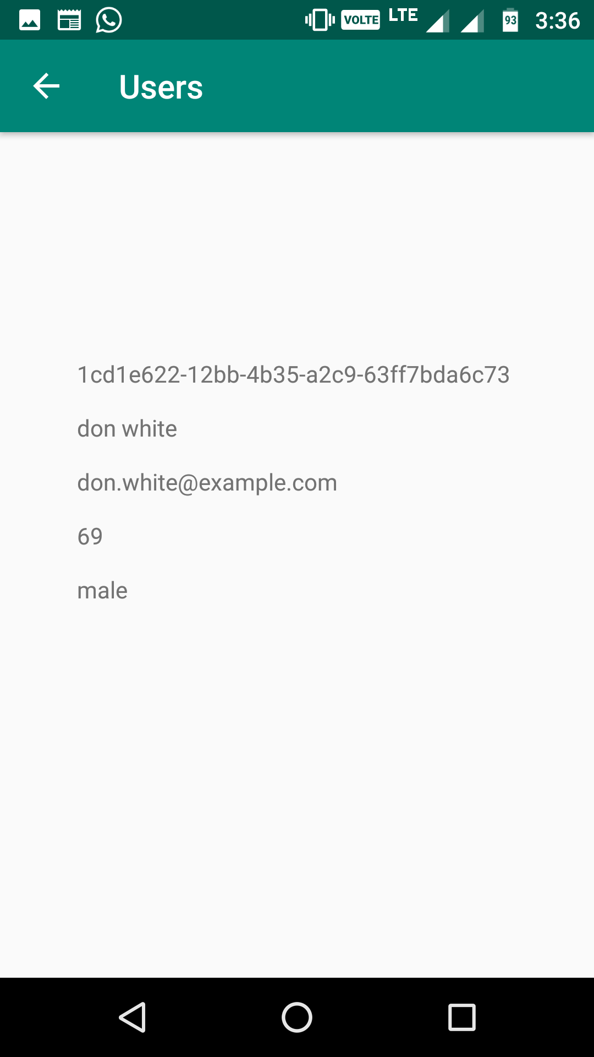

Slide 21
The end?
DI, Dagger ?
M1049764

