Slide 1
Mid TERM Presentation “Amis quatre”
Presented By :
Naveen Kumar

Slide 2
Research statement
Afghanistan Index : Insights on country’s development and conditions there
Trend of visitors in White house on some events impacting popularity of white house
Insights from data of American Statistical Association(ASA) on Movies with their revenues based on the release year and ratings of movie.
<number>
Notes:
<number>

Slide 3
Datasets used
IMDB Data Set
American Statistical Association DataSet on movies
White House Visitors
Statista Data : Afghanistan Index
IMF Data : Afghanistan Index
<number>

Slide 4
Tools used
Ipython
Python Libraries : panda, matplotlib , numpy ,seaborn
<number>

Slide 5
Use Case : Afghanistan Index
Data Source : Statista Data , IMF Report Data for Afghanistan
IMF Data Structure : Data is in tab separated file with following columns
<Country ,Subject Descriptor, Units Scale, Country/Series-specific Notes, 2002 ,2003 2004 ,2005 ,2006 ,2007 ,2008 ,2009 ,2010, 2011 ,2012, 2013,2014 ,2015, 2016, 2017 ,2018>
Subject Descriptor : Label like GDP ,Total Investment ,Inflation , etc .
In the next slide , there is a sample data figure.
<number>

Slide 6
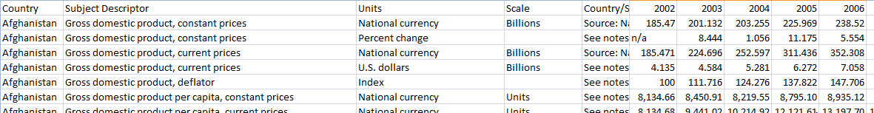
Use Case : Afghanistan Index
*Data Source : IMF ( http://goo.gl/rUyDia )
<number>

Slide 7
Use Case : Afghanistan Index
Statista Data :
Data for US war cost in different year in Afghanistan and Iraq
Terror Attacks in the country in different years
Number of people killed
Many other
<number>

Slide 8
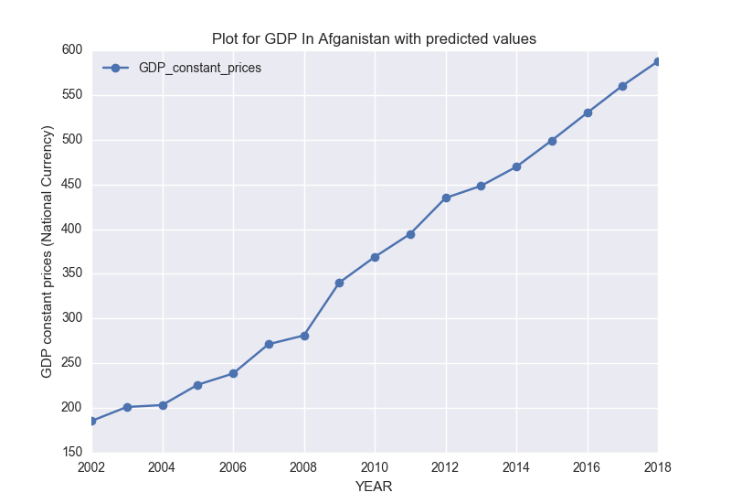
Use Case : Afghanistan Index
GDP figures in different year
We can see the increase with each year
After 2012 , IMF has provided its predicted data.
<number>

Slide 9
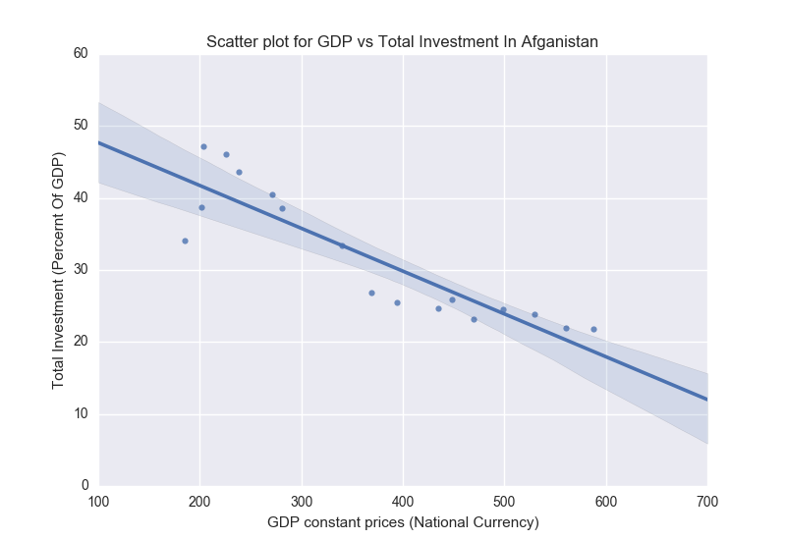
Use Case : Afghanistan Index
GDP figures Vs Total Investment In the country
Regression line shows that with the increase in GDP there is a decrease in total investment , that’s not a good sign for developing economy
<number>

Slide 10
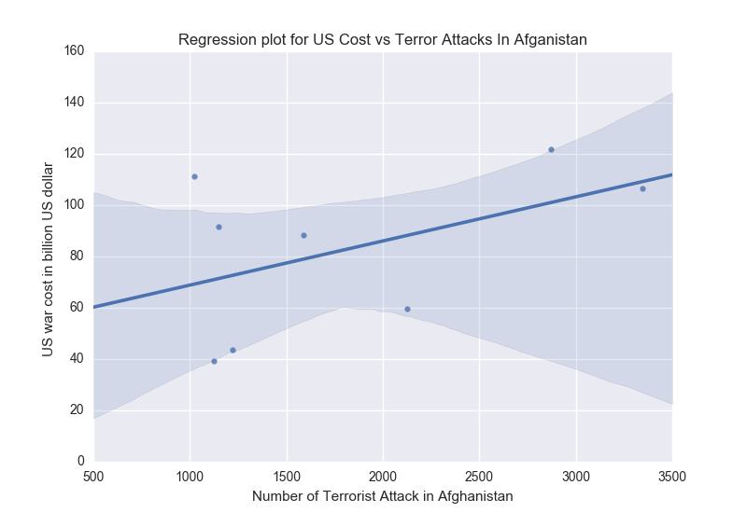
Use Case : Afghanistan Index
Plot for US War Cost in Afghanistan to number of terror attacks in Afghanistan
Regression line doesn’t show much of details as the scatter plot is pretty scattered so in the next slide we have line plot
Note : Cost is annual
<number>

Slide 11
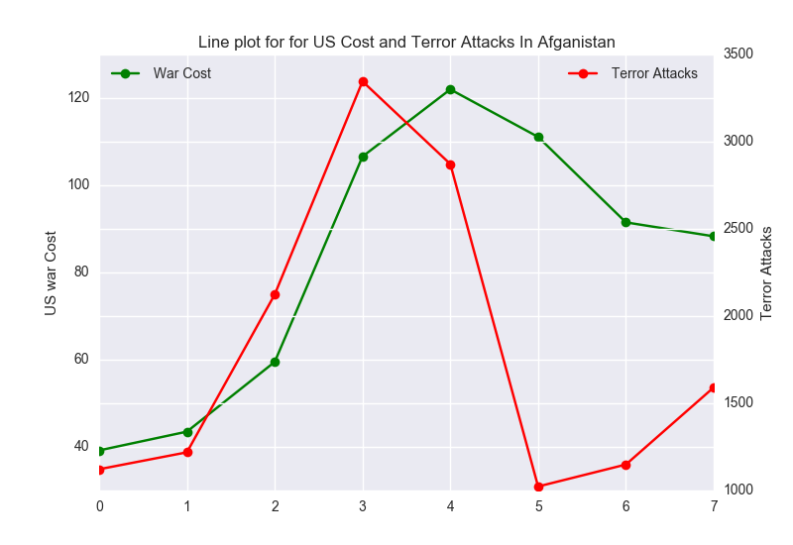
Use Case : Afghanistan Index
Line Plot for US War Cost in Afghanistan to number of terror attacks in Afghanistan
<number>

Slide 12
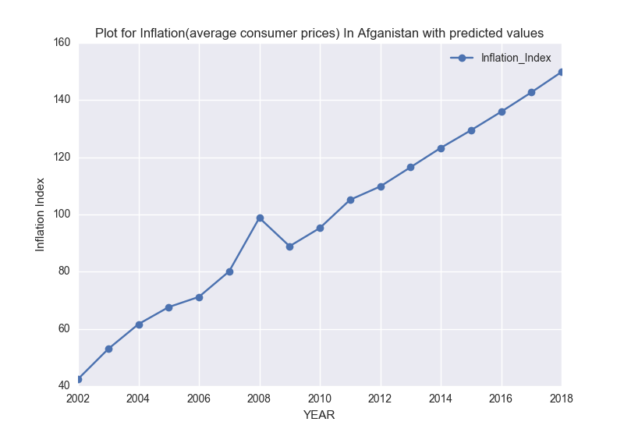
Use Case : Afghanistan Index
Line Plot for Inflation Index in Afghanistan with different years
<number>

Slide 13
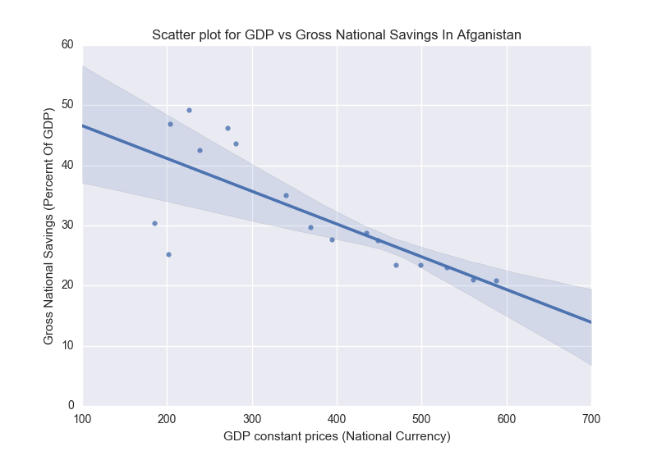
Use Case : Afghanistan Index
Regression Line plot for GDP to Gross National Savings
<number>

Slide 14
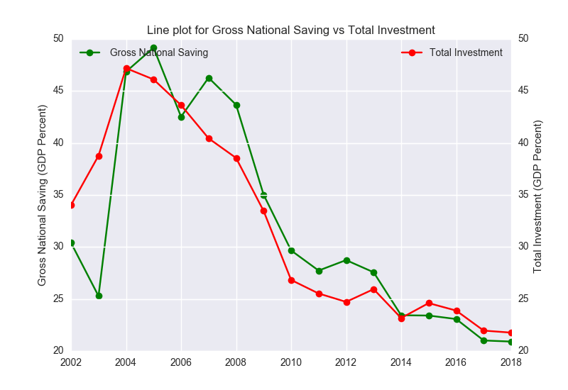
Use Case : Afghanistan Index
Line plot for Gross National Saving and Total Investment in the country
<number>

Slide 15
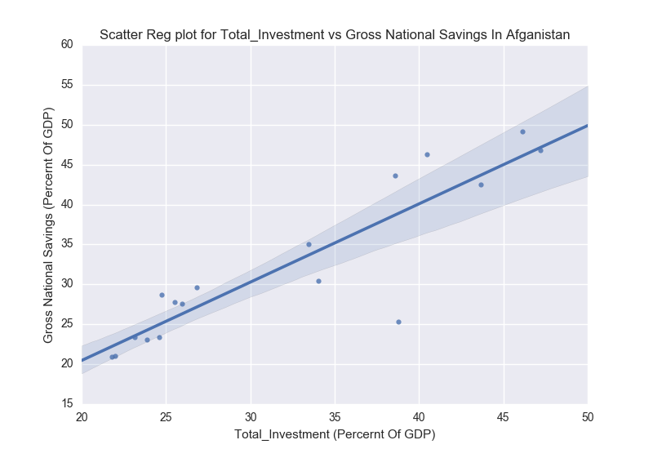
Use Case : Afghanistan Index
Regression Line plot for Gross National Savings to Total Investment in the country
<number>

Slide 16
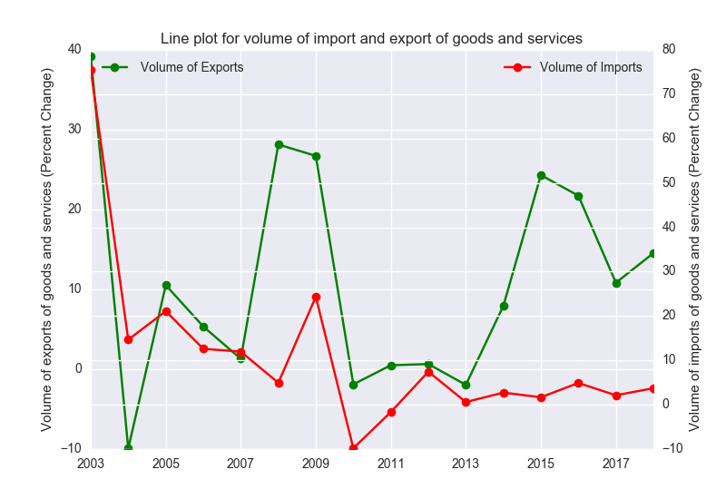
Use Case : Afghanistan Index
Line plot for Import and Export of goods and services in the country.
<number>

Slide 17
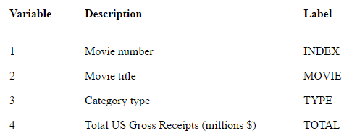
Use Case : MOVIES DATA
Data Source: American Statistical Association, IMDB Data Set
American Statistical Association : Data is in tab separated file with data structure as shown in figure. We have total of 50 Movies. There are some categories in which every movie is lined up into such as “Biggest Gross”, ”Best Picture” , “SERIES” ,etc.
<number>
Notes:
<number>

Slide 18
Use Case : MOVIES DATA
IMDB Data Set : It provides us with a API IMDBPy , through which we can get release dates , ratings and other details of the movie.
<number>
Notes:
<number>

Slide 19
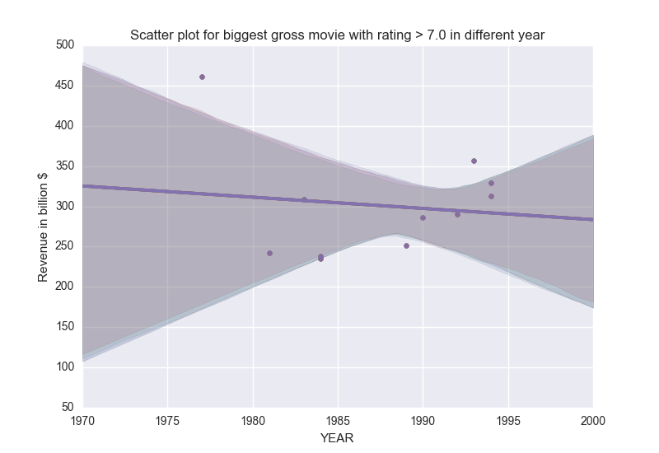
Use Case : MOVIES DATA
Line Plot for Revenue of movies which are in category “Biggest Gross” w.r.t years
Filter of movies having rating greater than 7
Here you can see regression line is not convincing because of “Star Wars”
<number>

Slide 20
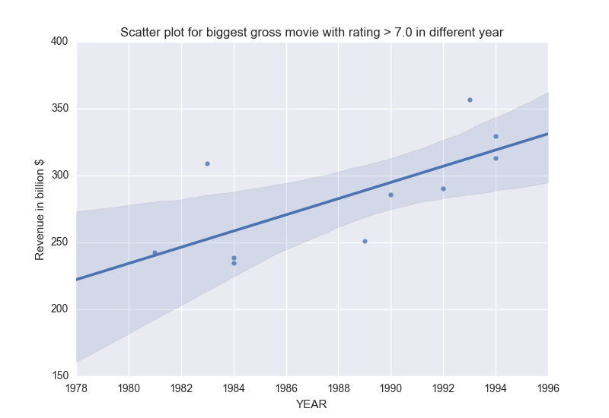
Use Case : MOVIES DATA
Line Plot for Revenue of movies which are in category “Biggest Gross” w.r.t years .
Filter of movies having rating greater than 7
Here we have removed Star Wars and line now show for the increase in revenue with year.
<number>

Slide 21
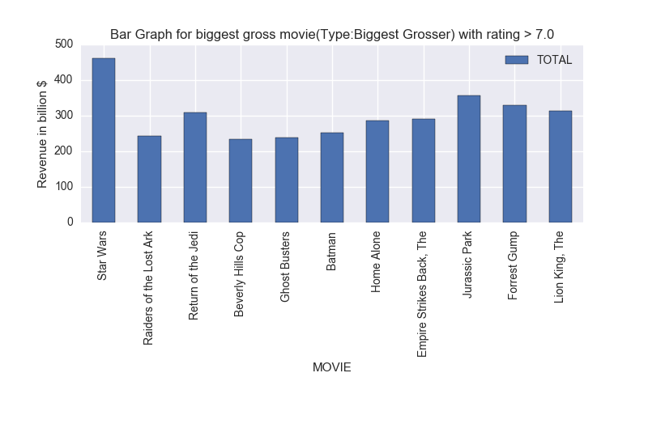
Use Case : MOVIES DATA
Bar Graph for Movies with their Revenue for movies of type “Biggest Gross”
Filter of movies having rating greater than 7
<number>

Slide 22
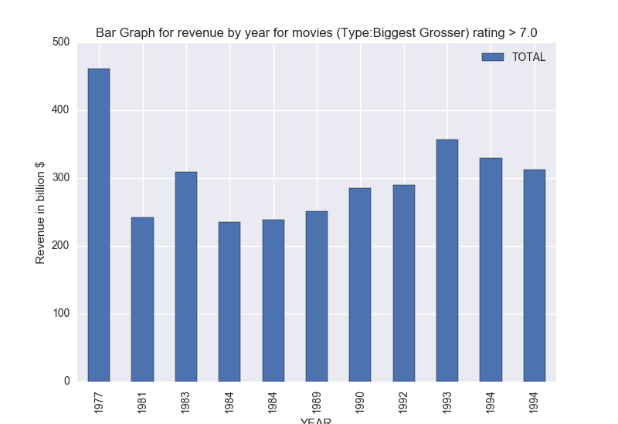
Use Case : MOVIES DATA
Bar Graph for Revenue of movies which are in category “Biggest Gross” w.r.t years
Filter of movies having rating greater than 7
<number>

Slide 23
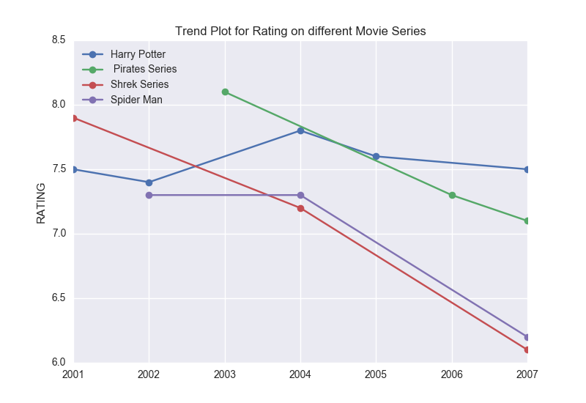
Use Case : MOVIES DATA
Trend Plot for Rating on different Movie series in data
<number>

Slide 24
Use Case : White House Popularity
White House Data Set :
Appointment dates
Number of people
<number>
Notes:
<number>

Slide 25
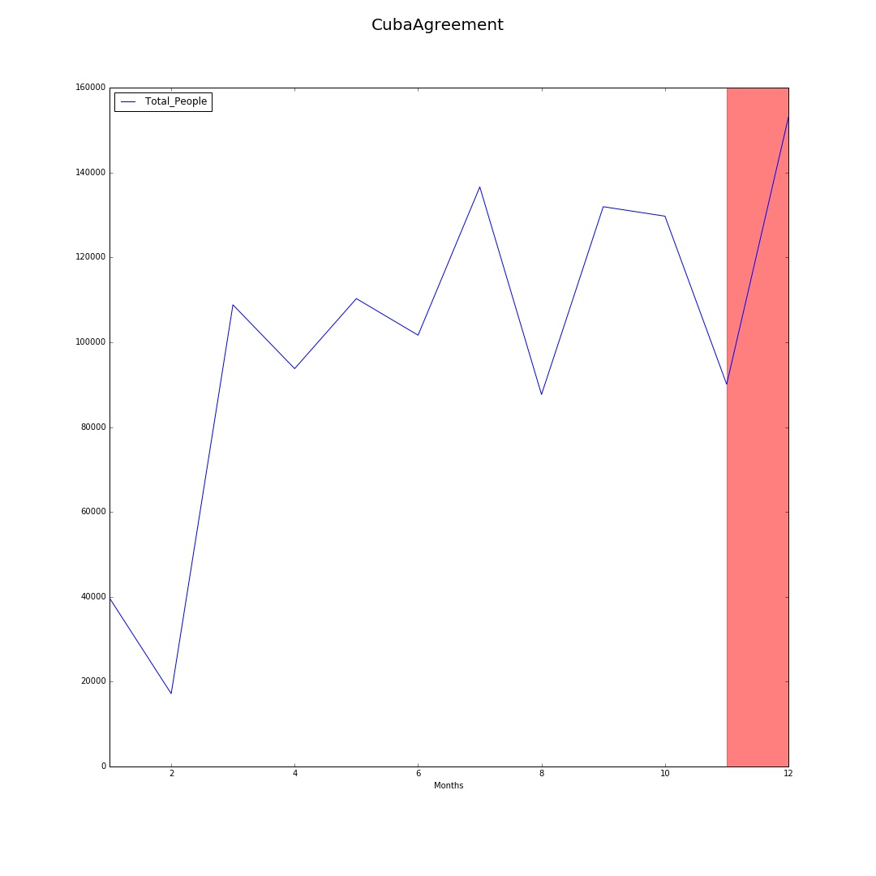
Use Case : White House Popularity
Cuba agreement on 17 December 2014
<number>

Slide 26
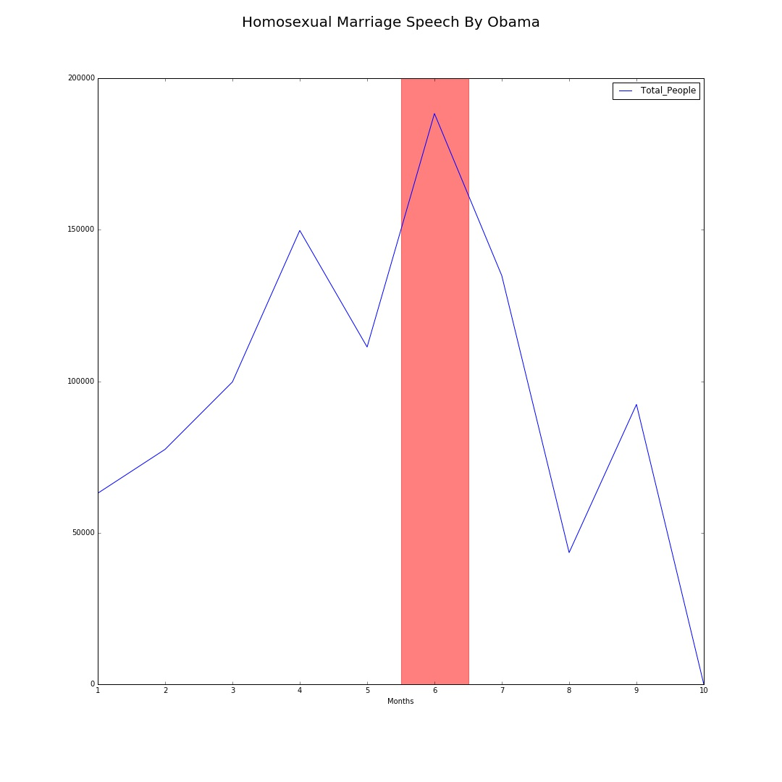
Use Case : White House Popularity
Obama’s Speech on same sex ruling marriage on 26 June 2015
<number>

Slide 27
FUTURE WORK
Use Case : White House :-
Analyzing data in more depth with more events
Making graphs more presentable
Use Case : Movies Data :-
Add more data and get insights with different time period
Use Case : Afghanistan Index:-
Get more insights from data related to impact of world politics
<number>

Slide 28
Summary
White House Data : Some events which are directly related to US Govt actions , may or may not have an impact on white house visitors data
Movies Data :
Movie Series : Most of them have lower rating for the sequels
Revenue : Generally , revenue has increased with years
Afghanistan Index :
War Cost spending and number of terrorist attack seems correlated
<number>

Slide 29
References
IMF Data
Brookings Reports
American Statistical Association
IMDB
White House Data
statista .com
<number>

