Slide 1
Object Detection with CNN
Mounika Marreddy

Slide 2
CNN (Convolutional Neural Networks)

Slide 3
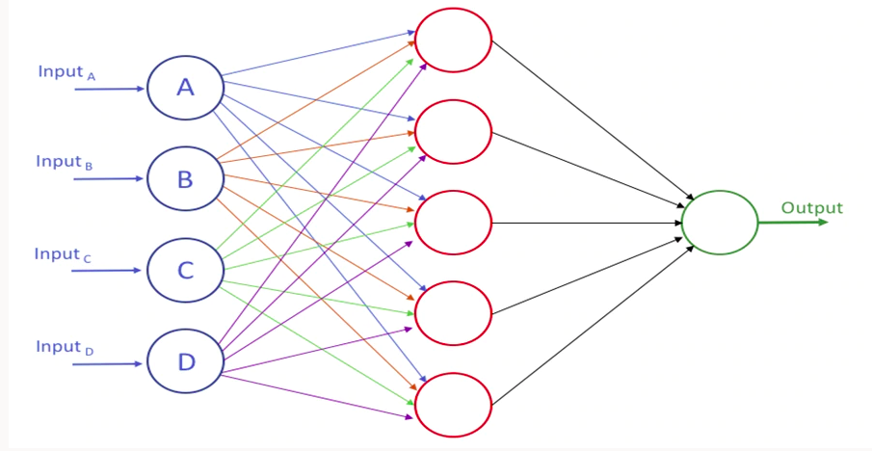
Neural Networks

Slide 4
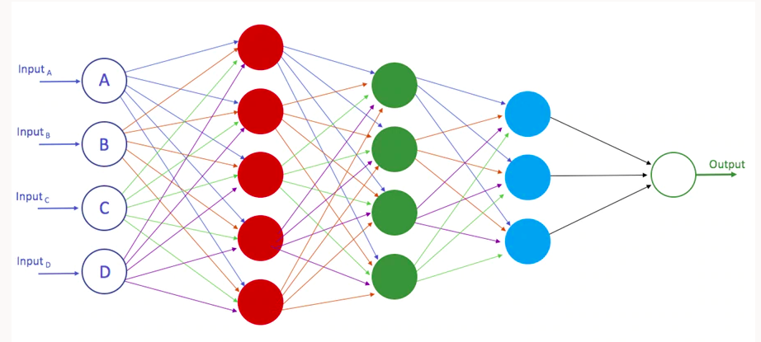
Deep Neural Networks

Slide 5
CNN is everywhere
Image classification
Image retrieval
Object detection
Image segmentation
Self driving cars
Face recognition

Slide 6
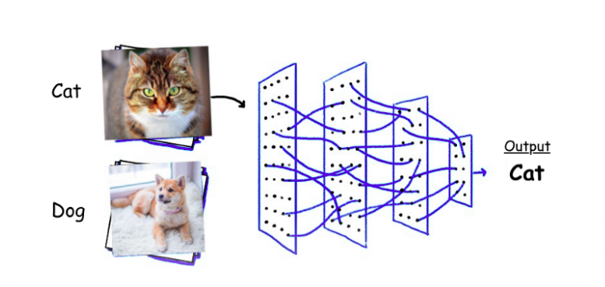
Image classification
Using CNN’s we can classify the images as cat or dog.

Slide 7
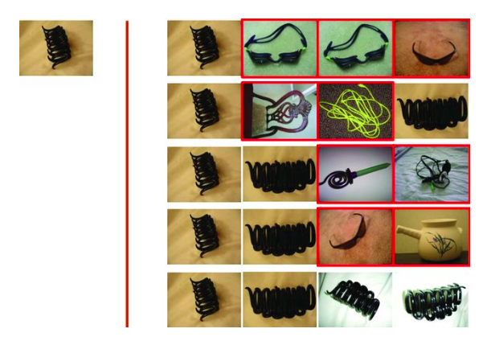
Image retrieval
Using CNN’s we can retrieve similar images from database. False positives are marked in red.

Slide 8
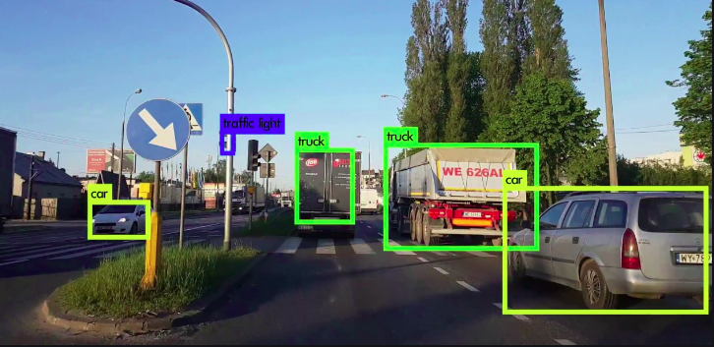
Object detection
Using CNN’s we can identify and locate objects in an image.

Slide 9
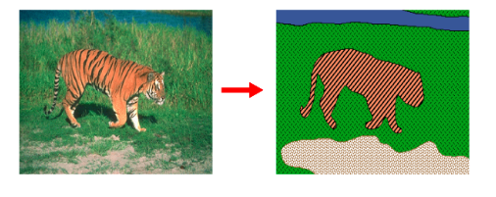
Image segmentation
Using CNN’s we can group the entities together in an image. This grouping depends on the pixels, sharing certain features such as color, intensity, or texture.

Slide 10
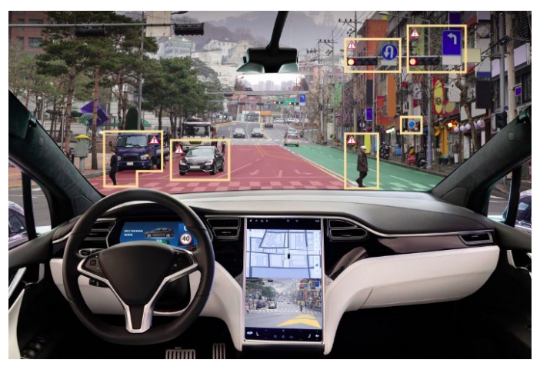
Self driving cars
Using CNN’s we can predict the steering angle to avoid all sorts of collisions.

Slide 11
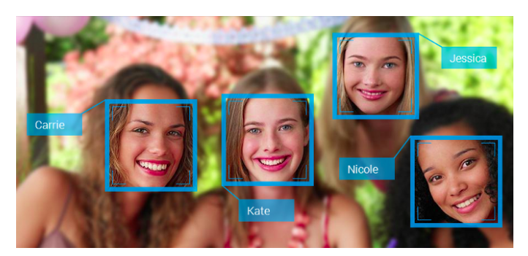
Face recognition
Using CNN’s we can classify the faces of individuals whose images saved in dataset .

Slide 12
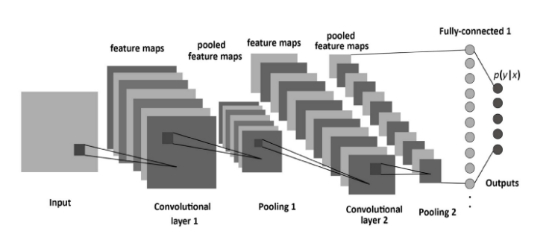
CNN Architecture

Slide 13
Layers in CNN
Input layer
Convolution layer
Pooling layer
Fully connected layer
Output layer

Slide 14
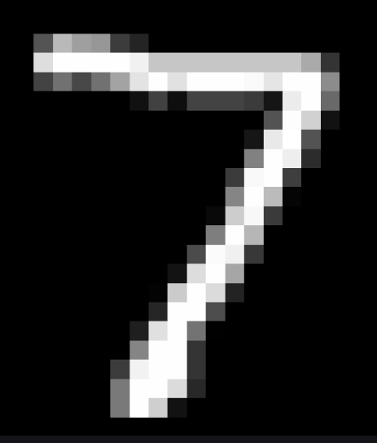
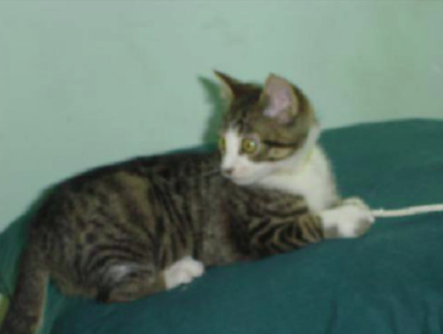
Why CNN
28x28x1 = 784 neurons
224x224x3 = 100,352 neurons

Slide 15
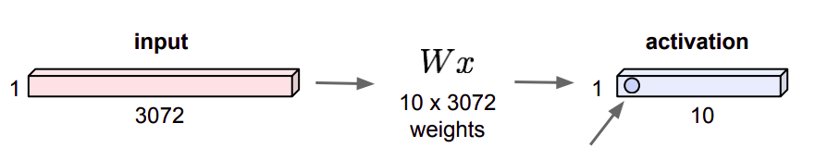
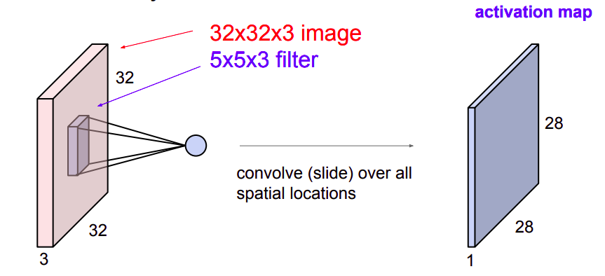
Fully connected layer vs convolution layer
In fully connected layer a 32x32x3 image changes to the dimension of 3072x1.
In convolution layer, spatial structure of the image is preserved.

Slide 16
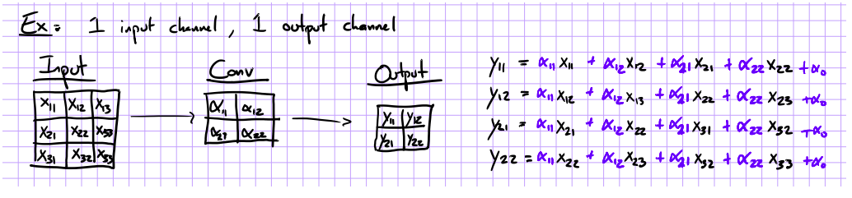
What is convolution?
The basic idea is to slide a matrix F (say 3x3) over an image (9x9) and compute the “inner product” (similarity) of F with the corresponding field of the image, and replace the pixel in the center of the field with the output of the inner product operation.

Slide 17
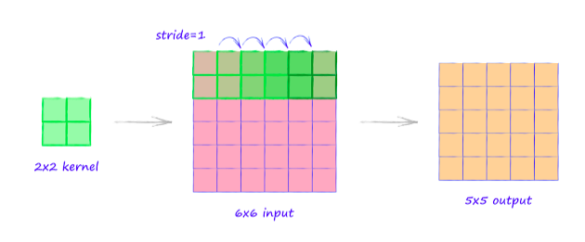
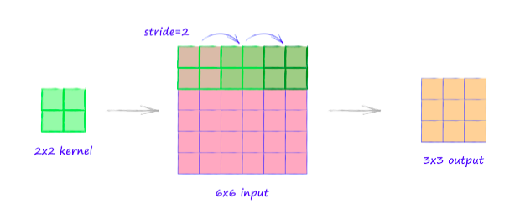
Strides
Stride is the number of pixels shifts over the input matrix.
Convolution with stride 1. Here we move the filters to 1 pixel at a time.
Convolution with stride 2. Here we move the filters to 2 pixels at a time.

Slide 18
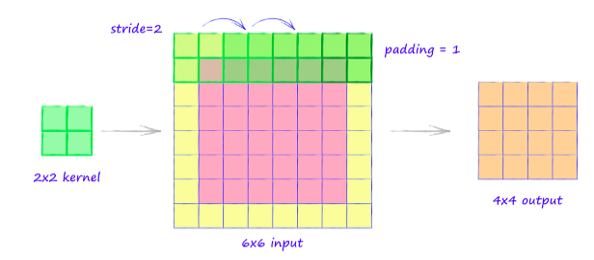
Padding
If the filter does not fit perfectly in input image then we need to pad the image with zeros.
Convolution with stride 2 and padding to 1.

Slide 19
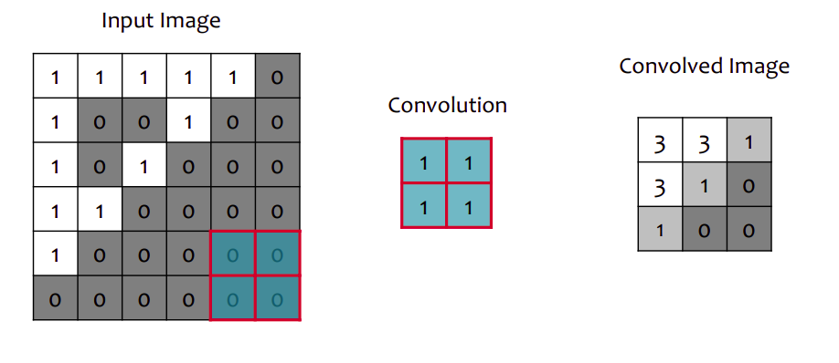
Example of convolution
Here 2x2 convolution matrix is applied on an image with stride 2.

Slide 20
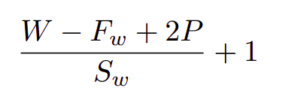
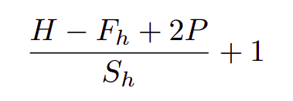
Calculating output image size
The exact size of convolution output for an input image is calculated as follows:
Output width =
Output height =
Here W and H are the width and height of an image, F_{w} and F_{h} are the width and height of filter and S_{w} and S_{h} are the width and height of stride.

Slide 21
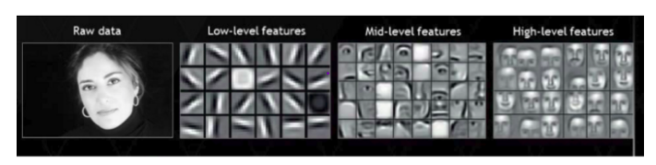
Filters
In CNN, we have different convolution layers and each layer have multiple filters
The filters at each layer learns the representation of image.
From fig: In layer 1, low level features like curves, lines were extracted. In intermediate layers mid-level features like nose, eyes and lips were learned. The last layer learns features of a full human face.

Slide 22
Which size for filter and stride should we take?
Small sizes for filter and stride can capture fine details of the image.
Big sizes for filter and stride can cause huge information loss.
Most common choice of size for filter is 2x2 and for stride is 2.

Slide 23
Convolution layer
Main idea: Treat convolution matrix as parameters and learn them.
Convolution layer is the first layer to extract features from image.
Convolution of an image with different filters can perform operations such as edge detection, blur and sharpen by applying filters.

Slide 24
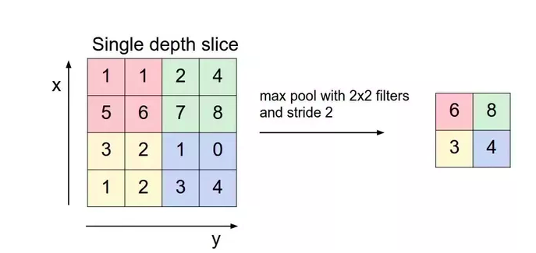
Pooling layer
Pooling layer makes the representations smaller and more manageable.
Some of the types of pooling are max pooling, average pooling and sum pooling.
Max pooling takes the largest element from the rectified feature map.

Slide 25
Fully connected layer
In fully connected layer, we flatten our matrix into vector and feed it to neural network.
This layer takes input from its preceding layer (say convolution or max pooling) and outputs an N dimensional vector where N is the number of classes that the program has to choose from.

Slide 26
Summary
Provide the input image into convolution layer.
Choose parameters, apply filters with strides, padding if requires. Perform convolution on the image and apply ReLU activation to the matrix.
Perform pooling to reduce the size.
Add as many convolution layers until satisfied.
Flatten the output and feed into a fully connected layer.
Output the class using an activation function and classify the images.

Slide 27
Pre-trained CNN Architectures

Slide 28
“You need a lot of data if you want to train/use CNN’s”

Slide 29
“You need a lot of data if you want to train/use CNN’s”
No. There are available pre-trained architectures where you can work with small amount of data.

Slide 30
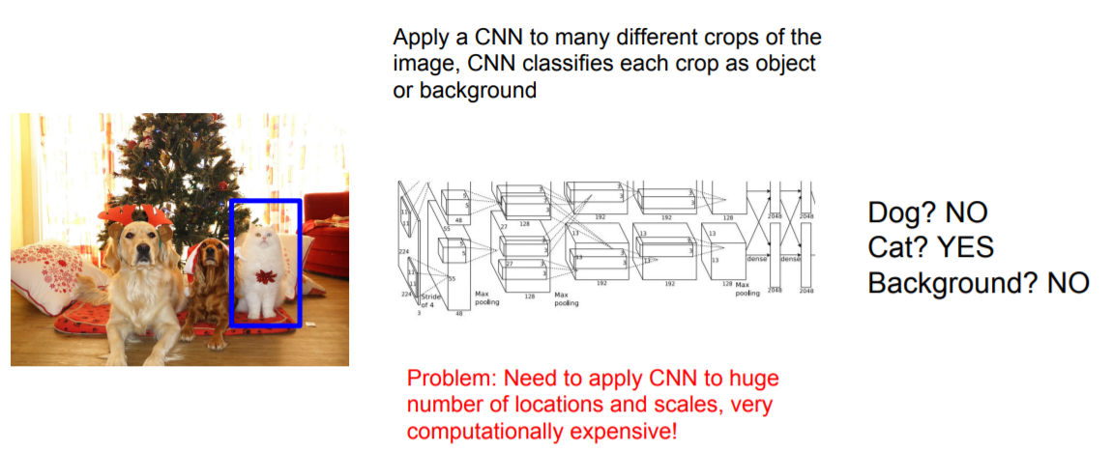
Object Detection as Classification: Sliding Window

Slide 31
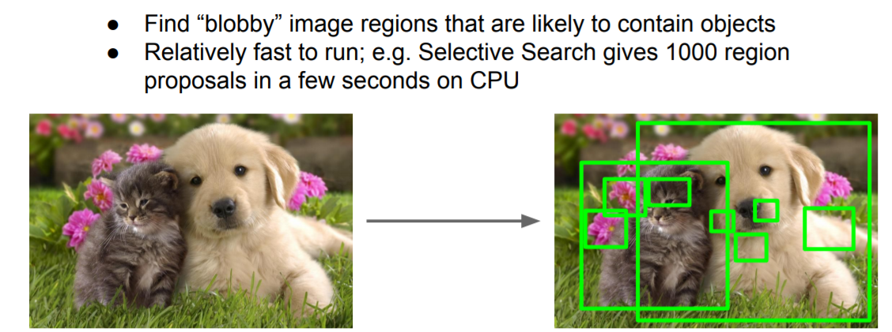
Region Proposals

Slide 32
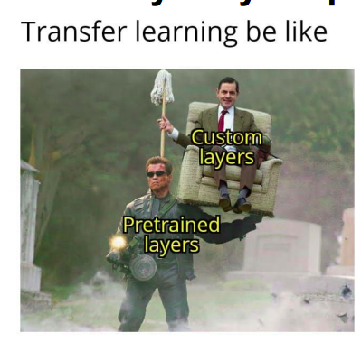
Takeaway for your projects and beyond:

Slide 33
Other pretrained architectures
AlexNet
VGGNet
GoogLeNet
ResNet
YOLO

