Slide 1




BITS Pilani
WILP
AIML CLZG516
ML System Optimization
BITS Pilani
Pilani Campus

Slide 2
AIML CLZG516
ML System Optimization
BITS Pilani
WILP
Multicore and GPGPU
- SIMD vs. MIMD execution
- Memory hierarchies and bandwidth considerations

Slide 3
Multicore CPUs and GPGPU: An Overview
Multicore CPUs:
Multiple independent cores on a single chip
Each core has its own L1/L2 cache and may share L3 cache
Executes different tasks or threads (MIMD)
GPGPU (General-Purpose Graphics Processing Unit):
Thousands of smaller, simpler cores
Executes massive number of threads in parallel (SIMD model)
Optimized for high throughput, not latency

Slide 4
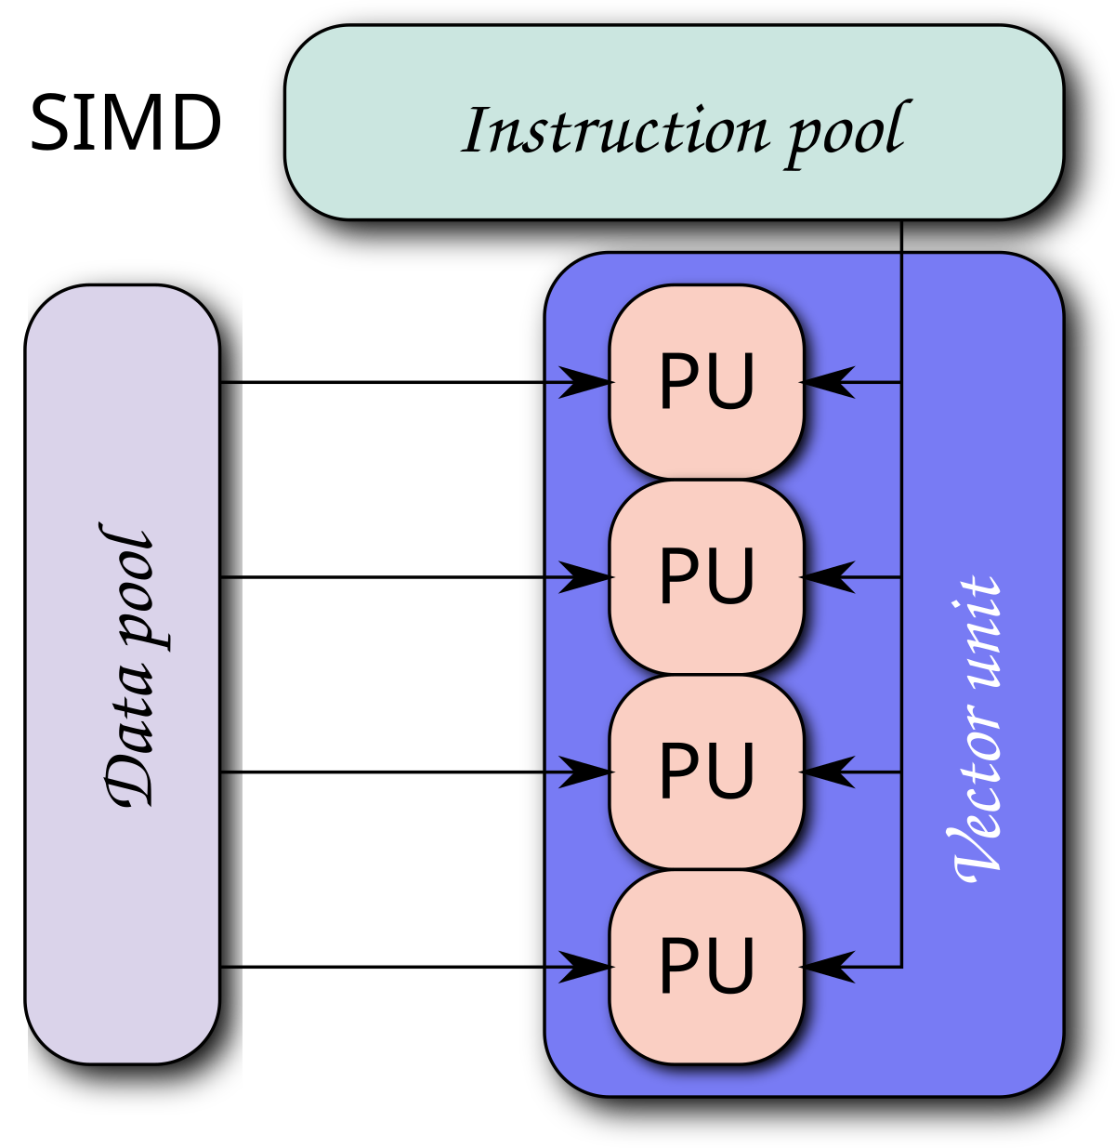
SIMD – Single Instruction, Multiple Data
Executes the same instruction across multiple data elements
Key Features:
Suitable for data-parallel applications
Lockstep execution – all processing elements perform same operation simultaneously
Examples of Use:
Vector and matrix operations
Image filters, audio processing
Scientific computation
Hardware Support:
Intel AVX, ARM NEON, NVIDIA CUDA (warps/wavefronts)

Slide 5
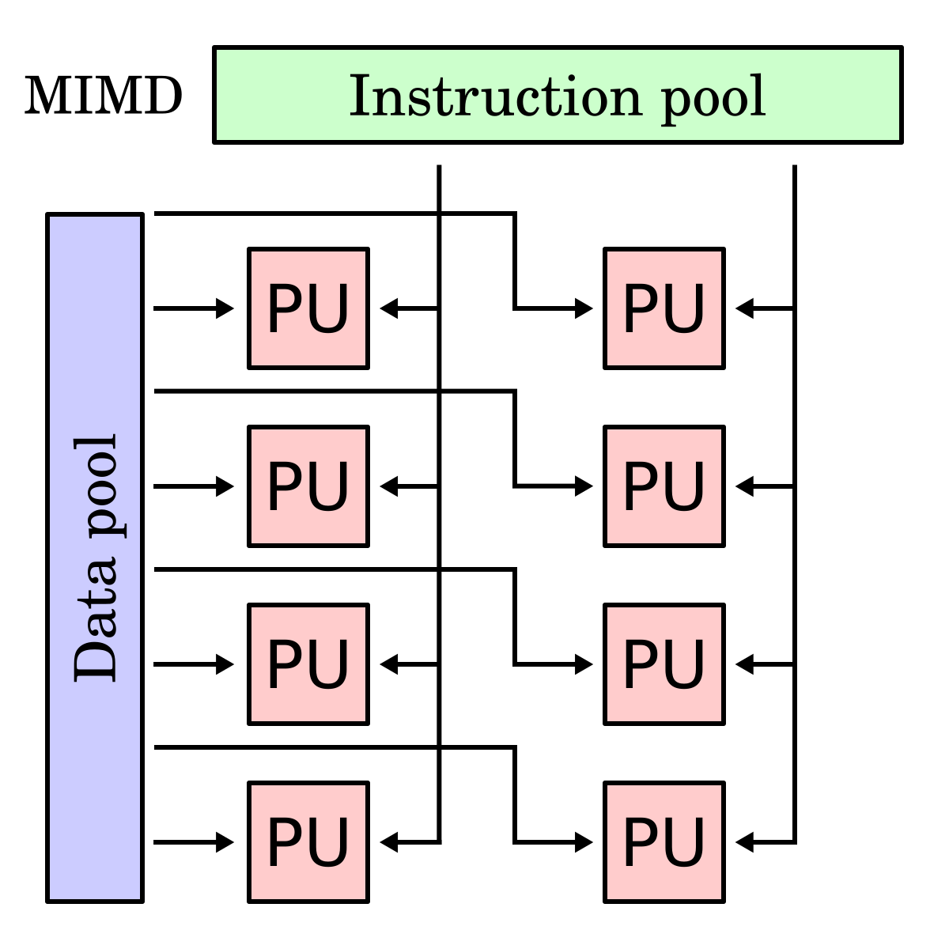
MIMD – Multiple Instruction, Multiple Data
Each processor or core can execute different instructions on different data
Key Features:
Flexible and versatile execution model
Ideal for task-parallel workloads
Examples of Use:
Operating systems
Web servers
Multithreaded applications
Hardware Support:
Multicore CPUs (Intel, AMD)
Some heterogeneous compute platforms (e.g., ARM big.LITTLE)

Slide 6
SIMD vs. MIMD – Key Differences
Aspect | SIMD | MIMD
Instruction Stream | Single | Multiple
Data Stream | Multiple | Multiple
Synchronization | High (lockstep) | Low (independent threads)
Control Flow | Less flexible | Highly flexible
Hardware Examples | GPUs, Vector Units | Multicore CPUs, Clusters
Use Cases | Matrix ops, signal processing | Web servers, OS-level tasks
Efficiency | High for regular data structures | High for diverse workloads

Slide 7
Challenges in SIMD & MIMD Execution
SIMD Limitations:
Branch divergence: Different threads follow different execution paths (common in GPU warps)
Memory alignment: Poor alignment leads to performance penalties
Limited for irregular, task-diverse workloads
MIMD Limitations:
Thread management: Requires careful synchronization
Race conditions and deadlocks
Cache coherence: Shared data consistency becomes complex.

Slide 8
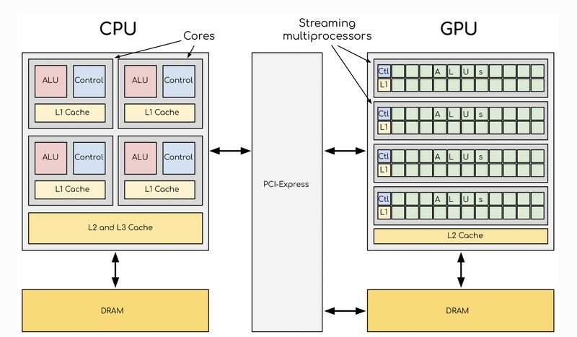
Memory Hierarchy in Multicore & GPGPU
Purpose: Bridge speed gap between fast processors and slow memory
Hierarchy Levels:
Registers: Fastest, smallest, processor-specific
L1, L2, L3 Cache: On-chip, close to core, progressively larger and slower
Main Memory (RAM): Shared DRAM, slower than cache
Disk/SSD: Persistent storage, very high latency
GPU-Specific:
Shared Memory: Fast, limited, user-controlled
Global Memory: Accessible by all threads, high latency
Constant/Texture Memory: Specialized, cached memory for specific use cases

Slide 9
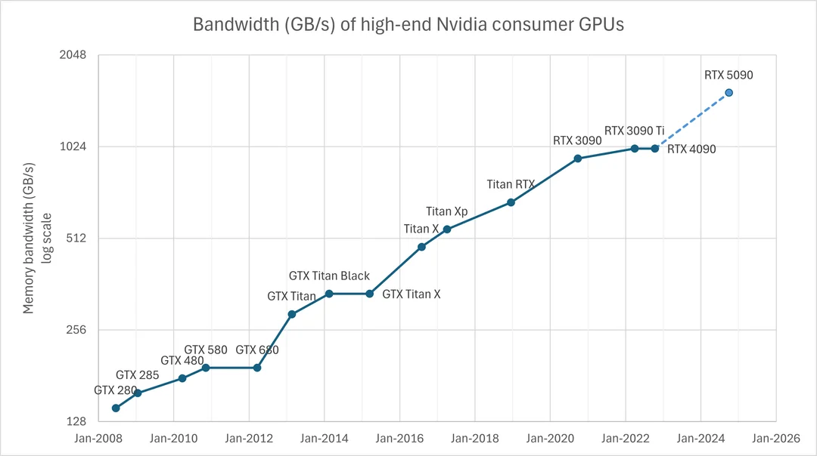
Memory Bandwidth Considerations
Memory Bandwidth:
Maximum rate at which data can be transferred between memory and processors
Why Important?
High computation speeds are meaningless without fast data access
Multicore CPUs:
Shared bandwidth among cores → contention possible
Cache reduces memory access latency
GPGPUs:
Very high theoretical memory bandwidth
Sensitive to access patterns
Coalesced access (threads accessing adjacent memory) is critical for performance

Slide 10
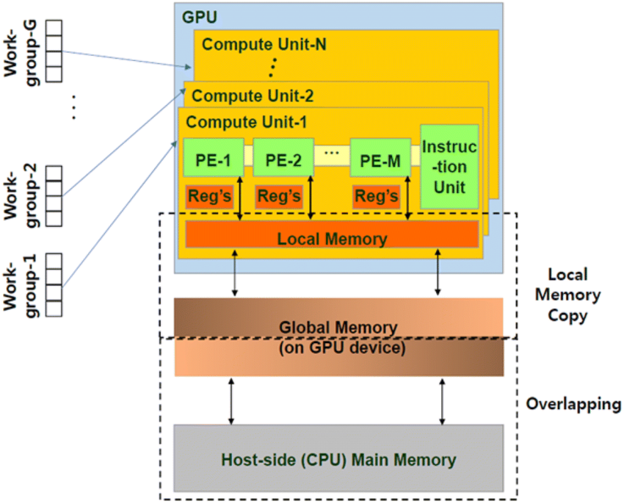
Optimizing Memory Performance
For Multicore CPUs:
Use locality of reference to benefit from caches
Avoid false sharing – separate data written by different threads
Use cache-aware data structures
For GPGPU:
Align memory access for coalescing
Utilize shared memory to avoid global memory latency
Minimize bank conflicts in shared memory
General Strategies:
Balance compute vs memory loads
Use pipelining and tiling techniques

Slide 11
Real-World Applications
Multicore CPUs:
Databases, compilers, real-time analytics
Multithreaded software, OS multitasking
GPGPUs:
Deep learning (training and inference)
High-performance computing (HPC)
Real-time rendering and image processing

Slide 12
AIML CLZG516
ML System Optimization
BITS Pilani
WILP
Distributed Clusters
- CPU-only vs. GPU-accelerated clusters
- Data sharding (horizontal vs. vertical)
- Parameter-server vs. all-reduce paradigms

Slide 13
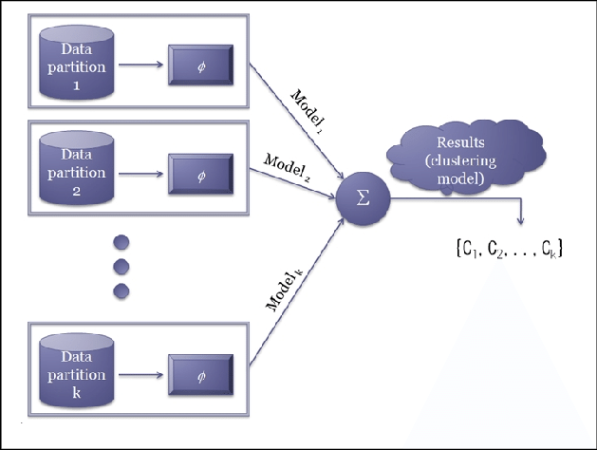
Introduction to Distributed Clusters
A distributed cluster is a network of independent computing nodes working together to process large-scale data or computational tasks.
Used in cloud computing, deep learning, big data analytics, and scientific simulations.
Key Goals:
High availability
Scalability
Fault tolerance
Load balancing

Slide 14
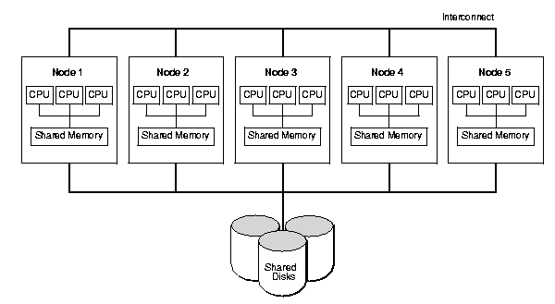
CPU-only Clusters
Comprised solely of multicore CPU-based nodes.
Suitable for:
Applications with control-heavy logic
Large in-memory databases
Distributed file systems and ETL pipelines
Benefits:
More memory per node (better for large datasets)
Well-supported by traditional distributed frameworks (e.g., Hadoop, Spark, MPI)
Easier to manage and deploy
Limitations:
Lower computational throughput
Slower performance in compute-intensive tasks like deep learning

Slide 15
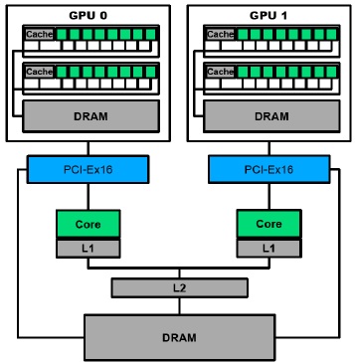
GPU-Accelerated Clusters
Consist of nodes with both CPUs and one or more GPUs (NVIDIA, AMD).
Ideal for:
Training large-scale deep learning models (CNNs, Transformers)
Image/video processing, simulations
Benefits:
Massive parallelism using thousands of CUDA cores
Faster matrix operations (e.g., GEMM, convolutions)
High floating-point throughput (TFLOPs range)
Limitations:
Lower memory per GPU
Requires GPU-compatible libraries (e.g., TensorFlow GPU, CUDA, NCCL)
Higher hardware and maintenance cost

Slide 16
CPU-only vs GPU-Accelerated Clusters
Feature | CPU-only Clusters | GPU-Accelerated Clusters
Compute Units | Multicore CPUs | CPUs + Dedicated GPUs
Memory per Node | High | Lower (per GPU)
Programming Model | Threading, MPI | CUDA, OpenCL, TensorFlow, PyTorch
Power Consumption | Lower | Higher
Ideal Use Cases | Control-heavy tasks, I/O-bound jobs | Deep learning, simulations, HPC
Cost | Lower | Higher (GPUs, cooling systems, etc.)

Slide 17
What is Data Sharding?
Data sharding is the process of partitioning a large dataset into smaller segments, known as shards, to improve scalability and performance in distributed systems.
Shards are distributed across multiple nodes to:
Enable parallel processing
Reduce network congestion
Improve system throughput
Two primary sharding techniques:
Horizontal Sharding (by rows)
Vertical Sharding (by columns)

Slide 18
Horizontal Sharding
Also called row-based partitioning
Each shard contains a subset of rows, but all columns.
Common in:
Distributed training of ML models
Partitioning of user data by user ID
Example:
Node A: User IDs 1–1000
Node B: User IDs 1001–2000
Advantages:
Simple to implement
Good for scaling read/write operations
Each shard is independent for most operations
Drawbacks:
Uneven distribution may cause data skew
Hard to perform global operations (e.g., join or sort)

Slide 19
Vertical Sharding
Also called column-based partitioning
Each shard contains all rows, but only a subset of columns/features.
Suitable for:
Feature-specific computations
Privacy isolation of sensitive fields (e.g., PII vs. transaction data)
Example:
Node A: Name, email
Node B: Transactions, credit score
Advantages:
Allows specialization and modular processing
Reduces query latency for column-specific workloads
Drawbacks:
Requires joins across nodes
Column dependencies introduce tight coupling

Slide 20
When to Use Which Sharding?
Aspect | Horizontal Sharding | Vertical Sharding
Partition By | Rows (records) | Columns (attributes/features)
Best For | Data-parallel training, analytics | Modularization, privacy isolation
Independence | High (each record is independent) | Low (joins may be required)
Query Complexity | Simpler | More complex (joins, merges)
Example Use Case | Distributed training in PyTorch | Microservices or privacy-centric apps

Slide 21
Parameter Server Paradigm
A central server or group of servers manage the global model parameters.
Worker nodes perform training on mini-batches of data:
Pull: Fetch current model parameters from the parameter server
Push: Send computed gradients back to server
Server updates the global model (sync or async)
Used in:
TensorFlow (TF1.x), MXNet, DistBelief (Google)
Advantages:
Asynchronous updates reduce idle time
Scalable to thousands of workers
Easier fault tolerance via replication
Challenges:
Communication bottleneck at server
Staleness in async updates can affect convergence
More complex system architecture

Slide 22
All-Reduce Paradigm
No central server – all nodes contribute equally
Each node:
Computes gradients on its own data shard
Uses collective communication (e.g., NCCL, MPI) to reduce gradients across all nodes (sum or average)
After aggregation, each node updates its local copy of the model
Used in:
Horovod (Uber), PyTorch DDP, TensorFlow (TF2.x)
Advantages:
No single point of failure
Near-linear scaling on high-speed interconnects
Challenges:
Requires synchronized updates
Sensitive to slow nodes ("stragglers")

Slide 23
Parameter Server vs. All-Reduce Comparison
Feature | Parameter Server | All-Reduce
Architecture | Centralized (master-worker) | Decentralized (peer-to-peer)
Update Mode | Async or sync | Usually synchronous
Fault Tolerance | Requires redundancy | Limited; single node failure halts
Communication Pattern | Many-to-one | All-to-all
Scalability | High (with async) | Efficient with high-bandwidth links
Framework Support | MXNet, TF1.x | PyTorch DDP, Horovod, TF2.x

Slide 24
Real-World Use Cases
CPU-only Clusters:
ETL pipelines in Apache Spark
Distributed databases (Cassandra, HDFS)
GPU-Accelerated Clusters:
Training GPT models in PyTorch
Autonomous vehicle simulation environments
Horizontal Sharding:
Image classification datasets (e.g., CIFAR, ImageNet)
Vertical Sharding:
Separating behavioral vs. demographic features in user profiling
Parameter Server:
Large-scale recommender systems (Google, Baidu)
All-Reduce:
Distributed training of ResNet, BERT, GPT

Slide 25
AIML CLZG516
ML System Optimization
BITS Pilani
WILP
Decision Trees & Random Forests
- - Distributed implementations (Spark-ML, XGBoost’s distributed GPU mode)

Slide 26
Introduction to Decision Trees
A Decision Tree is a supervised learning model used for classification and regression.
The model is structured as a tree:
Root Node: Represents the entire dataset
Internal Nodes: Represent features
Leaves: Represent class labels or regression values
Decision-making is based on feature splits using criteria like:
Gini Impurity
Entropy (Information Gain)
Mean Squared Error (for regression)

Slide 27
Introduction to Random Forests
A Random Forest is an ensemble of Decision Trees.
Trains multiple trees independently on bootstrapped data.
Each tree makes a prediction → final result is majority vote or mean.
Improves:
Accuracy
Robustness to overfitting
Generalization
Randomly selects a subset of features at each split (feature bagging)

Slide 28
Need for Distributed Training
Large datasets (millions of samples, thousands of features) require parallel processing.
Distributed training allows:
Faster training via parallelism
Handling data that doesn’t fit into memory
Leveraging multi-node clusters or GPUs
Especially critical in:
Big data applications
Online learning platforms
Production-level machine learning pipelines

Slide 29
Distributed Training – Two Main Approaches
Data Parallelism
Dataset is partitioned across multiple nodes
Each node builds a partial tree or submodel
Model Parallelism
Tree or split construction is parallelized
Nodes cooperate on a single tree or forest

Slide 30
Spark MLlib – Decision Trees and Random Forests
Apache Spark MLlib provides distributed implementations of Decision Trees and Random Forests
Built on top of RDDs and DataFrames
Key Concepts:
Pipeline API: Supports feature transformation + model training
Distributed Node Splitting:
Uses map-reduce pattern to compute best splits
Scales well on commodity clusters
Supports Classification & Regression
Pros:
Scales to TBs of data
Integrated with Hadoop ecosystem
Works with structured (DataFrame) APIs
Cons:
Training speed is slower than GPU frameworks
Limited to binary splits, No support for categorical features as natively as other frameworks

Slide 31
Distributed Decision Tree (e.g., Spark MLlib)
function Train_Distributed_DecisionTree(dataset D, max_depth):
broadcast D.schema to all workers
for depth in 0 to max_depth:
parallel_for each worker:
compute feature histograms for local data
aggregate histograms across workers at master
find best split using global histogram
broadcast split decisions to all workers
each worker partitions its data based on split
if stopping condition met:
break
return trained decision tree
Broadcast dataset schema to all workers for consistent data processing.
For each tree level: workers compute local histograms of feature-label statistics in parallel.
Aggregate (reduce) histograms globally to find the best split feature and threshold.
Broadcast split decision to all workers to partition their local data.
Repeat until maximum tree depth or pure leaves are reached.

Slide 32
Distributed Random Forest
function Train_Distributed_RandomForest(dataset D, num_trees, max_depth):
parallel_for tree_index in 1 to num_trees:
sample dataset D_sample (with replacement - bootstrap)
train DecisionTree on D_sample using Train_Distributed_DecisionTree
store trained tree in forest
return ensemble of decision trees (forest)
Train multiple trees independently on different bootstrap samples of the dataset.
Each tree is trained in parallel on distributed data partitions.
Each tree uses distributed decision tree training (histograms, splits).
Combine all trained trees into an ensemble for final prediction.
Ensemble improves stability and reduces overfitting.

Slide 33
Spark MLlib: Working Mechanism
Data Partitioning: Data is split across worker nodes
Feature Binning: Histograms are built for features
Split Evaluation: Workers evaluate splits independently
Best Splits: Aggregated via tree metadata
Model Update: Nodes update the tree structure
Communication overhead is minimized using reduce operations
Checkpointing is used for fault tolerance

Slide 34
XGBoost – Overview
XGBoost (Extreme Gradient Boosting) is a highly optimized implementation of Gradient Boosted Trees (GBT)
Supports:
Classification
Regression
Ranking
Time Series Forecasting
Key Features:
Regularization (L1, L2) to prevent overfitting
Tree pruning
Handling of missing values
Weighted quantile sketch for approximate split finding

Slide 35
XGBoost’s Distributed GPU Mode
XGBoost supports multi-GPU training for boosted decision trees.
Key Components:
DMatrix: Efficient data format for GPU
GPU Histogram Algorithm:
Constructs feature histograms in parallel
Enables fast approximate split finding
AllReduce Communication:
Aggregates partial gradients/splits across GPUs
Modes:
Single-node, multi-GPU
Multi-node, multi-GPU (via NCCL or Rabit)

Slide 36
XGBoost (Distributed GPU-based Gradient Boosted Trees)
function Train_XGBoost_Distributed(D, num_rounds, max_depth):
initialize prediction = 0 for all instances
for round in 1 to num_rounds:
parallel_for each GPU:
compute gradients and hessians for local partition
build histogram per feature (compressed)
all-reduce (sum) histograms across GPUs
master selects best split from global histogram
broadcast split info to GPUs
each GPU updates its data structure based on split
update prediction for each data point
return ensemble of boosted trees
Initialize predictions and compute gradients & Hessians per GPU on local data.
Build feature histograms to summarize gradient statistics efficiently.
Use AllReduce to aggregate histograms across GPUs for global split decisions.
Choose best splits and update tree structure synchronously on all GPUs.
Update predictions after tree construction for next iteration’s gradients.

Slide 37
XGBoost GPU Mode
Each GPU:
Processes a data shard
Builds histograms for gradient stats
Finds candidate splits
Master process:
Coordinates split selection
Merges updates via AllReduce
Synchronization after each boosting iteration
Benefits:
10x–50x faster than CPU for large datasets
Lower memory usage due to histogram-based algorithm
Good scalability on multi-GPU machines

Slide 38
Spark MLlib vs XGBoost (GPU Mode)
Feature | Spark MLlib | XGBoost (Distributed GPU Mode)
Language APIs | Scala, Java, Python | Python, R, C++, Julia
Parallelism Type | Data Parallel (RDD-based) | GPU Parallelism + AllReduce
Ensemble Method | Random Forests, GBT | Boosted Decision Trees (GBDT)
GPU Support | Limited/None | Full GPU Support
Scalability | Very high on CPU clusters | Very high on multi-GPU setups
Best Use Case | Structured batch pipelines | Real-time training with large datasets

Slide 39
AIML CLZG516
ML System Optimization
BITS Pilani
WILP
Support Vector Machines (SVM)
- - Parallelizing kernel computations (block-wise, map-reduce style)

Slide 40
Support Vector Machines (SVM)
Parallelizing Kernel Computations: Block-wise and MapReduce-style
What is SVM?
SVM is a supervised learning algorithm used for classification and regression.
It aims to find the optimal hyperplane that separates data into different classes.
Can use kernel trick to project data into higher-dimensional space for non-linear classification.
Kernel Computation in SVM
Core operation: Computing kernel matrix (Gram matrix) K(i, j) = φ(xᵢ) • φ(xⱼ)
For n data points: Kernel matrix is O(n²) in size → memory & compute bottleneck
Common kernels: RBF, polynomial, sigmoid, linear

Slide 41
Need for Parallelism
Kernel matrix computation is:
Quadratic in size: Hard to scale for large datasets
Embarrassingly parallel: Each (i, j) pair can be computed independently
Solutions:
Block-wise parallelism
MapReduce-style parallelism

Slide 42
Block-wise Kernel Computation
Block-wise Kernel Computation:
Divide the kernel matrix into blocks (tiles) of size B x B
Compute each block in parallel using multiple cores/GPUs
Works well in multicore systems and GPU architectures
Advantages:
Utilizes shared memory efficiently (e.g., in GPUs)
Reduces cache misses
Enables batch processing of kernel entries
Used in: CUDA-based SVM solvers, TensorFlow custom kernel ops

Slide 43
MapReduce-Style Kernel Computation
Suitable for distributed environments (e.g., Hadoop, Spark)
Steps:
Map phase: Each mapper computes a subset of the kernel matrix rows
Shuffle: Intermediate key-value pairs (row_index, kernel_row) are transferred
Reduce phase: Assemble the full matrix or partial results
Advantages:
Scales to large datasets across multiple machines
Tolerant to node failures
Works with disk-based data (out-of-core)
Used in:
Apache Mahout (Hadoop-based ML library)
Custom distributed SVM implementations using Spark

Slide 44
Tools & Frameworks Supporting Parallel SVM
Framework | Parallelization Type | Notes
cuSVM / ThunderSVM | GPU block-based | Very fast for RBF/Linear kernels
Apache Mahout | MapReduce (Hadoop) | Distributed kernel computation
Spark MLlib | Data parallel | Uses linear SVM (no kernel trick)
LIBSVM + MPI | Message-passing | Used for large-scale SVMs

Slide 45
AIML CLZG516
ML System Optimization
BITS Pilani
WILP
k-Nearest Neighbors (k-NN)
- Data partitioning & locality-sensitive hashing
- Distributed indexing (KD-tree, Ball-tree) vs. brute-force map-reduce
- Trade-offs: accuracy vs. latency in approximate k-NN

Slide 46
Overview of k-NN Algorithm
k-NN is a simple, intuitive algorithm for classification and regression.
For a query point, it finds the k closest points (neighbors) in the dataset based on a distance metric.
It then uses these neighbors to predict the label (classification) or value (regression).
Limitations:
Naïve implementation requires computing distances to all points → computationally expensive O(n⋅d).
Does not scale well for large datasets or high-dimensional data (curse of dimensionality).

Slide 47
Data Partitioning
Data partitioning divides the dataset into smaller parts to improve scalability and enable parallel processing.
Types of Partitioning:
Horizontal partitioning:
Splits dataset by rows — each partition contains a subset of data points.
Allows distributed processing where each node computes neighbors locally.
Vertical partitioning:
Splits dataset by columns — each partition contains subsets of features.
Used less often for k-NN since distance computations need full feature vectors.

Slide 48
Locality-Sensitive Hashing (LSH)
To reduce search complexity, approximate nearest neighbors methods like LSH are used:
Goal: Hash data points so that similar points collide in the same buckets with high probability.
How: Use hash functions sensitive to the chosen distance metric (e.g., Euclidean, cosine).
By querying only points in the same bucket, the search space reduces drastically.
Key Concepts:
LSH uses multiple hash tables to increase accuracy.
Query points are hashed similarly to retrieve candidate neighbors.
Final k-NN is selected from candidate neighbors by exact distance computation.
Advantages:
Sub-linear query time in large, high-dimensional datasets.
Easily parallelizable and distributable.
Limitations:
Approximate results — may miss some true neighbors.
Needs careful tuning of hash functions and parameters.

Slide 49
Locality-Sensitive Hashing (LSH) for Approximate k-NN
function LSH_Train(dataset D, num_tables L, num_hashes k, w):
for i in 1 to L:
generate k random vectors r₁...rₖ
create empty hash_table_i
for each x in D:
g = [floor((r_j ⋅ x + b_j)/w) for j in 1 to k]
hash_key = concatenate(g)
insert x into hash_table_i[hash_key]
function LSH_Query(query q):
candidate_set = set()
for each table:
g_q = compute_hash_for_query(q)
candidate_set += hash_table[g_q]
return kNN_BruteForce(q, candidate_set, k)
Approximate results
Sub-linear time with tuning
Used in high-dimensional data
LSH is used to find approximate nearest neighbors quickly in high-dimensional data by hashing points so that similar points end up in the same buckets with high probability.
How it works:
During training, multiple hash tables are created using randomly generated hash functions.
Each data point is hashed into buckets in each table based on projections and quantization.
For a query, its hash is computed in all tables to find candidate neighbors from the same buckets.
The final nearest neighbors are found by performing brute-force search only on this smaller candidate set.

Slide 50
Distributed Indexing Structures
KD-Trees
Binary tree that partitions space along axis-aligned hyperplanes.
Efficient for low-dimensional data (typically <30 dimensions).
Query complexity: O(log⁡n) average.
Not well-suited for high-dimensional data due to “curse of dimensionality.”
Difficult to scale across distributed systems because of tree traversal dependencies.
Ball Trees
Partitions data into nested hyperspheres (balls).
Each node stores center and radius of its points.
Allows pruning of large regions during search.
Better performance than KD-trees in moderately high dimensions.
Still challenging to distribute due to hierarchical structure.

Slide 51
KD-Tree-Based k-NN
KD-Tree organizes data points in a binary tree to speed up nearest neighbor searches, especially when the number of features (dimensions) is low (typically less than 30).
How it works:
The data is split recursively by choosing a dimension (axis) to split on at each tree level.
Points are sorted by that axis, and the median point becomes the current node.
Left subtree contains points smaller than the median, right subtree contains points greater.
For searching, the tree is traversed recursively to find nearest neighbors efficiently by pruning large parts of the search space.
Time complexity: On average, the search takes about O(log n) time, making it much faster than brute force for low-dimensional data.
function build_KDTree(points, depth = 0):
if points is empty:
return None
axis = depth mod d
sort points by axis
median = len(points) // 2
return Node(
point = points[median],
left = build_KDTree(points[0:median], depth + 1),
right = build_KDTree(points[median+1:], depth + 1)
)
function kNN_KDTree(query q, root, k):
initialize priority_queue pq
recursive_search(root, q, k, pq)
return top-k from pq
Efficient in low dimensions (<30)
Nodes are recursively split by axis

Slide 52
Distributed Indexing Structures
Brute-Force MapReduce
Distributed brute-force where dataset is partitioned across nodes.
Each node computes distances to local data points.
Results are aggregated and top-k selected.
Scales well but at the cost of high computation and communication.

Slide 53
Basic Brute-Force k-NN (Single Machine)
This method finds the k nearest neighbors to a query point by comparing it with every point in the dataset.
How it works:
For each point in the dataset, calculate the distance to the query point (using a distance metric like Euclidean distance).
Store all these distances along with the corresponding data points.
Sort the list of distances from smallest to largest.
Return the top k points with the smallest distances as the nearest neighbors.
Time complexity: Since it calculates the distance between the query and all points, and each distance computation involves all features (dimensions), the time complexity is O(n·d), where:
n = number of points in the dataset
d = number of features (dimensions)
function kNN_BruteForce(query_point q, dataset D, k):
distances = []
for each data_point x in D:
dist = compute_distance(q, x)
distances.append((dist, x))
sort distances by dist
return top-k elements from distances
Time Complexity: O(n·d)

Slide 54
MapReduce-Style Brute-Force k-NN (Distributed)
Map Function (each mapper):
for each query point q in Q:
for each local data point x in D_local:
dist = compute_distance(q, x)
emit (q.id, (dist, x.id))
Reduce Function (for each q.id):
collect all (dist, x.id) for the given q
sort distances
return top-k (x.id, dist)
Suitable for massive datasets in Hadoop/Spark
Inefficient but easy to scale
This method distributes the brute-force k-NN search across multiple machines (nodes) to handle very large datasets.
How it works:
The dataset is split across many nodes (each has its local data).
Each node (mapper) computes the distance from each query point to its local data points and emits these distances.
The reducer gathers all distances for each query from all nodes, sorts them, and selects the top-k nearest neighbors.

Slide 55
Distributed k-NN with LSH + MapReduce
Preprocessing:
For each data point x in D:
compute LSH hash h(x) and store in hash_table[h(x)] on respective node
Map Phase (query broadcast):
For each query q:
hq = compute LSH hash of q
emit (hq, q) → goes to node where matching bucket resides
Reduce Phase:
For each (hq, [q₁, q₂, ...]):
for each qᵢ:
candidate_set = hash_table[hq]
result = kNN_BruteForce(qᵢ, candidate_set, k)
emit (qᵢ.id, result)
Optimized for speed, suitable for big data platforms
This method combines Locality-Sensitive Hashing (LSH) with MapReduce to speed up approximate nearest neighbor search on very large datasets distributed across many nodes.
How it works:
Preprocessing: Each data point is hashed using LSH and stored in buckets on different nodes based on the hash value.
Map phase: For each query, compute its LSH hash and send the query to the node containing the matching bucket.
Reduce phase: For each query on that node, compare it only with data points in the same bucket using brute-force search, returning the approximate nearest neighbors.

Slide 56
Trade-offs: Accuracy vs. Latency
Aspect | Brute-Force | KD/Ball Trees | LSH
Accuracy | Exact | Exact (low-d) | Approximate
Latency | High | Low (low-d) | Very Low
Scalability | Good (with clusters) | Limited | Excellent
Dimensionality Suitability | Any | Low to moderate | High
Brute-force: Accurate but computationally expensive.
KD/Ball Trees: Fast for low dimensions but degrade with dimensionality.
LSH: Sacrifices some accuracy for speed and scalability; good for very high-dimensional data.

Slide 57
AIML CLZG516
ML System Optimization
BITS Pilani
WILP
Gradient Descent
- Minibatch vs. synchronous vs. asynchronous SGD

Slide 58
Gradient Descent Overview
Gradient Descent (GD): Optimization algorithm to minimize loss functions by iteratively updating parameters in direction of negative gradient.
Update rule: θ ← θ − η ∇_{θ} J(θ) where η = learning rate, J(θ) = loss function.

Slide 59
Types of Gradient Descent
Type | Description | Update Frequency | Pros | Cons
Batch GD | Uses the entire dataset for each update | After processing whole dataset | Stable convergence | Slow on large datasets
Stochastic GD | Updates parameters after each training example | After each single data point | Faster updates, more noise | Noisy updates, less stable
Mini-batch GD | Uses a subset (mini-batch) of data per update | After fixed-size mini-batches | Balance between speed & noise | Requires batch size tuning

Slide 60
Synchronous SGD
All workers compute gradients on different batches in parallel, then synchronize and aggregate gradients before updating parameters.
Process:
Each worker computes gradient on its batch.
Gradients are averaged/summed synchronously.
Parameter update is performed once per iteration.
Pros: Consistent updates, easier debugging.
Cons: Bottleneck due to waiting for slowest worker (straggler problem).

Slide 61
Asynchronous SGD
Workers compute and update parameters independently without waiting for others.
Process:
Worker computes gradient and immediately applies update to shared parameters.
No synchronization barrier.
Pros: Faster updates, no straggler bottleneck.
Cons: Potential stale gradients causing convergence issues or instability

Slide 62
Mini-batch Gradient Descent
for epoch in 1 to max_epochs:
shuffle(dataset)
for batch in dataset_batches:
gradient = compute_gradient(batch, theta)
theta = theta - learning_rate * gradient
Mini-batch Gradient Descent updates the model by using a small random portion (mini-batch) of the data instead of the entire dataset. This makes training faster than using all data at once and more stable than using only one data point at a time.
By processing mini-batches, it balances the speed of learning and smoothness of updates, helping the model to converge efficiently.

Slide 63
Synchronous SGD (Distributed)
initialize theta
for epoch in 1 to max_epochs:
distribute_batches_among_workers(dataset)
parallel_for each worker:
local_gradient = compute_gradient(worker_batch, theta)
aggregated_gradient = average(local_gradients from all workers)
theta = theta - learning_rate * aggregated_gradient
Multiple workers each compute gradients on different parts of the data at the same time.
They then wait for all workers to finish, average their gradients, and update the model together.
This ensures all workers use the same updated model every step, making training stable but sometimes slower due to waiting.

Slide 64
Asynchronous SGD (Distributed)
initialize shared theta
parallel_for each worker:
while not converged:
batch = get_next_batch()
gradient = compute_gradient(batch, theta)
lock(theta)
theta = theta - learning_rate * gradient
unlock(theta)
Workers compute and update the model independently, without waiting for others.
This speeds up training but means some updates might use outdated model values, which can cause less stable or slower convergence.

Slide 65
Gradient Descent Variants
Variant | Update Frequency | Synchronization | Pros | Cons
Mini-batch GD | After each mini-batch | No | Balanced speed & stability | Needs batch size tuning
Synchronous SGD | After all workers done | Yes (barrier sync) | Consistent updates | Slow due to stragglers
Asynchronous SGD | Immediately per worker | No | Fast, scalable | Potential stale gradients

Slide 66
Mini-batch vs Synchronous vs Asynchronous SGD
Aspect | Mini-batch SGD | Synchronous SGD | Asynchronous SGD
Parallelism | Single or multiple batches | Parallel workers, synchronized | Parallel workers, unsynchronized
Update latency | Medium (per mini-batch) | High (wait for all workers) | Low (immediate updates)
Convergence | Stable, less noisy | More stable (due to sync) | Less stable, potential staleness
Scalability | Moderate | Limited by synchronization overhead | Highly scalable
Use cases | General training | Small clusters, consistent results | Large clusters, distributed ML

Slide 67
AIML CLZG516
ML System Optimization
BITS Pilani
WILP
k-Means Clustering
- Lloyd’s algorithm in MapReduce (each worker computes local centroids)
- Mini-batch k-means & streaming variants
- Convergence criteria and communication reduction (compressing updates)

Slide 68
Lloyd’s Algorithm in MapReduce
Overview:
Lloyd’s algorithm is the standard iterative method for k-Means clustering.
It alternates between assigning points to the nearest cluster centroid and recalculating centroids.
MapReduce adaptation:
Map phase:
Dataset is divided among multiple worker nodes.
Each worker assigns local data points to the closest centroid,Computes partial sums of points and counts per cluster.
Reduce phase:
Aggregates partial sums and counts from all workers.
Calculates new global centroids by dividing summed points by counts.
Benefits:
Efficient parallel processing of large datasets,Scales well with increasing data size by distributing workload.
Challenges:
Requires synchronization after each iteration to aggregate centroids.
Communication overhead can increase with the number of clusters and workers

Slide 69
Lloyd’s Algorithm in MapReduce (Distributed k-Means)
Goal: Partition data points into k clusters by iteratively updating centroids (cluster centers).
How it works:
The dataset is split across multiple worker nodes.
Each worker assigns its local points to the closest centroid.
Instead of sending individual points back, each worker computes partial sums of points assigned to each centroid and counts how many points belong to each centroid.
The reducer (master node) aggregates these partial sums and counts from all workers.
It calculates the new centroids by averaging: new centroid = sum of assigned points / number of points assigned
Updated centroids are broadcast back to all workers.
This repeats until the centroids no longer change significantly (convergence).
initialize centroids randomly
repeat until convergence:
Map Phase (each worker):
for each data point x in local partition:
find nearest centroid c
emit (c.id, (x, 1)) # send data point and count 1
Reduce Phase (master node):
for each centroid id c:
sum all points assigned to c -> sum_points
sum all counts -> total_count
new_centroid = sum_points / total_count
update centroid c with new_centroid
broadcast updated centroids to all workers

Slide 70
Mini-batch k-Means
Mini-batch k-Means:
Uses small, random subsets (mini-batches) instead of the full dataset per iteration.
Updates centroids incrementally based on the mini-batch statistics.
Advantages:
Faster convergence and lower computational cost.
Good trade-off between accuracy and speed.
Use cases:
Large datasets where full-batch k-Means is too slow.
Situations needing quicker approximate clustering

Slide 71
Mini-batch k-Means
Goal: Speed up k-Means by updating centroids more frequently using small random subsets (mini-batches) instead of the whole dataset.
How it works:
Instead of calculating cluster assignments for all points in every iteration, randomly select a small batch (e.g., 100-1000 points).
Assign these points to the nearest centroids.
Update centroids incrementally toward the selected points using a learning rate (like in stochastic gradient methods): c←c+η×(x−c)
where c is the centroid, x is the data point, and η is the learning rate.
Repeat this process many times until convergence.
Why use mini-batches? Balances the computational efficiency of stochastic updates with the stability of batch methods.
initialize centroids randomly
for iteration in 1 to max_iterations:
sample a mini-batch of points from dataset
for each point x in mini-batch:
find nearest centroid c
update centroid c:
c = c + learning_rate * (x - c) # move centroid toward x incrementally

Slide 72
Streaming Variants
Streaming k-Means:
Designed for continuously arriving data (data streams).
Maintains and updates cluster centers incrementally as new data points come.
Does not require storing the entire dataset, enabling real-time processing.
Often uses techniques like reservoir sampling or exponential decay to weigh recent data more.
Applications:
Real-time analytics, sensor networks, online recommendation systems.

Slide 73
Streaming k-Means
Goal: Cluster data that arrives continuously (streaming data) without needing the entire dataset at once.
How it works:
Start with initial centroids.
For each incoming data point:
Find the nearest centroid.
Update that centroid incrementally toward the new point using a learning rate.
This allows clusters to evolve over time.
initialize centroids randomly
for each new incoming data point x:
find nearest centroid c
update centroid c:
c = c + learning_rate * (x - c) # adjust centroid for each new point

Slide 74
Convergence Criteria
Convergence Criteria:
Stop the algorithm when:
The change in centroids’ positions between iterations is below a predefined threshold (centroid displacement).
The assignments of points to clusters no longer change significantly.
A maximum number of iterations is reached.
Ensures a balance between computation time and clustering accuracy.

Slide 75
Communication Reduction
Communication Reduction in Distributed Systems:
Problem:
Frequent communication of centroid updates between nodes can cause network congestion and slowdowns.
Techniques to reduce communication overhead:
Compression: Compress updates via quantization or encoding deltas (differences) rather than full values.
Sparse updates: Only communicate significant changes in centroids.
Update frequency control: Aggregate updates locally and send to master node less frequently.
Asynchronous updates: Allow nodes to work with slightly stale centroids to reduce synchronization needs.
Benefits:
Improves scalability and efficiency in large-scale distributed clustering

Slide 76
Communication Reduction (Compressing Updates) in Distributed k-Means
initialize centroids randomly
repeat until convergence:
Map Phase (worker):
for each data point x in local partition:
find nearest centroid c
accumulate partial sums and counts locally
before sending to master:
compute delta = partial_sum_new - partial_sum_old
compress delta
send compressed deltas to master
Reduce Phase (master):
decompress and aggregate all deltas
update centroids
broadcast updated centroids to workers
Problem: In distributed k-Means, frequent communication of centroid updates can cause network bottlenecks.
Solution: Compress and send only deltas (changes) instead of full sums:
Each worker maintains old partial sums of points per centroid.
After processing a batch, compute the difference (delta) between new and old sums.
Compress this delta (using quantization, sparsification, or encoding).
Send only the compressed delta to the master.
Master decompresses and aggregates deltas from all workers to update centroids.

Slide 77
AIML CLZG516
ML System Optimization
BITS Pilani
WILP
Convolutional Neural Networks (CNNs)
- Data vs. model parallelism (layer splitting, tensor slicing)
- Mixed-precision & pipeline parallelism
- Distributed training frameworks (Distributed TensorFlow)

Slide 78
Data Parallelism in CNNs
Data Parallelism:
The same CNN model is copied to multiple GPUs or nodes.
Each replica processes a different mini-batch of the input data.
After forward and backward passes, gradients are averaged (or summed) across all replicas to update weights.
Most commonly used for training CNNs on large datasets.
Advantages:
Simple to implement.
Scales well with large datasets.
Challenges:
Requires synchronization between devices (communication overhead for gradients).
May suffer from inefficiencies if batch sizes are too small.

Slide 79
Data Parallelism
Each GPU gets a mini-batch of data, computes gradients independently, and then synchronizes the model parameters.
Working:
The full dataset is split into smaller chunks (mini-batches).
Each GPU has a full copy of the CNN model and processes a different batch.
After forward and backward passes, each GPU computes gradients on its own.
The gradients are then averaged (or summed) across all GPUs.
The global model weights are updated and synchronized across GPUs.
initialize model θ
split dataset into mini-batches
distribute model copies across N GPUs
for each epoch:
for each mini-batch in dataset:
parallel_for each GPU:
compute gradients on batch copy
average all gradients
update global model θ
broadcast updated θ to all GPUs

Slide 80
Model Parallelism in CNNs
Model Parallelism:
The CNN model is split across devices; each GPU holds a part of the model (e.g., layers or tensor partitions).
Input data flows sequentially through devices — forward pass goes from one GPU to another.
Types of model parallelism:
Layer Splitting:
Layers of the model are distributed across devices.
Example: GPU 1 holds layers 1–3, GPU 2 holds layers 4–6, etc.
Tensor Slicing:
Each tensor (like weight matrices or activation maps) is split across devices.
For example, split channels or spatial dimensions.
Advantages:
Useful for very large models that don’t fit on one GPU, Efficient use of memory.
Challenges:
More complex to implement, Requires careful management of inter-device communication

Slide 81
Model Parallelism (Layer Splitting Example)
# Suppose Model has 3 layers split across 3 GPUs
forward_pass(input):
on GPU1:
h1 = Layer1(input)
send h1 to GPU2
on GPU2:
h2 = Layer2(h1)
send h2 to GPU3
on GPU3:
output = Layer3(h2)
return output
backward_pass(grad_output):
on GPU3:
grad_h2 = backprop_Layer3(grad_output)
send grad_h2 to GPU2
on GPU2:
grad_h1 = backprop_Layer2(grad_h2)
send grad_h1 to GPU1
on GPU1:
backprop_Layer1(grad_h1)
Each part of the CNN (like convolutional layers, pooling, etc.) is placed on a different GPU and runs sequentially.
Working:
The CNN is split by layers (or groups of layers), and each part is assigned to a different GPU.
The input flows from one GPU to another in order (forward pass).
During backpropagation, the gradients flow back in the reverse order (from the last layer to the first).
Requires high inter-GPU communication but is memory efficient.
Used when a single model is too large to fit on one GPU.

Slide 82
Mixed-Precision
Mixed-Precision Training:
Uses both 16-bit (float16) and 32-bit (float32) representations during training.
Most computations are done in float16, but some (like loss scaling) stay in float32 to maintain accuracy.
Advantages:
Faster computation (due to lower precision).
Reduced memory usage (enabling larger batch sizes or models).
Supported by modern GPUs (e.g., NVIDIA Tensor Cores).
Challenges:
Needs careful handling to avoid loss of numerical stability (e.g., underflow in gradients).
Often requires loss scaling to stabilize training

Slide 83
Mixed-Precision Training
initialize model θ in float32
convert layers to use float16 where safe
for each batch:
forward pass (mostly in float16)
compute loss
scale loss to prevent underflow
backward pass (gradients in float16)
unscale gradients
update model weights in float32
Use float16 for most operations and float32 for critical ones (like weight updates).
Working:
Speeds up training and reduces memory usage by using half-precision (float16).
Sensitive operations like weight updates are still done in float32 to preserve accuracy.
Gradients are scaled to prevent underflow (very small numbers turning to zero).
After computing gradients in float16, they’re converted back to float32 for the update.
Popular in NVIDIA Tensor Cores and frameworks like Apex (PyTorch) or TensorFlow’s mixed precision API.

Slide 84
Pipeline Parallelism
Pipeline Parallelism:
Model is divided into sequential stages, and each stage is assigned to a different device.
Training is done in a pipelined manner:
While one stage is processing forward pass for batch N, another can be doing backprop for batch N–1.
Advantages:
Improves hardware utilization.
Works well for large models.
Challenges:
Difficult to balance workload among stages.
Pipeline bubbles (idle time between stages) can reduce efficiency.
Requires scheduling and buffering

Slide 85
Pipeline Parallelism
# Suppose model is split into 4 pipeline stages
pipeline_schedule = queue()
for each microbatch in batch:
stage_0.forward(microbatch) → queue for stage_1
stage_1.forward(microbatch) → queue for stage_2
stage_2.forward(microbatch) → queue for stage_3
stage_3.forward(microbatch) → compute loss
# Backward in reverse
stage_3.backward()
stage_2.backward()
stage_1.backward()
stage_0.backward()
Split the input batch into micro-batches and process them in a pipelined fashion across stages of the model on different devices.
Working:
The model is divided into stages, each running on a separate GPU.
Instead of processing one big batch, it is split into micro-batches.
While GPU 1 is working on micro-batch 2, GPU 2 can work on micro-batch 1 — maximizing hardware usage.
Forward and backward passes are pipelined, reducing idle time on GPUs.
Requires a scheduler to manage micro-batch flow and synchronization.

Slide 86
Distributed Training Frameworks (e.g., Distributed TensorFlow)
Distributed TensorFlow:
Enables training CNNs across multiple machines and GPUs.
Supports both data parallelism and model parallelism.
Uses tf.distribute.Strategy to manage distributed execution.
Key strategies:
MirroredStrategy: For multi-GPU on a single machine.
MultiWorkerMirroredStrategy: For multi-GPU across multiple machines.
TPUStrategy: For TPU-based training.

Slide 87
Distributed Training Frameworks (e.g., Distributed TensorFlow)
Key components:
Parameter Servers: Store and update model parameters centrally.
Workers: Perform forward and backward passes.
Advantages:
Built-in support for fault tolerance, checkpointing, and gradient synchronization.
Scales to large clusters.
Challenges:
Requires proper cluster configuration and network setup.
Debugging and performance tuning can be more complex than single-machine training

