Slide 1
Chatbots

Slide 2
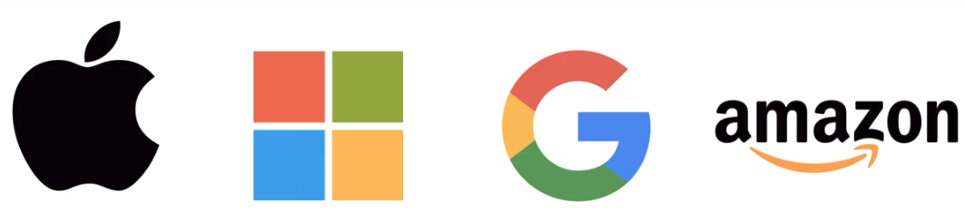

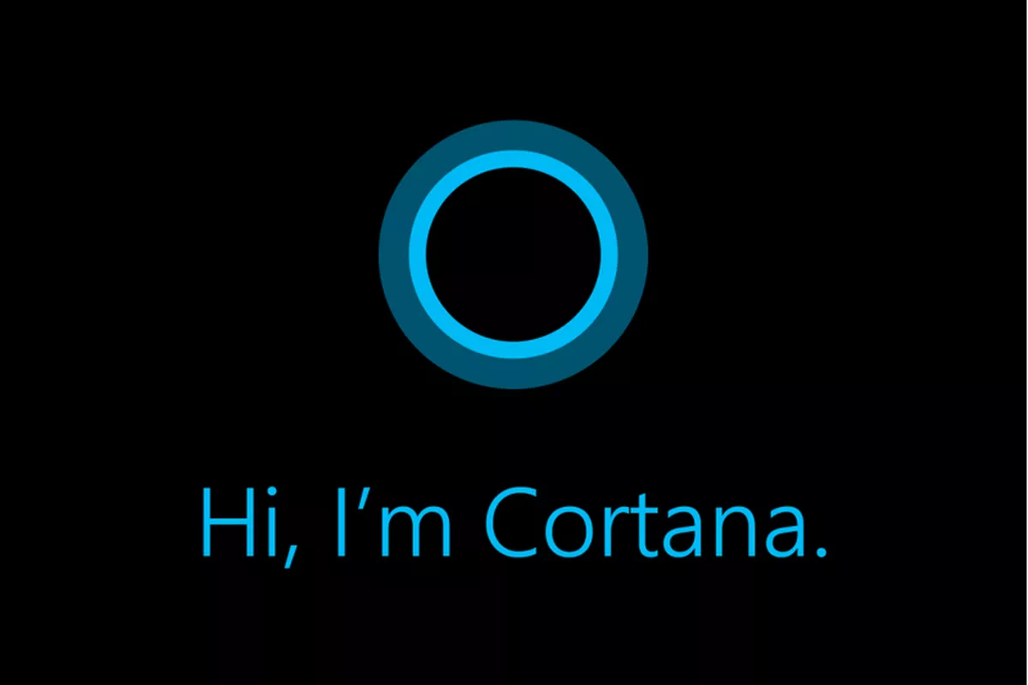
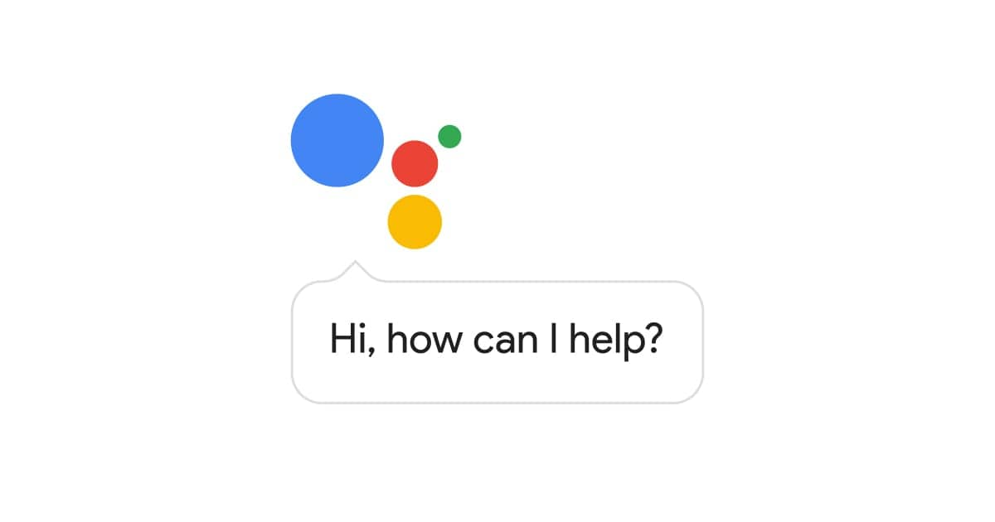

What’s so exciting about chatbots?

Slide 3
But Chatbots is just one of the application areas of the broader concept called deep learning based NLP. What are the other applications?
Language Translation
Text Summarization
Image & Video Captioning
Speech Transcription

Slide 4
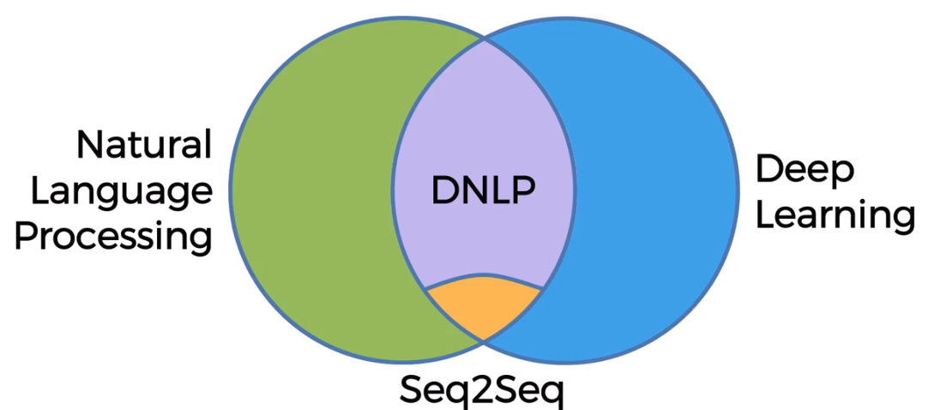
So lets understand Deep NLP

Slide 5
Recap of RNNs
Output Layer
Hidden Layer
Input Layer

Slide 6
Recap of RNNs
Output Layer
Output Layer
Hidden Layer
Input Layer
Input Layer

Slide 7
Recap of RNNs
Output Layer
Output Layer
Hidden Layer
RNN Layer
Input Layer
Input Layer

Slide 8
Recap of RNNs
=
…
Time

Slide 9
Recap of RNNs
…
…
…
Time

Slide 10
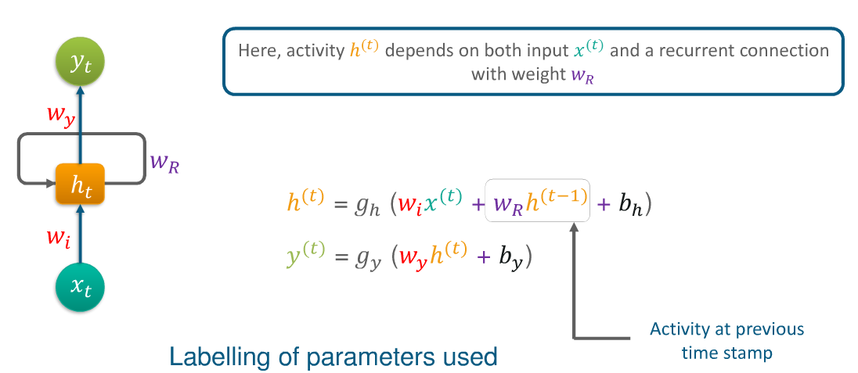
Recap of RNNs

Slide 11
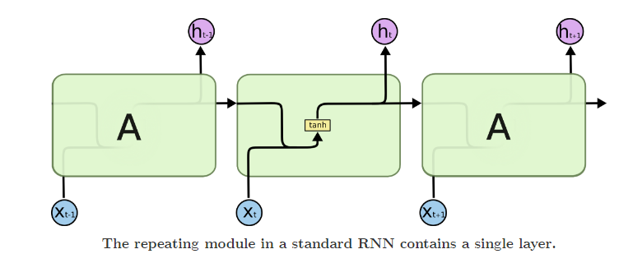
Recap of RNNs

Slide 12
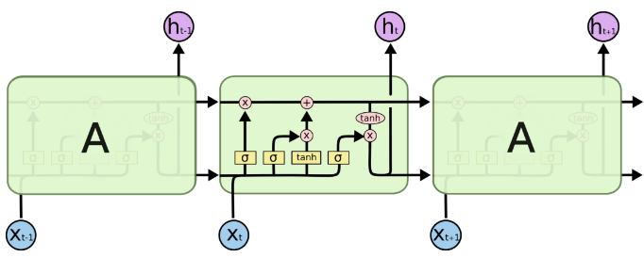
Recap of RNNs

Slide 13
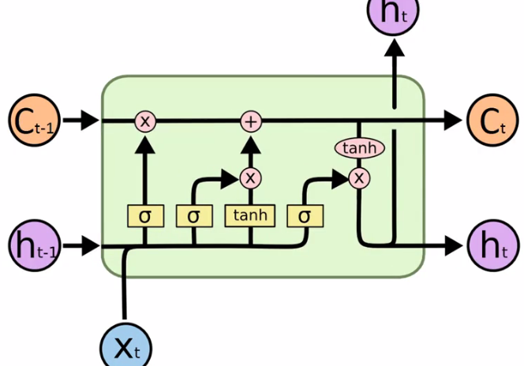
Recap of RNNs

Slide 14
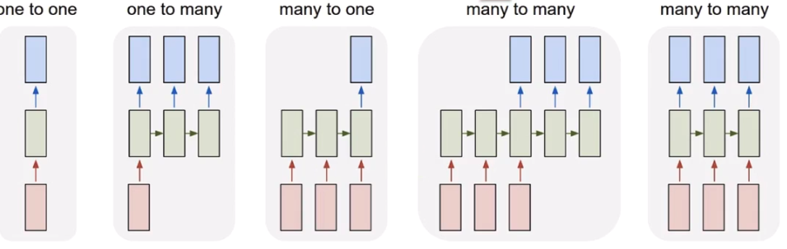
Recap of RNNs

Slide 15
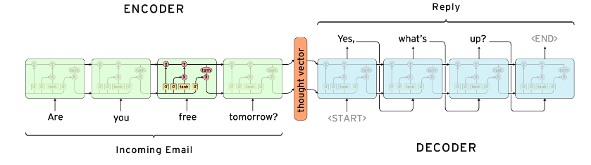
Seq2seq architecture
- Difference between Training and Inference
- How does it deal with variable length inputs and outputs

Slide 16
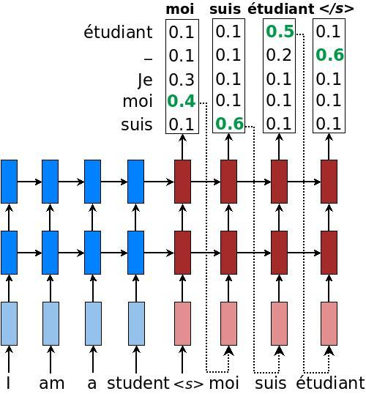
Greedy Decoding

Slide 17
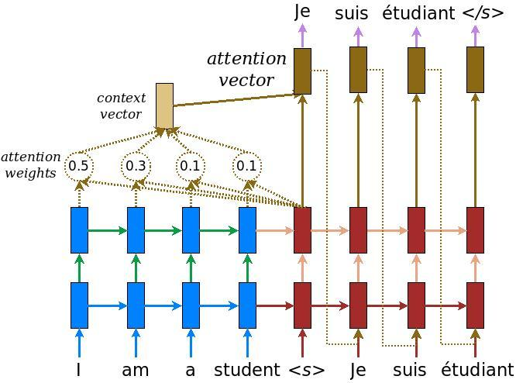
Attention Mechanism
Global & Local Attention

Slide 18
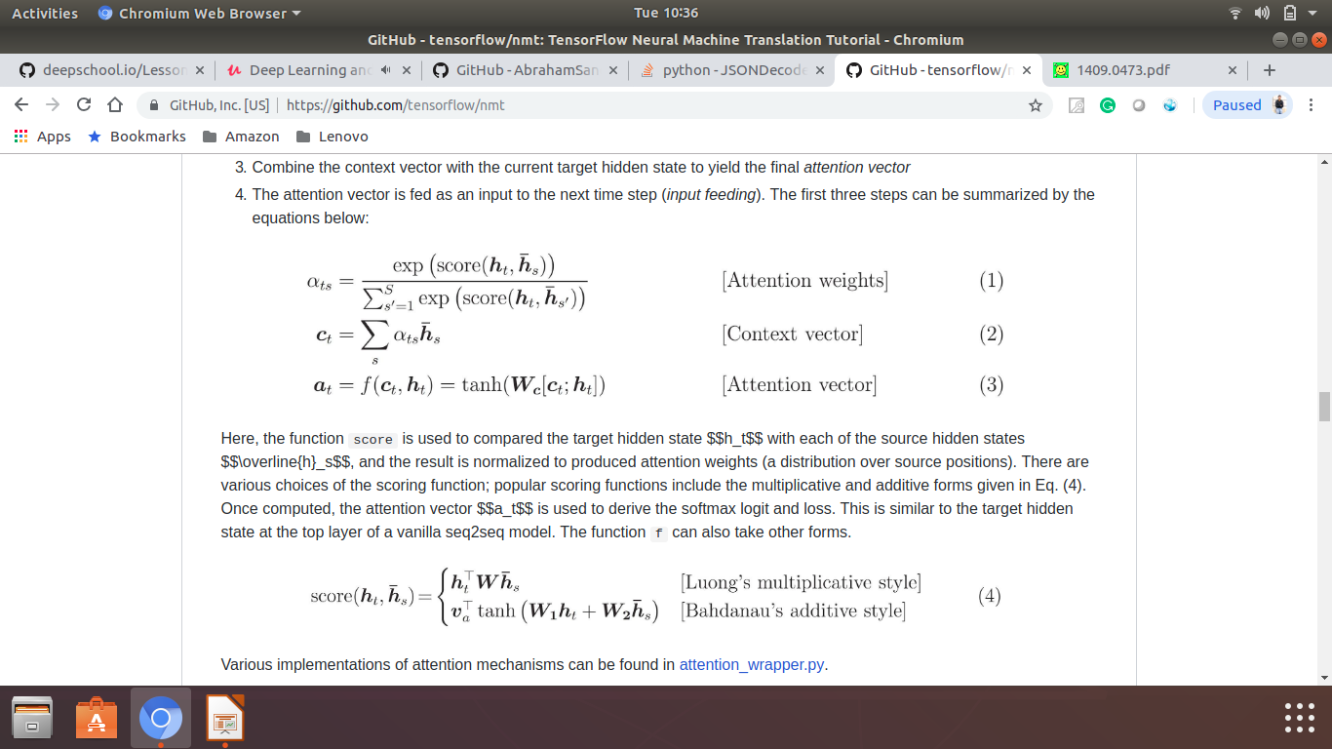
Attention Mechanism

Slide 19
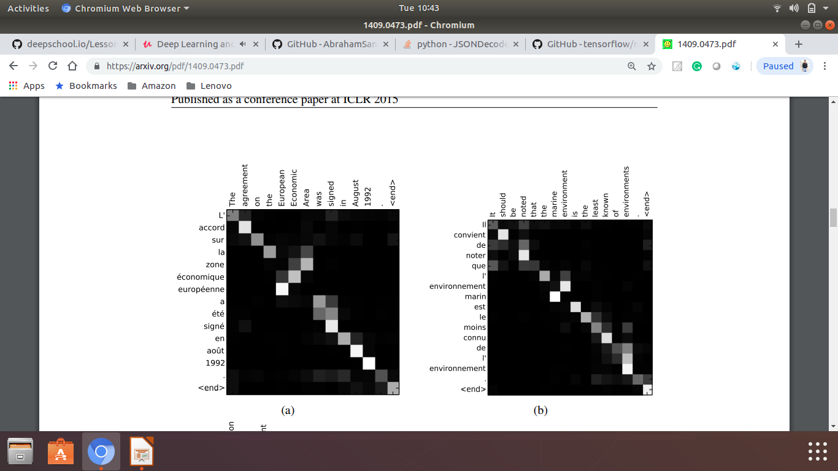
Attention Mechanism

Slide 20
Attention Mechanism

Slide 21
Tensorflow Steps
Build a computational graph, this can be any mathematical operation TensorFlow supports.
Initialize variables, to compile the variables defined previously
Create session, this is where the magic starts!
Run graph in session, the compiled graph is passed to the session, which starts its execution.
Close session, shutdown the session.

